Slide 1
Machine Learning (25SC2107E)
Customer Purchase Propensity Prediction
Team Members (Section 5)
Ch. Navya Sai Sree (2520030244)
Deepika (2520030137)

Slide 2
Introduction
Customers have different buying behaviors.
Some customers are more likely to buy than others.
Businesses need to identify customers who are likely to purchase.
Machine Learning can analyze customer information and find these patterns.
Our project predicts whether a customer is likely to purchase or not.
It also gives the probability of purchase.

Slide 3
Problem Statement
Businesses may find it difficult to identify customers who are likely to purchase.
Traditional methods such as manual analysis, historical customer data and general marketing strategies may not accurately identify individual customer behavior.
Main Goal
To develop a Machine Learning system that predicts the likelihood of a customer making a purchase.

Slide 4
Objectives
Collect customer information.
Understand the customer dataset.
Clean and prepare the data.
Find patterns in customer behavior.
Group customers based on similar behavior.
Build a Machine Learning model to predict purchase.
Evaluate the model's performance.
Predict the probability of customer purchase.

Slide 5
Dataset Overview
Dataset Used: Customer Purchase Data for Logistic Regression
The dataset contains 3,000 customer records.
It contains customer demographic and purchase-related information.
The data includes both numerical and categorical features.
The target variable is Purchase.
Target Variable
1 → Customer purchased
0 → Customer did not purchase
Problem Type
Supervised Learning → Binary Classification

Slide 6
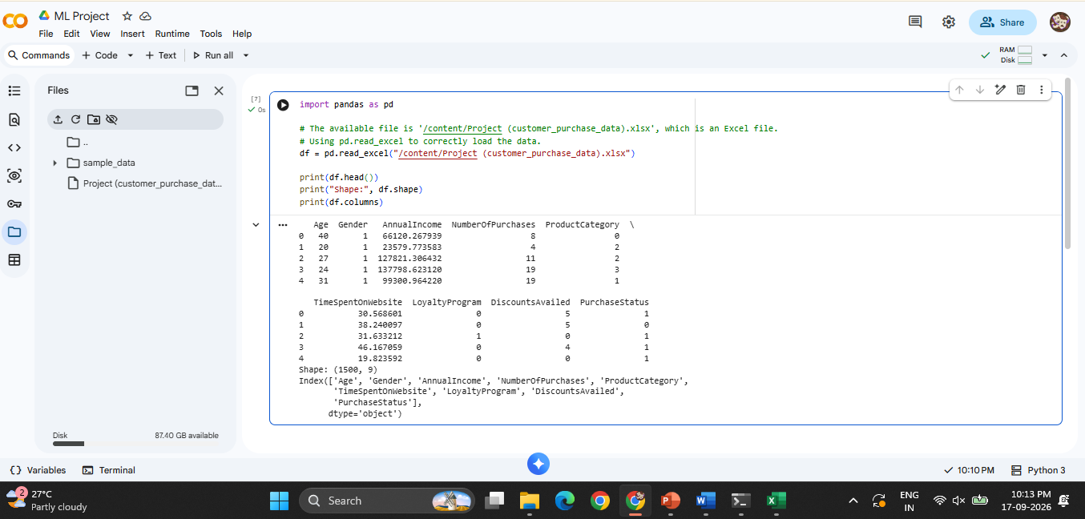
Dataset Overview

Slide 7
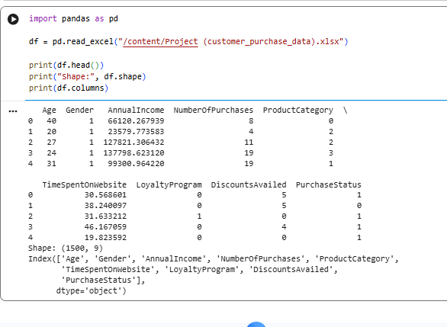
Load Dataset
The customer purchase dataset was loaded using Pandas.
The dataset contains 1,500 customer records and 9 attributes related to customer demographics and purchasing behavior.

Slide 8
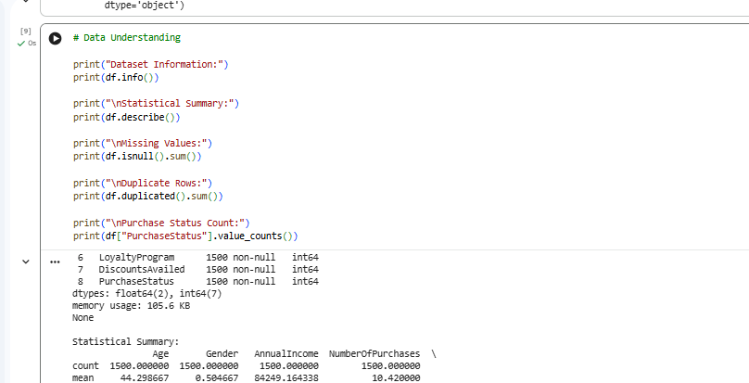
Data Understanding
The dataset was analyzed to understand its structure, data types, statistical values, missing values, duplicate records, and purchase status distribution.

Slide 9
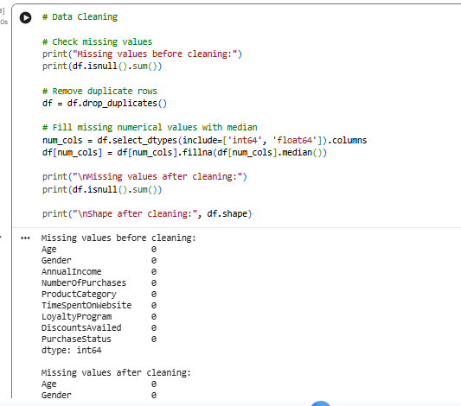
Data Cleaning
Checked the dataset for missing values.
Removed duplicate records.
Handled missing numerical values using median.
Verified the dataset after cleaning.

Slide 10
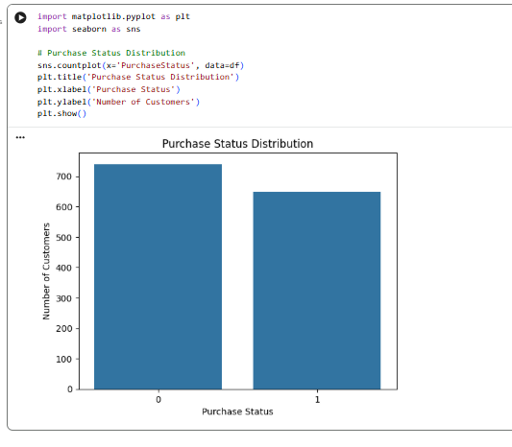
Exploratory Data Analysis (EDA)
EDA is used to understand patterns in customer purchase behavior.
The purchase status distribution was analyzed.
The target variable contains two classes: Purchased and Not Purchased.
It compares: 0 → Did not purchase; 1 → Purchased

Slide 11
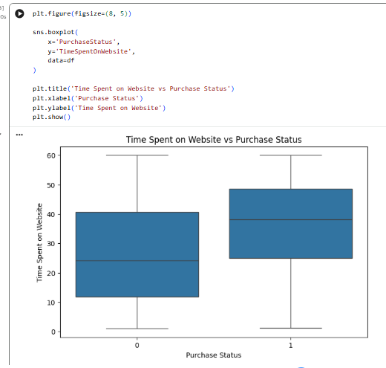
EDA: Time Spent on Website
TimeSpentOnWebsite = approximately how much time a customer spends browsing the shopping website.
The graph compares website time for: 0 → Did not purchase; 1 → Purchased

Slide 12
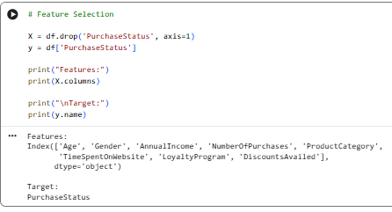
Feature Selection
The input features were separated from the target variable. Customer demographic and behavioral attributes are used as input features, while PurchaseStatus is used as the target variable.

Slide 13
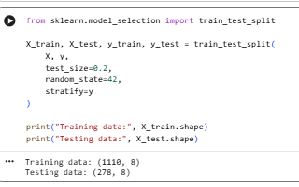
Train-Test Split
The dataset was divided into 80% training data and 20% testing data. The training data is used to build the model, while the testing data is used to evaluate its performance.

Slide 14
Logistic Regression
Logistic Regression is selected as the classification algorithm for predicting customer purchase behavior.
The target variable PurchaseStatus represents two possible outcomes: 0 (No Purchase) and 1 (Purchase).
Since the dataset contains both numerical and categorical attributes, categorical features are converted into numerical representations using one-hot encoding.
The selected customer attributes are provided as input features, while PurchaseStatus is treated as the target variable.
The prepared training data is given to the Logistic Regression model using the fit() method.
During training, the model identifies relationships between customer characteristics and their purchase behavior.
The trained model can then be used to estimate the purchase outcome for previously unseen customer data.

Slide 15
Conclusion
The project focuses on predicting customer purchase behavior using Machine Learning techniques.
Customer demographic and behavioral attributes were analyzed to identify patterns related to purchasing.
The dataset was loaded, understood, cleaned, and prepared for Machine Learning.
Exploratory Data Analysis was performed to examine relationships between customer attributes and PurchaseStatus.
Logistic Regression was selected to build the initial purchase prediction model.

Slide 16
Thank you

