Slide 1
SPLUNK DASHBOARD
Demo for agile tools report on

Slide 2
Problem Statement
Initially there were no proper monitoring expiration of Agile Tools licenses and Add-on licenses.
For fetching user login information also

Slide 3
Solution
To overcome the problem, Dieter has come up with the request to create a proper reporting dashboard on Splunk.
There will be separate dashboard for license info, use login info, license pricing info, etc.

Slide 4
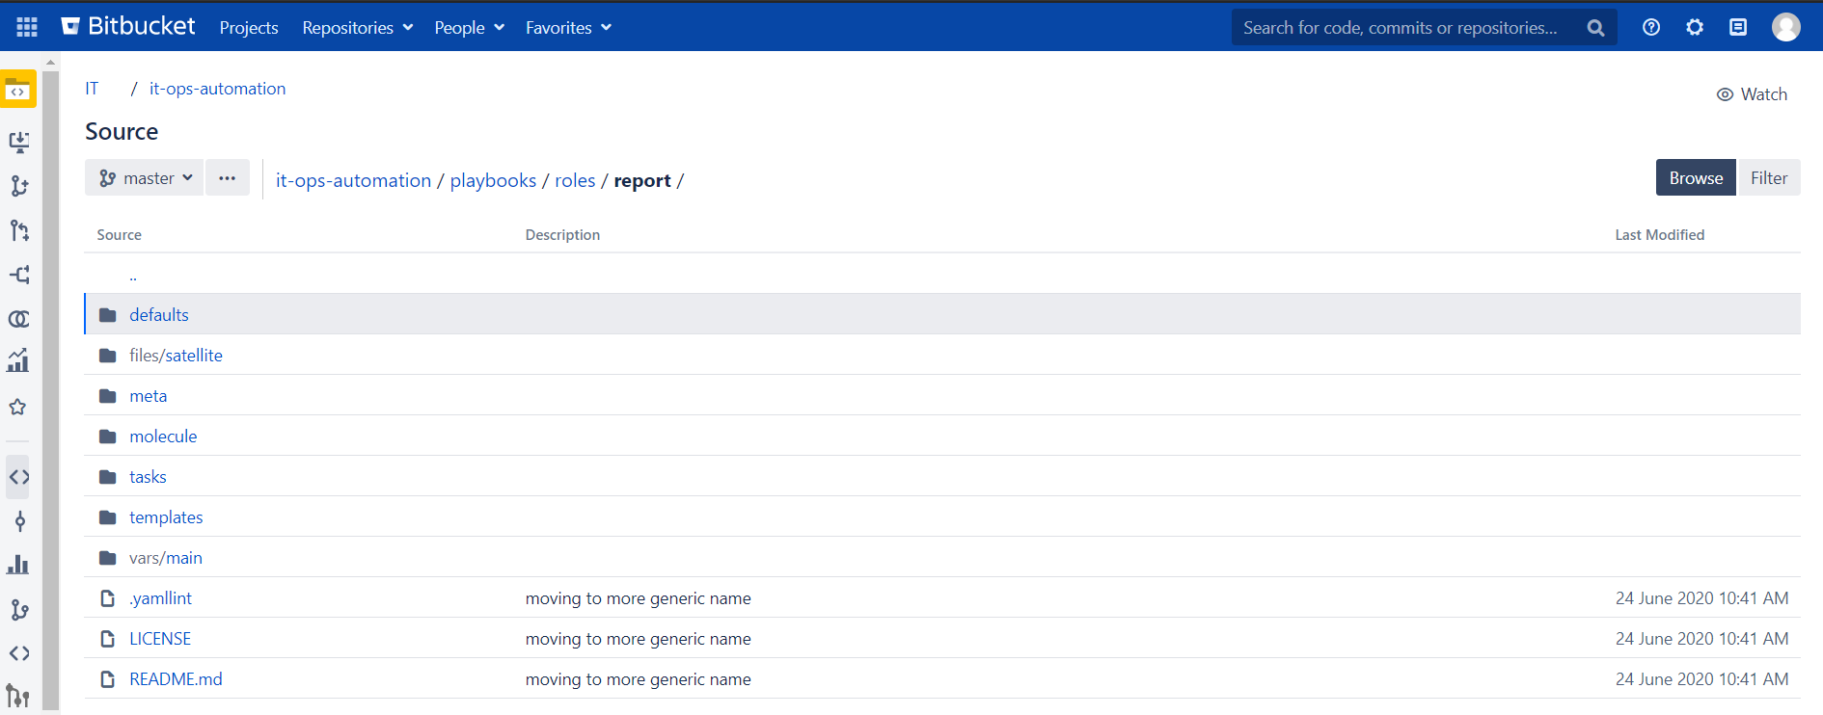
How We Started?
We started with the license information part by gathering the required information from the agile tools.
There was a rest API available which provided all the required information to start with.
As a part of automation, we worked on the ansible role called “report”.

Slide 5
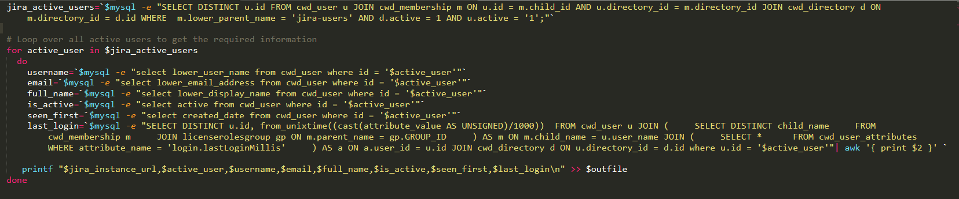
Original Query

Slide 6
Number of Database calls
There were a total of 7 queries(6 inside for loop and 1 outside)
For each id, there were 6 DB calls.
Suppose there are 4000 users.
No. of DB calls = Query outside + (4000 * no. of queries inside)
= 1 + (4000 * 6)
= 24,001
Since, there were 24,001 DB calls, it was taking near about 30-45 mins to fetch the values.

Slide 7
Optimized Query

Slide 8
Number of Database Calls
There is only one query and that too outside the for loop.
Since Database call for fetching the value.
Since, there is a single DB call, it is taking near about 1-2 sec to fetch the values.

Slide 9


Testing & Comparison
For testing purpose, there were a total of 66 records
For 66 records, the old script ran for ~42 secs
For the same 66 records, the new script ran for <1 sec
For the older script, as the number of records increases, the DB calls increases resulting in more execution time for fetching values

Slide 10
Dashboards

