Slide 1
CALENDARING SOFTWARE
WANT TO BE MORE SUCCESSFUL?
START USING THE CALENDARING SOFTWARE
TEAM NO: 20
NAME: K.NAVYA SHRUTHI
S.BHAVANI
ROLL NO:1602-19-737-143
1602-19-737-173
SECTION:IT-C
GITHUB LINKS:
https://github.com/navyashruthi15
https://github.com/bhavanisilasagaram

Slide 2
ABSTRACT
In today’s world most of us are dependent on the calendar for various purposes. We have decided to make your work more easier and efficient with our calendaring software. It is a software that minimally provides users with an electronic version of a calendar. This application will be built on the console without using graphic properties; instead, it utilizes many other window properties to give the application a colourful look and feel. Our software would enable the users to add notes , remainders and it enables the user to prepare a to-do list for a particular day with the time slots assigned. The software also enables the user to check for overlapping events etc features.
Future work: We will add time blocking-Allows users to organise their days into chunks. Additionally the software may provide an appointment book , address book, and/or contact list.

Slide 3
USE CASES
USER
Register into the software
If already registered, log into the software
View the calendar of the month
View the calendar of the year
Find the day of the week with the given date on the console
View the occupied days in the calendar with some sort of distinction
View or add notes
Prepare or edit the to-do list
Prompt the system to Check for over-lapping events
Set remainders
Prompt the system to display the current time

Slide 4


REGISTER
ALREADY REGISTERED
USER
<<include>>
SOFTWARE
LOGIN
--------------
DISPLAY ERROR MSG
VIEW THE PRESENT TIME
<<extend>>
CHECK FOR OVERLAPPING EVENTS
<<extend>>
<<extend>>
PREPARE A TO-DO LIST
------
VIEW NOTES
-------
PROMPT THE SYSTEM TO DISPLAY NAME OF THE WEEK
DATE IS GIVEN
<<include>>
------------
------
<<extend>>
DISPLAY ERROR MSG
ENTERING A NUMBER FROM 1 TO 12
<<include>>
VIEW CALENDAR OF THE MONTH
-----------
<<extend>>
DISPLAY AVAILABLE TIME SLOTS
----------------------
-------
SET REMAINDERS
<<extend>>

Slide 5
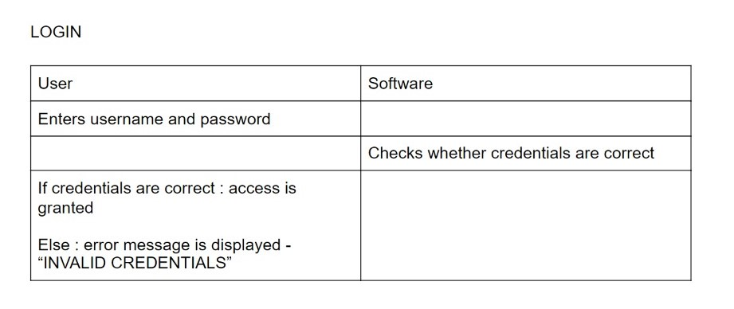
LOGIN UC01
Actor: USER
Description: User login to access
Pre-Conditions: User must be registered
Post-Conditions: User has access to Calendaring Software

Slide 6
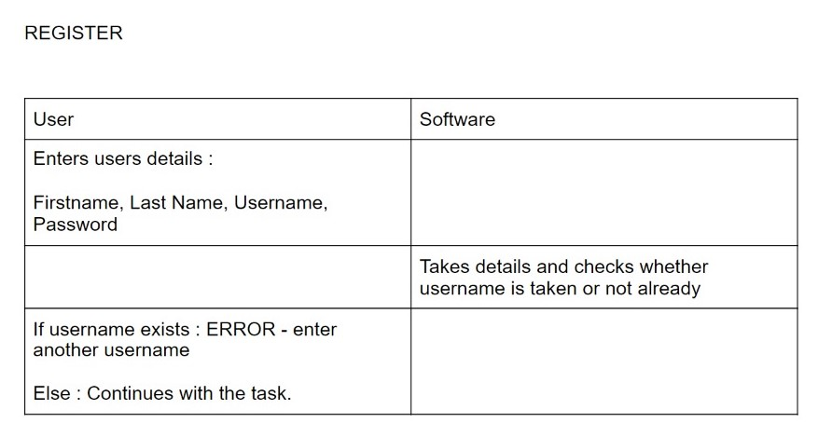
REGISTER UC02
Actor: User
Description: User register to Calendaring software
Pre-Conditions: NIL
Post-Conditions: User is a member of Calendaring software

Slide 7
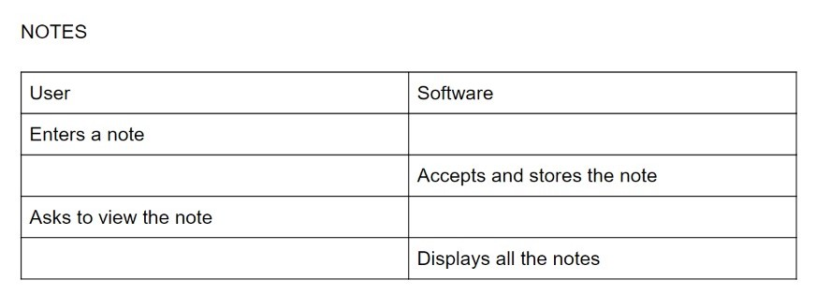
NOTES UC03
Actor: User
Description: User enters a note to be stored
Pre-Condition: Registered
Post-Condition: Notes are displayed

Slide 8
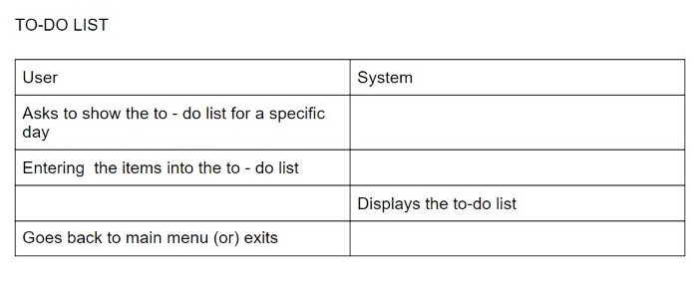
TO-DO LIST UC04
Actor: User
Description: User asks to show to-do list or asks to enter an entry to the to-do list
Pre-Condition: Registered
Post-Condition: To-do list is displayed

Slide 9
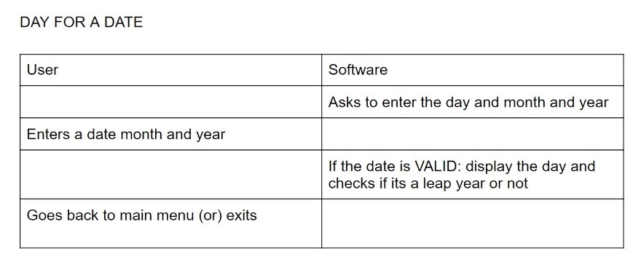
DAY UC05
Actor: User
Description: Day of the weak and leap year is checked
Pre-Condition: User enters a date, month and year
Post-Condition: Displays whether the year is a leap year or not and day of the week is displayed

Slide 10
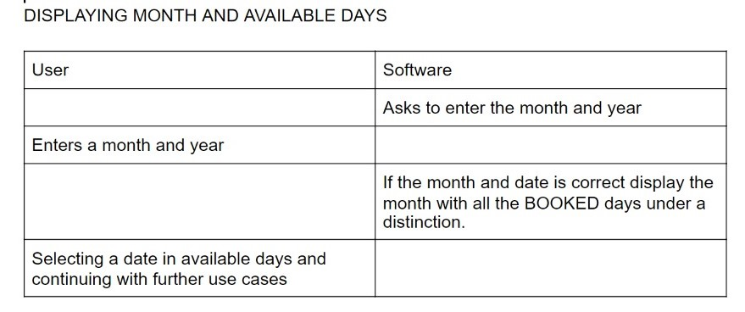
DISPLAYING MONTH AND DAY UC06
Actor: User
Description: All booked days are shown in the calendar
Pre-Condition: Days need to be booked prior and valid date should be given
Post-Condition: Month is displayed with a box around the booked days

Slide 11
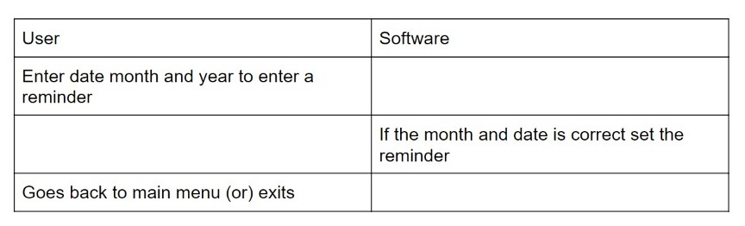
REMAINDERS UC07
Actor: User
Description: All remainders are displayed on the screen after entering
Pre-Conditions: Remainders have to be entered prior
Post-Condition: Remainders are displayed

Slide 12
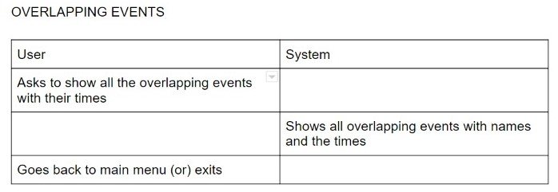
OVERLAPPING EVENTS UC08
Actor: User
Description: Shows all overlapping events with names and times
Pre-Condition: Having at least 1 overlapping event else 0 is displayed
Post-Condition: All overlapping conditions are displayed

Slide 13
VIEW CURRENT TIME UC09
Actor: User
Description: View Current time
Pre-Condition: Must be a registered user
Post-Condition: Current time is displayed
USER
SYSTEM
Prompt the system to display current time
Displays the current time
THANK YOU

