Slide 1



NKYAA
Influencer Collaboration Proposal
Reserach and Proposal for Influencer Brand
Collaboration
SkillCraft Technology

Slide 2


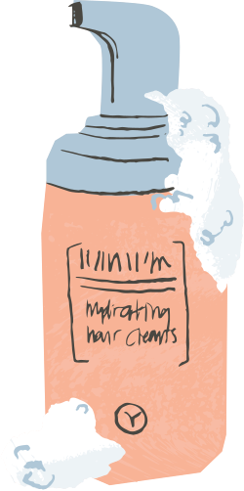


About Nykaa
Nykaa is one of India’s leading beauty and lifestyle platforms, offering makeup, skincare, haircare, fragrances, wellness products, and more. The brand connects customers with a wide range of beauty products and brands through its online and offline presence.
TARGET AUDIENCE:
Gen Z & Millennials
Beauty & makeup enthusiasts
Skincare lovers
Fashion & lifestyle audiences
CAMPAIGN GOAL:
Increase brand awareness,engagement, product discovery,
and reach among young
beauty-conscious consumers.

Slide 3
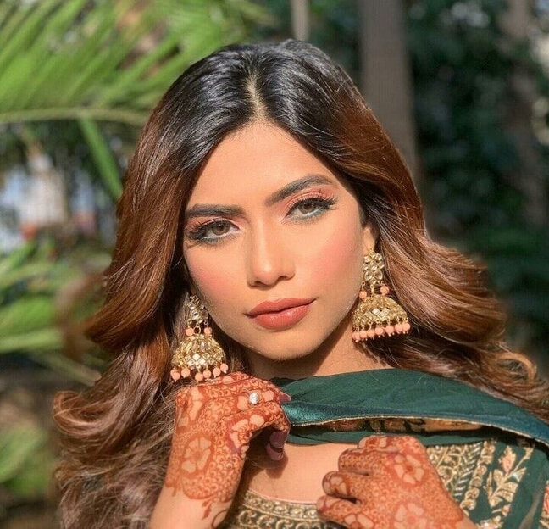

Nagma Mirajkar
Nagma Mirajkar is an Indian beauty, fashion and lifestyle creator known for engaging content and a strong young audience.
P
Potential Beauty & Lifestyle Collaboration
CONTENT
FOCUS:
Beauty
Fashion
Lifestyle
8.2M
3.47%
Instagram Followers
Engagement Rate

Slide 4




Audience Profile
Gen Z & Millennials
Beauty & Makeup Enthusiasts
The campaign is designed for young, trend-conscious
audiences who value
authentic content, beauty inspiration, and engaging visual storytelling
Skincare Lovers
Fashion & Lifestyle Followers
Trend-Conscious shoppers

Slide 5

Creative Direction
Eye-catching
Engaging
The campaign uses authentic and visually engaging content to connect Nykaa with young beauty and lifestyle audiences. Influencer-led posts will highlight product experiences, beauty tips, tutorials, and fashion & lifestyle inspiration in a relatable way.
Visual
Authentic

Slide 6

Content Strategy
The campaign focuses on influencer-led beauty and lifestyle content to increase awareness, engagement, and product discovery among young consumers.
1
Influencer Teasers
2
Product launch
4
Audience Engagement
3
Beauty Tutorials
5
Performance Review

Slide 7


Social Campaign
8M
4.5%
Impressions Goal
Engagement Rate
30-Day
Campaign
Short-form videos, influencer collaborations, beauty tutorials, product reviews, and interactive posts designed to increase brand awareness, engagement, and product discovery among young consumers.

Slide 8





Get In Touch
nykaa@nykaa.com
www.nykaa.com
1800-267-9999
Let’s create meaningful beauty experiences together.

