Slide 1


FOOD SWIPE
M. Mosritha (192211456)
M. Sravya (192211453)
B. Navya Sri (192211260)
Guided by:
Dr. K. Jayasakthi Velmurgan

Slide 2

OBJECTIVES
User friendly interface:
Provide a seamless and intuitive user experience with easy navigation and responsive design.
Efficient Order Processing:
Streamline the order placement and processing system to ensure quick and accurate fulfillment.
Wide Selection of Restaurants:
Offer a diverse range of restaurant options to cater to various tastes and preferences.
Real-Time Tracking:
Implement real-time order tracking to keep customers informed about the status of their orders.
Secure Payment Systems:
Ensure robust security measures for safe and convenient online transactions.

Slide 3
Existing systems & Disadvantages
Grubhub - connecting users with local restaurants.
Disadvantage: High commission fees, Customer service issues
Uber Eats - provides real-time tracking of orders
Disadvantage: High service fees, Customer service issues
DoorDash - It offers features like scheduled deliveries, group ordering
Disadvantage: Controversies over tipping policy, Inaccurate restaurant listings
Postmates - offers on-demand delivery of food, groceries, and other goods.
Disadvantage: Limited availability in some areas, Pricing inconsistencies
In addition to these specific disadvantages, all online food ordering systems may share some common drawbacks, such as those related to delivery delays, order accuracy issues, and environmental concerns associated with packaging waste.

Slide 4
Proposed systems & Advantages
Customizable Menu Builder - Provides flexibility for restaurants to showcase their unique dishes and update menus based on their offerings and preferences.
Advantage: Allow restaurants to easily create and customize their menus based on their offerings and preferences.
Integrated Loyalty Program - Encourages customer retention and incentivizes users to order frequently
Advantage: Incorporate a built-in loyalty program that rewards customers for repeat orders and referrals.
Predictive Ordering Algorithm - Streamlines the order process by offering personalized recommendations.
Advantage: Utilize ML algorithms to analyze customer preferences & predict their next orders.
Real-Time Delivery Tracking - Improves transparency & reducing uncertainty for customers.
Advantage: Implement a robust delivery tracking system that provides real-time updates on order status and driver location.

Slide 5
Architecture Diagram
Visual Representation:
Technologies used HTML, CSS
Features:
login , Browse restaurants, view menu, order tracking
Database:
User data storage, order data storage, restaurant & menu data storage
Verify stock availability and confirm order with restaurant and create order entry
Sending order confirmation to user and notify restaurant and delivery personal
Payment Gateway:
Providers: phone pay, g pay..
Features: Refund handling, transaction history.

Slide 6
Modules
Hyper text markup language(html)
01
DATABASE CONNECTIVITY
03
CASCADING STYLE SHEET(CSS)
02

Slide 7
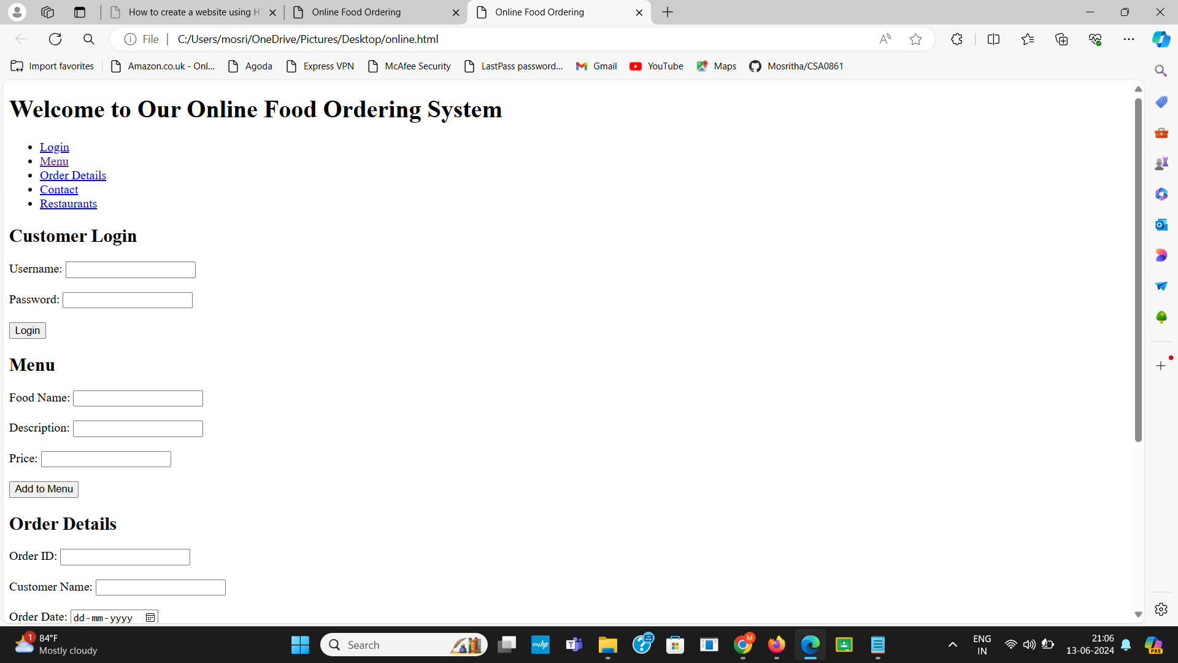
HTML :
It is standard language used to create and design web pages. It serves as the foundation of the World Wide Web, defining the structure and layout of web content. HTML utilizes a system of tags and elements to organize and format text, images, links, and other media on a webpage.

Slide 8
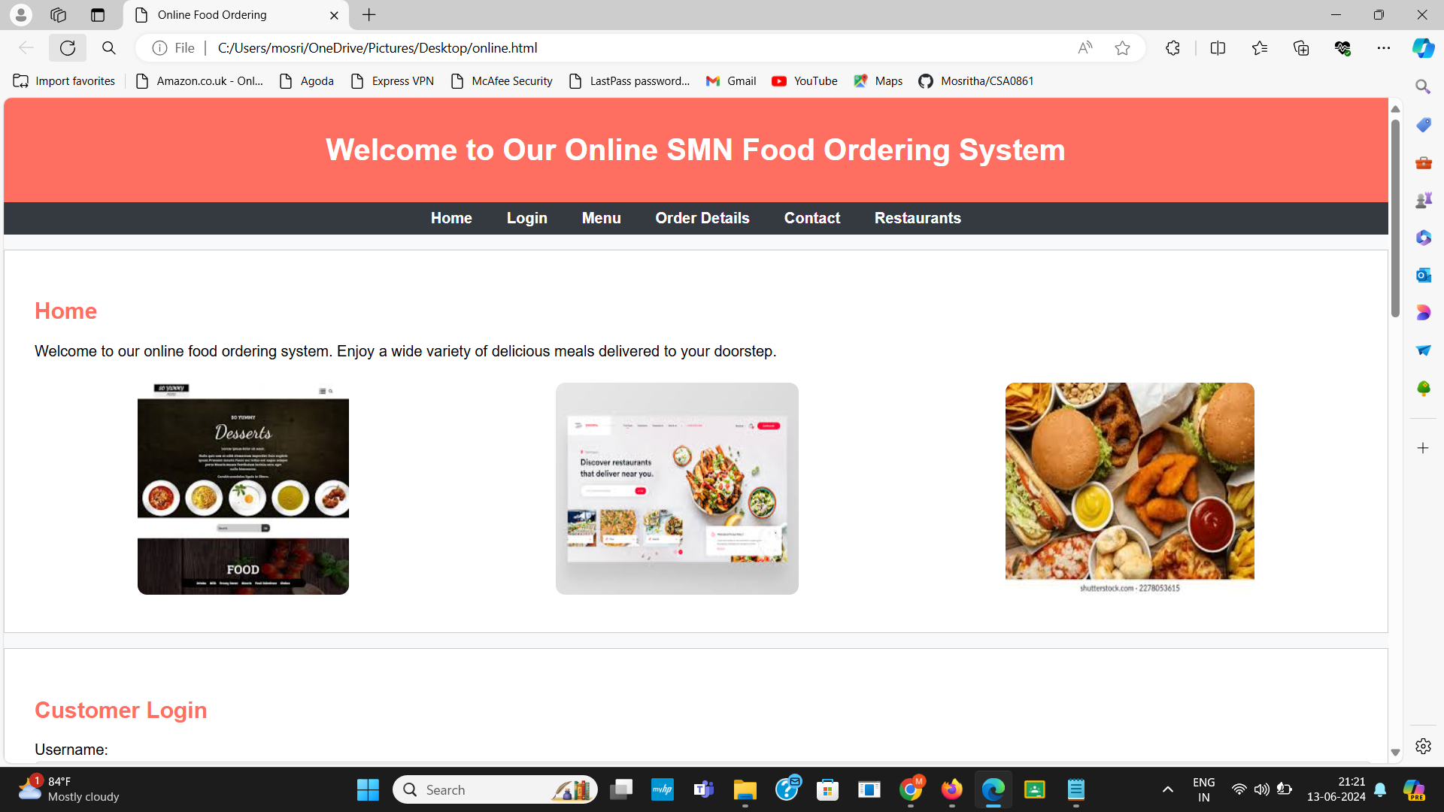
CSS:
It is a language used to describe the presentation of a document written in HTML or XML. It controls the layout and appearance of web pages, allowing developers to separate content from design for more manageable and flexible web development.

Slide 9
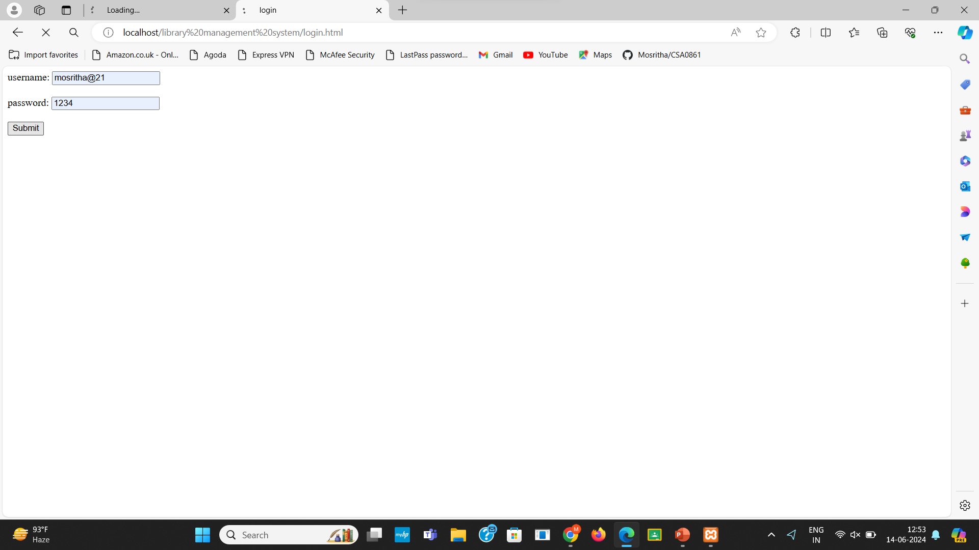
PHP:
PHP, which stands for "Hypertext Preprocessor," is a widely-used open-source server-side scripting language primarily designed for web development. It is embedded within HTML, making it particularly effective for creating dynamic web pages and web applications.

Slide 10
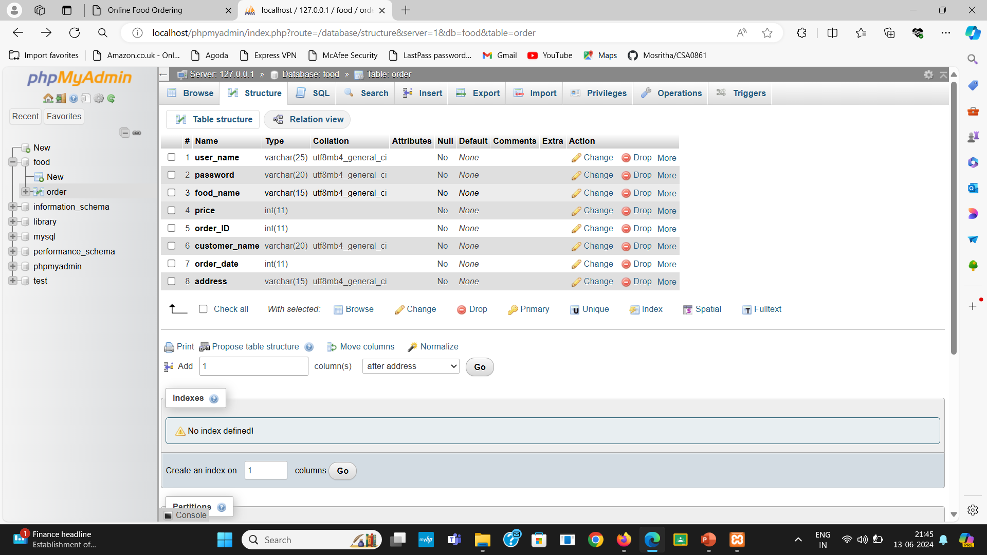
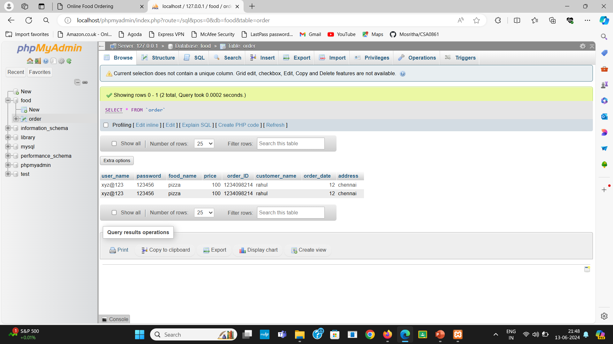
DATABASE CONNECTIVITY:
It refers to the methods and processes used to connect a database to an application or system, allowing for data retrieval, manipulation, and storage. This is a crucial aspect of web development, enabling dynamic content and data-driven applications.

Slide 11
Conclusion
It provides convenience and accessibility for customers, allowing them to browse menus, place orders, and arrange deliveries or pickups from the comfort of their own homes. For restaurant owners, it opens up new revenue streams, expands their customer base, and streamlines operations through automated ordering and payment systems.

Slide 12
References
Rathore S. Suryadev, Chaudhary Mahik (2018). “Consumer's Perception on Online Food Ordering”. International journal of Management and Business Studies, Volume 8, Issue 4, Oct-Dec 2018, ISSN 2230-9519 (Online) and ISSN: 2231-2463 (Print)
Panse Chetan, Rastogi Shailesh (2019), “Understanding Consumer Behaviour Towards Utilization of Online Food Delivery Platforms”Journal of theoretical and applied information technology., Volume 97, No.16, ISSN: 1992-8645, E-ISSN: 1817- 3195
Sethu H.S., Saini Bhavya (2016). “Customer Perception and Satisfaction on Ordering Food via Internet”.Proceedings of the Seventh Asia-Pacific Conference on Global Business, Economics, Finance and Social Sciences (AP16Malaysia Conference) ISBN: 978-1-943579-81-5 Kuala Lumpur, Malaysia. 15-17, July 2016. Paper ID: KL631
Das Jyotishman (2018). “Consumer Perception Towards ‘Online Food Ordering and Delivery Services’: An Empirical Study”. Journal of Management (JOM), Volume 5, Issue 5, September-October 2018, ISSN Print: 2347-3940 and ISSN Online: 2347-3959, pp. 155–1635) Hong, L., Li, Y. N., & Wang, S. H. (2016). Improvement of Online Food Delivery Service Based on Consumers’ Negative Comments. Canadian Social Science, 12 (5), 84-88. Available from: http://www.cscanada.net/index.php/css/article/view

Slide 13

ANY QUERIES?

