Slide 1
FRONT-END PROJECT
ON
AI Resume Builder
Presented by: K.Navya Sri

Slide 2
ABSTRACT
The AI Resume Builder is a web-based application developed using HTML, CSS, and JavaScript. It helps users create professional resumes quickly and easily through a simple and user-friendly interface. Users enter their personal details, professional summary, skills, education, and work experience, and the application instantly generates a well-formatted resume. It also provides a print/download option, making it convenient for job seekers and students to prepare resumes without advanced technical knowledge. The project is responsive, easy to use, and saves time while creating attractive resumes.

Slide 3
INTRODUCTION
The AI Resume Builder is designed to make resume creation simple and fast. Users only need to enter their information into a form, and the application instantly creates a professional-looking resume. It is built using HTML for the structure, CSS for the design, and JavaScript for generating the resume and download functionality. This project saves time and helps users prepare resumes without any special technical knowledge.

Slide 4
OBJECTIVE
To develop a simple and user-friendly resume builder.
To generate a professional resume instantly from user input.
To reduce the time and effort required to create a resume.
To provide a responsive design that works on desktop and mobile devices.
To allow users to print or download their resume easily.
To improve the resume creation experience for students, freshers, and job seekers.

Slide 5
SAMPLE CODE
```html
<!Doctype html>
<Html>
<Head>
<Title> AI resume builder</title>
</Head>
<Body>
<H2>ai resume builder</h2>
<Input type="text" id="name" placeholder="enter your name">
<Button onclick="generateresume()">generate resume</button>
<H3 id="resume"></h3>
<Script>
Function generateresume() {
let name = document.Getelementbyid("name").value;
Document.Getelementbyid("resume").Innerhtml = "name: " + name;
}
</Script>
</Body>
</Html>

Slide 6
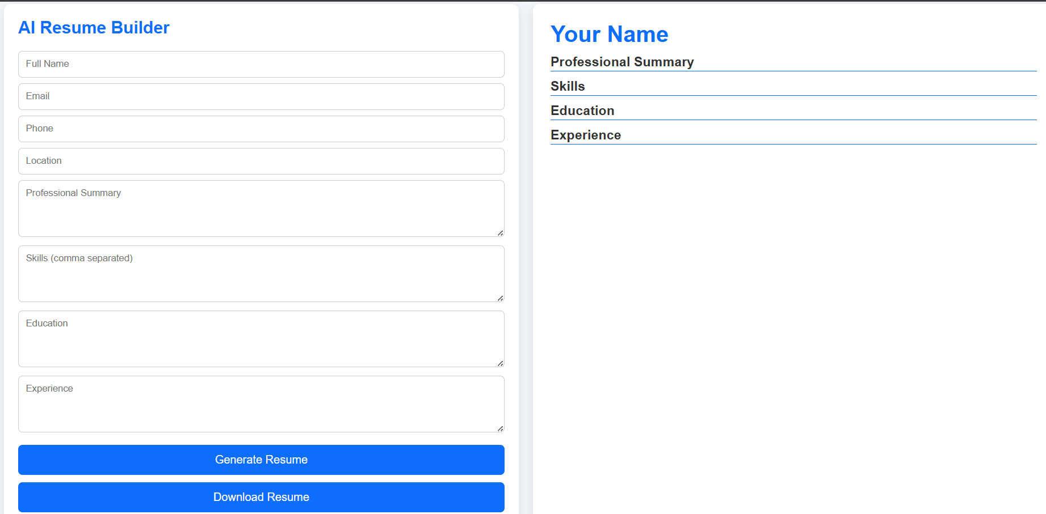
OUTPUT

Slide 7
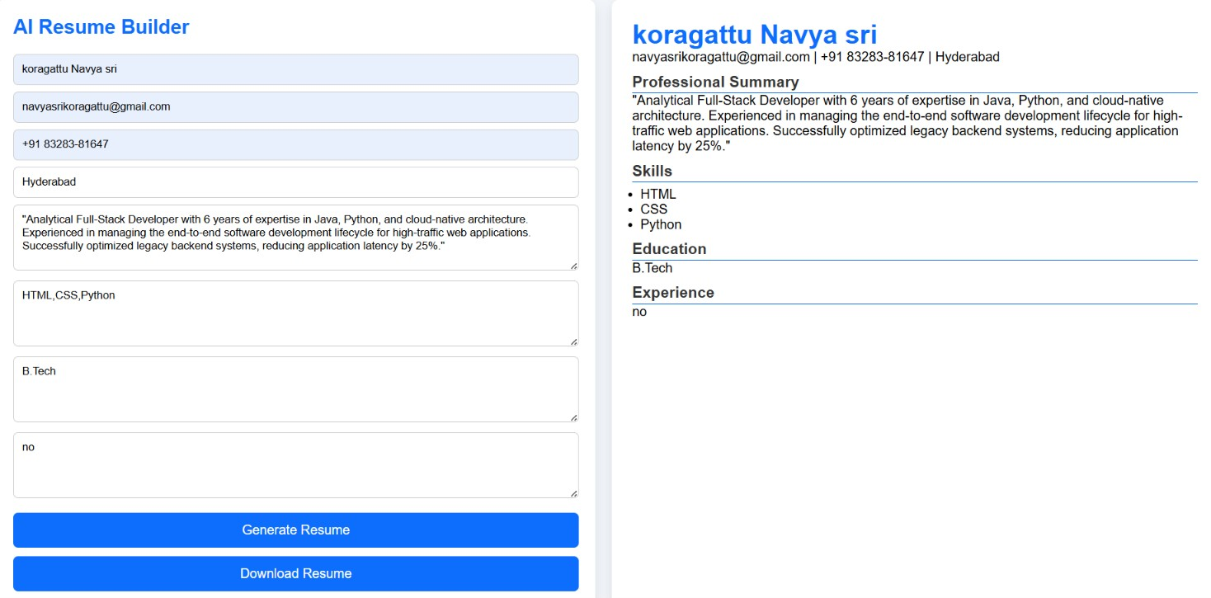

Slide 8
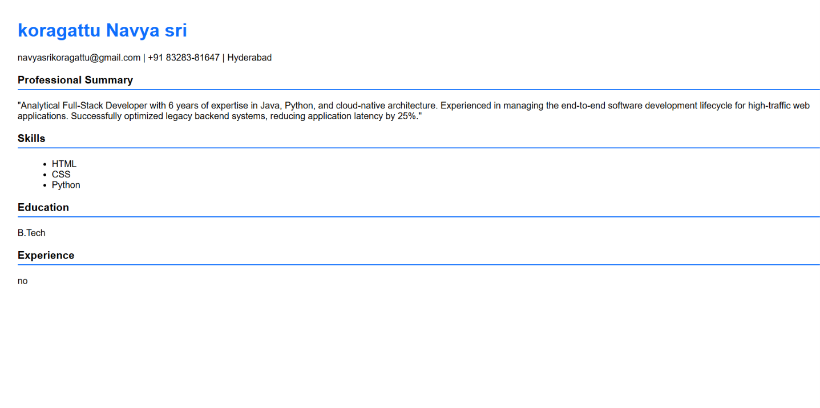

Slide 9


