Slide 1

Intelligent Platform Management Interface
IPMI Server Management
IPMI

Slide 2




IPMI chronology
PROMOTERS
1998 IPMI v1.0
2001 IPMI v1.5
2004 IPMI v2.0
IPMI

Slide 3






IPMI overview
power control
Power
Blade
monitor
alert
Rack Mount
recovery
I/O expansion
Peripheral
UPS
logging
inventory
RAID
Different Platforms
Always Available
Same Platform Management

Slide 4




IPMI solution
Common hardware interfaces and abstraction
IPMI
Defines common, abstracted message-based interfaces to platform intelligent hardware
Defines common abstracted records describing devices and their characteristics
Notes:
Standardized Hardware interfaces give and abstract commands isolates
the software from the platform hardware changes.

Slide 5
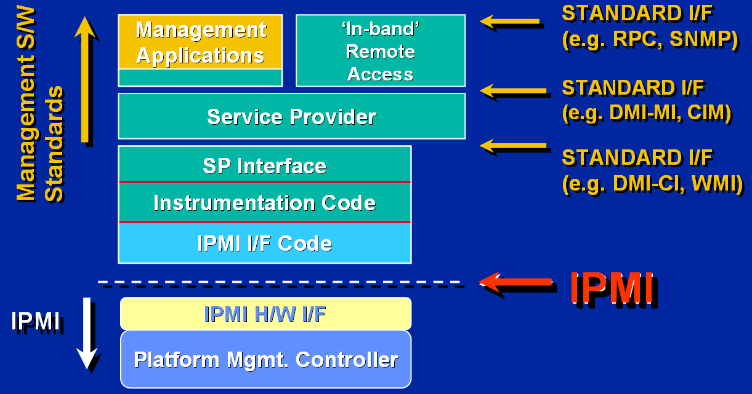
IPMI software stack
Notes:
IPMI is a hardware level interface specification that is ‘management software neutral’ providing monitoring
and control functions that can be exposed through standard management software interfaces such as DMI,
WMI, CIM, SNMP, etc. As a hardware level interface, it sits at the bottom of a typical management software
DMI – Desktop Management Information
Format for description of management sytems
Apis for components to communicate with the service provider
Service provider API for Management applications
CIM – Common Information Model
WMI – windows modeling information

Slide 6
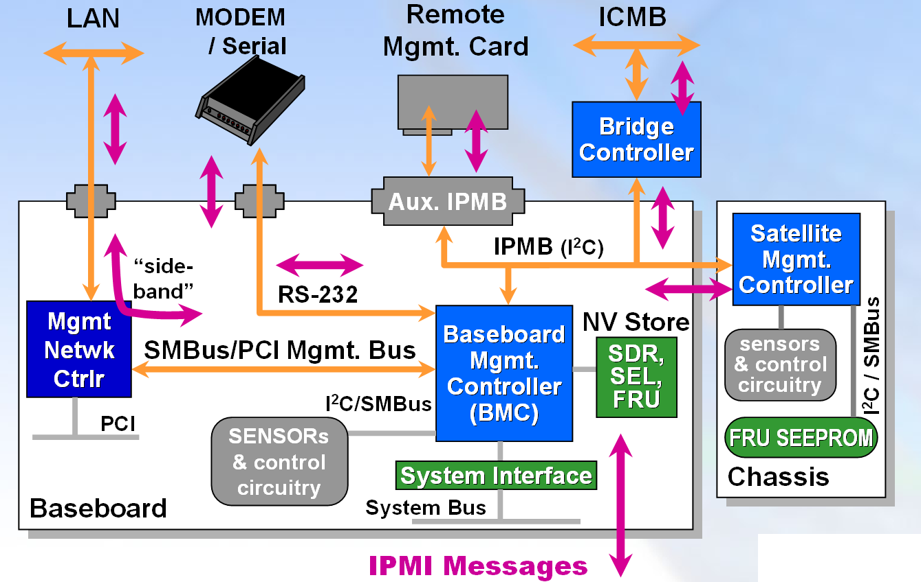
IPMI architecture

Slide 7
IPMI hardware - BMC
Baseboard Management Controller
Microntroller providing intelligence to IPMI
Manages the interface between system management
software and the platform management hardware
Autonomous monitoring
Event logging
Recovery control
Serves as the gateway between system management software and the IPMB and ICMB
Available even if system is powered down and no OS loaded
Notes:
RMCP Remote Management & Control Protocol
UDP based protocol for system control when a managed client is in an OS-absent state.
RMCP is part of DMTF ASF sandart

Slide 8
IPMI architecture

Slide 9
IPMI hardware – system interfaces
Keyboard Controller Style
- Classic 8742 interface
- Available built-in to micros
Server Management Interface Chip
- Simple 3 I/O port, byte based interface
- Implementable using FPGA or discrete logic
Block Transfer
- Simple 3 I/O port, byte based interface
- Implementable using FPGA or discrete logic

Slide 10
IPMI architecture

Slide 11
IPMI hardware – NV storage
Non Volatile Storage
System Event Log
Centralized nv storage for timestamped event messages
Sensor Data Repository
Centralized nv storage for sensor data records. SDR contains information about the type and number of sensors in the platform, sensor threshold support, event generation capabilities, and information on what types of readings the sensor provides
Field Replaceable Unit
Distributed nv storage for FRU information. The FRU data includes information such as serial number, part number, model, and asset tag
Notes:
Run the ipmitool to show what is the SEL, SDR and FRU
Ipmitool –vI open sel
(this is give the sel version and the occupation of the SEL storage an characteristics)
Ipmitool –vI open sel list
Record Type = standard / OEM types of records
Generator ID = identifies a component in the platform for eg 20 = power unit
Sensor Type = the type of sensor what type o f events the sensor is monitoring
Sensor Num = an instance of the sensor type
Event Direction = in which direction is passing the threshold
ipmitool -vI open sdr list
ipmitool –vI open fru print

Slide 12
IPMI architecture

Slide 13
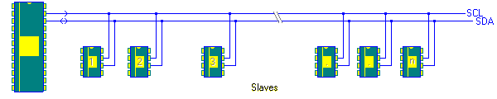
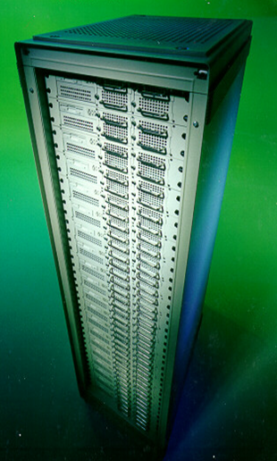
IPMI hardware – IPMB/ICMB
Intelligent Platform Management Bus
Standardized bus and protocol for extending management, control
monitoring and event delivery within chassis. Base on multi-master
I²C bus
Intelligent Chassis Management Bus
Bus that extends IPMI to multiple hosts and
peripheral chassis. Support up to 64 chassis

Slide 14
IPMI – platform access
LOCAL PLATFORM MANAGEMENT
System Interfaces
  KCS, SMIC, BT
REMOTE PLATFORM MANAGEMENT
- Serial / Modem
  Basic Mode, PPP, Terminal Mode
- LAN

Slide 15
IPMI - communication infrastructure
Channel
Connection to the BMC
Up to 9 connections
(system interface, IPMB plus seven media dependent)
Session
- Framework for authentication
- Multiple IPMI messages streams on a channel

Slide 16
IPMI - security
Users
Identify a collection of privileges and authentication information
Password
Separated from the OS and BIOS passwords
Privilege levels
Callback, user, operator, administrator
Privilege limits
Maximum privilege that a user can have on a given channel
Authentication
Per message authentication and link authentication
Notes:
Callback ability for the BMC to estabilish an IPMI Message session
User read data structures like the sensors power off/on, reset … not allowed
Operator all commands are allowed to the exception of the configuration commands
All BMC commands are allowed

Slide 17
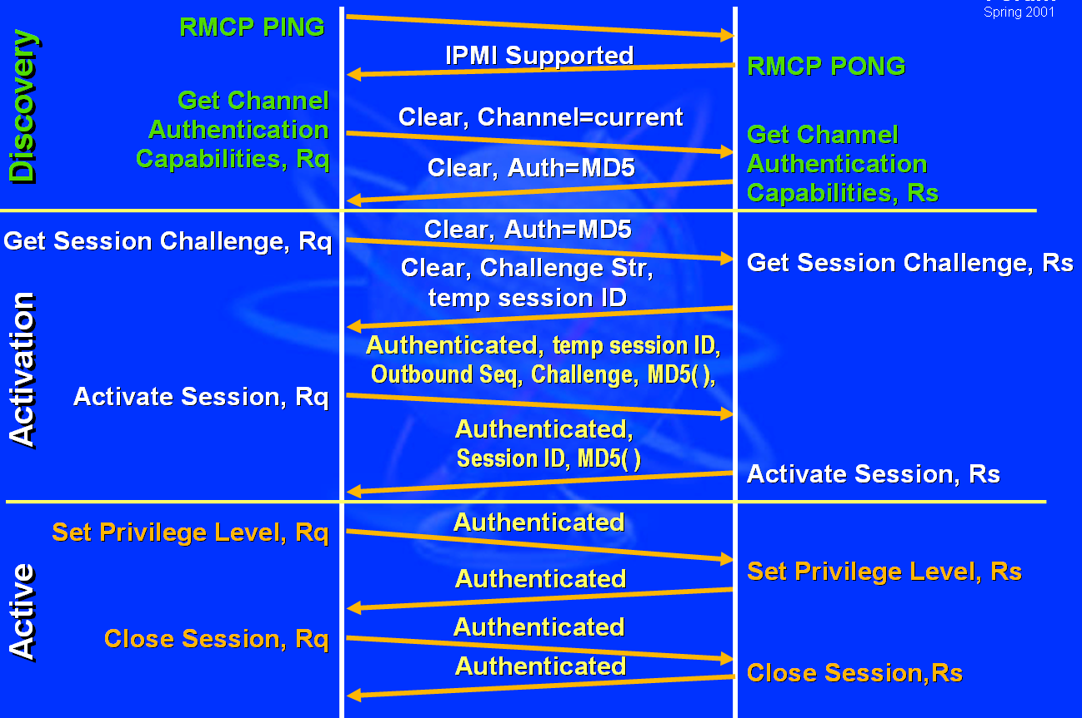
IPMI - LAN session activation
Notes:
RCMP Ping
RMCP Pong
3) The remote console will issue what is the authentication for this connection
4) The server will reply none/MD2 checksum/MD5 checksum
5) The remote console will send the username
6) The server will send a generated string, temp sesssion id
7) The remote console will them tell to activate a session in the server signing the packet with a checksum of the pass+challenge string+temp session id
8) The server then verifies if the password used to sign the packe is correct, and if yes the server sends a session id

Slide 18
IPMI - functionality
Power Control
- Status, power on/off, cycle, reset, NMI diag
Monitoring
- Sensor values
Inventory
- Field replaceable unit
Logging
- System event logging
Recovery
- BMC takes actions on event messages that it receives
Alert
- SNMP Traps format over media LAN and PPP
- Perform pagging via serial/modem connection
Serial Console Redirection

Slide 19
IPMI – GNU/Linux
IPMI local management ( System interface )
- Board supporting the IPMI
- IPMI driver ( openipmi, Intel, … )
- Application ( command line, … )
IPMI remote management ( LAN interface)
- Board supporting the IPMI
- IPMI driver ( openipmi, Intel, … )
- Configure BMC for LAN access and Serial over LAN
- Application ( command line, … )

Slide 20
IPMI – version 2.0
Spec out on 12/02/2004
Enhanced Authentication
VLAN Support
Serial Over LAN (SOL)
Payloads
Encryption Support
Extended User Login Options
Firmware Firewall
SMBus System Interface (SSIF)
Notes:
Extensions to the protocols for IPMI over IP, collectively referred to as “RMCP+”, support new
algorithms that provide more robust key exchange process for establishing sessions and authenticating
users.
Serial Over LAN provides a mechanism that enables the serial controller of a managed system to be
redirected over an IPMI session over IP.
RMCP+ adds the ability to enable IPMI over IP sessions to other types of traffic in addition to IPMI
messages.
IPMI messages and other payloads carried over RMCP+ can be encrypted.
New options support “Role Only” logins for simple environments where it is desirable to just enable
logins according to a given privilege level, without the need to assign or configure usernames.
Firmware Firewall is the name for a collection of commands that enable a BMC implementation to
restrict the ability to execute certain commands or functions from a given interface. This can be used
to protect against operations that errant or malicious software may use to affect the managed system or
other systems. For example, this enables a BMC to block the ability for local software to send a
Chassis Control command to reset another blade in a modular server implementation where BMCs on
individual blades share a common management bus across the blade backplane.

Slide 21
IPMI - reference
IPMI : http://developer.intel.com/designs/servers/ipmi
DMTF : http:://www.dmtf.org
IPMItool :http://ipmitool.sourceforge.net
panicsel: http://panicsel.sourceforge.net
openipmi: http://openipmi.sourceforge.net
freeipmi: http://freeipmi.sourceforge.net
Intel Server Management: http://www.intel.com/design/servers/ism
IPMI and Linux System Monitoring: http://www.intel.com/cd/ids/developer/asmo-na/eng/os/linux/resources/whitepapers/53867.htm
Microsoft Server Management: http://www.microsoft.com/whdc/system/platform/server
I²c bus: http://www.semiconductors.philips.com/buses/i2c
SMBus: http://www.smbus.org

