Slide 1

NEIL GOGTE INSTITUTE OF TECHNOLOGY
LogSense: An Automated System for log analysis
Avyukth Nunna 245323748009
Pammi Rishita 245323748049
A Ritesh Kovid 245323748002
Under the Guidance
Of
Dr K Vinuthna Reddy
Associate Professor
Department of CSE (ARTIFICIAL INTELLIGENCE & MACHINE LEARNING)

Slide 2
Introduction
Brief Overview of the Topic
Two-Stage AI Pipeline: 8B LogLLM (Classifier) + 3B Llama (Explainer).
Full-Stack App: FastAPI backend linked to an interactive React dashboard.
Hardware-Optimized: Dual T4 GPUs with 4-bit quantization and dynamic VRAM management.
Background Information
The Log Explosion: Systems generate millions of complex, unstructured logs daily.
The Silent Failure Trap: Critical errors often lack obvious "error" keywords, hiding as broken execution paths.
Legacy Limitations: Traditional rule-based regex tools require constant manual updates and miss structural anomalies.
Why the Topic is Important
Proactive Stability: Catches hidden architectural anomalies before full system failures.
Faster Resolution (MTTR): Turns raw, confusing logs into instant, readable incident reports.
Superior Context: AI maps intricate system dependencies faster and more accurately than manual human review.

Slide 3
Objectives
Aim of the Project
Automated Intelligence: An end-to-end platform that instantly detects and explains hidden system anomalies without manual intervention.
Proactive Monitoring: Shifting from reactive "post-mortem" debugging to real-time pipeline observation.
Key Goals
Classification Pipeline: Build a dual-GPU backend to parse manual log sequences and isolate structural anomalies using the 8B LogLLM.
Explainer Fine-Tuning: Optimize a 3B Llama model (via PEFT/LoRA) to translate machine event IDs and latencies into clear human-readable text.
Seamless Frontend: Develop a React interface to reliably send multi-line logs through an Ngrok proxy tunnel without triggering CORS or gateway timeouts.

Slide 4
Problem Statement
What Problem Are We Solving?
Keyword Blindspots: Traditional tools rely on explicit "ERROR" tags, completely missing silent failures like broken sequences or dropped connections.
Contextless Alerts: Standard monitors flag isolated lines, forcing developers to manually reconstruct complex events across server nodes.
Troubleshooting Bottlenecks: Manually sifting through millions of unstructured log lines during a crash causes massive, costly delays.
Why Is It Important?
Minimizing Downtime: System outages cause severe financial losses; this AI pipeline shifts detection time from hours down to milliseconds.
Navigating Complexity: Modern log environments are too intricate for manual review. AI provides the rapid contextual awareness needed for highly accurate anomaly flagging.

Slide 5
Methodology / Approach
Data Collection & Representation
Dual-Dataset Training: Trained the 8B classifier on standard HDFS logs, and the 3B explainer on a custom synthetic dataset.
Log Preprocessing: Used wildcard tokens (<*>) to parse raw strings into semantic templates, converting them into structured, chronological Event ID paths.
Operational Workflow
Ingestion & Tokenization: React inputs are split by newlines and mapped by a PyTorch collator to manage dynamic sequence boundaries.
Classification & Diagnostics: LogLLM detects structural anomalies, instantly routing flagged failures to the Llama model for root-cause reporting.
Technology Stack & Tools.
Framework: React,Python, FastAPI (Asynchronous REST API routing).
Core Libraries & Optimization: Unsloth , PyTorch, Hugging Face Transformers.

Slide 6
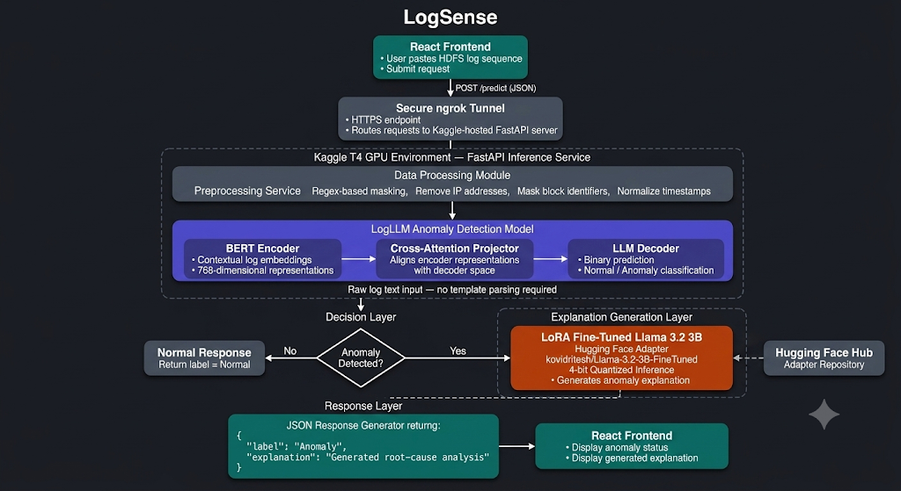
Architecture

Slide 7
Materials / Tools Used
Hardware Infrastructure
Local Training & Testing: NVIDIA RTX 3050 GPU (utilized for fine-tuning the 3B explainer model and executing initial local pipeline tests).
Cloud Production Inference: Dual NVIDIA T4 GPUs (hosted on Kaggle to provide split-VRAM hosting for both deep learning models simultaneously).
Software & Frameworks
Development & Run Environments: Kaggle Notebooks (cloud engine) and Ngrok (secure proxy tunnel).
AI & Optimization Libraries: Unsloth (accelerated training framework), PyTorch, Hugging Face Transformers, and PEFT.
Full-Stack Web Web Architecture: FastAPI (asynchronous Python backend) and React (interactive client interface).
Data Resources
HDFS Log Dataset: Baseline data used to map and establish distributed system behavior.
Custom Synthetic Dataset: Specialized text mappings designed to train the explainer model's domain-expert capabilities.

Slide 8
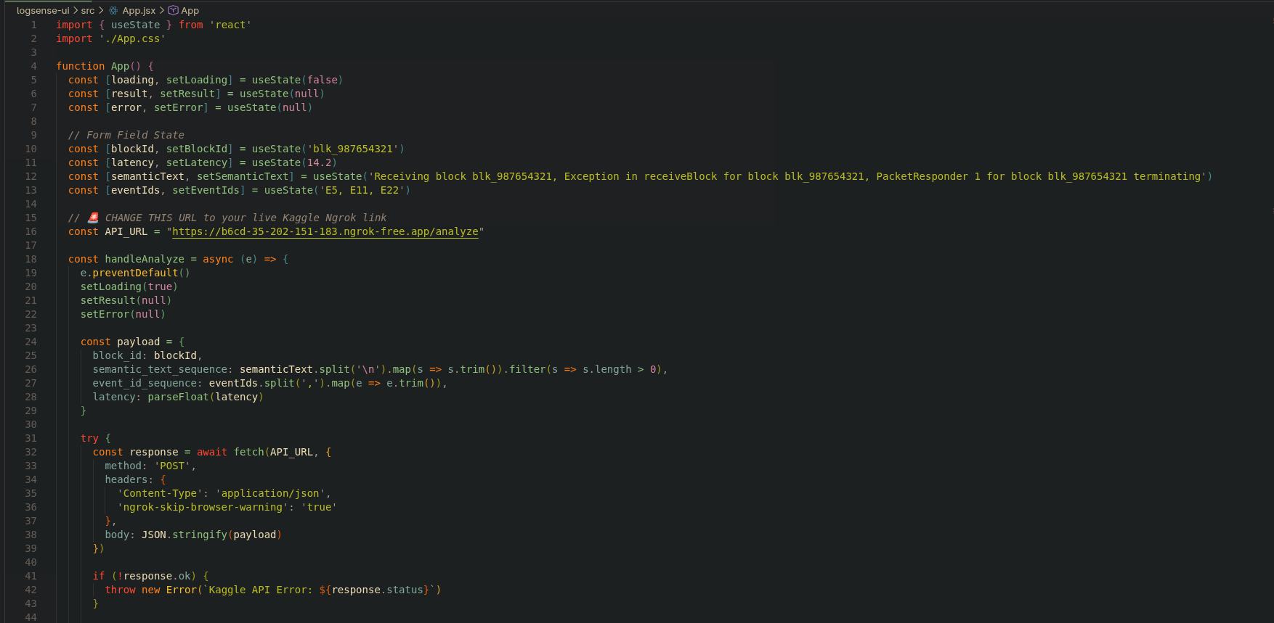
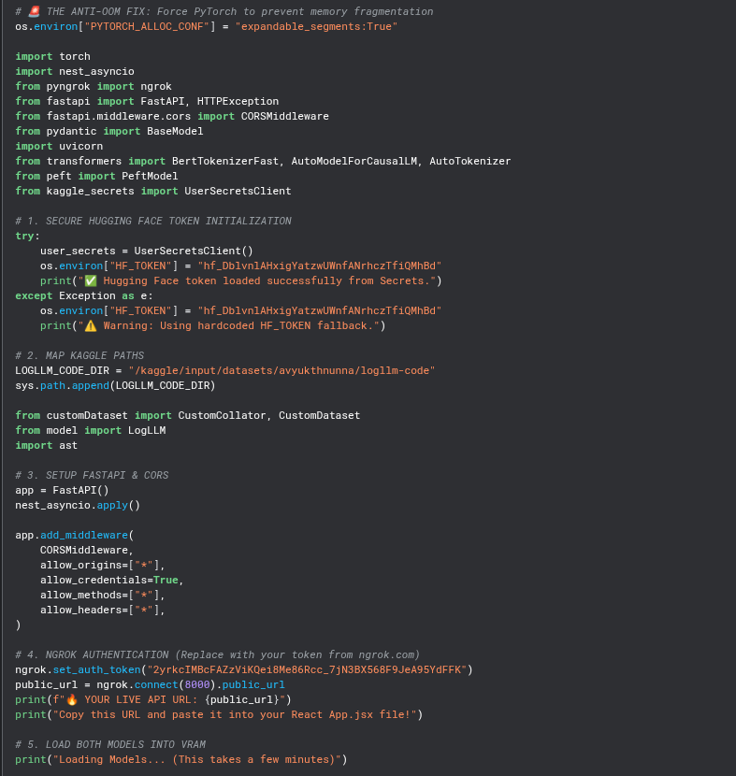
Implementation
Code Snippets
Frontend(React)
Backend(Python)

Slide 9
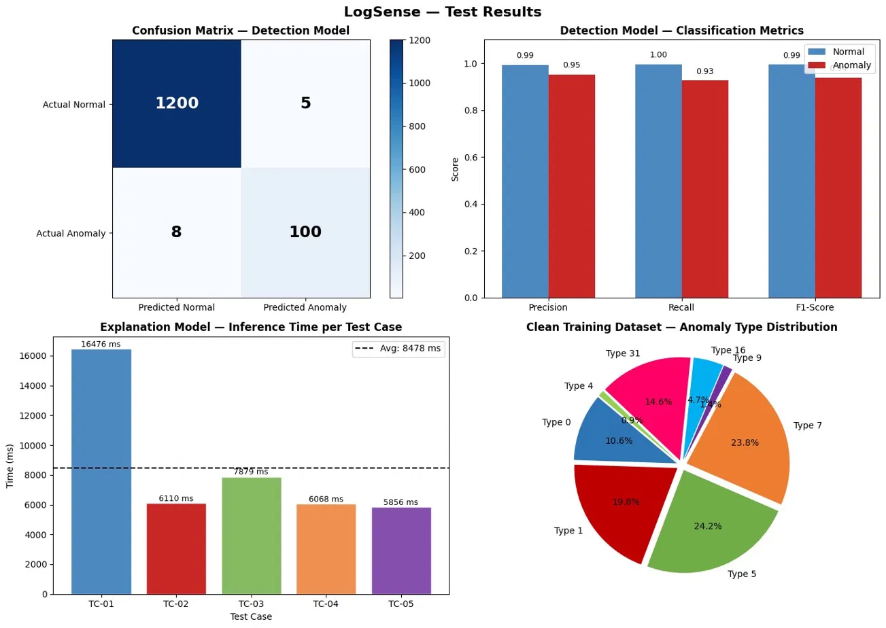
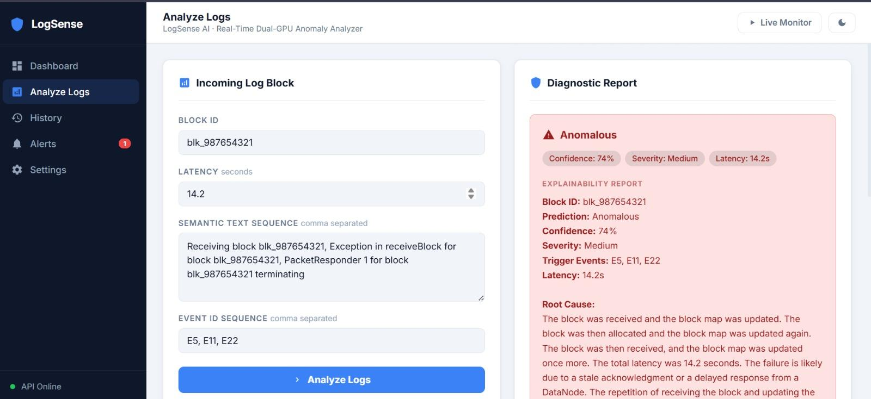
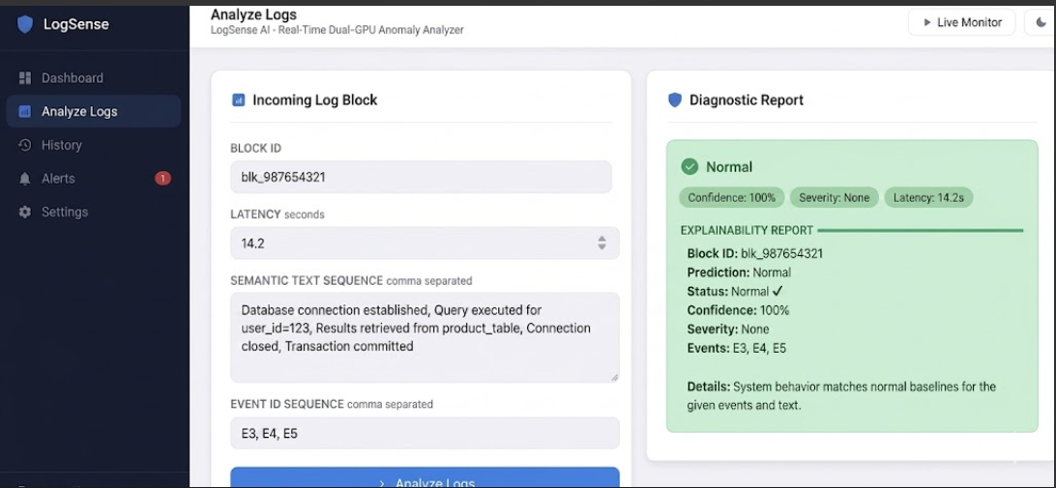
Results / Findings
Graphs / charts
Screenshot/Test cases

Slide 10
Discussion / Analysis
Explanation of Results
High-Quality Output: Despite its compact 3B size, the fine-tuned explainer delivers precise, context-aware incident diagnostics.
Flawless Pipeline Routing: The automated logic successfully processes user-submitted log sequences, filtering normal behavior and pushing anomalies to the secondary model with zero dropped data.
Reliable UI Rendering: The end-to-end data loop functions perfectly, instantly displaying dynamic root-cause explanations on the frontend dashboard.
What Do These Results Mean?
Robust Pattern Discrimination: The 8B classifier accurately distinguishes between normal operations and system anomalies based entirely on structural footprints.
Effective Fine-Tuning: Targeted synthetic training allows a compact 3B model to generate enterprise-grade technical explanations without massive compute costs.
Validated Architecture: The tiered AI framework (Gatekeeper + Specialist) is highly viable, laying a proven foundation for advanced infrastructure diagnostics.

Slide 11
Conclusion
Summary of Project
Built LogSense, an end-to-end, two-model deep-learning pipeline deployed entirely on free-tier infrastructure via FastAPI and Ngrok.
What You Learned
Specialization Wins: Separating anomaly detection from root-cause explanation into two independent models is far more effective than forcing a single model to do both.
Accessible Compute: Fine-tuning a 3-billion-parameter model in just 25 minutes is highly viable using LoRA and Unsloth on free hardware.
Final Outcome
Achieved 99.0% detection accuracy (0.94 F1-score) on the HDFS test set.
Successfully generated fluent, precise root-cause diagnostics in an average of 8.5 seconds per anomalous sequence.

Slide 12
Future Scope
Future Scope
Cross-Domain Expansion: Extend support beyond HDFS to diverse infrastructure logs (Spark, Hadoop, BGL) using a shared encoder.
True Real-Time Streaming: Implement WebSockets and batch endpoints for continuous, high-throughput log ingestion.
Global Accessibility: Introduce multi-language support for multinational operations teams.
Improvements Possible
Production Hosting & Security: Migrate off Kaggle to dedicated 24/7 GPU servers (e.g., vLLM) and implement API key authentication.
Enhanced Training Data: Replace synthetic datasets with thousands of real-world, SRE-labeled incident post-mortems to improve diagnostic quality.
Automated Evaluation: Introduce strict quantitative metrics (BLEU, ROUGE, LLM-as-judge) to rigorously test explanation accuracy.
Ideas for Future Work
Active Learning Loop: Add a feedback system (thumbs up/down) to the React UI, allowing the model to continuously learn from human engineers.
Persistent Audit Trail: Build a database layer to log historical predictions, enabling long-term analytics and drift detection.

Slide 13
References
Articles & Academic Papers
LogLLM: Chen, W., et al. (2024). A Framework for Log-Based Anomaly Detection Using Large Language Models. arXiv preprint.
DeepLog: Du, M., et al. (2017). Anomaly Detection and Diagnosis from System Logs through Deep Learning. ACM SIGSAC (CCS).
LogBERT: Guo, H., et al. (2021). Log Anomaly Detection via BERT. IJCNN.
Drain: He, P., et al. (2017). An Online Log Parsing Approach with Fixed Depth Tree. IEEE ICWS.
LoRA: Hu, E. J., et al. (2022). Low-Rank Adaptation of Large Language Models. ICLR.
Llama 2: Touvron, H., et al. (2023). Open Foundation and Fine-Tuned Chat Models. arXiv preprint.
Loghub: He, S., et al. (2020). A Large Collection of System Log Datasets towards Automated Log Analytics. arXiv preprint.
QLoRA: Dettmers, T., et al. (2023). Efficient Finetuning of Quantized LLMs. NeurIPS.
Transformers: Wolf, T., et al. (2020). State-of-the-Art Natural Language Processing. EMNLP.
LogRobust: Zhang, X., et al. (2019). Robust Log-Based Anomaly Detection on Unstable Log Data. ACM ESEC/FSE.
Websites & Software Repositories
Meta AI: (2024). The Llama 3 Herd of Models — Llama 3.2 release notes and model card. ai.meta.com/blog/llama-3-2/
Unsloth Team: (2024). Unsloth: 2× Faster Llama Fine-Tuning with 70% Less Memory. github.com/unslothai/unsloth

Slide 14
Thank You

