Slide 1
Course Outlines
CMP7228 - MACHINE LEARNING
MSc Artificial Intelligence
Besher Alhalabi
(besher.alhalabi@bcu.ac.uk)
Nov 2021

Slide 2
Introduction
Learning Topics
This course will cover the following topics:
  Supervised and unsupervised learning paradigm.
  Probability Theory & Statistical inference
  Linear Regression and regularisation
  Kernel Methods & Ensemble learning
  Clustering algorithms
  Hypothesis testing and model evaluation

Slide 3
Module Learning Outcomes
Critically evaluate machine learning techniques for suitability to a given industry problem
Implement machine learning techniques to formulate and solve real-life data-based problems.
Professionally report findings from a data analysis project to a technical audience.
Evaluate learning algorithms and utilise model selection effectively.

Slide 4
Assessment Brief
In this assessment the student will apply modern machine learning techniques to solve real-world analytics problems. Each student will submit a comprehensive report detailing the proposed work, results and conclusions. The report will be submitted as one deliverable in the form of a written report. The standard of academic writing should be excellent. (Maximum words: 4000 words, excluding tables, figures and references).

Slide 5
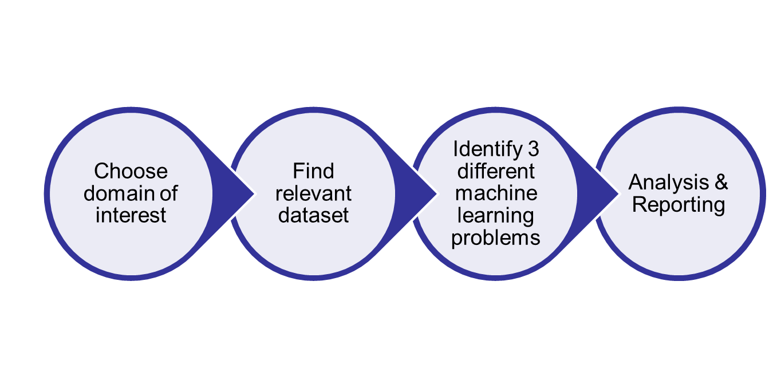
Assessment Steps

Slide 6
Assessment Details
Each Student will select a domain of interest (e.g. Healthcare, Education, Sport, Finance, Meteorology, etc.)
In consultation with the course tutor, each student has to find a data set that is related to the chosen domain. The chosen data set should be publicly available (eg, Kaggle, UCI repository, etc.) with 1,000 rows/instances and 5 columns/attributes (at least).
In consultation with the course tutor. each student has to identify three different machine learning problems (where at least one will be supervised & at least one will be unsupervised) that are related to the dataset.
Each student will critically evaluate the chosen machine learning problems and propose solutions for them using supervised and unsupervised techniques. The solution should include data prepressing, data exploration, model building and model evaluation. Finally, the student should discuss the results using appropriate methods as discussed in the module.

Slide 7
Report Sections
Ideally, the reports should include the following sections:
Cover page (report title, student ID and name).
Domain description.
Problems definition.
Data set description.
Data set exploration (preprocessing and wrangling).
Experiments (three machine learning techniques) and evaluations.
Analysis and Results.
Conclusions.
References.
Appendixes: (codes, charts, etc.)

Slide 8
Our Agenda
Week1(17 Nov) : Introduction + Labs
Week1(18 Nov): EDA + Regression + Labs
Week2(24 Nov): Classification + Labs
Week2(25 Nov):Clustering + Labs
Week3(2 Dec) : Kernel Methods + Labs
Week3(3 Dec) Ensemble Learning + Labs
Week4(8 Dec): Probability Theory & Statistical inference + Labs
Week4(9 Dec): Hypothesis testing + Assessment Support

Slide 9
Our GitHub Page
All labs with related datasets could be found on the course’s GitHub page
https://bit.ly/2RZWqYi

Slide 10
Questions

