Slide 1
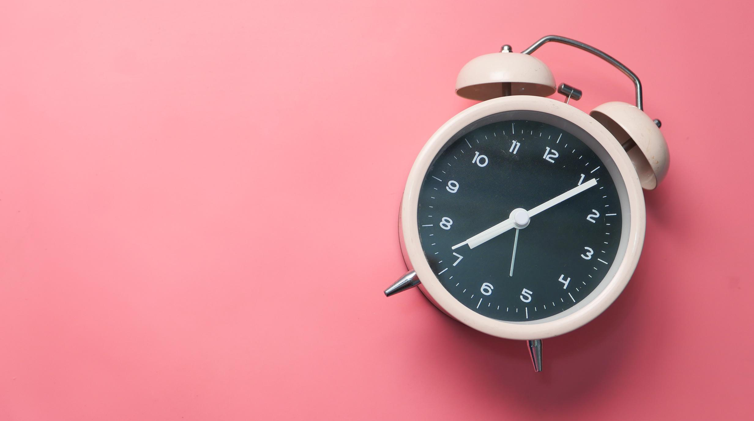
PYTHON MINI PROJECT
ALARM CLOCK
MEMBERS
PARTH KADAM , 27
VEDANT KALWAR, 29
ATHARVA NAWADKAR, 43

Slide 2
LIBRARIES USED:
TKINTER
WINSOUND
Python offers multiple choices for developing a GUI (Graphical User Interface). Out of all the GUI strategies, tkinter is that the most ordinarily used technique. It’s a customary Python interface to the Tk GUI toolkit shipped with Python.
The winsound module provides access to the essential sound-playing machinery provided by Windows platforms. It includes functions and a number of other constants.

Slide 3
TIME
DATETIME
Time module in Python provides varied time-related functions. This module comes with Python’s normal modules.
The main focus of datetime is to form it simpler to access attributes of the thing associated with dates, times, and time zones

