Slide 1
HUMAIN HACKATHON · CHALLENGE 2: DELIVER AI WITH LESS COMPUTE
OptiRoute
A bilingual (Arabic / English) compute cascade that sends each task to the cheapest tier able to answer it correctly, with every number measured on recorded real model runs.
−79.6%
4.7×
86.1%
1.6 ms
compute vs always-large-model (kTok × active params)
cheaper per successful task (CPS)
accuracy on 36 held-out cases (always-14B: 88.9%)
total CPU overhead per task for all 4 guard components
Nawaf Alduaij
qwen2.5:3b → qwen2.5:14b, both co-resident on one AMD RX 7900 XTX (24 GB) · 180 recorded calls · deterministic replay in under 2 s

Slide 2
THE ISSUE
Most enterprise requests overpay for compute
The default setup sends every request to the largest model with the whole document attached.
Measured on our 36 held-out bilingual tasks:
• Always-14B on raw context: 192 kTok·B, 13,712 tokens, 88.9% accuracy
• Always-3B: 79.1% cheaper and only 2.8 pts less accurate, so most tasks never needed the large model
• Pruning alone removes 70.1% of context tokens; with 4× distractor noise, 94.0%
• A naive semantic cache returns the answer for #INV-8841 when asked about #INV-8842: a cheap but wrong result
WHAT THE CHALLENGE ASKS, AND WHERE OPTIROUTE ANSWERS IT
1
Model choice per task
route easy work to the 3B model
2
Context that earns its tokens
pruning + boilerplate removal
3
Verification where it pays
< 1 ms rule checks, escalate only on failure
4
Cost per successful task
CPS reported for every configuration
5
Accuracy & latency floors
graded by a separate ground-truth scorer
OptiRoute · HUMAIN Hackathon · Challenge 2: Deliver AI with Less Compute
2 / 10

Slide 3
OUR SOLUTION
A 3-tier cascade with deterministic CPU guards between the tiers
Pruner
Cache Guard
Router
Tier-1 + Verifier
Tier-2
char n-gram + word TF-IDF
+ shared-number bonus
AR clitic normalizer
Tier-0 · 0 LLM tokens
cosine ≥ 0.88 AND
numbers/IDs exactly equal
complexity C from 4
inspectable signals
C < τ → Tier-1
qwen2.5:3b
refusal · schema ·
grounding · language
qwen2.5:14b
direct if C ≥ τ, or on
verifier escalation
Verifier fails → escalate. A refusal means the pruner starved the context, so retry with the full context; otherwise retry with the top-4 chunks.
Adaptation loop: a W = 20 window of Tier-1 verifier outcomes and P95 latency moves τ ∈ [0.25, 0.75]. τ tightens by 0.08 when the pass rate drops below 70% or P95 exceeds the SLO, and recovers by 0.05 per step after 5 healthy steps (hysteresis).
Every component is deterministic, CPU-only and individually timed: mean pruner 1.34 ms · cache 0.18 ms · router 0.02 ms · verifier 0.11 ms.
OptiRoute · HUMAIN Hackathon · Challenge 2: Deliver AI with Less Compute
3 / 10

Slide 4
HOW IT WORKS
Four steps, each one measurable and switchable for ablation
1
Context pruning & numeric-guarded cache
2
Complexity routing & Tier-1 execution
• Paragraphs scored: 0.50·cos(char 3–5g) + 0.35·cos(word TF-IDF) + 0.15·shared numbers/IDs
• Arabic: Alef/Teh-Marbuta/Alef-Maksura unified, tashkeel stripped, proclitics (وال، بال، لل…) removed
• Cache key = query wording (digits masked) + hash of top-2 chunks; hit only if entity sets are identical
• C = 0.30 multi-hop + 0.30 arithmetic + 0.25 strict JSON/table + 0.15 relevance dispersion
• C < τ → qwen2.5:3b on the pruned context; C ≥ τ → qwen2.5:14b directly
• Measured: 28 of 36 tasks finished on Tier-1, 2 on Tier-0 cache
3
Verification & full-context escalation
4
Bidirectional τ adaptation + shadow audit
• Refusal/degeneracy · JSON schema · numeric grounding (each output number must appear in, or follow by + − × ÷ % from, the context) · Arabic-in/Arabic-out
• Precision 100% and recall 57% on recorded Tier-1 outputs; never sees ground truth
• Refusal → Tier-2 with full context (recovers pruner misses); other failures → top-4 relaxed context
• Estimated Tier-1 health = verifier pass rate × agreement on sampled Tier-2 audits (every 4th verified answer)
• Tightens when health < 70% or P95 > SLO; recovers +0.05/step after 5 healthy steps (hysteresis)
• Recorded wave: τ 0.55 → 0.47 in the hard burst (request 26) → back to 0.55 (requests 38, 39)
OptiRoute · HUMAIN Hackathon · Challenge 2: Deliver AI with Less Compute
4 / 10

Slide 5

IMPLEMENTATION & LIVE DEMO
A working prototype you can click through
WHAT WAS BUILT
• Cascade engine (src/): pruner, entity-guarded cache, router, verifier, adaptive τ, orchestrator; every component can be switched off for ablation
• Interactive UI: 8 bilingual presets replay recorded runs; custom questions run on the live models; every stage visualised with its cost vs always-14B
• evaluate.py: --record / --replay / --sim, 2 ablation tables, 5 robustness experiments
• 31 unit tests; slides and reports generated from measured results
TECH STACK
Python · Ollama on ROCm (AMD RX 7900 XTX, 24 GB) · qwen2.5 3B / 14B (+ llama3.2 3B, qwen2.5 0.5B) · OpenAI-compatible client · tiktoken · FastAPI + Chart.js · pytest · python-pptx
github.com/nawafalduaij/optiroute
Live UI: the #INV-8842 trap is blocked by the entity guard (wording cosine 1.000, IDs differ)
OptiRoute · HUMAIN Hackathon · Challenge 2: Deliver AI with Less Compute
5 / 10

Slide 6
EVALUATION METHODOLOGY
Held-out, recorded once, replayed, graded separately
Category | Cases | What it stresses
standard | 20 | single-chunk policy / invoice lookups
low lexical overlap | 4 | paraphrased query, almost no shared keywords
multi hop | 4 | facts from 2 chunks + arithmetic (SLA credit, penalties)
arabic orthographic variants | 4 | missing hamza, ه/ة, ي/ى, clitics, mixed numerals
cache near duplicates | 4 | 2 paraphrase hits + 2 traps (#INV-8841→8842, 6→8 days)
total | 36 | 21 English / 15 Arabic · separate 10-case dev set
Record & replay
180 real calls (36 tasks × raw/pruned/relaxed × tier), temperature 0, models pre-warmed so load time is excluded, prompt hash stored to detect drift
No circular metrics
Accuracy comes from a ground-truth scorer (numeric tolerance, required facts, JSON fields). The runtime verifier is graded against it, never used for it.
Measured units
tiktoken o200k token counts · compute = Σ tokens/1000 × active params (3B / 14B, cache = 0) · latency = recorded LLM time + perf_counter CPU time
Reproducible
Full evaluation replays in 2.6 s without a GPU or API keys; 31 unit tests in sim mode
OptiRoute · HUMAIN Hackathon · Challenge 2: Deliver AI with Less Compute
6 / 10

Slide 7
RESULTS: HELD-OUT, RECORDED REAL RUNS
Cumulative build-up: what each component adds
Configuration | Accuracy | Tokens | Compute kTok·B | Δ compute | CPS | P50 ms | Tier 0/1/2 | False cache hits
1 Always Tier2 Raw | 88.9% (32/36) | 13,712 | 192.0 | +0.0% | 6.00 | 472 | 0/0/36 | 0/2
2 Always Tier1 Raw | 86.1% (31/36) | 13,363 | 40.1 | -79.1% | 1.29 | 129 | 0/36/0 | 0/2
3 Router Only | 86.1% (31/36) | 13,580 | 60.6 | -68.4% | 1.96 | 146 | 0/32/4 | 0/2
4 Pruner Plus Router | 80.6% (29/36) | 6,519 | 30.1 | -84.3% | 1.04 | 148 | 0/32/4 | 0/2
5 OptiRoute Full | 86.1% (31/36) | 6,847 | 39.2 | -79.6% | 1.26 | 152 | 2/28/6 | 0/2
Full cascade vs always-14B
• −79.6% compute, −50.1% tokens
• CPS 1.26 vs 6.00 kTok·B per success (4.7× cheaper)
• P50 latency 152 ms vs 472 ms
• Accuracy 86.1% vs 88.9%: 1 fewer correct answers out of 36
OptiRoute · HUMAIN Hackathon · Challenge 2: Deliver AI with Less Compute
7 / 10

Slide 8
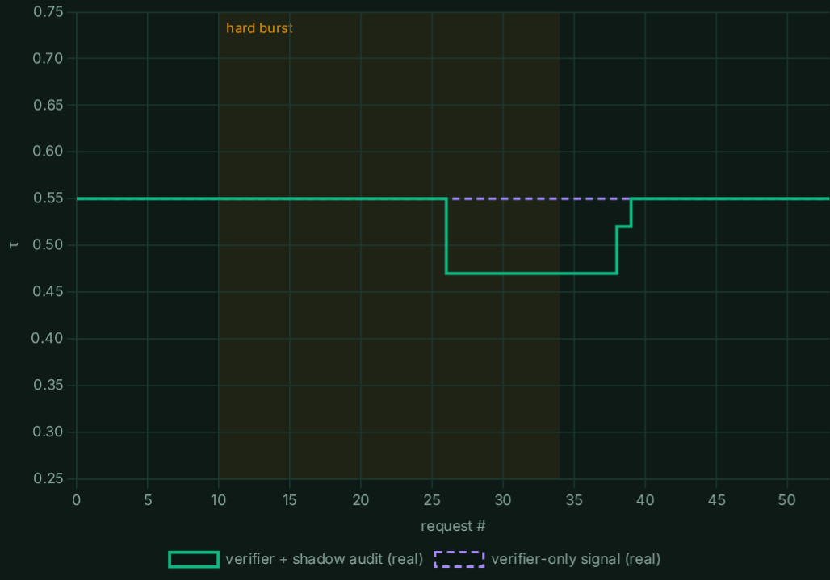
ABLATIONS & ROBUSTNESS
Leave-one-out, other models, and adaptation on real runs
Configuration | Accuracy | Tokens | Compute kTok·B | Δ compute | CPS | P50 ms | Tier 0/1/2 | False cache hits
Full OptiRoute | 86.1% (31/36) | 6,847 | 39.2 | -79.6% | 1.26 | 152 | 2/28/6 | 0/2
LOO No Cache | 86.1% (31/36) | 7,255 | 40.4 | -79.0% | 1.30 | 152 | 0/30/6 | 0/2
LOO No Cache Entity Guard | 83.3% (30/36) | 6,401 | 35.1 | -81.7% | 1.17 | 148 | 4/27/5 | 2/2
LOO No Pruner | 86.1% (31/36) | 13,235 | 64.5 | -66.4% | 2.08 | 142 | 2/29/5 | 0/2
LOO No Verifier | 80.6% (29/36) | 6,111 | 28.9 | -85.0% | 1.00 | 142 | 2/30/4 | 0/2
LOO No Adaptation | 86.1% (31/36) | 6,847 | 39.2 | -79.6% | 1.26 | 152 | 2/28/6 | 0/2
SAME CASCADE, DIFFERENT RECORDED MODELS (only the recording changes)
REAL τ(t), WAVE WORKLOAD
Tier-1 model (Tier-2: qwen2.5:14b) | Tier-1 alone | OptiRoute | Compute vs 14B | CPS 14B → OptiRoute | Verifier P / R
qwen2.5:3b (3B) | 86.1% | 86.1% | -79.6% | 6.00 → 1.26 | 100% / 57%
llama3.2:3b (3.2B) | 88.9% | 86.1% | -79.3% | 6.00 → 1.28 | 75% / 50%
qwen2.5:0.5b (0.5B) | 55.6% | 75.0% | -84.1% | 6.00 → 1.13 | 100% / 47%
Entity guard: 0/2 false cache hits vs 2/2 without it · Verifier: +5.6 pts accuracy · Pruner: −48% tokens vs no pruner
With a weak qwen2.5:0.5b (0.5B) Tier-1 the cascade adds 19.4 pts over using that model alone.
Tightens in the burst, then recovers · +42% compute
OptiRoute · HUMAIN Hackathon · Challenge 2: Deliver AI with Less Compute
8 / 10

Slide 9
HONEST LIMITATIONS & ROADMAP
What this prototype does not solve yet
1. Grounded-but-wrong arithmetic slips past the verifier
PRODUCTION ROADMAP
• Calculator tool + program-of-thought for multi-hop math, with the verifier recomputing the expression
• Small bilingual embedding re-ranker as a fallback when the lexical scores are flat
• Token-logprob confidence as a 5th verifier signal for confident-but-wrong answers
• Output language guard on Tier-2 (catches code-switching)
• Risk-weighted audit sampling + a larger dev set to calibrate τ, the SLO and the verifier
• Serve with vLLM + batching; swap in HUMAIN/ALLaM models through the same OpenAI-compatible client
Recall is 57%: rule checks cannot tell 10% of the fee from 25% when both numbers are in the context. Multi-hop accuracy is 25% for the cascade, and even the 14B gets only 50% (it wrote 900×4 + 1200×3 = 4,500, and switched to Chinese mid-answer in Arabic).
2. A lexical pruner is blind to zero-overlap paraphrases
Low-overlap accuracy is 75% with the pruner vs 100% without it. Recovery only works when the 3B admits it doesn't know; a confident wrong answer ("USB copy forbidden by the encryption policy") passes.
3. Adaptation needs a costly signal; small benchmark
Rule checks miss confident errors: verifier-only health never fell below 80%, so τ stayed flat. Shadow audits make τ react on real runs but cost +42% compute, and since complexity scores cluster, a 0.08 τ shift barely re-routes tasks. n = 36 synthetic docs: ±1 task = 2.8 pts.
OptiRoute · HUMAIN Hackathon · Challenge 2: Deliver AI with Less Compute
9 / 10

Slide 10
TAKEAWAYS
Cheap only counts if it is right, and we measured both
−79.6%
4.7×
0/2
100%
compute vs always-14B
cheaper per successful task
false cache hits with the entity guard
verifier precision (no wasted escalations)
Why this design
• Evaluation first: a held-out set, recorded real runs, and leave-one-out ablations, instead of a prompt wrapper with hand-picked numbers
• Bilingual by construction: Arabic normalization in the pruner, cache and verifier
• Runs fully local on one 24 GB GPU: no rate limits, no API cost, data stays on-premise
• Model-agnostic: any OpenAI-compatible endpoint; verified with 3 recorded model pairs
• Every guard is inspectable and costs about 1.6 ms of CPU time
github.com/nawafalduaij/optiroute
pip install -r requirements.txt
python evaluate.py --replay data/recorded_runs.jsonl
uvicorn app:app --port 8000 # live demo UI
Re-record on your own hardware:
python evaluate.py --record --fresh
Nawaf Alduaij · thank you
OptiRoute · HUMAIN Hackathon · Challenge 2: Deliver AI with Less Compute
10 / 10

