Slide 1
FINAL PROJECT TEMPLATE

Slide 2
THREAT SUMMARY
Summary of Situation: A financially motived pop-up “Fin4 Bit Cryptor” has appeared in hospitals A, B, and C, informing that the attacker has encrypted all personal files. The files will only be decrypted and released upon payment of a ransom, which is requested in bitcoins. The incident originated from a user in the technology department who opened an email attachment. It is important to note that Hospital X has not experienced this incident thus far.
Asset: Personal Documents, Systems & tools used by hospital staff, Patient statistics, Doctor reports.
Impact: Confidentiality, integrity, availability (Critical)
Threat Actor: External threat actors in this context encompass cyber-criminals who execute attacks with the aim of financial gain. On the other hand, a potential internal threat actor could be an employee who deliberately opens an email attachment with the intention of causing harm and is driven by financial motives.
Threat Actor Motivation: The main motivation here from the Fin4 Bit Cryptor pop-up here is financial gain, unsatisfied employees within the organization may resort to seeking retribution by utilizing digital means and exploiting resources. Additionally, there may be instances where individuals who have been terminated engage in data theft either during their departure or even after their separation from the company.
Common Threat Actor Techniques:
Intention threats - Attackers employ various techniques such as Phishing and Spear Phishing to deliberately pose threats and gain access to sensitive information through email attachments.
Unintentional threats, on the other hand, can arise from unsuspecting victims, such as security-unaware employees who fall prey to social engineering tactics.

Slide 3
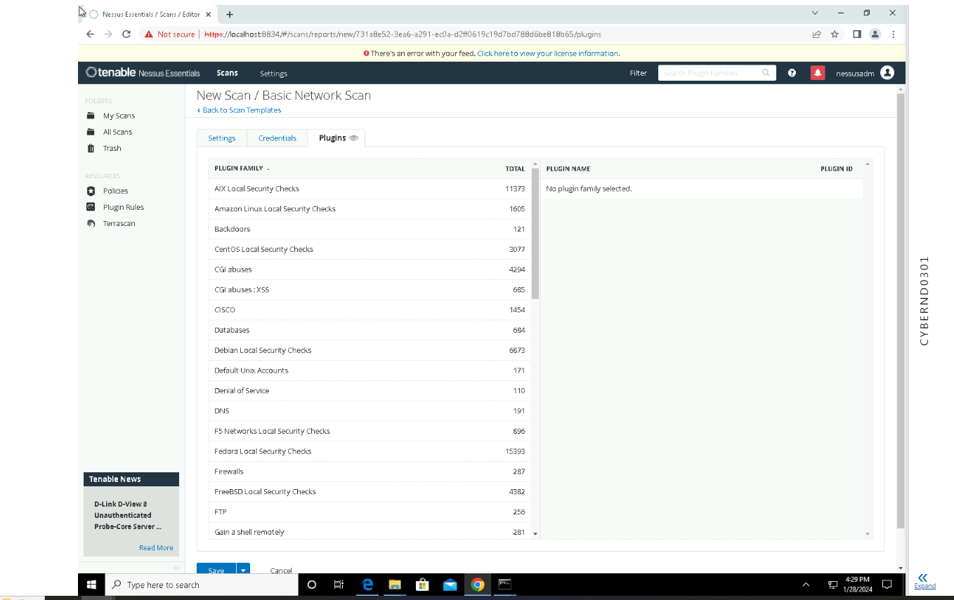
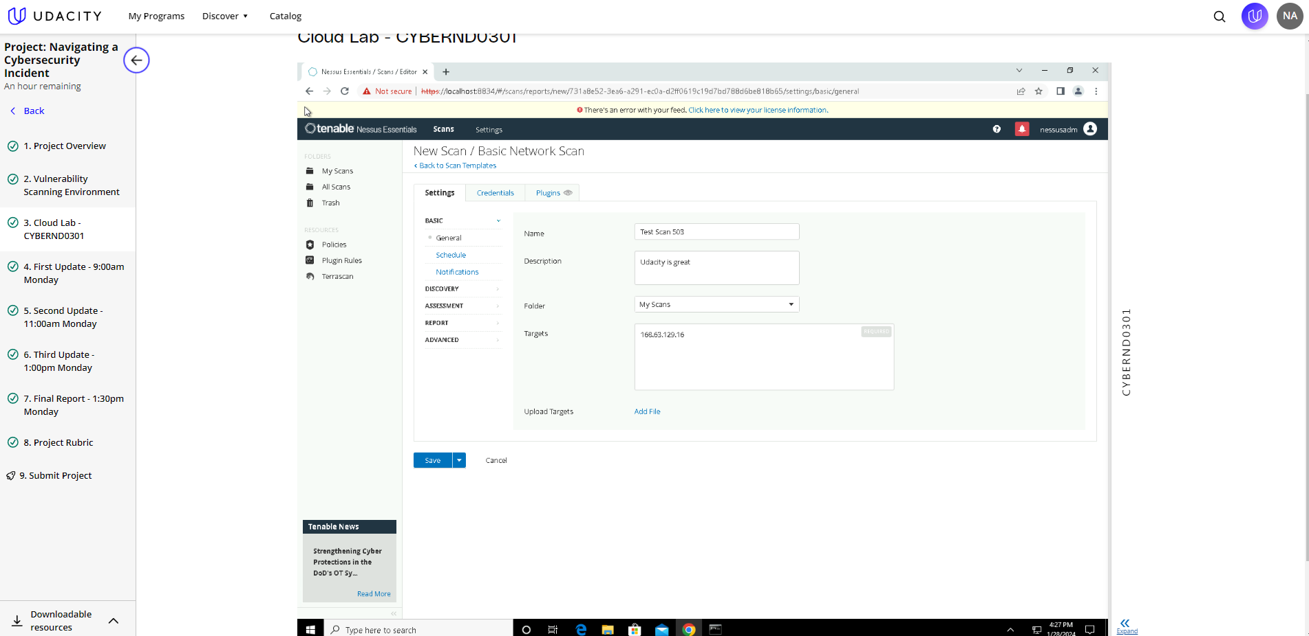
VULNERABILITY SCANNING TARGETS
Summary of scan targets:
Number of devices scanned: 1
Device type: Virtual Machine
Primary purpose of device: General Purpose

Slide 4
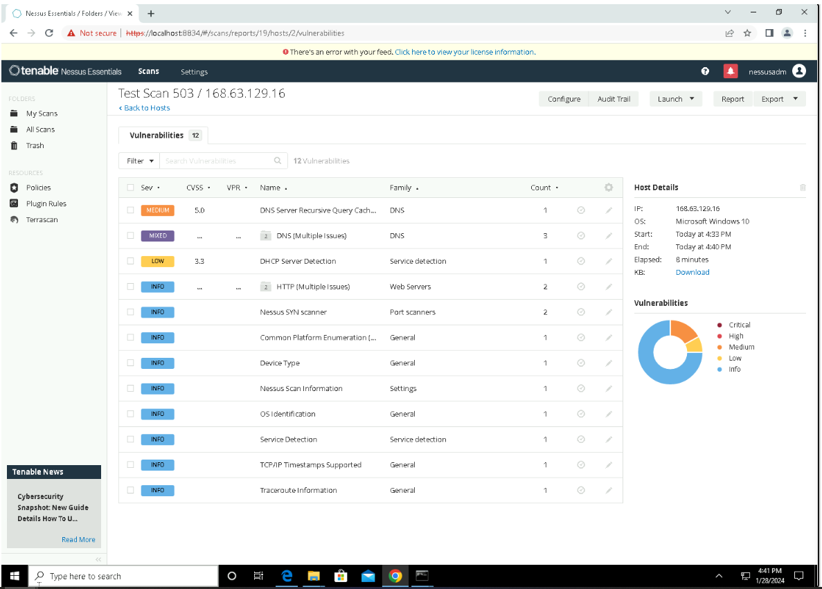
VULNERABILITY SCAN RESULTS
Summary of findings:
Total number of actionable findings: 12
Critical: 0
High: 0
Medium:1
Low:1

Slide 5
REMEDIATION RECOMMENDATION
Fix within 7 days
Finding | Severity Rating | Recommended Fix
No Critical/High Vulnerabilities
Fix within 30 days
Finding | Severity Rating | Recommended Fix
DNS Server Recursive Query Cache Poisoning Weakness | Medium | Restrict recursive queries to the hosts that would use nameserver
DNS server spoofed request amplification DDoS | Medium | Restrict access to your DNS server from public network or reconfigure it to reject such queues
Finding | Severity Rating | Recommended Fix
DHCP Server Detection | Low | Applying filtering to keep this information off the network and remove any options that are not in use.
Fix within 60 days

Slide 6
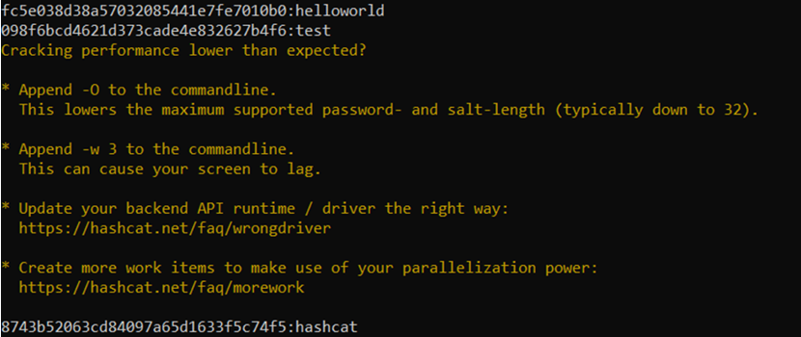
PASSWORD PENETRATION TEST OUTCOME
Methodology: Place hashed passwords in a text file. Download a password list (rockyou). Open command prompt and type the command hashcat –m (is the hash type) –a (attack mode) and the hashfile and masked file with the rule at the end.
Number of passwords tested: 44
Number of passwords cracked: 5
Evidence of weak passwords: 5
Recommended steps to improve passwords security: 8 character length; change every 90-120 days; use special characters, numbers, captials, ect.

Slide 7
INCIDENT RESPONSE PRELIMINARY ASSESSMENT
Summarize ongoing incident:
A security incident has taken place where the assailant has encrypted all personal documents. In order to regain access to these documents, the attacker is demanding a payment of 1 million dollars in bitcoins. Unfortunately, the medical staff, including doctors, nurses, and administrative personnel, are unable to access the control systems used to monitor patient statistics. This lack of access hinders the doctors' ability to provide necessary treatments as they do not have access to detailed information and patient statuses. Additionally, the log analysis tool is currently inaccessible, exacerbating the severity of this critical security incident.
Document actions or notes from the following steps of the initial incident response checklist
Step 1: Assemble a group of experts proficient in addressing cybersecurity challenges.
Step 2: Refuse to make the payment demanded as there is no assurance that anything will be returned to you.
Step 3: Restore backups
Step 4:Find source of incident
Step 5: Isolate source of incident
Step 6: Plan strategy to avoid ransom
Step 7: Conduct proper training to cyber security staffs
Step 8: Conduct regular backups

Slide 8
INCIDENT RESPONSE RECOMMENDED ACTION
Summarize recommendation to contain, eradicate, and recover:
The origin of the incident needs to be identified. The email attachment should be either removed or isolated. Subsequently, the files and servers should be restored using the backups. As per the attacker's statement, the software can be deleted. Once deleted, all remnants of the software must also be eliminated. The severity of this incident is classified as high. The medical personnel are unable to provide treatment to patients due to the unavailability of information. This could potentially result in the loss of patient lives. To prevent such incidents in the future, regular information sessions must be conducted for the staff. These sessions should outline the actions that the staff should take and those that they should avoid. Additionally, regular backups of data and servers should be performed to ensure data availability in case of any issues.
Documented actions and notes from the IR checklist
Step 7: Malware response, DoS response, Insider threat response.
Step 8: Figure out if it was intentional or not
Step 9: Assure patches and backups in place
Step 10: Document the attack, what caused it, overall impact, risk rating , procedure to overcome the situation.
Step 11: Have a proper planning mechanism until the incident is solved as well as for the future.

