Slide 1
Deep Q-Network (DQN) for Traffic Light Control
Authors: Nawaf Salman, Nahel Awidat
Supervisor: Dr. Ayal Taitler
Institution: Technion - Israel Institute of Technology
Submission Date: 07/11/2024
Semester: Winter 2023

Slide 3
Introduction
Fixed-schedule traffic lights can't adapt to real-time traffic, causing congestion and longer wait times.
Importance of efficient traffic management in modern cities:
- Reduces waiting times
- Minimizes pollution
- Enhances quality of life
Objective: Implement adaptive traffic light control.

Slide 4
Problem Statement
Challenges:
-Reduce waiting times
-prioritize public transport
This requires a dynamic solution that responds to real-time conditions.
Use RL and DQN

Slide 5
Explored Solutions
Compared methods:
- Max Pressure:
Fixed, static optimization.
- Actor-Critic Algorithms:
High computation requirement.
Training Requires direct environment interaction.
Chosen: DQN.
- Adapts to complex, changing environments.
- Handles large state spaces.
- ability to learning from past data without interaction with environment.

Slide 6
Why Reinforcement Learning?
RL provides adaptive, responsive control suitable for real-time scenarios.
Why RL for traffic management?
- Handles dynamic traffic conditions
- Learns optimal control strategies over time
- Can handle high pressure
- Can prioritize public transport efficiently

Slide 7
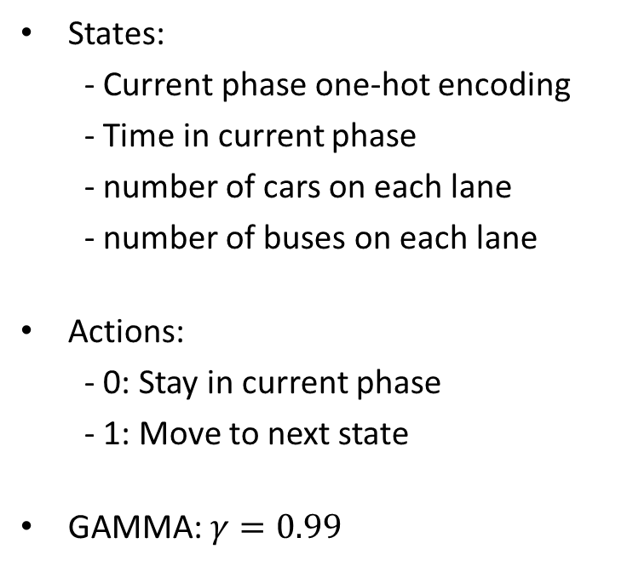
Markov Decision Process (MDP)
States:
- Current phase one-hot encoding
- Time in current phase
- number of cars on each lane
- number of buses on each lane
Actions:
- 0: Stay in current phase
- 1: Move to next state
GAMMA: $γ=0.99$
Rewards: we examine 2 rewards functions:
- Minus TTT (Total Travel Time)
- Minus Weighted TTT:
Car weight = x1 Bus weight = x15

Slide 8
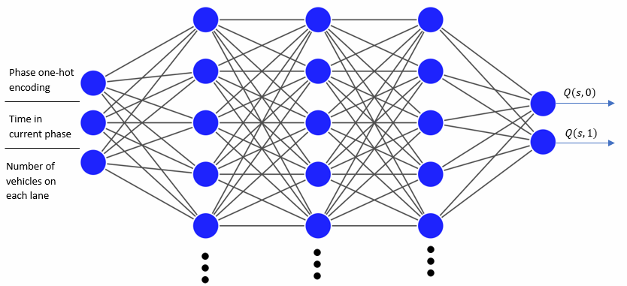
Overview of DQN Algorithm
DQN leverages deep neural networks to estimate the Q function
Network Input: State Vector
Network Output: Q values of each action

Slide 9
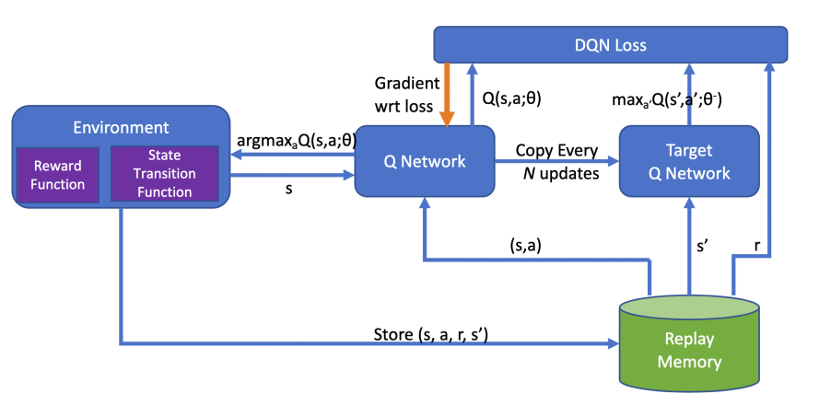

Training Process
Training DQN involves:
- Replay memory for experience storage
- Target network for stability
- Soft updates for gradual learning
- choose optimal action using $ε−exploration$ method

Slide 10
Simulation Environment
SUMO (Simulation of Urban MObility):
- create junction and traffic light system (TLS)
- create cars and buses flows
- provides ability to customize the environment
TRACI:
- API to communicate with SUMO
- Get data about junction status
- Control the TLS

Slide 11
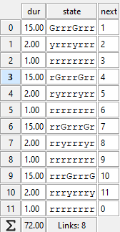
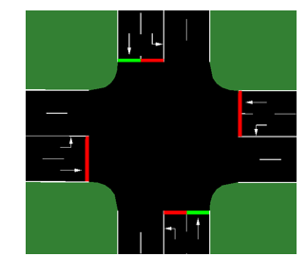
Simulation Setup
Traffic setup includes:
- Vehicle types: cars, buses
- Pre-defined traffic phases
Exponentially distributed intervals mimics real traffic flow.

Slide 12
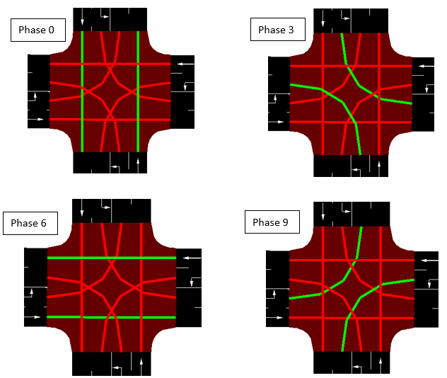

Slide 13
Results - Low Traffic
Diagram/Image Placeholder
DQN Results in Low Traffic:
Converges efficiently, minimizing delays, comparable to Max Pressure.
[Insert diagrams comparing methods]

Slide 14
Results - High Traffic
Diagram/Image Placeholder
DQN Results in High Traffic:
Outperforms static methods like Max Pressure.
Adapts dynamically, showing lower delays in high-density conditions.
[Insert space-time plots]

Slide 15
Conclusion
Key Findings:
- DQN improves intersection traffic flow
- RL enhances control in smart traffic systems

Slide 16
Future Directions
Potential future work:
- Adding convolutional layers for improved learning
- Exploring multi-agent RL for larger networks
- Experimenting with other RL methods like PPO, A3C

