Slide 1

S-RED
NOSHIN NAWAL
1805061

Slide 2
Reference
T. J. Ott, T. V. Lakshman and L. H. Wong, "SRED: stabilized RED," IEEE INFOCOM '99.

Slide 3
Overview
SRED : Stabilized Random Early Drop
Additional Feature from RED : Wide range of load levels help it stabilize its buffer occupation at a level independent of the number of active connections
Estimates the number of active flows in a bottleneck link statistically
Finds the candidate for “misbehaving flows”

Slide 4
Methodology
Zombie List : M recently seen flows, with extra information “count” and “time stamp”
Zombies : flows in the zombie list
Zombie list starts out empty, As packets arrive, as long as the list is not full, for every arriving packet the packet flow identifier (source address, destination address, etc.) is added to the list, the count of that zombie is set to zero, and its timestamp is set to the arrival time of the packet

Slide 5
Methodology
Once the zombie list is full it works as follows: Whenever a packet arrives, it is compared with a randomly chosen zombie in the zombie list.
Hit : If the arriving packet’s flow matches the zombie we declare a “hit”.
Count ++
Update timestamp
No Hit : If the two are not of the same flow, we declare a “no hit”. In that case, with probability p the flow identifier of the packet is overwritten. With probability 1 - p there is no change to the zombie list.

Slide 6
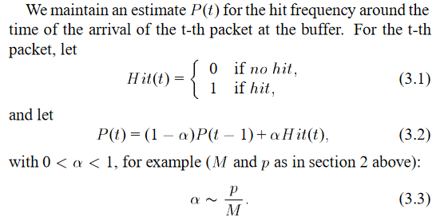
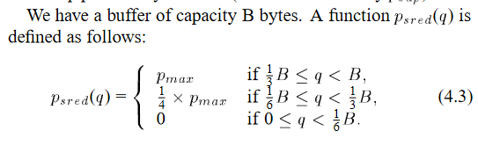
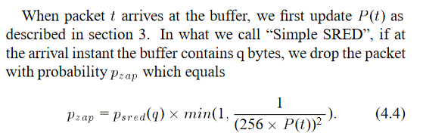
Formulas

Slide 7
THANK YOU

