Slide 1
Global Disaster Hotspot Mapping & Country-Level Vulnerability Analysis (2000–2025)
By: Nawal Krishna S (2025EMAI10027)

Slide 2
objectives
To identify global disaster hotspots using geospatial coordinates.
To analyze disaster frequency and patterns across regions from 2000–2025.
To compute a Vulnerability Index combining total deaths, affected population, and economic losses.
To compare vulnerability across countries and highlight high-risk regions.
To provide insights that can support disaster preparedness and risk management.

Slide 3
Dataset overview
EM-DAT International Disaster Database
Time period: 2000–2025
Total records: ~16,000 disaster events
Regions included: Africa, Americas, Asia, Europe, Oceania
Data fields:
Disaster type
Subgroup & group
Country and region
Total deaths
Total affected population
Economic damage
Latitude & Longitude
Start date information

Slide 4
Data challenges
Missing values in location (up to 88%)
Missing economic data
Outliers in deaths and affected counts
Inconsistent formats (dates, numeric fields)

Slide 5
Preprocessing
Key Preprocessing Steps
Converted numeric fields (deaths, affected, damage).
Handled missing dates using default imputation.
Removed events outside 2000–2025.
Cleaned and validated latitude & longitude values.
Applied domain-based validation for numeric ranges.
Applied outlier capping using 1st–99th percentiles.

Slide 6
Missing data exploration
Observations
Location data missing for ~88% events.
Economic damage missing for ~80% events.
Deaths missing for ~20% events.
Handling Strategy
For hotsp
ot maps → removed rows without coordinates.
For vulnerability index → treated NAs as 0 or imputed safely.
Validated values using domain knowledge.

Slide 7
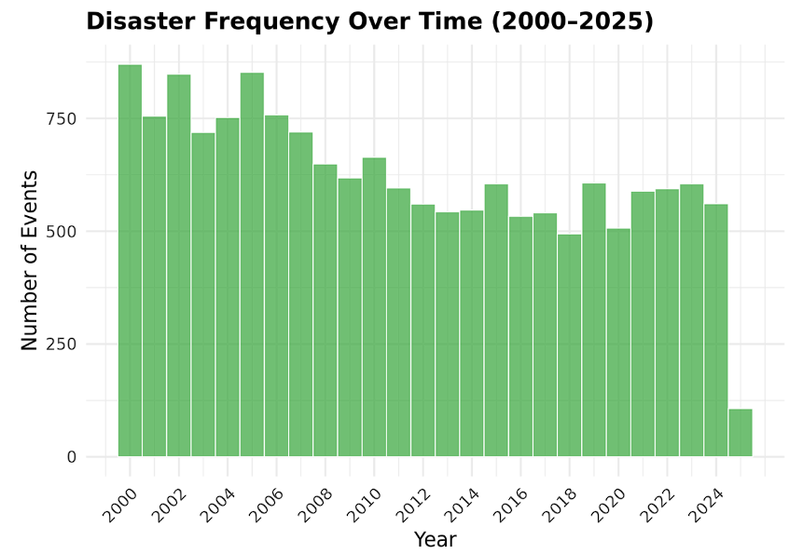
Key finding 1 :
Disaster Frequency Over Time
Number of recorded disasters increased steadily between 2000–2010.
Slight variation between 2010–2025 due to better reporting and climate impacts.
Floods and storms dominate most years.

Slide 8
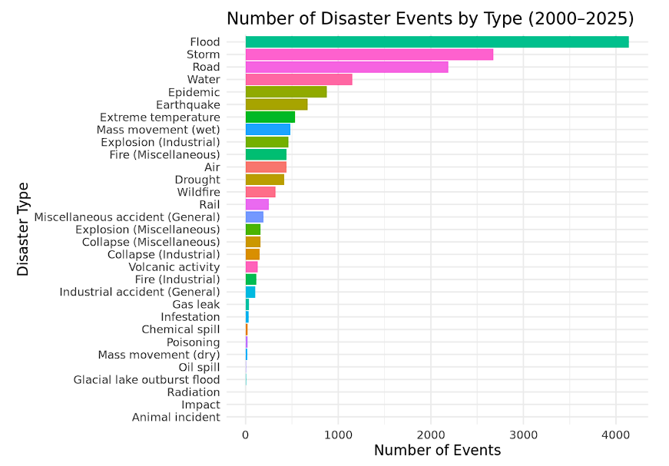
Key finding 2 :
Disaster Distribution by Type
Most common disaster types:
Floods
Storms
Epidemics
Earthquakes
Floods account for a large share due to seasonal monsoons and river basins.

Slide 9
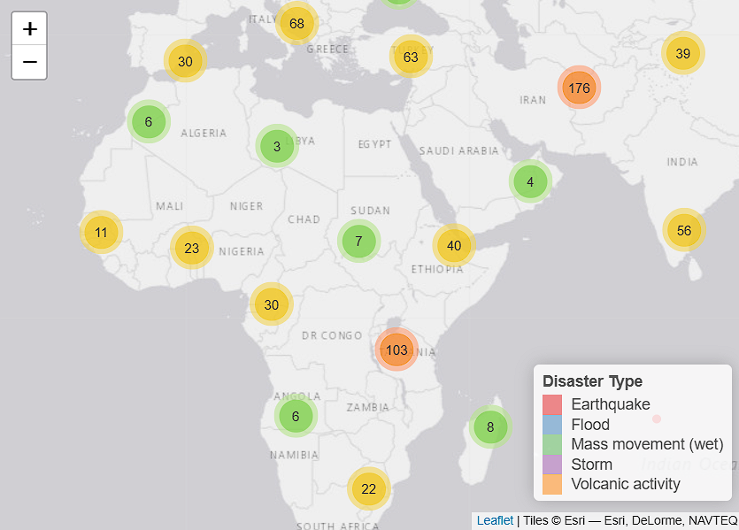
Key finding 3 :
Global Hotspot Mapping
High-density disaster hotspots appear in:
South & Southeast Asia (India, Bangladesh, Philippines, Indonesia)
East Africa (Ethiopia, Kenya)
Central America
Asia has the highest concentration of extreme events.

Slide 10
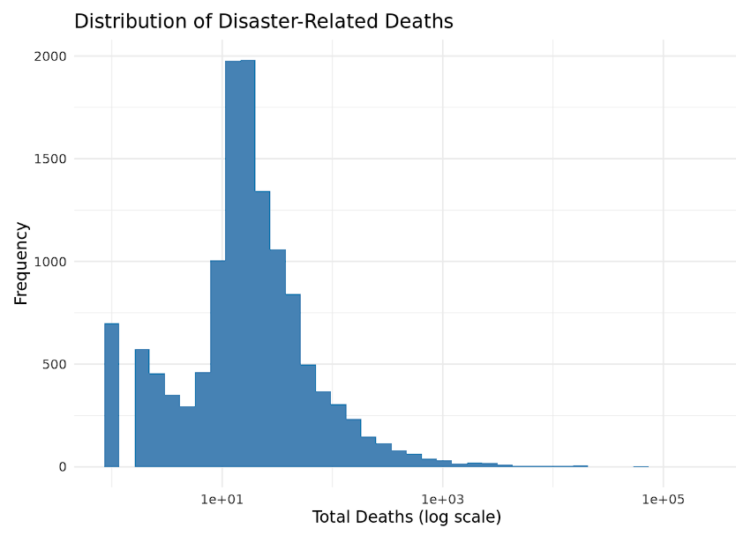
Key finding 4 :
Human Impact Analysis
A few events cause extremely high casualties (right-skewed distribution).
Majority of disasters have <50 deaths.
Epidemics and earthquakes contribute to extreme death counts.

Slide 11
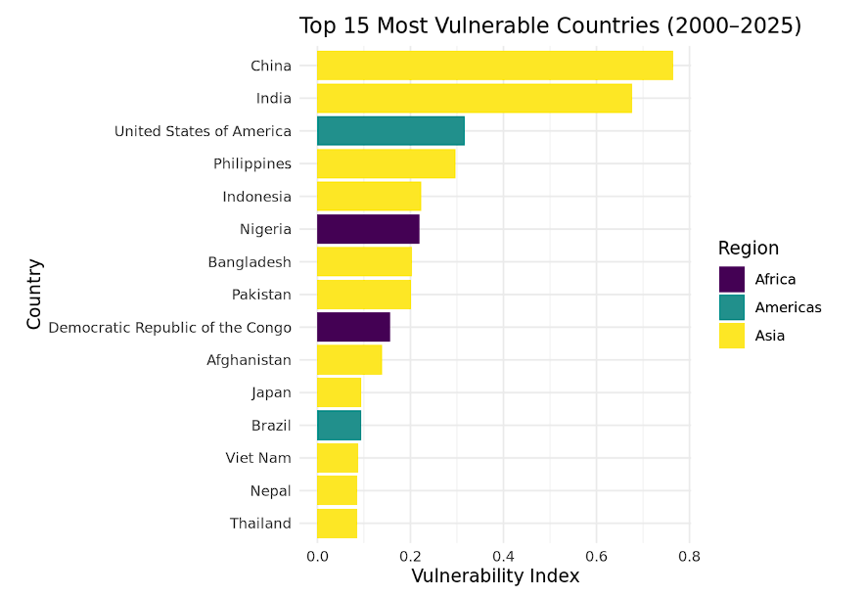
Key finding 5 :
Country-Level Vulnerability Index
Vulnerability score = 0.5 × deaths_norm + 0.3 × affected_norm + 0.2 × damage_norm
Top 15 Most Vulnerable Nations
Mostly developing countries.
High exposure + limited resources.
Repeated floods, storms, and epidemics.

Slide 12
Additional Insights
Additional Observations
Countries with low disaster count but high severity show high vulnerability (e.g., Haiti).
Economic loss is highest in rapidly growing economies (China, India).
Disaster types cluster by geography (e.g., earthquakes in Pacific Ring of Fire).
Missing economic data limits precise financial comparisons.

Slide 13
Recommendation
Based on Analysis
Strengthen early warning systems in high-risk regions.
Improve disaster reporting and data collection (especially location & economic losses).
Allocate resources to vulnerable countries for preparedness.
Encourage governments to invest in infrastructure resilience.
Promote international cooperation for disaster response.
Integrate data-driven insights in risk planning and policy drafting.

Slide 14
Limitations
High missingness in location data limited hotspot precision.
Economic damage data unreliable for many countries.
Vulnerability index is simplified; real risk is multi-dimensional.
Mapping accuracy depends on available coordinates.

Slide 15
Conclusion
Disaster patterns show clear regional and temporal trends.
Asia is the most disaster-prone continent.
Hotspot mapping reveals continental clusters of repeated events.
Vulnerability Index helps highlight countries requiring urgent attention.
The study successfully integrates geospatial and statistical analysis.

