Slide 1

Heart Disease Project
Dr. Nawana Coyle

Slide 2

PROBLEM
Looking at given clinical data, can we predict who will develop heart disease?

Slide 3

WHY IT’S IMPORTANT PREDICT HEART DISEASE
According to CDC (2022),
Heart disease is the leading cause of death for men and women in the US.
One person dies every 36 seconds in the US from cardiovascular disease.
About 659,000 people in the US die from heart disease every year- that’s 1 in every 4 deaths.
Heart disease costs the US about $363 billion each year from 2016-2017.
https://www.cdc.gov/heartdisease/facts.htm

Slide 4
Data for The Project
Original data came from the Cleavland data from the UCI Machine Learning Repository
Data is available on Kaggle. https://www.kaggle.com/ronitf/heart-disease-uci

Slide 5

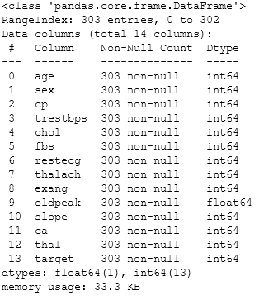
Data Cleaning
14 Columns and 303 rows
All numerical values
No missing data
No duplicated values
Shuffled data to minimize variance and create a model
Performing exploratory data analysis (EDA) was straight forward

Slide 6
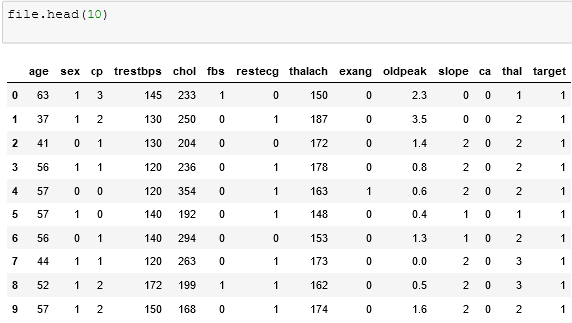
Exploratory Data Analysis (EDA)

Slide 7
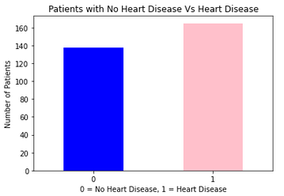
Exploratory Data Analysis (EDA)
Ratio of patients,
Heart disease: No heart disease =~ 1:1
Even distribution of data for the project.

Slide 8
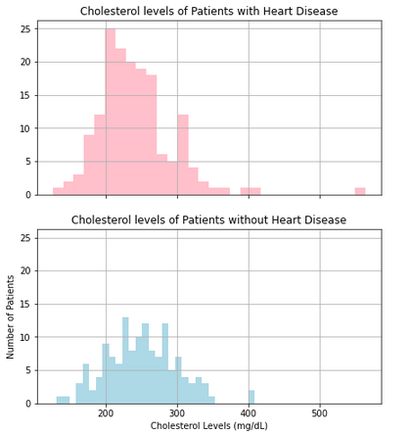
Cholesterol Lveles Vs Prevalence of Heart Disease
Majority of patients with heart disease and without heart disease have cholesterol levels 200-300mg/dL.
In general, high cholesterol → Higher chance of developing heart disease.
Contradicting results. Increase the size of the dataset?

Slide 9
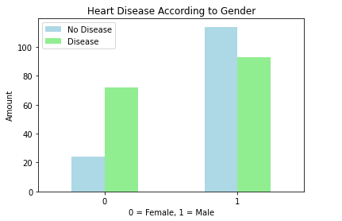
Gender Vs Prevalence of Heart Disease
Significantly more Women with Heart Disease compared to men
Selection Bias?
Or
Reflection of the real world?
Further research is required.

Slide 10
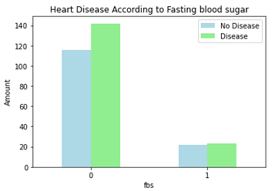
Fasting Blood Sugar vs Heart Disease
Observation: Fasting blood sugar doesn’t have a significant effect on developing heart disease.
Selection Bias?
Or
Reflection of The Real World?
According to CDC, high glucose levels can damage blood vessels and nerves that control the heart.
Findings are contradictory.
Further research is required.

Slide 11
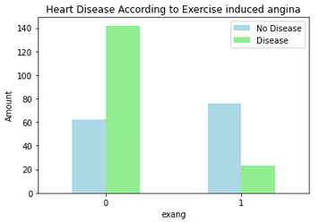
Exercise Induced Angina vs Heart Disease EDA Continued…
Observation: Many people with exercise induced angina do not develop heart disease.
According to Clevelandclinic.org, chest pain during exercise is a warning sign for heart disease.
Contradictory results.
Selection Bias?
More data and research is required.

Slide 12
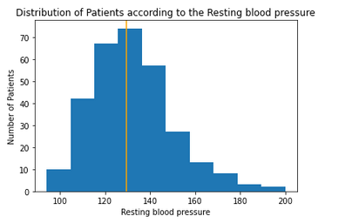


Resting Blood Pressure Vs Heart Disease Exploratory Data Analysis (EDA) Continued…
A normal distribution.
Outliers: 90 and 170 mmHg and 9 data records out of 303 in outliers = 3% of total data
BP over 170, yet number of patients without heart disease > number of patients with heart disease.
Needing more data evaluations, misdiagnosis or something else?

Slide 13
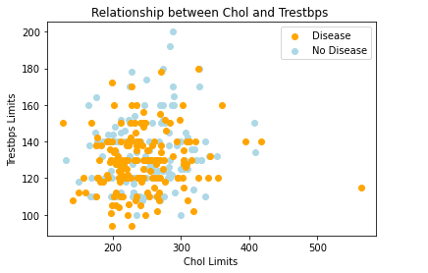

Cholesterol Levels vs Heart Disease Exploratory Data Analysis (EDA) Continued …
General norm
Higher BP
Higher cholesterol
Higher potential for heart disease.
These results contradict the general norm.
Where is the disconnect?

Slide 14
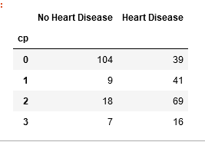
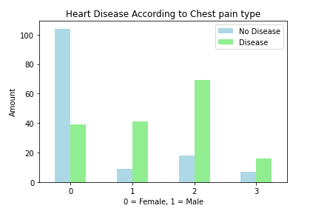

Chest Pain Vs Prevalence of Heart Disease Exploratory Data Analysis (EDA) Continued …
cp - chest pain type
0 :Typical angina: chest pain related decrease blood supply to the heart
1. Atypical angina: chest pain not related to heart
2. Non-anginal pain: typical esophageal spasms
3. Asymptomatic: chest pain not showing signs of disease
According to the data observations,
Percentage of cp2 patients with Heart Disease
Percentage of cp 0 patients with Heart Disease
How is this possible???
Selection bias, error in diagnosis
or something else?

Slide 15
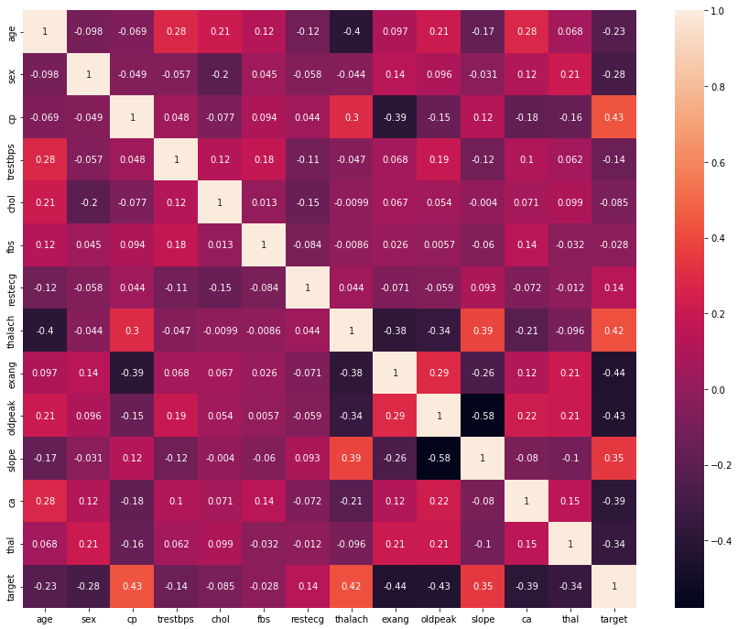
Feature Correlation Exploratory Data Analysis (EDA) Continued …
+1 or -1 → strong correlation between features.
Positive correlation:
Feature 1 increase → feature 2 also increase
Negative correlation:
Feature 1 increase → feature 2 decrease
Close to 0 → Poor correlation between features

Slide 16

Data Modeling
Defining success for this project: Reaching accuracy over 95%
Baseline Models:
RandomForestClassifier
KNeighborsClassifier
LogisticRegression
XGBClassifier

Slide 17

Why Choose RandomForestClassifer
Easy to use and generates quick results
provides high level of accuracy
Easy to cross validate
Robust to outliers
Handles non balanced data
Does not over fit
Great for large datasets

Slide 18
Why Choose KNeighborsClassifier?
Easy to implement
Fewer parameters to tune: k and distance metric
No training required to make predictions
New data can be added when predicting without impacting the outcome

Slide 19
Why Choose Logistic Regression?
Easier to implement, interpret, and efficient to train without requiring high computational power.
The feature importance of features can be identified with negative or positive direction.
Very fast at classifying unknown records
Good accuracy

Slide 20
Why Choose XGBClassifier?
Works well in small to medium datasets
supports regularization to avoid overfitting
Faster because it uses parallel processing
Allows to run cross-validation on each iteration

Slide 21
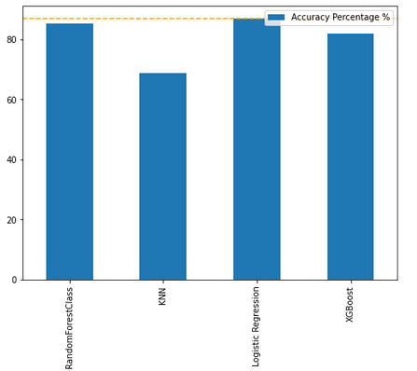

Modeling
Splitting data : Randomly chosen data, 80% for training, 20% for testing
4 models were evaluated according to their accuracy scores
2. Visualize the accuracy scores as percentages

Slide 22
Modeling Continues…
3. Hyperparameter Tuning
Since RandomForestClassifier and LogisticRegression models have the highest accuracy score, grid were created to tune them
Best parameters were identified
RandomForestClassifier:
best_rfc_grid = {'n_estimators': [300],
'min_samples_split' : [4],
'min_samples_leaf': [6],
'max_features' :['sqrt'],
'max_depth': [3]}
LogisticRegression:
best_lg_grid = {'solver': ['liblinear'],
'penalty':['l2'],
'C': [0.20433597178569418]}
c) Data were retrained on tuned models with best parameters
d) Accuracy scores with best parameters were recalculated for the models.

Slide 23
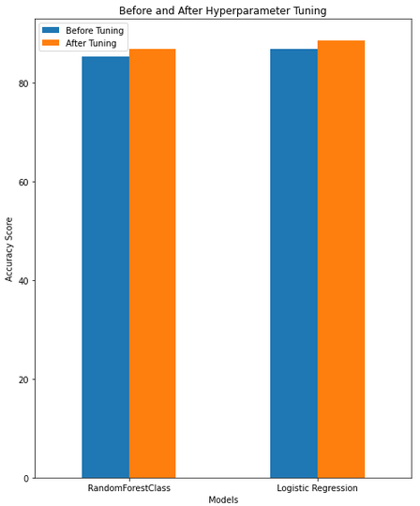
Modeling Continues…
4. Accuracy score before and after hyperparameter tuning.
Observation:
Accuracy scores have improved after parameter tuning in both models.
LogisticRegression has achieved the highest accuracy score.

Slide 24

Evaluating The Models
ROC curve
Confusion Matrix
Classification Report
Precision
Recall
F1-score

Slide 25
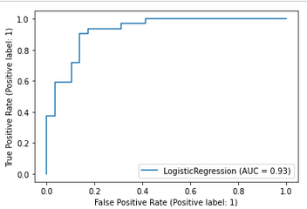
Evaluating The Model Continues…
ROC Curve
The area under the curve (AUC) in LogisticRegression model is 0.93 which is great.
This indicates that there’s only little chance for a patient to be falsely positive.
Certainly there’s room for improvement.

Slide 26
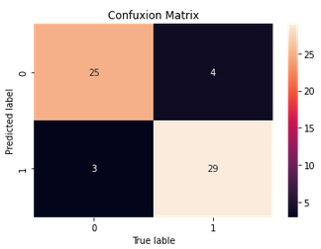
Evaluating The Model Continues…
Confusion Matrix
The focus of this project is to identifying patients with potential for developing heart disease.
Improving true positives and reducing false negative values (truly have a higher risk, yet predicts as not) is more important than reducing false positives (model predicts are high risk when they're not).
Recall is a important feature to focus for this heart disease project.
Recall = TP / TP + FN = 29 / ( 29 + 4 ) = 0.8787

Slide 27
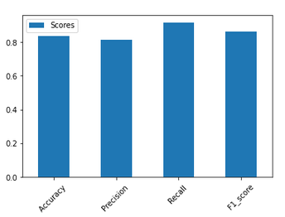
Evaluating The Model Continues…
Classification Report

Slide 28
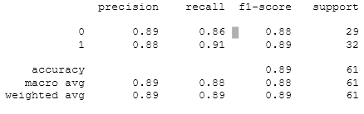
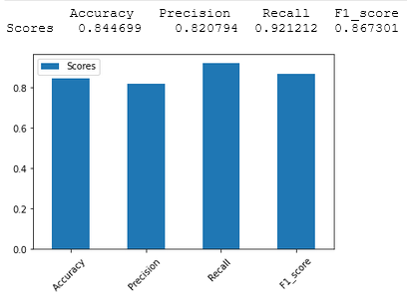
Evaluating The Model Continues…
Classification Report
Cross Validated Accuracy, Precision, Recall, F1-Score
Note: Cross validation provided better scores.

Slide 29
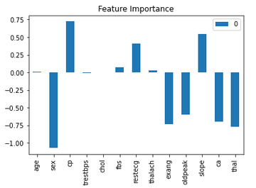
Feature Importance
It answers the question, “which features contributing most to the outcomes of the model?”
Understanding features that help make predictions is import
It helps make better predictions and in data gathering process.

Slide 30
Feature Importance
Features with positive attributes: has a positive correlation with developing heart disease.
Higher the value of the attribute, more likely heart disease is developed.
E.g.: higher the degree of chest pain, or slope of ST segment, higher likelihood of developing heart disease.

Slide 31
Feature Importance Continues…
Features with negative values: : has a negative correlation with developing heart disease.
Higher the absolute value of the negative feature, it is less likely that heart disease is developed.
E.g.: According to EDA, more women (0) has heart disease compared to men (1). So higher the value of sex go (0 to 1) less likely heart disease will be developed.
Similarly, more blood vessels visible by flourosopy, better blood supply there is to the heart, and less likely heart disease will be developed.

Slide 32
Summary of the project
Problem
Looking at given clinical data, can we predict who will develop heart disease?
Findings
According to data, significantly more women with heart disease compared to men – Could this be true in the real world?
According to data, there’s no significant effect of fasting blood sugar on developing heart disease. – Could this be true in the real world?
According to data, many people with exercise induced angina do not develop heart disease – Could this be true in the real world?
High blood pressure and high cholesterol levels have no significant effect on developing heart disease - – Could this be true in the real world?
Results
Logistic regression made the best predictions, compared to other models.
The highest accuracy score reached was 88.52% even though the target was 95%.
Cross validation provided better recall results, which was indicative that number of false negative values were reduced.
Feature importance showed that certain attributes had a positive correlation while the others had a negative correlation.

Slide 33
Areas for improvements
Consulting with a subject matter experts to understand the disconnect between the findings of the project and what the general public know about heart disease.
Obtain more random data to represent the general public.
Try other predictive models
Try tuning different hyperparameters to obtain better results.

Slide 34
Thank you!

