Slide 1
Guidelines
Kindly use the given template for submitting your prototype(Make a copy of the template)
One team is only required to submit one project.
Follow this template while preparing your presentation.
You are welcome to add as many POCs and design concepts to support your project.
The project should be feasible and the team members should be capable enough, to come up with the fully functioning prototype of the same idea, if required.
In case of queries, kindly reach out to us at solutionchallengesupport@hack2skill.com
Note: Prototype must include cloud deployment and use at least one Google AI model or service (e.g., Gemini) as part of the solution.

Slide 2


Team Details
Team Name: Team Lapper
Team Leader: Nawang Dorjay
Members: Nawang Dorjay (ML/Backend), Team Members (Frontend, UI/UX, Data)
UN SDG Alignment:
• SDG 1 — No Poverty (Resource equity in crises)
• SDG 11 — Sustainable Cities (Resilient communities)
• SDG 17 — Partnerships for the Goals
Problem Statement: During crises, traditional NGO resource allocation is drastically inefficient — taking hours of manual labor to dispatch help. NGOs struggle to find vetted, accurately skilled volunteers in their immediate geographical radius. Lapper solves this life-saving bottleneck using Hybrid AI.

Slide 3
Brief about your solution
Lapper: Smart Resource Allocation Engine
The Crisis:
During the 2023 Turkey earthquake, NGOs reported 4+ hour delays in mobilizing volunteers. Manual dispatching costs lives in time-critical disasters.
The Solution:
Lapper is a production-ready, full-stack AI platform designed to intelligently pair vetted volunteers with real-time NGO crisis requests — reducing allocation time from hours to milliseconds.
How It Works:
Our hybrid AI engine uses Scikit-learn's Logistic Regression to evaluate volunteers across 5 dimensions: Skill Overlap, Proximity, Urgency, Availability, and Experience. Google Gemini then translates these scores into transparent, human-readable explanations — bridging the gap between ML output and administrative trust.

Slide 4
Opportunities
How different is it from any of the other existing ideas?
How will it be able to solve the problem?
USP of the proposed solution
Market Opportunity & Differentiation
Market Size: The global volunteer management market is $1.8B+ and growing at 12% YoY.
Why Existing Solutions Fail:
• VolunteerHub, Better Impact: Rigid keyword filtering — no AI scoring
• Google.org tools: No real-time ML matching pipeline
• Manual NGO spreadsheets: Hours of delay; no geo-proximity awareness
Why Lapper Wins:
• Hybrid ML + LLM: Only platform combining Logistic Regression with Gemini explanations
• Speed: Sub-500ms match vs 4+ hours manual
• Transparency: Every decision is explainable — critical for NGO accountability
• Scalability: Docker + Cloud Run ready; scales to millions of volunteers

Slide 5
List of features offered by the solution
Key Platform Features
⚡ Real-Time AI Dispatching
Interactive dashboard updates constraints and volunteer statuses instantly.
🤖 Hybrid AI Scoring Engine
Logistic Regression pipeline scores candidates across 5 critical features.
💡 Gemini Explainable AI
Google Gemini 1.5 Flash generates transparent rationale for every match decision.
🗄️ Scalable Data Pipeline
Python backend imports, cleans, and sanitizes thousands of volunteer records.
📊 Live Analytics Dashboard
Charts show match success rates, regional coverage, and volunteer trends.
🔐 Settings & API Management
Users can configure their own Gemini API key securely from the UI.

Slide 6
Process flow diagram or Use-case diagram
Automated AI Workflow Pipeline — Sub-500ms End-to-End
1. NGO Posts
Urgent Request
2. Engine Fetches
Vetted Candidates
3. Logistic Regression
Scores Fit
< 500ms ⚡
4. Gemini AI
Explains Logic
(Google Gemini 1.5)
5. Admin Reviews &
Deploys Volunteer ✓

Slide 7
Wireframes/Mock diagrams of the proposed solution (optional)
Built with Google AI — End to End
🔵 Google Gemini 1.5 Flash (Core AI Feature)
Every volunteer match generates a transparent, human-readable rationale via the Gemini API.
Turns raw ML probability vectors into clear English for NGO administrators.
🟣 Google Antigravity (AI Development Assistant)
The entire Lapper platform was built collaboratively with Google Antigravity — Google DeepMind's advanced agentic AI coding assistant. Antigravity helped architect the matching engine, debug the Flask REST API, design the premium UI, configure Docker, manage the GitHub CI/CD pipeline, and deploy to Render. This accelerated development from weeks to days — demonstrating how Google AI amplifies developer productivity.
🟡 Google AI Studio
Used for Gemini API key provisioning and prompt engineering & testing.
🟢 Google Cloud Ready
Dockerfile configured for Google Cloud Run deployment.

Slide 8
Architecture diagram of the proposed solution
System Architecture — Cloud-Ready Stack
AI Pipeline
(Google Stack)
User Browser
(HTML5/CSS/JS
Dashboard)
Python Flask
Backend API
(main.py)
Gemini 1.5 Flash
(Explainability)
Scikit-learn
Logistic Regression
Antigravity AI
(Built with)
SQLite Database
(volunteer_lite.db)

Slide 9
Technologies to be used in the solution
Core Technologies & Google Integration
Backend: Python 3.11 | Flask REST API | SQLite | Gunicorn
Frontend: HTML5, Vanilla CSS, JavaScript | Chart.js | Lucide Icons
ML Engine: Scikit-learn (Logistic Regression, StandardScaler Pipeline)
Containerization: Docker | Google Cloud Run compatible
Hosting: Render.com (Live: google-ai-solution-challenge-smart.onrender.com)
Google Technologies:
• Google Gemini 1.5 Flash API — Explainable AI rationale generation
• Google AI Studio — API key management & prompt engineering
• Google Antigravity — AI-assisted end-to-end development acceleration
• Google Cloud Run — Production deployment target (Dockerfile included)
GitHub: github.com/nawangdorjay/google-ai-solution-challenge--smart-resource-allocation

Slide 10
Estimated implementation cost (optional)
Product Roadmap — Path to Impact at Scale
Phase 1 — NOW
✅ MVP Live
Logistic Regression
Gemini Explainability
Flask API + SQLite
Docker + Render Deploy
Phase 2 — 3 Months
🔄 Scale Up
Vertex AI AutoML
Real-time GPS tracking
Firebase Auth
Mobile-Responsive PWA
Phase 3 — 6 Months
🚀 Production
Multi-language Gemini
Native Mobile App
NGO Analytics Suite
Government API Integrations

Slide 11
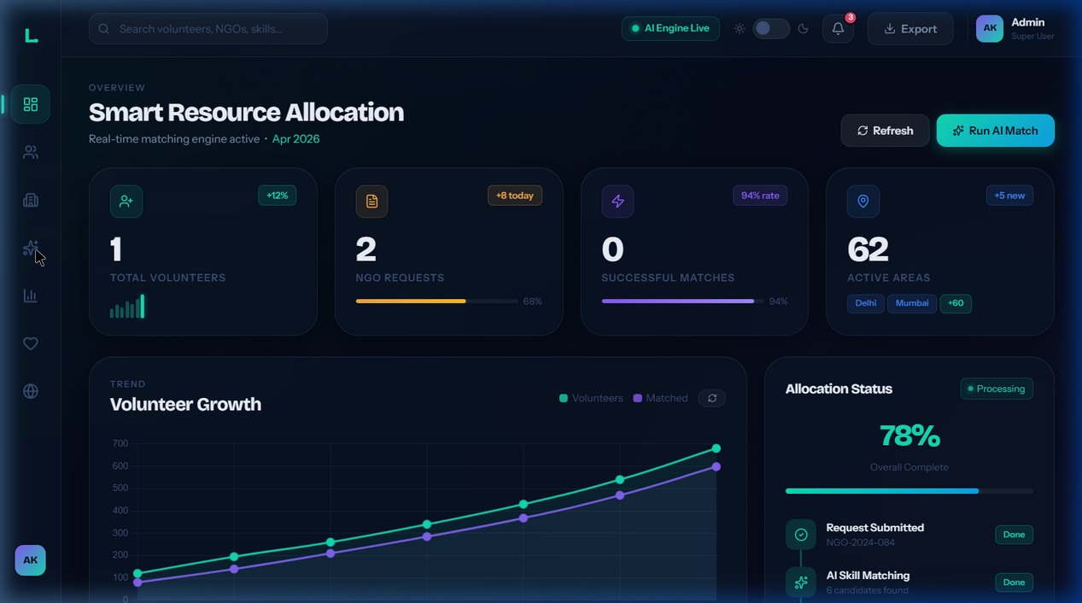
Snapshots of the MVP
Live MVP Snapshots
🌐 Live App: https://google-ai-solution-challenge-smart.onrender.com
💻 GitHub: https://github.com/nawangdorjay/google-ai-solution-challenge--smart-resource-allocation

Slide 12
Additional Details/Future Development (if any)

Slide 13
Provide links to your:
GitHub Public Repository
Demo Video Link (3 Minutes)
MVP Link
Working Prototype Link

Slide 15


