Slide 1
Guidelines
Kindly use the given template for submitting your prototype(Make a copy of the template)
One team is only required to submit one project.
Follow this template while preparing your presentation.
You are welcome to add as many POCs and design concepts to support your project.
The project should be feasible and the team members should be capable enough, to come up with the fully functioning prototype of the same idea, if required.
In case of queries, kindly reach out to us at solutionchallengesupport@hack2skill.com
Note: Prototype must include cloud deployment and use at least one Google AI model or service (e.g., Gemini) as part of the solution.

Slide 2


Team Details
Team name: Mind_Mesh
Team leader name: Nawang Dorjay
Team Member Name: Nawang Dorjay , Swayam, Twisha, Sayan Kundu
Problem Statement: During crises, traditional NGO resource allocation is drastically inefficient, taking hours of manual labor to dispatch help. NGOs struggle to find vetted, accurately skilled volunteers in their immediate geographical radiuses. Lapper solves this life-saving bottleneck using Hybrid AI.

Slide 3
Brief about your solution
Lapper: The Smart Resource Allocation Engine Lapper is a production-ready, full-stack AI platform designed to intelligently pair vetted volunteers with real-time NGO crisis requests. Instead of manual dispatcher logistics, our system leverages a hybrid AI engine: Scikit-learn's Logistic Regression model mathematically evaluates volunteers across complex constraints (Proximity, Urgency, Skill Overlap, and Availability) to assign Match Confidence Scores. Simultaneously, Google's Gemini Generative AI dynamically translates these raw mathematical weights into transparent, human-readable explanations. This uniquely bridges the gap between predictive ML output and administrative trust, enabling NGOs to allocate relief resources accurately in mere milliseconds.

Slide 4
Opportunities & Market Differentiation
How is it different? Traditional volunteer routing systems enforce rigid, inaccurate keyword filtering. Lapper dynamically learns and evaluates complex weight features. By coupling a deterministic Machine Learning pipeline with conversational LLM explanations (Google Gemini), we provide NGOs with high predictability, speed, and complete transparency into WHY a volunteer was selected. How will it solve the problem? By fully automating the assessment and ranking pipeline, Lapper slashes assignment wait times. In a crisis, saving administrative hours directly translates to mobilizing critical relief instantly.

Slide 5
List of features offered by the solution
Key Platform Features: 1. Dynamic Real-Time Dispatching: An interactive dashboard updates NGO constraints and tracks volunteer deployment statuses instantly. 2. Hybrid AI Scoring: Proprietary Logistic Regression pipeline dynamically scores candidate pools across 5 critical independent features. 3. Transparent AI Rationale: Deep Gemini Integration generates instant explanations for algorithmic decisions to maintain human-in-the-loop accountability. 4. Scalable Data Pipeline: Python backend easily imports and sanitizes thousands of database entries. 5. Automated UI Synchronization: The SQLite engine is directly integrated to live HTML/JS components.
6. Smart Data Cleaning and CSV pipeline

Slide 6
Process flow diagram or Use-case diagram
Automated Workflow Pipeline
1. NGO Posts
Urgent Request
2. Engine Fetches
Vetted Candidates
3. Logistic Regression
Scores Fit
4. Gemini API
Explains Logic
5. Admin Allocates
& Deploys Volunteer

Slide 7
Wireframes/Mock diagrams of the proposed solution (optional)

Slide 8
Architecture diagram of the proposed solution
AI Pipeline Engine (Google)
Gemini LLM API
(Explainability)
Frontend Dashboard
(HTML5, CSS, JS)
Python Flask SERVER
(main.py / matcher.py)
Scikit-learn
Logistic Regression
SQLite Database
(volunteer_lite.db)

Slide 9
Technologies to be used in the solution
Core Technologies & Google Integration To ensure scalability and powerful algorithmic performance, Lapper exclusively utilizes modern frameworks: - Language: Python 3 - Web Framework: Flask REST API Server - Database: SQLite Relational Database Engine, MS Excel - Machine Learning: Scikit-learn (Logistic Regression model trained with standardized volunteer features) - Google Cloud & AI: Google Generative AI (Gemini 1.5) API dynamically transforms algorithmic vector mathematics into transparent, contextual English to guarantee 'Explainable AI' for end users.

Slide 10
Estimated implementation cost (optional)
1.Hosting (Google Cloud Run): ~$10.00 - $20.00
Paying for sustained compute time during peak traffic hours.
2.Permanent Database (Google Cloud SQL - PostgreSQL): ~$15.00 - $40.00
To safely store user data without it deleting when the server restarts, you will need a managed database. A basic db-f1-micro instance is around $15/month, while a more robust standard instance is roughly $40/month.
3.AI Explanations (Gemini API Pay-as-you-go): ~$2.00 - $5.00
Assuming 10,000 to 50,000 matching requests a month, the cost remains highly economical due to the efficiency of the Flash model.
4.Third-Party APIs (Optional): ~$5.00 - $10.00
Google Maps API: $200 monthly credit is free, which covers tens of thousands of map loads.
Twilio SMS: ~$0.01 per text message for real-time volunteer notifications.

Slide 11
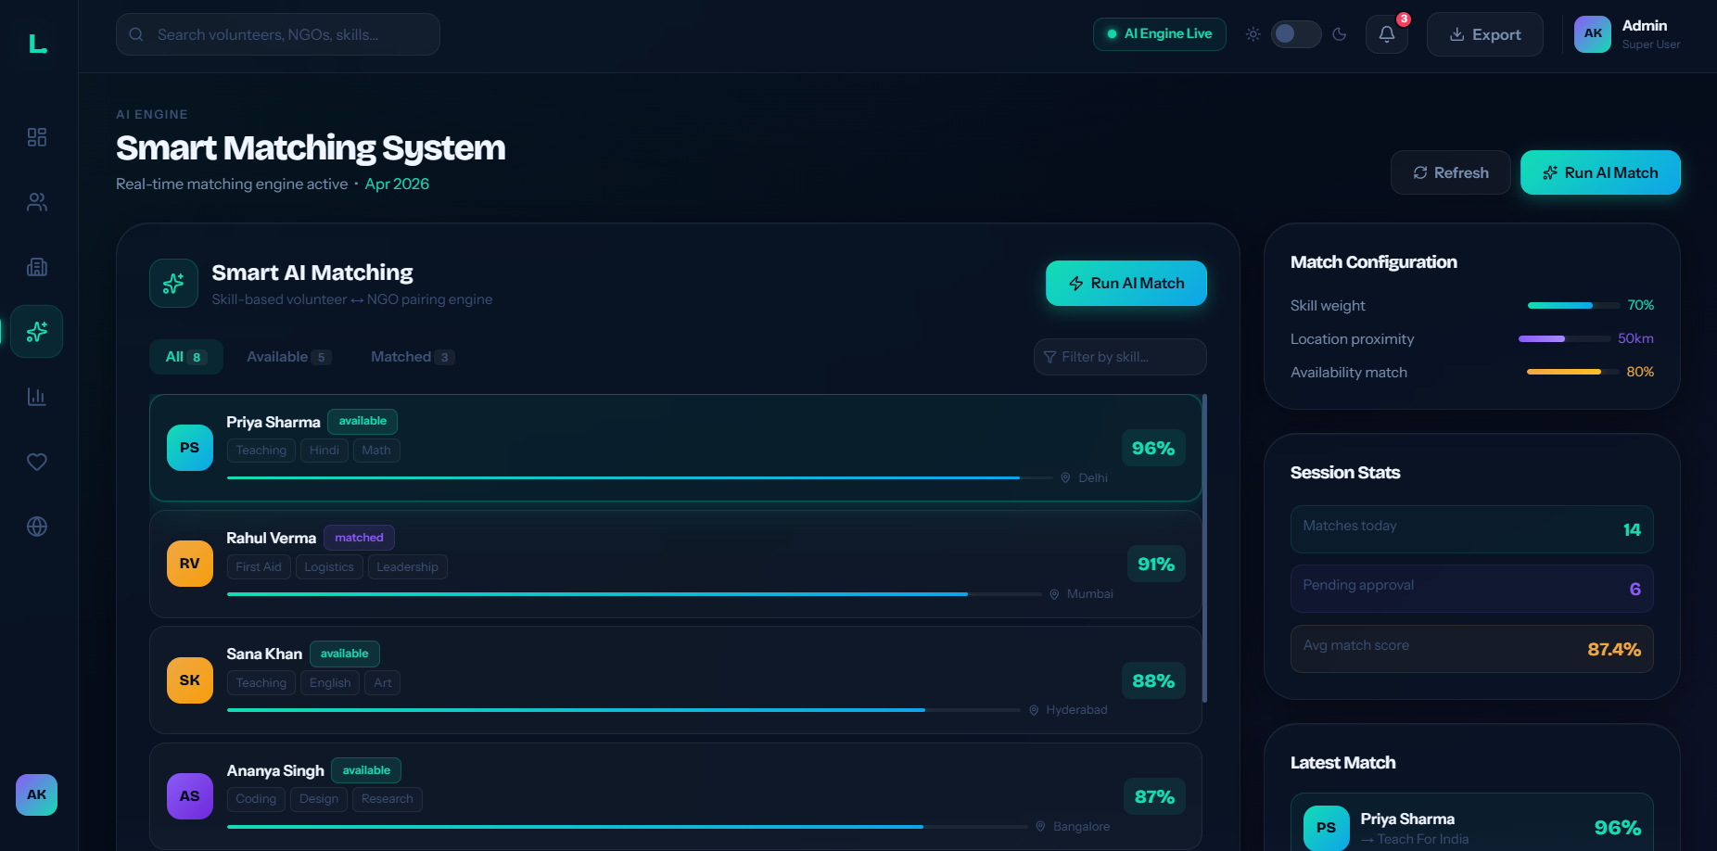
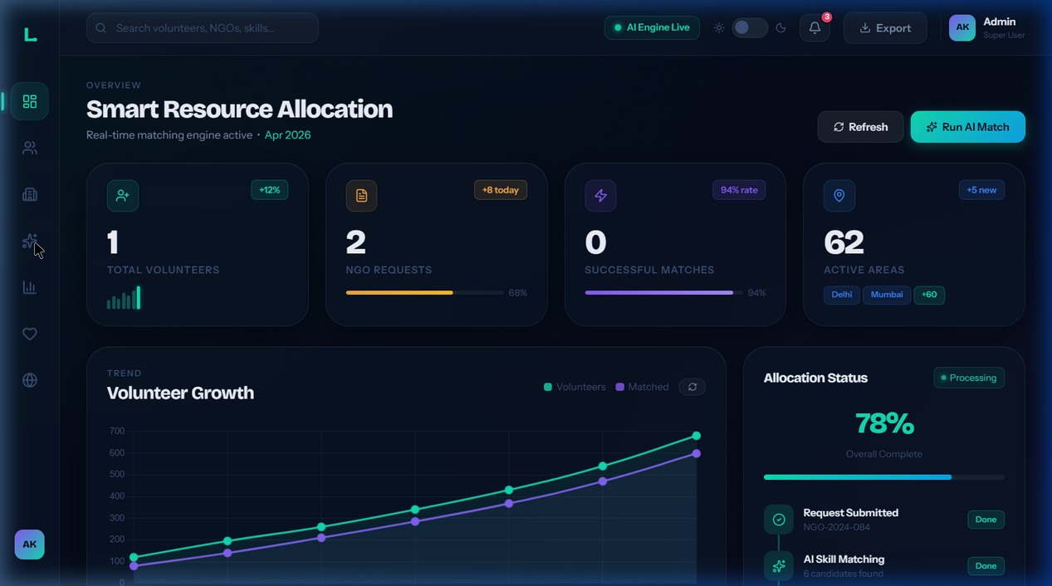
Snapshots of the MVP

Slide 12
Additional Details/Future Development (if any)
1.Advanced AI & Matching Engine Upgrades: Moving from exact string overlap to semantic skill matching (vector embeddings), implementing real GPS/geocoding distances, and establishing a continuous learning loop.
2.Platform Features & UI/UX: Adding an interactive map using Leaflet.js or Google Maps to visualize requests, integrating real-time SMS/Email notifications, and building a global analytics dashboard.
3.Backend & Architecture Scaling: Migrating the current SQLite database to PostgreSQL, moving to a fully decoupled frontend framework like React or Vue, and processing Gemini AI explanations asynchronously using background workers.
4.DevOps & Production Readiness: Utilizing docker-compose for local environments, setting up CI/CD pipelines (e.g. GitHub Actions)

Slide 13
Provide links to your:
GitHub Public Repository - https://github.com/nawangdorjay/google-ai-solution-challenge--smart-resource-allocation
Demo Video Link (3 Minutes):
MVP Link : - https://google-ai-solution-challenge-smart.onrender.com
Working Prototype Link: - https://google-ai-solution-challenge-smart.onrender.com

Slide 15


