Slide 1
Graphical Modeling
Nawar Halabi
Notes:
<number>

Slide 2
About Me
Work since August-2018 in ING.
Not a statistician.
Have built and deployed graphical models before and they worked well for certain applications.
1

Slide 3
Motivation
Graphical Models are more scalable now.
It works well for certain applications where missing, small or sparse data.
Freedom of designing any model.
Transparency of assumptions.
Benefits to understanding machine learning in general.
1

Slide 4
Disclaimer
probabilistic models or Bayesian thinking are not magic:
According to Efficient and Robust Automated Machine Learning, no single ML model has performed best on all their datasets which they included in their test.
According to Do we Need Hundreds of Classifiers to Solve Real World Classification Problems? Show that on average, a type of tree classifiers worked best on average for all the datasets they included. But, no single classifier was best for most datasets.
So maybe probabilistic modeling is suitable for some datasets!
1

Slide 5
Agenda
Presentation:
Define Graphical Modeling ~10mins
Graphical Modeling Notation ~15mins
A bit of theory ~10mins
Known models usually represented as graphical models ~5mins
Optimisation for graphical models ~10mins
Design Patterns, Tools, Advanced topics ~?mins
Practical:
Practical with PyStan ~45mins
Linear Regression
La Liga results
Pareto/NBD
Questions ~15mins
Note: Please ask questions as we go.
1

Slide 6
Graphical Modeling Definition
Notes:
<number>

Slide 7
Definition of Graphical Models
Representing probability distributions (or a set of them) with graphs.
Probabilistic Modeling is a more general term than graphical modeling.
Hierarchical Modeling is another term that is related to GMs.
1

Slide 8
Utilisation in Machine Learning
Machine Learning:
Data: [(X1, Y1), … , (Xn, Yn)]
Model: Logistic, linear, tree, etc.
Loss function: Likelihood, mean squares etc.
Probabilistic Machine Learning (frequentist):
Data: The same.
Model: A set of probability distribution (over the data)
Loss function: Likelihood (sometimes no loss function)
1

Slide 9
Some Terms in Probabilistic Modeling
Prior which is the distribution over the parameters before training
Posterior which is the distribution over the parameters after training
Prior Predictive Distribution P(x,y|θ) (predict more data before gathering data)
Posterior Predictive distribution P(x,y|X,Y,θ) (predict more data after gathering data)
1

Slide 10
2 Questions to ask: Generative or Discriminative
For example, find the most likely distribution which generated the data we observed.
Or, find the most likely conditional distribution which would generate y given x.
1

Slide 11
2 Questions to ask: Frequentist or Bayesian
Frequentists ask the same questions we have seen in the previous slide.
Bayesians ask what do we know about the world after seeing the data.
1

Slide 12
Probability Distributions
Notes:
<number>

Slide 13
Probability Distributions
A function which maps an outcome or event to a number between 0 and 1 which represents its probability of occurrence:
Outcomes can be represented by discrete or continuous numbers.
θ = 0.325636 is an outcome, y = 1 is an outcome.
1

Slide 14
Probability Distributions
Probability distributions can be univariate or multivariate.
Univariate: The probability P(theta = 0.43)
Multivariate: The probability P(theta = 0.43 & y = 1)
P(x,y,θ): The joint probability over your data and parameters.
P(x,y,θ) = P(x,y|θ) * P(θ): Chain rule.
Chain rule taken for granted and hence Bayes.
P(x,y,θ) relates to all possible distributions (infinite possibilities). Imagine if you had 1 probability and you had to split it between all combinations of x,y,θ assignments.
1

Slide 15
In short, in Probabilistic Modeling
In probabilistic machine learning usually we ask one of these questions:
Which is the most likely θ which generated the data x, y? (more frequentist)
Which is the most likely θ which given the x part of the data, generated the y part of the data? (also frequentist)
What do I know about θ before and after seeing the data? (more Bayesian)
1

Slide 16
In short, in Probabilistic Modeling
Frequentist: Maximise P(Xi,Yi|θ) for θ
Bayesian (This workshop’s focus): Find the distribution P(θ|Xi,Yi)
1

Slide 17
How to Represent P(x,y,θ)?
Infinite possibilities of distributions P(x,y,θ).
We have to simplify it, and that’s where Graphical Models kick in.
1

Slide 18
Graphical Modeling Notation
Notes:
<number>

Slide 19
Other Types of Graphical Models
We present Directed Acyclic Graphs (DAGs). There are other types of graphical models:
Undirected Graphs (UGs): Parameterise by a splitting the random variables into subsets and giving each subset (clique) a parameterised joint distribution
Factor Graphs (FGs): Like UGs, they represent the joint distribution with the product of many subjoint distributions but with different visual and mathematical representation
We will focus on DAGs:
All 3 types of graphs are able to model all types of distributions. They just have different parameterisations and usually different learning loss functions and algorithms
There are different laws of conditional independence for each type of graph.
1

Slide 20
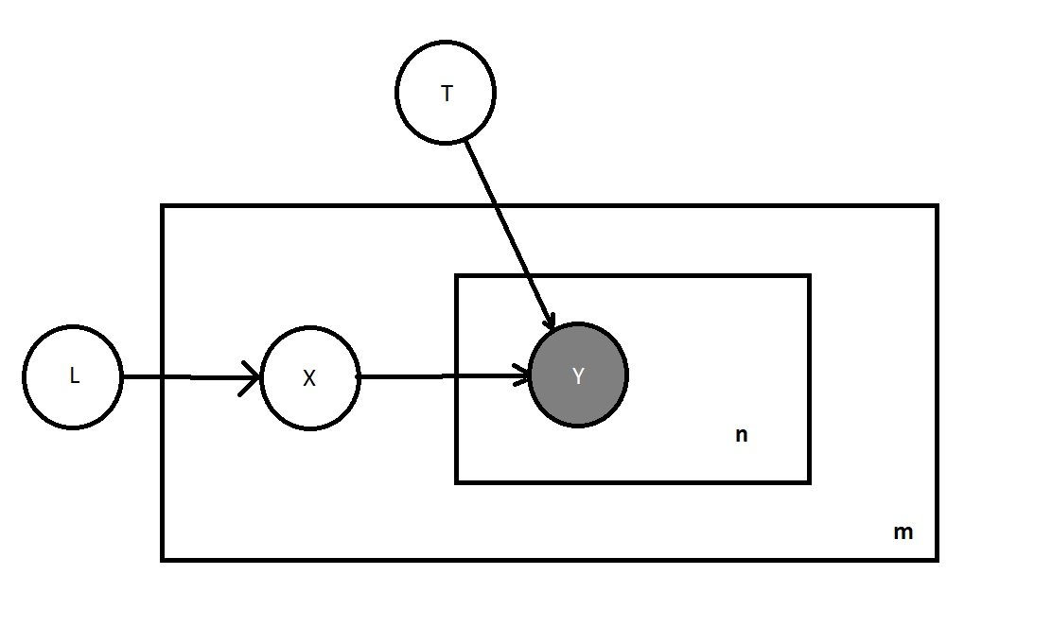
Graphical Modeling: The Graphs
Covers the “Model” part in the last slide.
1

Slide 21
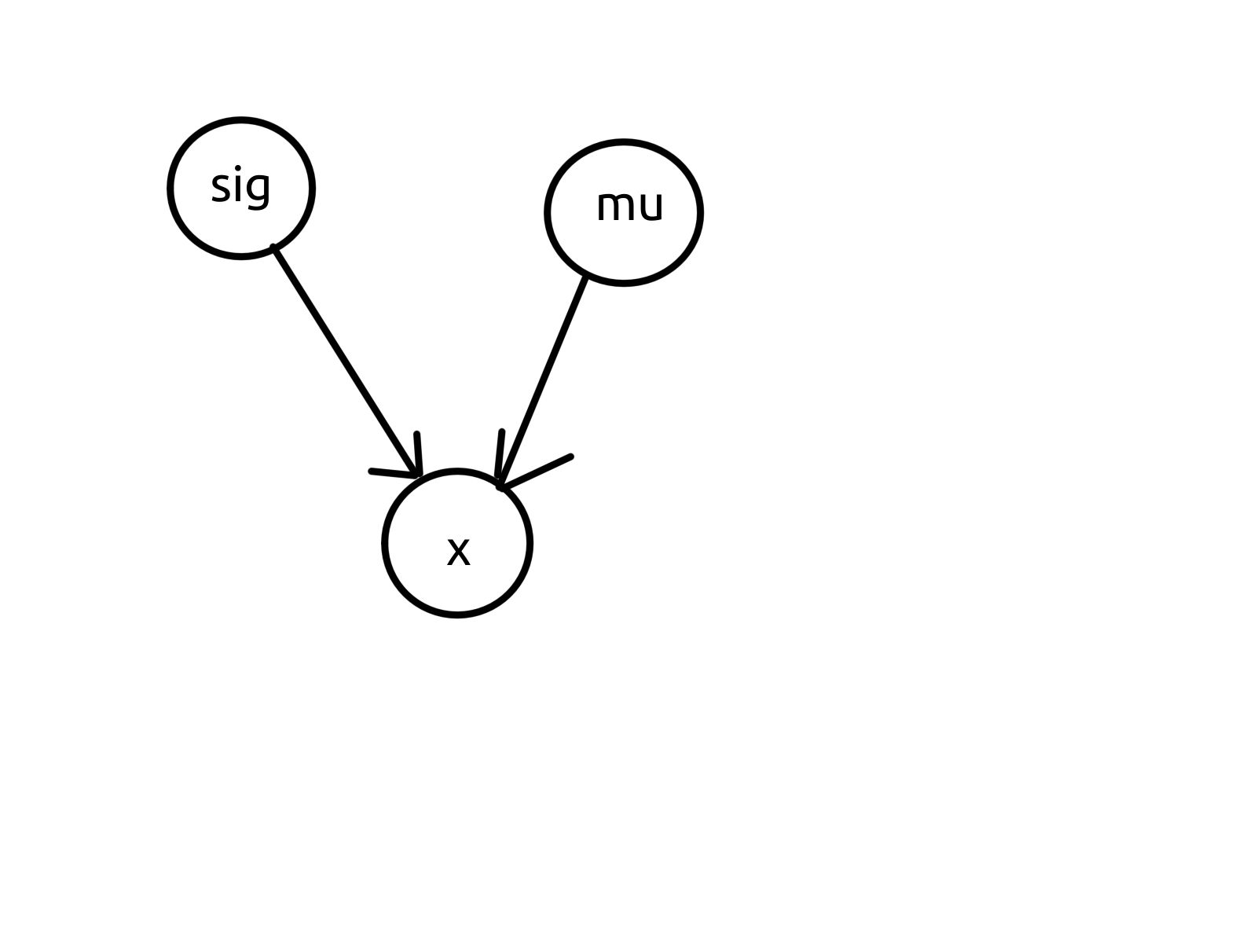
Graphical Modeling
Gaussian with all possible means and standard deviations.
1

Slide 22
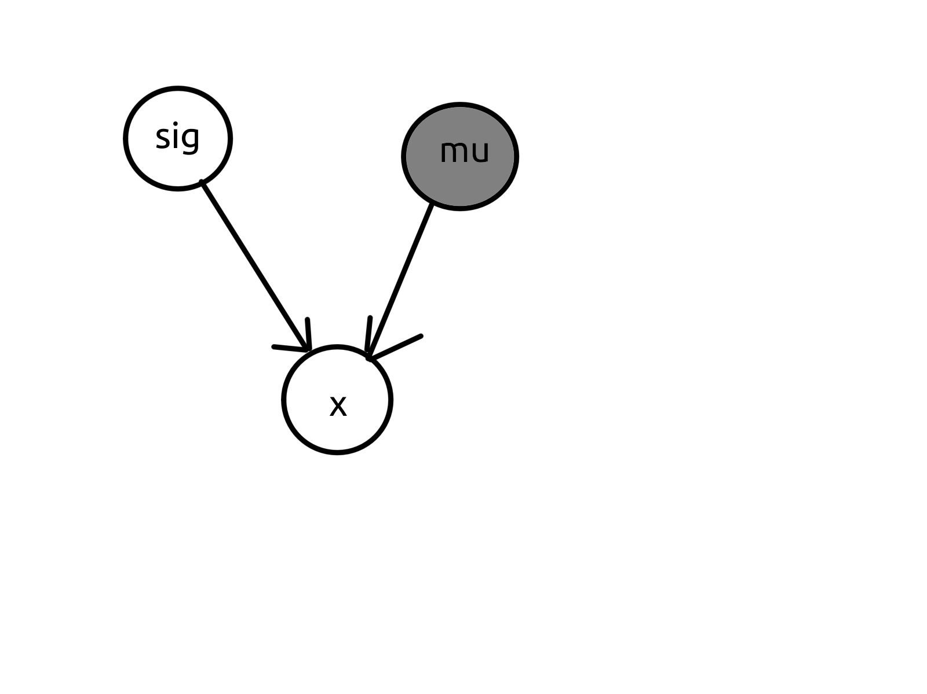
Graphical Modeling
Gaussian with constant mean but any standard deviations. See, we are creating this heap of possible distributions.
1

Slide 23
Graphical Modeling
Non-shaded nodes are Random Variables (RVs).
Edges represent a probabilistic or discriminative way of estimating an RV from other RVs.
Shaded nodes are known values.
Plate Notation is used to avoid duplication.
Sometimes probabilistic or deterministic edges are distinguished with dotted lines and non-dotted lines.
1

Slide 24
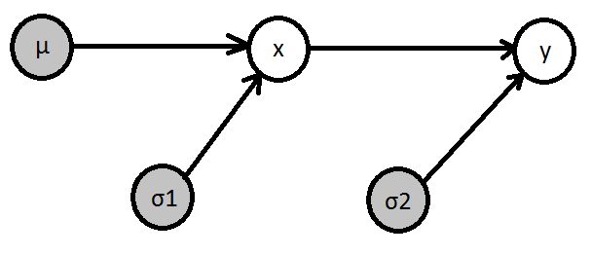
How is This a Probability distribution
Let me explain:
1

Slide 25
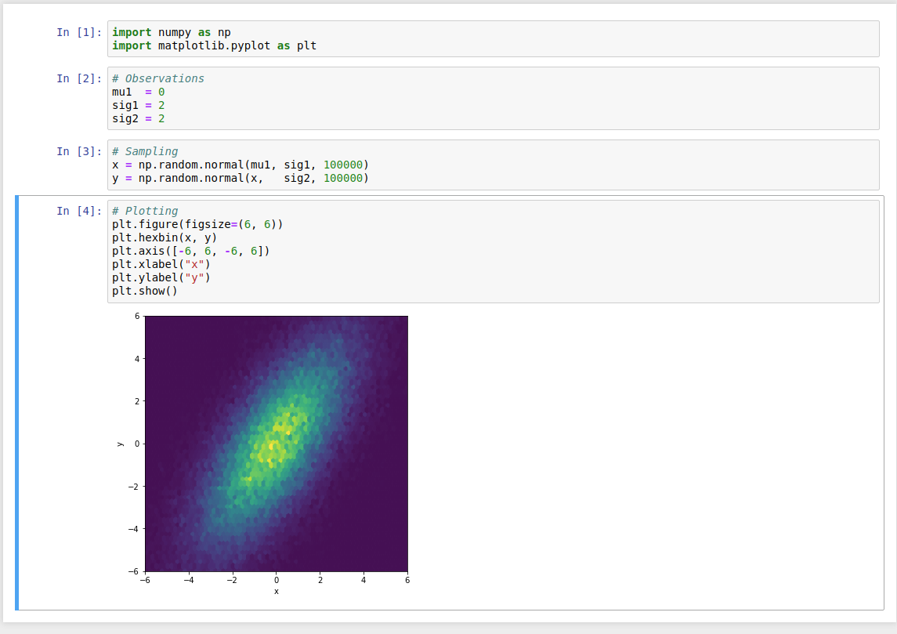
How is This a Probability distribution
Notice: I did not need to specify a co-variance matrix.
- This has implications on simplification of visualization and optimisation
1

Slide 26
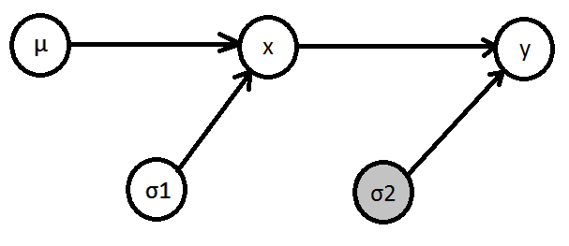
How is this a (set of) probability distributions
A set of probability distributions:
1

Slide 27
How is this a (set of) probability distributions
The edges do not contain info about how target RV is generated
1

Slide 28
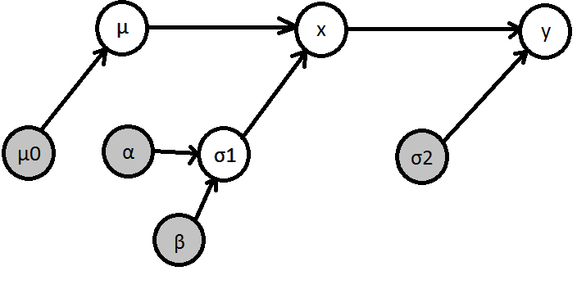
Being Bayesian
Adding proper priors to all variables (everything is a random variable).
This also involves changing view on the world and the optimisation methods.
Frequentist and Bayesian match under certain conditions.
1

Slide 29
A Bit of Theory
Notes:
<number>

Slide 30
Back to the basics P(x,y,z)
Using the chain rule: P(x,y,z) = P(x|y,z) * P(y,z) = P(x|y,z) * P(y|z) * P(z)
We can see that the set of all possible, multivariate distributions factorises to simpler parameterised (conditional) univariate distributions.
Still the collective complexity has not changed
1

Slide 31
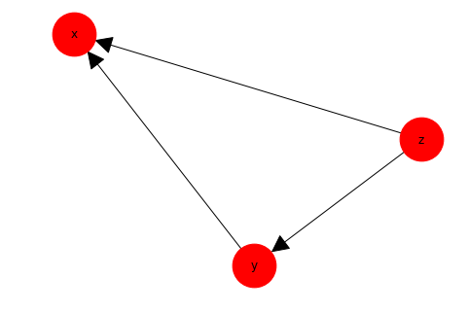
Back to the Basics: Graphical Models
Represent distribution with a set of conditional dependencies from the chain rule.
Reduce the complexity by assuming conditional independence relations.
These assumptions of conditional independence are usually informed.
P(x,y,z) = P(x|y,z) * P(y,z) = P(x|y,z) * P(y|z) * P(z)
1

Slide 32
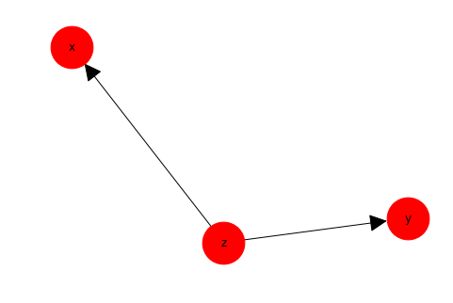
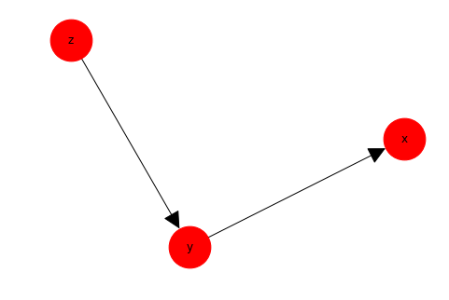
Now Simplify
From: P(x,y,z) = P(x|y,z) * P(y|z) * P(z)
To: P(x|z) * P(y|z) * P(z) P(x|y) * P(y|z) * P(z)
Bayes Assumption Markov Assumption
1

Slide 33
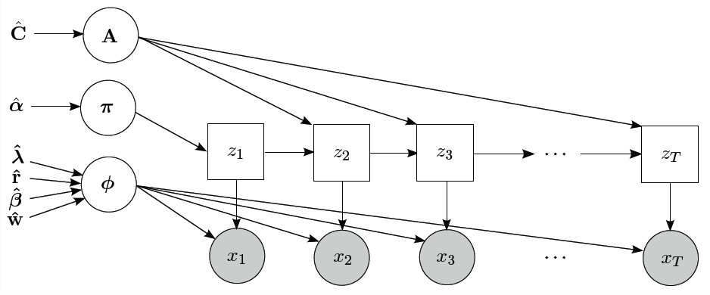
Some Known Graphs: HMM
From: http://blog.oliverparson.co.uk/2014/12/infer-hmm-infernet-implementation-of.html
1

Slide 34
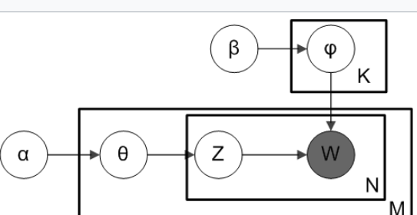
Some Known Graphs: LDA
From: https://en.wikipedia.org/wiki/File:Smoothed_LDA.png
1

Slide 35
Optimisation
Notes:
<number>

Slide 36
Optimisation
Maximum Likelihood (closed form solution or gradient descent)
Variational Inference (EM being a special case)
Markov Chain Monte Carlo (MCMC). Which we will present in the demo.
1

Slide 37

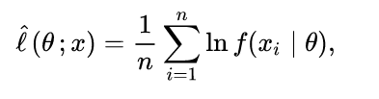
Maximum Likelihood and Maximum a Posteriori
A measure of how plausible is a parameter assignment produced the data that we have seen.
Can be optimised with a closed form solution, Gradient Descent, EM algorithm and other methods.
When we have a prior on the parameters we are now doing Maximum a Posteriori. This is similar to regularisation.
From Wikipedia:
1

Slide 38
MCMC (Markov Chain Monte Carlo)
Gather samples from the posterior P(theta|x,y) and then make conclusions about theta. Here are some example methods:
Gibbs sampling (we can run an example of) (needs to be derived): Sample from conditional distributions iteratively until you cover the space of events of the probability distribution.
Metropolice Hastings (A type of rejection sampling).
Hamiltonian MC. Adds momentum.
NUTS (state of the art) extends on classical Hamiltonian.
https://www.youtube.com/watch?v=VnNdhsm0rJQ
Has Good visualisations of Hamiltonian MCMC
1

Slide 39
Variational Inference
Variational Inference (EM being a special case thereof and the HARD EM is an even more special case):
Apporximate the posterior P(theta|x,y) with a simpler, factorised distribution which will miss the correlation properties of the posterior. But you will still get insight about each variable (like MAP).
1
Notes:
Variational Inference (EM being a special case thereof and the HARD EM is an even more special case). This is supposed to be faster than MCMC but only single point estimates for the parameters (unless parameters are treated like random variables), not samples.
Apporximate the posterior P(theta|x,y) with a simpler, factorised distribution which will miss the correlation properties of the posterior. But you will still get insight about each variable (like MAP).

Slide 40
Design Patterns
Notes:
<number>

Slide 41
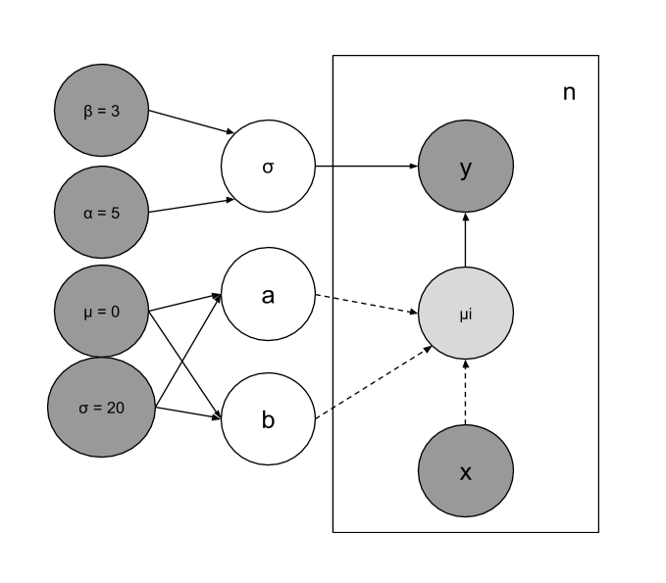
Linear Regression
σ,μ: Prior of slope and intercept
α,β: Prior for error
x,y: Data points
a,b: Slope and intercept
σ: Error standard deviation
1

Slide 42
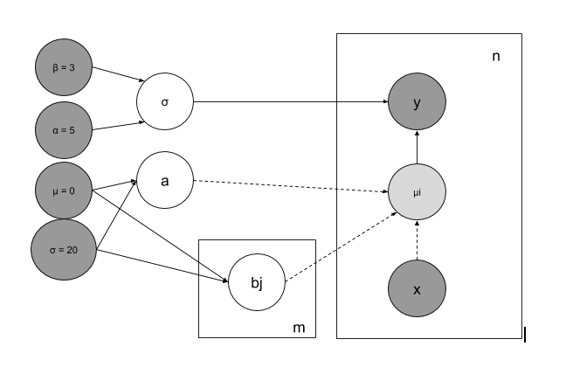
Linear Regression (with partial pooling AKA mixed effects)
1

Slide 43
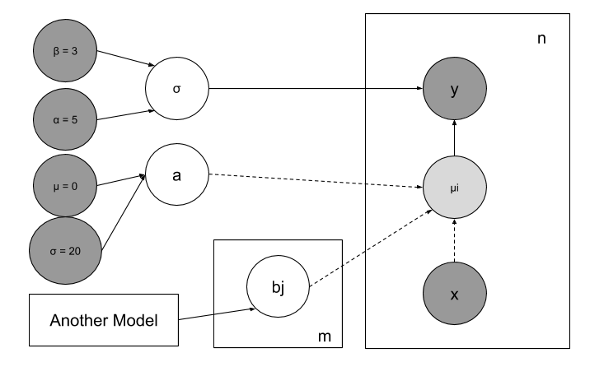
Linear Regression (with group-level predictors)
1

Slide 44
Tools
Notes:
<number>

Slide 45
Tools
Stan: The one we are using today with its python wrapper PyStan.
JAGS: Older. Has a wrapper for python which reasonably maintained.
Edward: I find it promising. The same person who initiated Stan moved there. Based on TensorFlow.
PyMC3: I think it is based on theano which is not supported any more.
OpenBugs, WinBugs: OLD but well known
Lots more.
1
Notes:
Stan: The one we are using today with its python wrapper PyStan. Well maintained, big team, no sampling form discrete vars. Does not depend on other libs.
JAGS: Older. Has a wrapper for python which reasonably maintained. Uses similar language to Stan but allows sampling from discrete vars.
Edward: I find it promising. The same person who worked with Stan moved there. Based on TensorFlow.
PyMC3: I think it is based on theano which is not supported any more.
Emcee:
OpenBugs, WinBugs

Slide 46
Random Slides
Notes:
<number>

Slide 47
Do not Confuse!
Discriminative and Generative models.
Are not analogies of UGs and DAGs!
Are not analogies of Bayesian and non-Bayesian models.
We can speak about these later in the practical.
1

Slide 48
Notes about Graphs
The arrows in a DAG can sometimes be completely deterministic operations.
Basically, each node is deterimined by ALL the incoming arrows by:
Parameterising a probability distribution
Input to a deterministic formula
Deterministic Operations are usually represented with different style of edges.
Plate Notation: When there are parts of the graph which repeat many times, the plate notation helps confine the graphical model's visualisation size.
Simplification is not only by reducing the number of edges in the graph, but also by determining how every arrow works (every conditional dependency). Is it Normal? Is it Gamma? Is it ...?
1

Slide 49
D Separation
Have a look at Bishop’s presentation on the topic.
It is the set of rules using which we can infer whether two variables are independent conditioned on other variables.
We can discuss it further in the practical.
1

Slide 50
Network Analysis
Notes:
<number>

Slide 51
Network Analysis
I have included La Liga example as the matches results can be thought of as a network structure.
Graphical Models can be used on transaction data as we will show in the Pareto/NBD example. But this not network analysis necessarily.
Structure Learning for Bayesian Networks: Not covered here.
1

Slide 52
More Advanced Graphical Modeling
Notes:
<number>

Slide 53
Scalability
Using GPUs: I am not aware if Stan is able to do so or if probabilistic modeling can utilise GPU.
Distributed MCMC: PyStan allows running parallel MCMC chains, but not on multiple machines. This can be implemented separately though.
Companies have deployed probabilistic models in practice. This blog is a good example: https://www.smartly.io/blog/tutorial-how-we-productized-bayesian-revenue-estimation-with-stan
I used probabilistic models in practice but implement their optimisation algorithm myself using numpy not PyStan.
1

Slide 54
Gaussian Processes
Can be used for non-parametric regression and part of larger models.
1

Slide 55
Bayesian Neural Networks
Weights are now learned probability distributions not floating point numbers.
This example using PyMC3 can be easily ported to Stan is an example: https://docs.pymc.io/notebooks/bayesian_neural_network_advi.html
1

Slide 56
La Liga Analysis
Notes:
<number>

Slide 57
Three Points for a Win
https://en.wikipedia.org/wiki/Three_points_for_a_win
“Encourage attacking play”
“Avoid collusion”
1

Slide 58
Every Team has 4 Random Variables
Home Defense (HD)
Home Offense (HO)
Away Defense (AD)
Away Offense (AO)
P(Number of visitor goals = x) ~ P(x|AO1,HD2)
P(Number of home goals = x) ~ P(x|HO2,AD1)
1

Slide 59
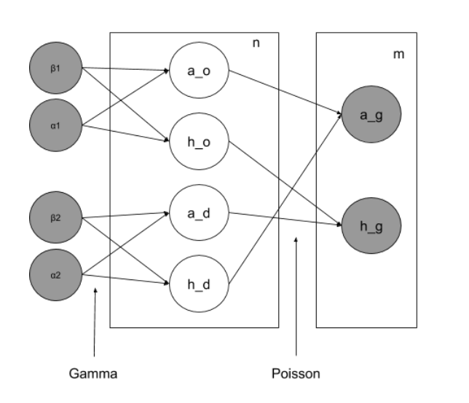
La Liga Model
α1,β1,α2,β2: Gamma priors
a_o,h_o,a_d,h_d: scoring/defending rates
a_g,h_g: Slope and intercept
m: number of matches
n: number of teams
1

Slide 60
Pareto/NBD
Notes:
<number>

Slide 61
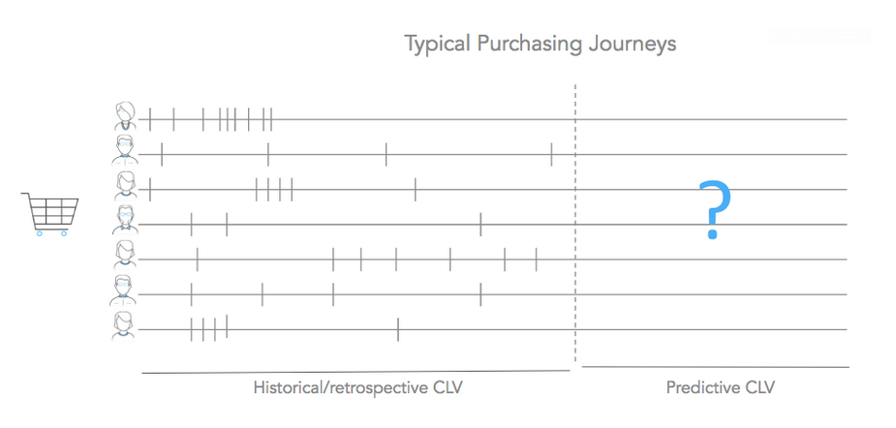
Purchase (transaction history)
https://www.datascience.com/blog/intro-to-predictive-modeling-for-customer-lifetime-value
1

Slide 62
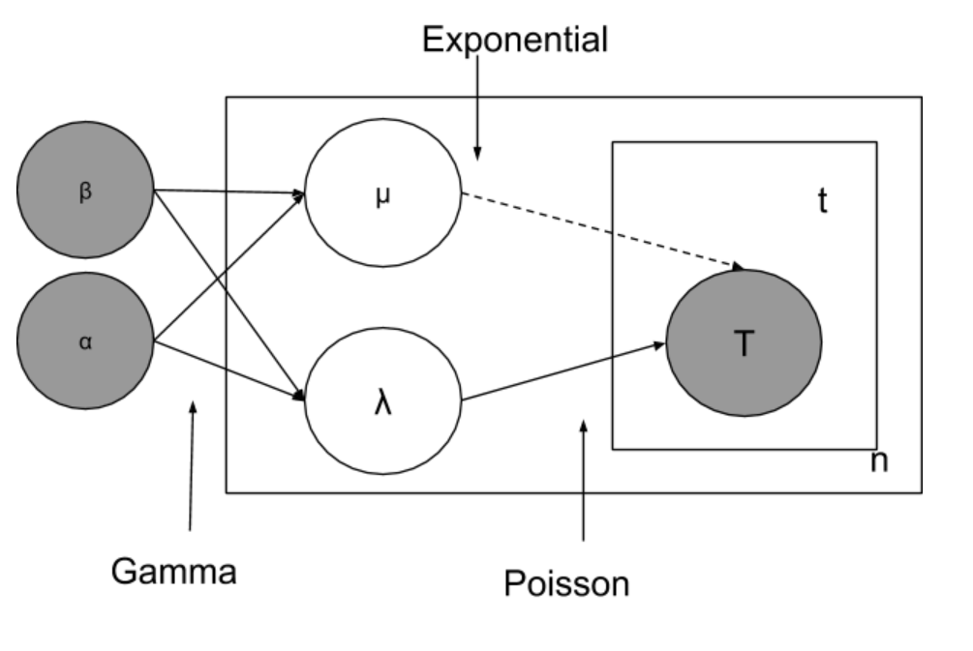
Model
α,β: Gamma priors
μ: User lifetime
λ: Customer purchase rate
t: number of transactions
n: number of customers
T: Transactions results
https://www.datascience.com/blog/intro-to-predictive-modeling-for-customer-lifetime-value
<number>

Slide 63
References
https://github.com/nawarhalabi/graphical_modeling
https://www.tjmahr.com/plotting-partial-pooling-in-mixed-effects-models/
https://cran.r-project.org/web/packages/rstanarm/vignettes/pooling.html
http://mc-stan.org/users/documentation/case-studies/radon.html
http://www.injuryepi.org/styled-4/styled-11/code-8/
https://www.kaggle.com/ricardomoya/football-matches-of-spanish-league
http://www.datascienceassn.org/sites/default/files/Stan%20Modeling%20Language%20User%27s%20Guide%20and%20Reference%20Manual%2C%20Version%202.2.0.pdf
https://www.youtube.com/watch?v=ju1Grt2hdko
http://jmlr.csail.mit.edu/papers/volume15/delgado14a/delgado14a.pdf
https://ml.informatik.uni-freiburg.de/papers/15-NIPS-auto-sklearn-preprint.pdf
https://docs.pymc.io/notebooks/bayesian_neural_network_advi.html
https://www.youtube.com/watch?v=VnNdhsm0rJQ
http://www.datascienceassn.org/sites/default/files/Stan%20Modeling%20Language%20User%27s%20Guide%20and%20Reference%20Manual%2C%20Version%202.2.0.pdf
http://citeseerx.ist.psu.edu/viewdoc/download?doi=10.1.1.597.3165&rep=rep1&type=pdf
https://github.com/datascienceinc/oreilly-intro-to-predictive-clv/blob/master/oreilly-an-intro-to-predictive-clv-tutorial.ipynb
<number>

