Slide 1
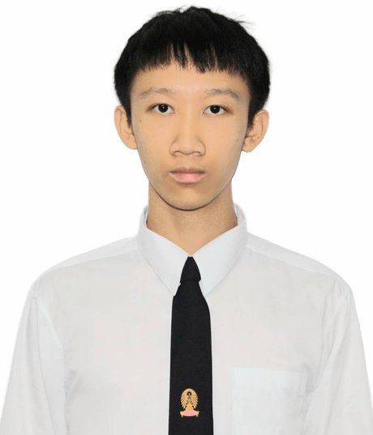
Nawat
Pimolsathien
Computer Engineer · building AI things, shipping web apps
i
Profile
CONTACT
A third-year Computer Engineering student with a strong foundation in programming and web development, built through coursework and personal projects. Internships sharpened my website and SQL skills; since then I've expanded into machine learning, data analytics, IoT, cloud, and cyber security, plus desktop software and add-in development in C# and .NET. I like building things that are genuinely useful to the people who use them.
nawatpim@gmail.com
088-864-5743
github.com/rainydayo
Nonthaburi, Thailand
EDUCATION
Experience
B.Eng. Computer Engineering & Digital Technology
■
Chulalongkorn University
Software Engineer Intern NOW
AUG 2025 — PRESENT
2025 · Year 3
Muang Thai Life Assurance
• Building a sales-assistance chatbot to support agents & customers.
• Delivering additional engineering projects across the team.
SKILLS
Software Developer (Intern / Part-time)
MAY 2025 — SEP 2025
// frontend
Power Partner Co., Ltd.
Next.js · React · Figma
• Developed desktop software products end to end.
• Delivered complete, client-facing projects.
// backend
Teaching Assistant
AUG 2024 — MAR 2026
.NET / C# · Spring Boot · Go · Node.js · C++
Chulalongkorn Univ. — Logic · DSA · Frontend Dev
• Guided students, answered questions, graded assignments.
• Returned as Frontend Dev TA for a 2nd term (Mar 2026).
// ai & data
Software Engineer Intern
TensorFlow · scikit-learn · Python · PostgreSQL · SQL
MAY 2024 — JUL 2024
NITMX Co., Ltd.
// tools
• Built website projects with the team.
• Delivered presentations & progress reports to mentors.
Docker · Blender
LANGUAGES
◎
Focus Areas
Thai native
English professional
AI language models & ML
Full-stack web (Next.js)
Desktop & add-ins (C#/.NET)
Data analytics & databases
Cloud & containers (Docker)
3D modelling in Blender
github.com/rainydayo · nawatpim@gmail.com · updated June 2026

