Slide 1
Extreme Learning Machine
Abdulrhman Aljouie
CS698 – Current topics in Data Science
2/23/17
CS698 Current Topics in Data Science- Abdulrhman Aljouie Extreme Learning Machine

Slide 2
Outline
Extreme Learning Machine Motivation.
Structure of the proposed Extreme Learning Machine (ELM).
Basis of Extreme Learning Machine.
Gradient based Algorithms for Single Hidden Neural Net.
Show an Example of training small data using ELM algorithm.
Show an Example of predicting small data using ELM algorithm.
Matlab functions for ELM Learning and predicting on example data.
Extreme Learning Machine Performance Results.
2/23/17
CS698-Current Topics in Data Science- Abdulrhman Aljouie Extreme Learning Machine

Slide 3
Motivation
Feedforward Neural Nets such as back-propagation are slow and the reason is:
  Training using gradient based learning algorithms e.g. many iterative steps required to achieve better performance.
  The weights are adjusted iteratively using gradient methods.
Extreme Learning Machine (ELM) was proposed to overcome these issues and offer better generalization performance.
2/23/17
CS698 Current Topics in Data Science- Abdulrhman Aljouie Extreme Learning Machine
Notes:
Gradient based algorithms are slow because: 1. Many iterative learning steps to gain better performance. And other issues such as converge to silly local minima.

Slide 4
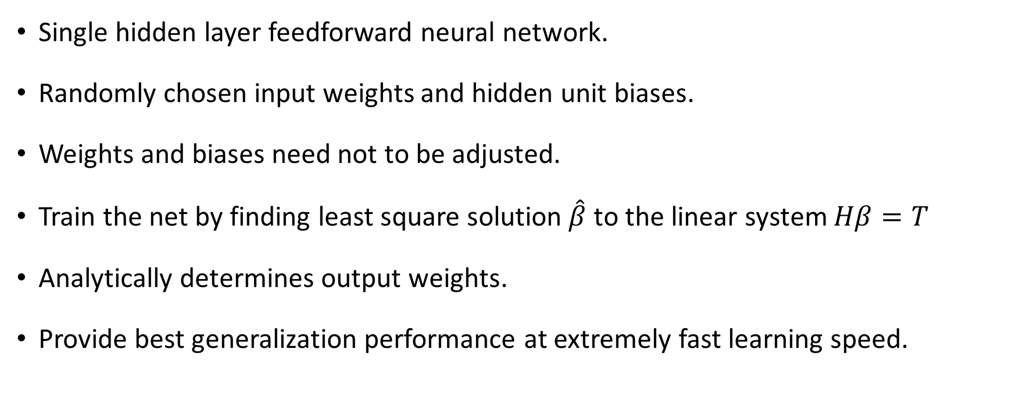
The proposed algorithm - Extreme Learning Machine (ELM)
2/23/17
CS698 Current Topics in Data Science- Abdulrhman Aljouie Extreme Learning Machine
Notes:
Better generalization because if the updates are not adjusted it has been shown in practice that it gives better generalization performance. Also, if the loss function minimize the magnitude of the norm it gives better generalization.

Slide 5
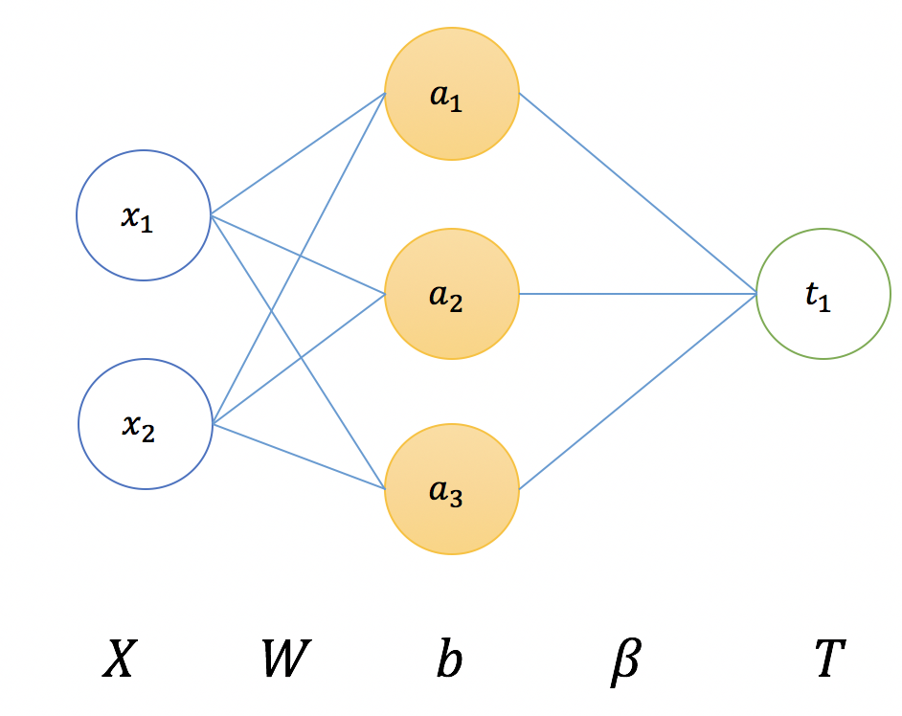
Structure of Extreme Learning Machine
2/23/17
CS698 Current Topics in Data Science- Abdulrhman Aljouie Extreme Learning Machine

Slide 6
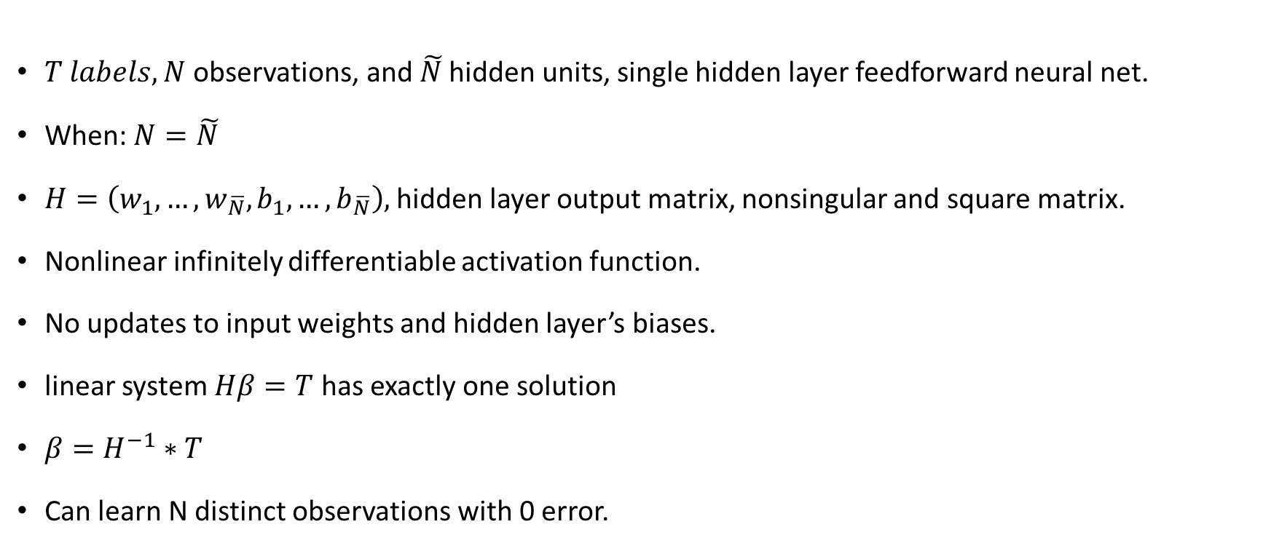
Initial idea
2/23/17
CS698 Current Topics in Data Science- Abdulrhman Aljouie Extreme Learning Machine
Notes:
To train the network simply find the least square estimate beta hat of linear system HB = T

Slide 7
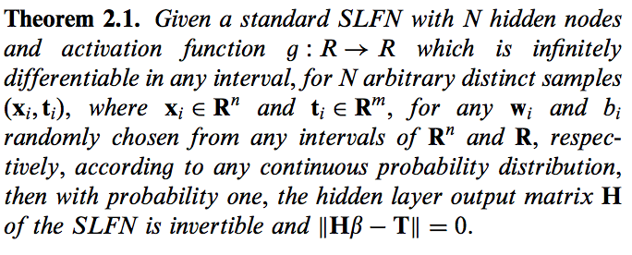
Theorem
Proof: Tamura and M. Tateishi (1997)
2/23/17
CS698 Current Topics in Data Science- Abdulrhman Aljouie Extreme Learning Machine

Slide 8
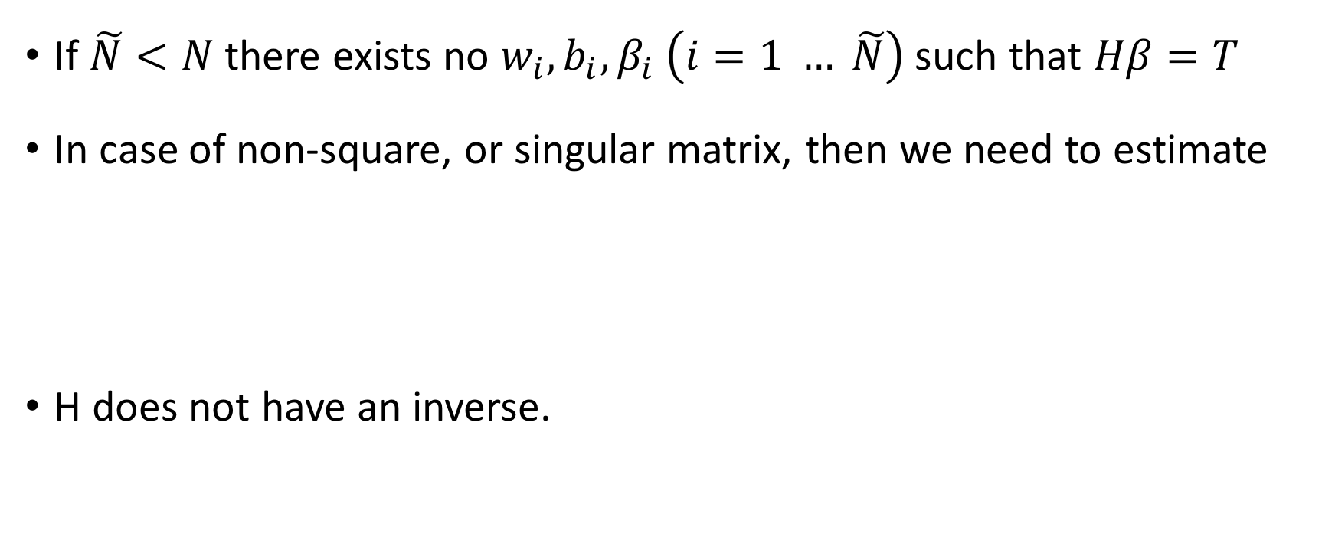
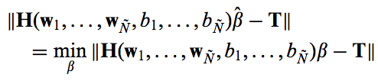
Issues
2/23/17
CS698 Current Topics in Data Science- Abdulrhman Aljouie Extreme Learning Machine

Slide 9
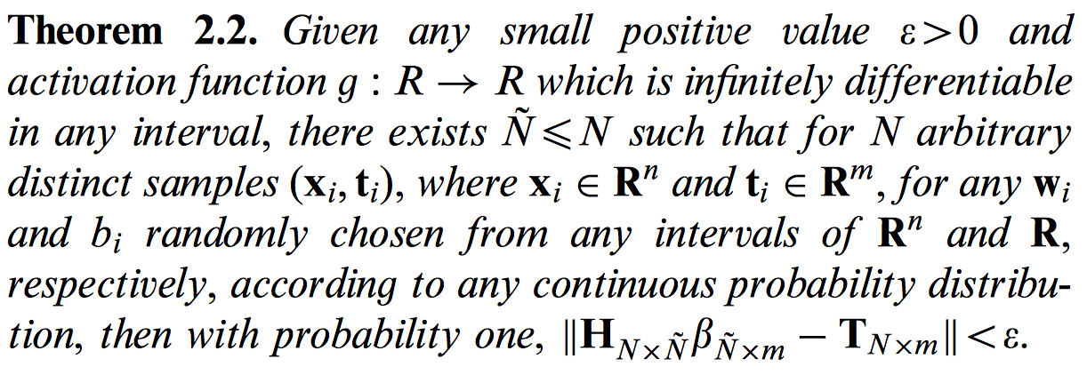
The # hidden layer units << the # input units
2/23/17
CS698 Current Topics in Data Science- Abdulrhman Aljouie Extreme Learning Machine

Slide 10
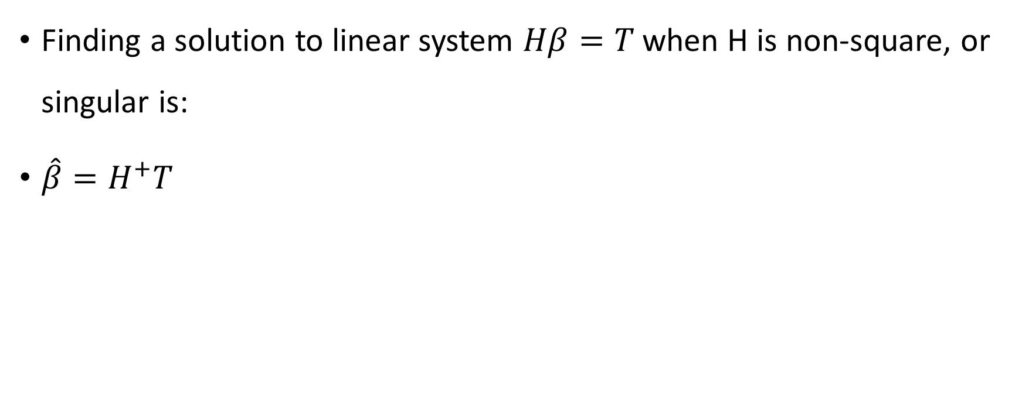
H is non-square or singular
2/23/17
CS698 Current Topics in Data Science- Abdulrhman Aljouie Extreme Learning Machine

Slide 11
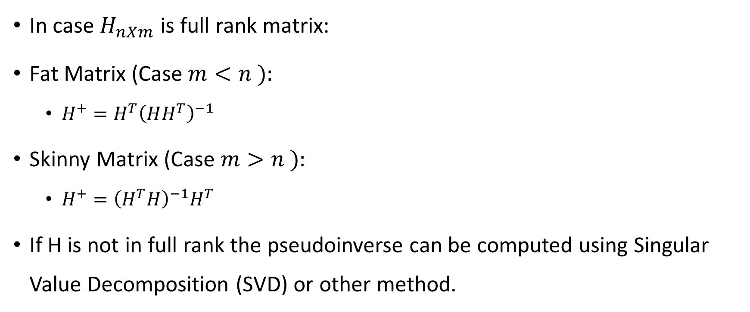
To calculate the pseudoinverse
2/23/17
CS698 Current Topics in Data Science- Abdulrhman Aljouie Extreme Learning Machine
Notes:
If one or more columns, in case columns > rows, are linearly dependent on other cols, e.g. when we add two cols we derive the thirds col. Then the mat is not in full rank. In case mat is square we can say it is linearly independent iff its determinant is non-zero.

Slide 12
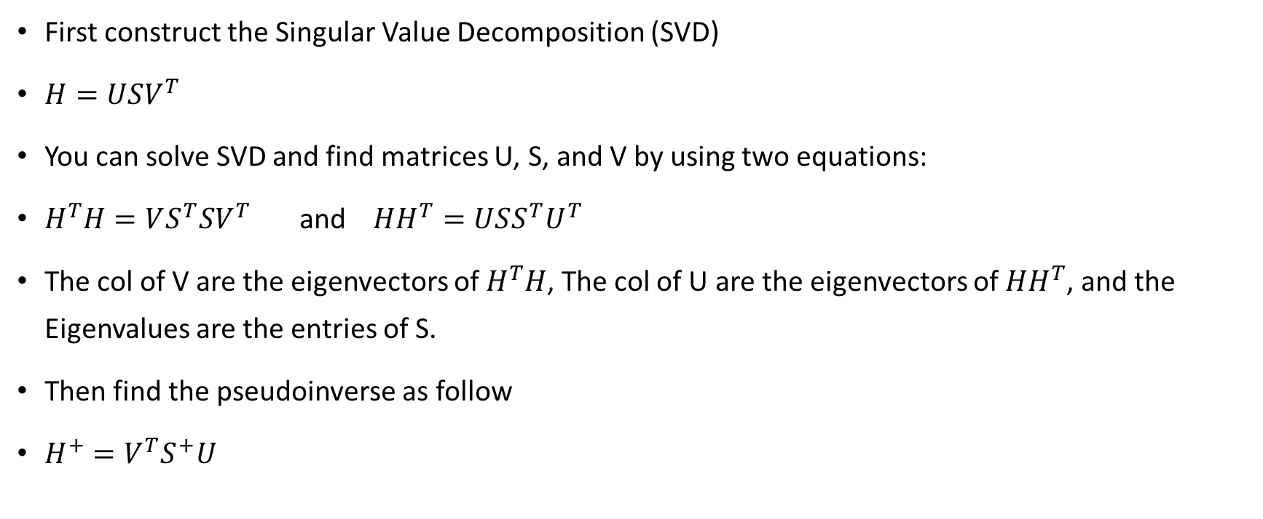
How to compute the pseudoinverse in case matrix H is not invertible i.e. non-square and H not full rank?
2/23/17
CS698 Current Topics in Data Science- Abdulrhman Aljouie Extreme Learning Machine
Notes:
Note: U transpose U is 1 since U is an orthogonal matrix. Eigenvalues are the entries of S and S is Diagonal

Slide 13

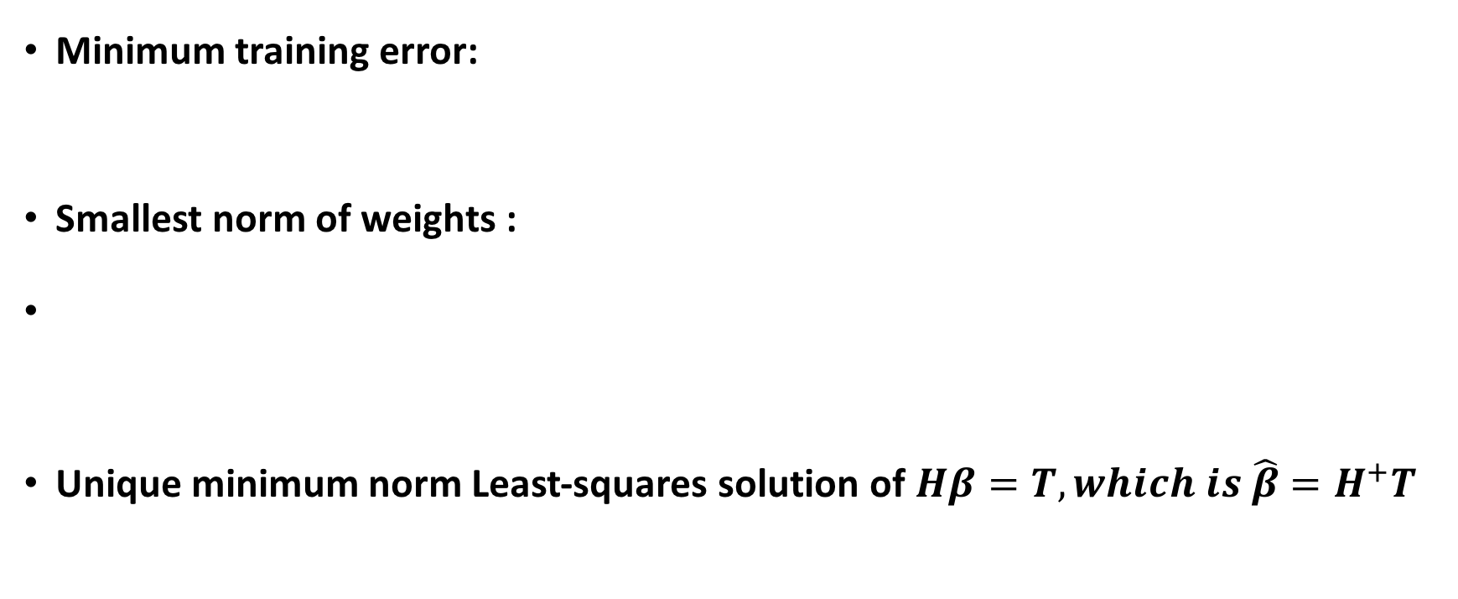
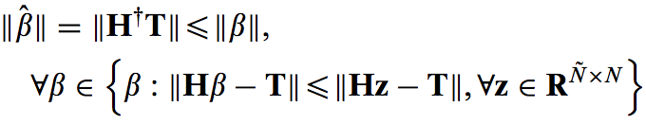
2/23/17
CS698 Current Topics in Data Science- Abdulrhman Aljouie Extreme Learning Machine

Slide 14
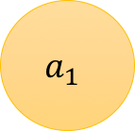
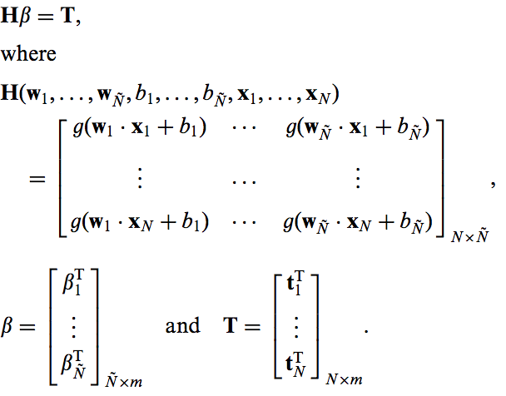
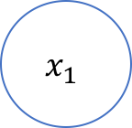
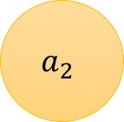
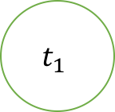
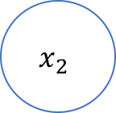
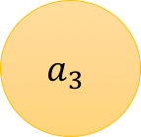
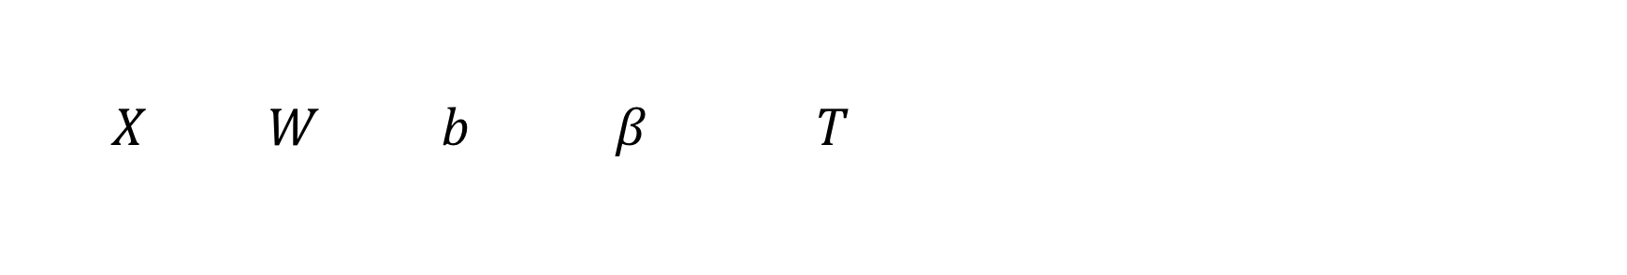
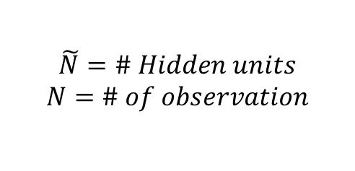
Extreme Learning Machine
2/23/17
CS698 Current Topics in Data Science- Abdulrhman Aljouie Extreme Learning Machine

Slide 15
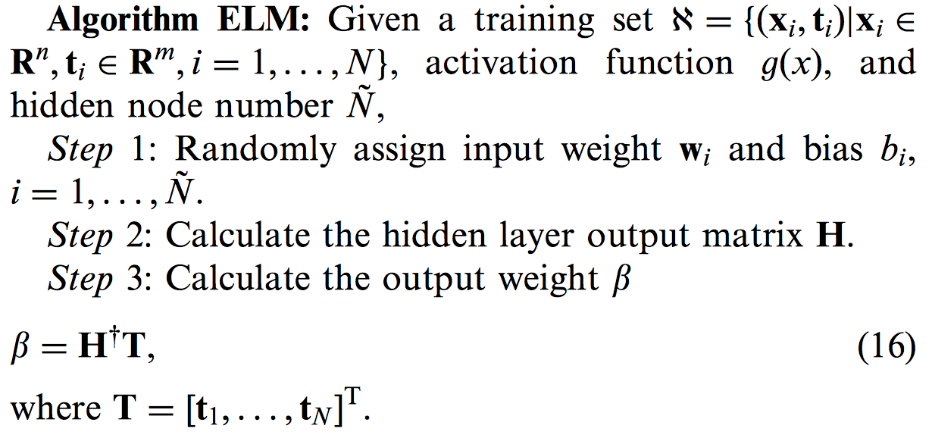
ELM Algorithm
2/23/17
CS698 Current Topics in Data Science- Abdulrhman Aljouie Extreme Learning Machine

Slide 16
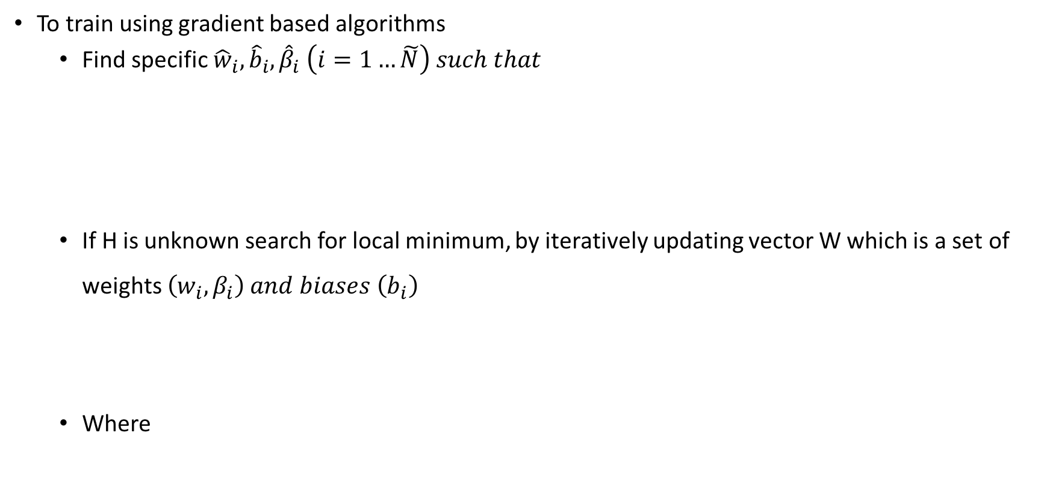
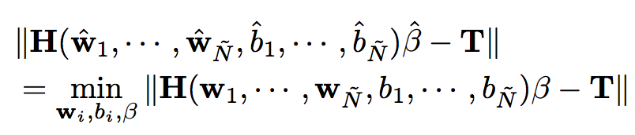


Gradient based Algorithms with Single Hidden Layer Network
2/23/17
CS698 Current Topics in Data Science- Abdulrhman Aljouie Extreme Learning Machine

Slide 17
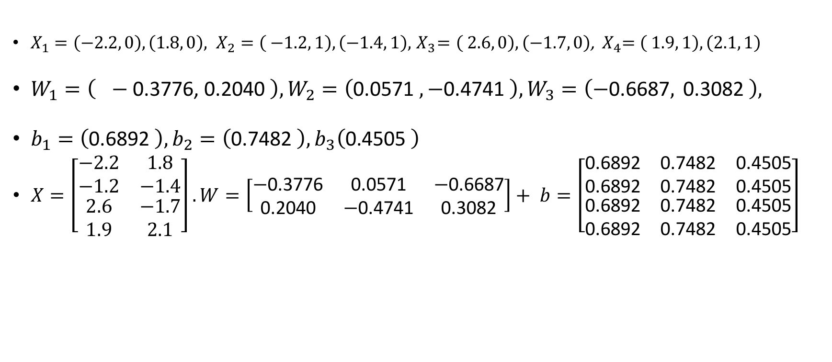
ELM Training Example
2/23/17
CS698 Current Topics in Data Science- Abdulrhman Aljouie Extreme Learning Machine

Slide 18
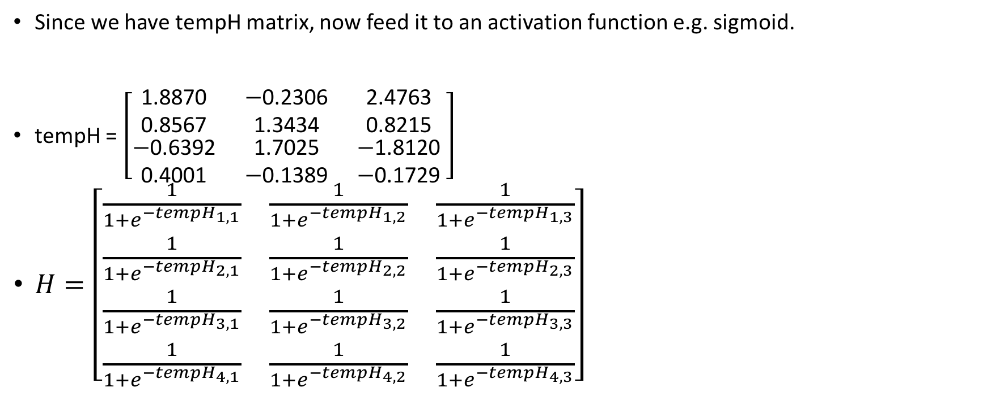
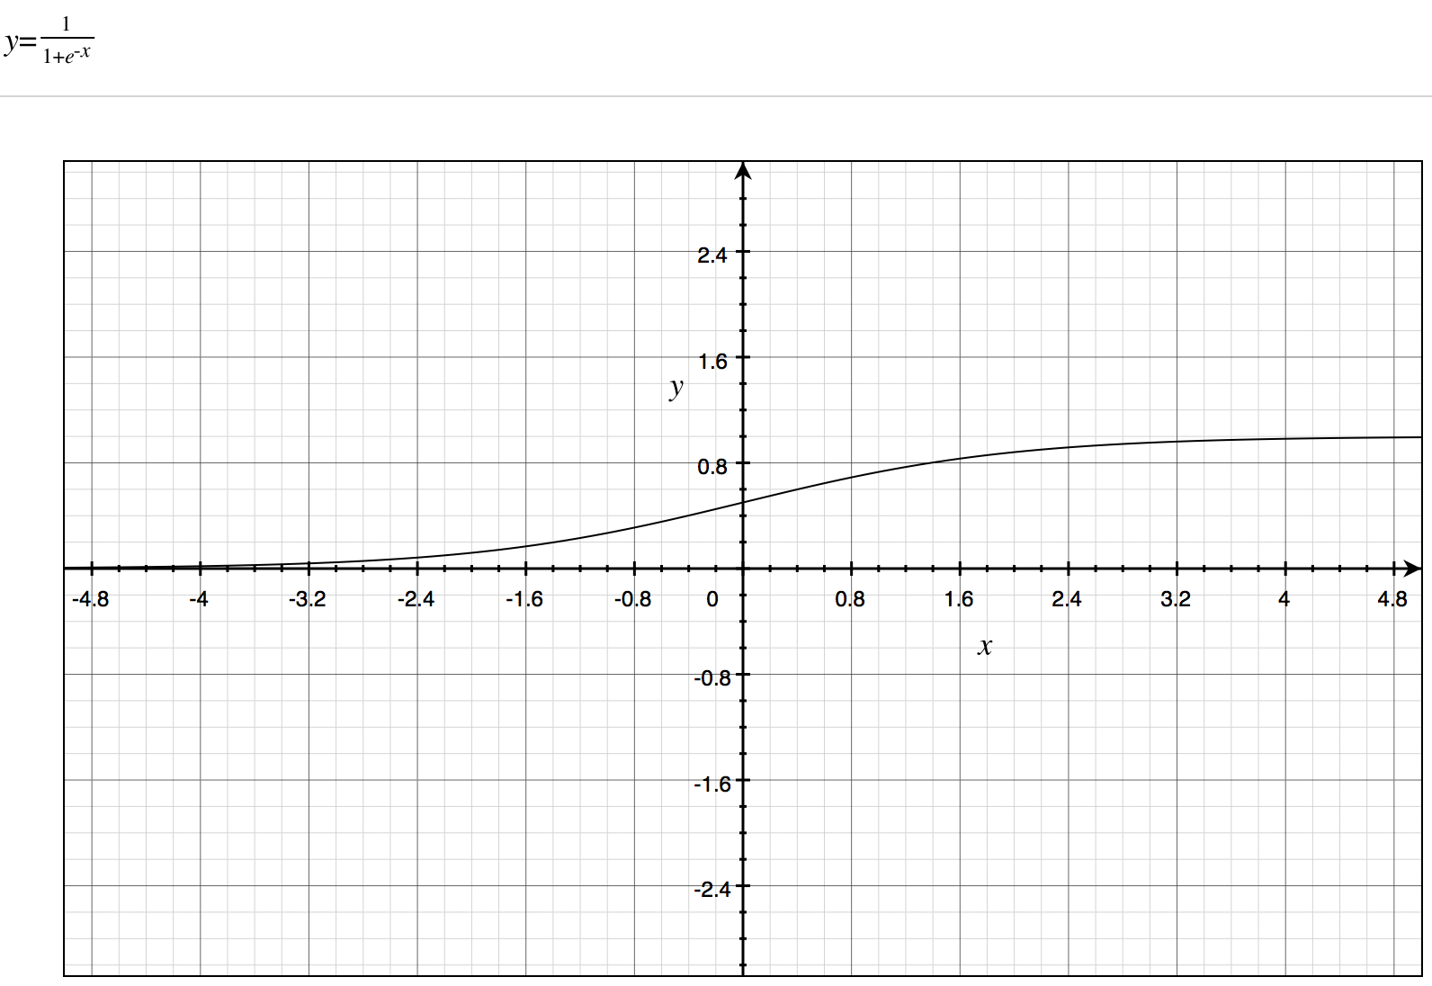
ELM Training Example (continued)
2/23/17
CS698 Current Topics in Data Science- Abdulrhman Aljouie Extreme Learning Machine

Slide 19
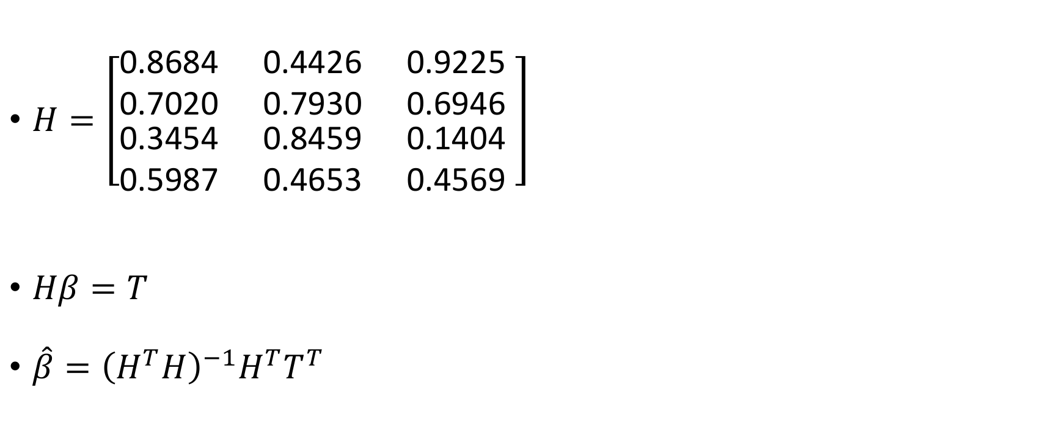
ELM Training Example (continued)
2/23/17
CS698 Current Topics in Data Science- Abdulrhman Aljouie Extreme Learning Machine

Slide 20
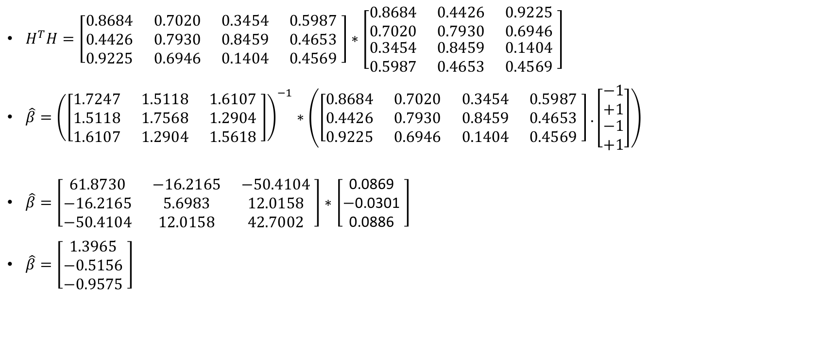
ELM Training Example (continued)
2/23/17
CS698 Current Topics in Data Science- Abdulrhman Aljouie Extreme Learning Machine

Slide 21
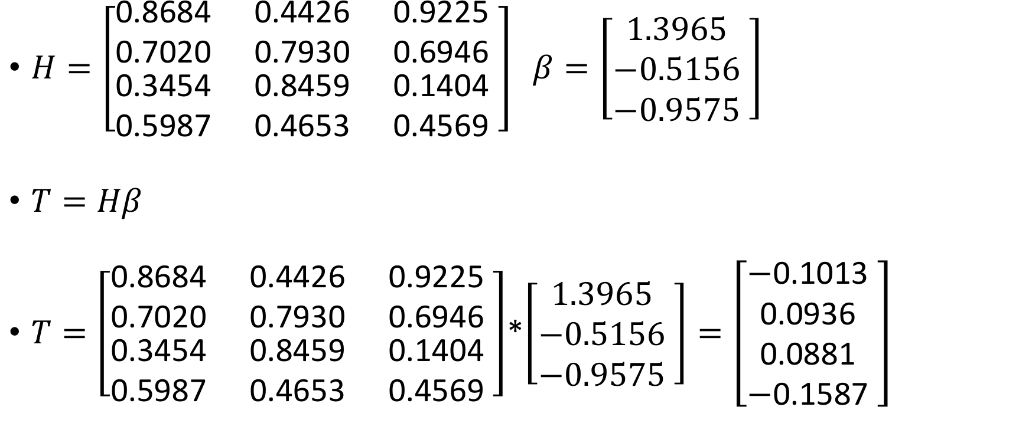
2/23/17
CS698 Current Topics in Data Science- Abdulrhman Aljouie Extreme Learning Machine

Slide 22
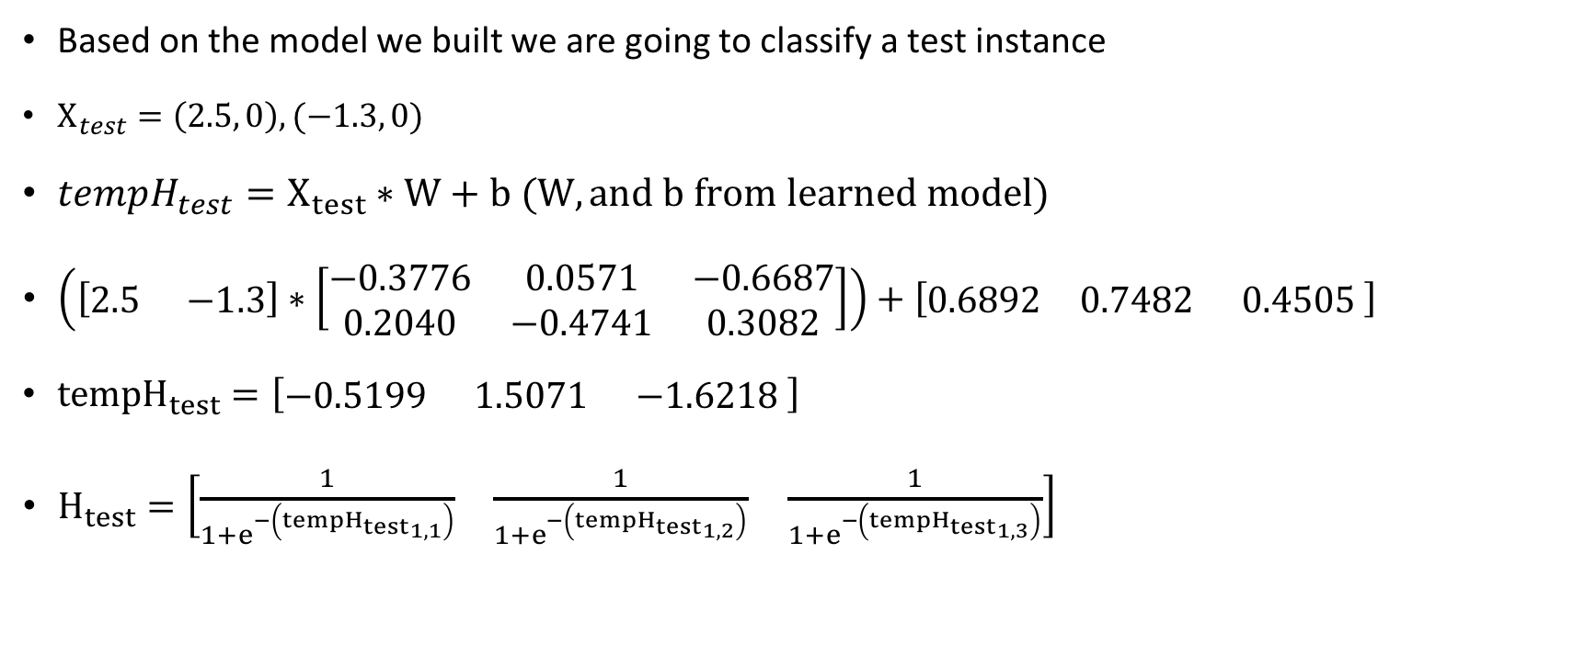
ELM Classify Example
2/23/17
CS698 Current Topics in Data Science- Abdulrhman Aljouie Extreme Learning Machine

Slide 23
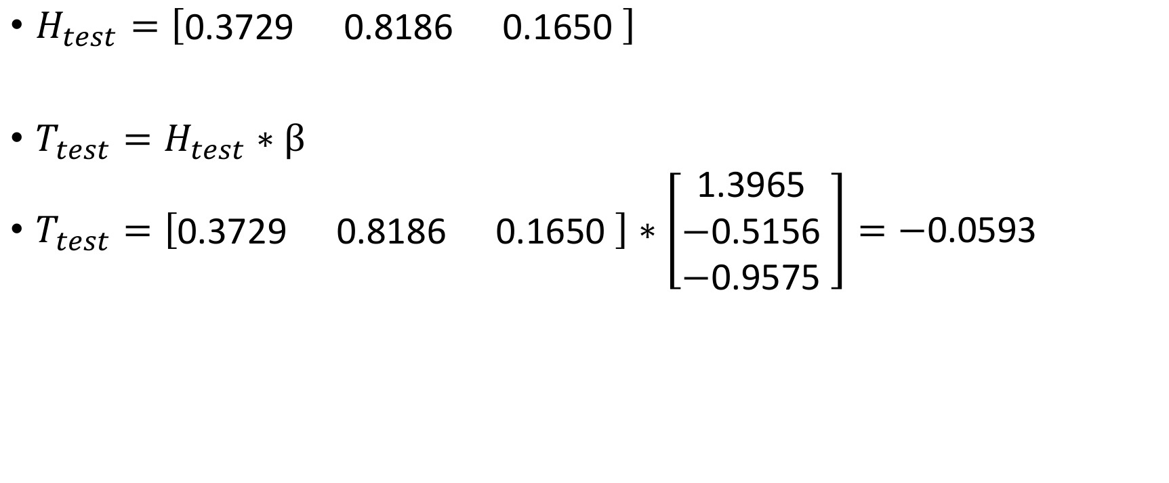
ELM Classify Example
2/23/17
CS698 Current Topics in Data Science- Abdulrhman Aljouie Extreme Learning Machine

Slide 24
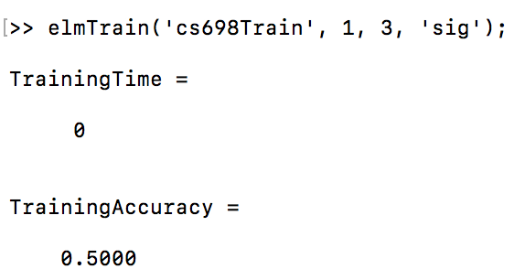
Matlab code for ELM on the example data
2/23/17
CS698 Current Topics in Data Science- Abdulrhman Aljouie Extreme Learning Machine

Slide 25
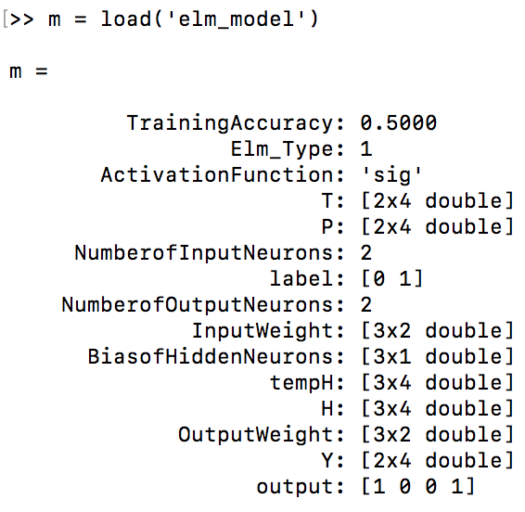
Training model in Matlab
2/23/17
CS698 Current Topics in Data Science- Abdulrhman Aljouie Extreme Learning Machine

Slide 26
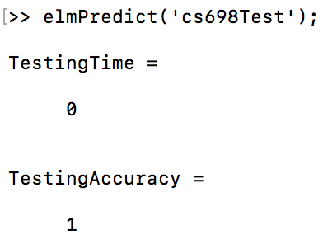
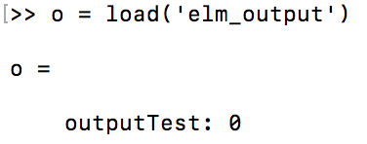
Predicting with function predict
2/23/17
CS698 Current Topics in Data Science- Abdulrhman Aljouie Extreme Learning Machine

Slide 27
ELM have better generalization compared to gradient based algorithm such as BP
Extreme Learning Machine (ELM) | Gradient based Algorithms e.g. Backpropagation
Unique minimum solution | Prone to local minima convergence trap
Reach both smallest training error and smallest weight norm. | Minimizes Error alone.
Does not need a stopping methods. | Overtraining when objective function doesn’t have proper stopping methods and validation.
2/23/17
CS698 Current Topics in Data Science- Abdulrhman Aljouie Extreme Learning Machine

Slide 28
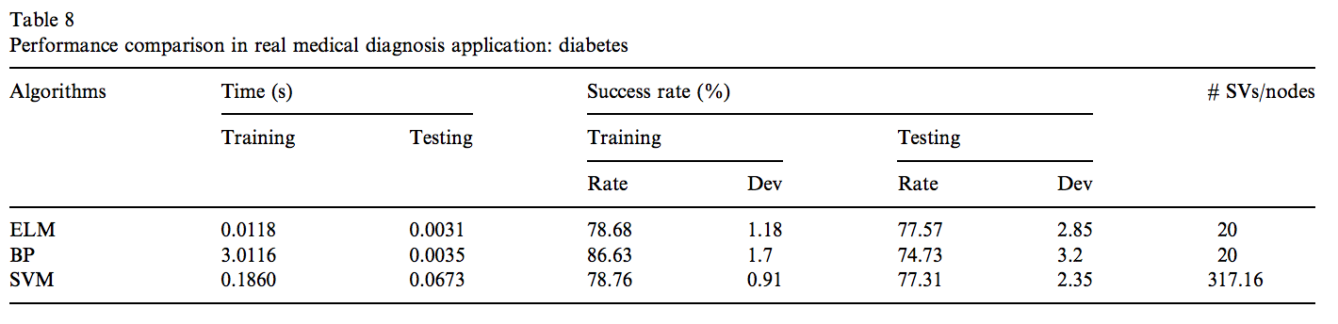
ELM Results on medical application
2/23/17
CS698 Current Topics in Data Science- Abdulrhman Aljouie Extreme Learning Machine

Slide 29
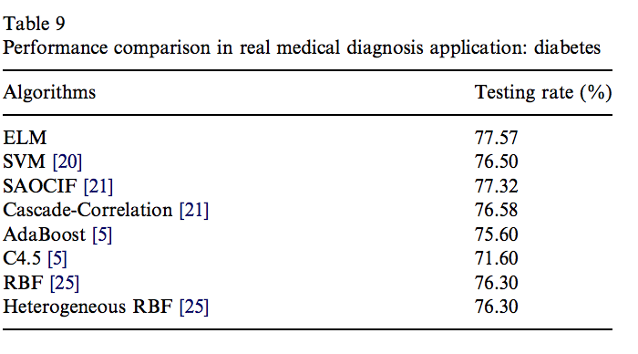
ELM Results (continued)
2/23/17
CS698 Current Topics in Data Science- Abdulrhman Aljouie Extreme Learning Machine

