Slide 1
REVIEW PAPER
Restricted Boltzmann Machine to Determine the Input Weights for Extreme Learning Machines
Andre G. C. Pacheco, Renato A. Krohling, Carlos A. S. da Silva
2017
Expert Systems With Applications
SJR: 1.433(Q1)
Aris setyawan

Slide 2
LATAR BELAKANG MASALAH(1)
Obyek Penelitian
Extreme Learning Machines
Masalah Penelitian
The Extreme Learning Machine (ELM) is a single-hidden
layer feedforward neural network (SLFN) learning
algorithm that can learn effectively and quickly.
However, random weights in the input layer may affect
the algorithm performance less effective.

Slide 3
MASALAH PENELITIAN (MP) DAN LANDASAN
MP | LANDASAN
The Extreme Learning Machine (ELM) is a single-hidden layer feedforward neural network (SLFN) learning algorithm that can learn effectively and quickly. However, random weights in the input layer may affect the algorithm less effective performance. | Comparing it with backpropagation (Rumelhart et al., 1986), the most common algorithm used to train neural networks, its learning stage can be thousand of times faster and it can achieve a better generalization (Huang et al., 2006).
The randomness of the input weights can make the algorithm less effective, depending on the assigned values for W. (Wang et al., 2011)
The randomness of input weights influences the algorithm performance, i.e., the ELM output is not quite stable (Wang et al., 2015)

Slide 4
PENELITIAN YANG BERHUBUNGAN
ELM; Standard ELM (Huang et al, 2012)
ELMAE; ELM AutoEncoder (Kasun et al, 2013)
ELMRO; ELM Random Orthogonal (Wang and Liu, 2017)

Slide 5
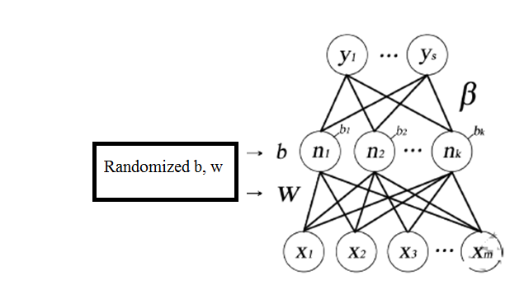
ELM (Huang et al, 2012)

Slide 6
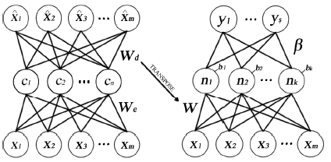
ELM AE (Kasun et al, 2013)
AE
ELM

Slide 7
ELMRO (Wang and Liu, 2017)
RO
ELM

Slide 8
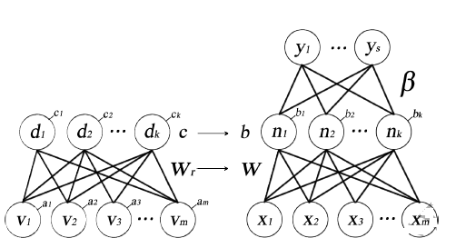
METODE YANG DIUSULKAN (MYD)
RBM (Smolensky, 1986; Hinton, 2002)
ELM (Huang, 2004)

Slide 9
ANALISIS PERBEDAAN PYB DAN MYD
METHODE | Datasets | Permutation | Input Weighting | Evaluation
Standard ELM (Huang et al, 2012) | 20 Datasets from UCI | Default, otherwise shuffled* | Random | ACC
ELM AutoEncoder (Kasun et al, 2013) | MNIST | 17% Testing, 83% Training | AE | ACC
ELM Random Orthogonal (Wang and Liu, 2017) | 11 Datasets from UCI | Default from UCI | RO | RMSE
Restricted Boltman Machine ELM | 9 Dataset from UCI | Default from UCI, otherwise shuffled and split (70% Training, 30% Testing) | RBM (Smolensky, 1986; Hinton, 2002) | ACC, Friedmen, Wilconson
Notes:
*partition is not mentioned
<number>

Slide 10
TAHAPAN PENELITIAN
Experimental setup
Python and Tensorflow
Intel core i7-6 CPU @ 2.50 GHz PC with 8 GB of RAM and a Nvidia Geforce 940M
Preparing dataset
Using 9 UCI Datasets
Statistical analysis
Untuk mengidentifikasikan pengaruh RBM terhadap kinerja ELM jika dibandingkan metode penentuan weight input lainnya

Slide 11
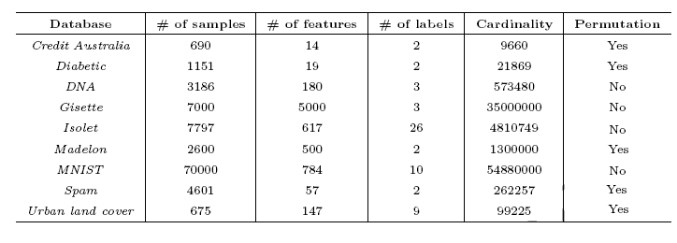
DATASET
The datasets are from the UCI Repository

Slide 12
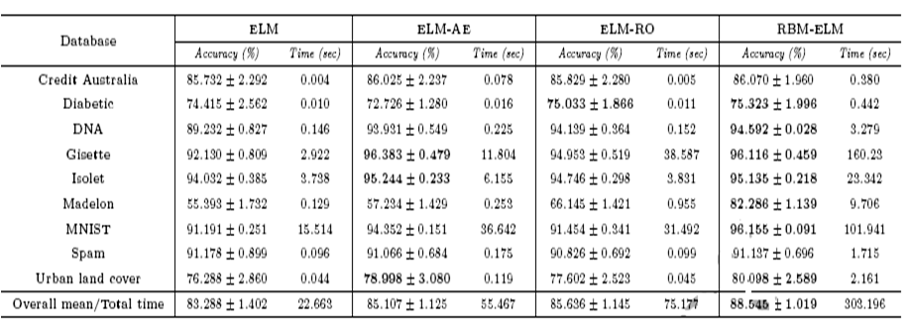
HASIL PENELITIAN

Slide 13
KESIMPULAN
Using Friedmen Test (p <= 0.05)
Credit australia (NoSig)
Spam (NoSig)
Rest of datasets (Sig)
Wilconson Test (p <= 0.01)
MNIST, DNA, and madelon: RBM-ELM vs Others (Sig)
DNA, and madelon: RBM-ELM vs ELM-RO, RBM-ELM, ELM (Sig)
Diabetic: ELM-AE vs RBM-ELM (NoSig). ELM-AE vs RBM-ELM vs Others (Sig)
Overall, the RBM-ELM vs Other (Sig)

