Slide 1
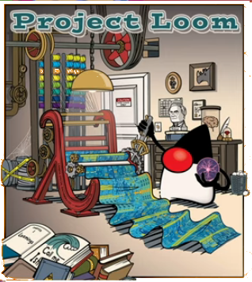

Slide 2

Disclaimer
Changing prototype implementation
Changing APIs (including deprecations)
I do not fully understand Loom
Nawazish Khan

Slide 3
Machine Vs Developer
Cores in the machine has increased, dramatically.
Threads as langugage construct to fully utilize machine cores.
Synchronous processing
Incoming
Requests
Req. Processing Threads
Developer :) | Machine :(
Notes:
Synchronous (thread per request model);
Easy to code programming model, exception handling, debugging, profiling all are easier to implement in this model.
Network socket connections can easily outrun the available threads with OS
Unless we take operating system for granted; show ThreadFailure.java

Slide 4
Machine Vs Developer
Asynchronous processing
Callback hell
Incoming
Requests
Developer :( | Machine :)
Notes:
Scales but
Hard to reason, debug, profile especially when action and reaction hops between thread pools.

Slide 5
Loom: Virtual Threads
Developer makes synchronous calls
Runtime makes it asynchronous.
Virtual Threads: Developer :) + Machine :)
Light weight/user-mode threads with ability to park/unpark.
Notes:
Virt. Threads: low footprint, context switching costs less
To express park/unpark capabilities run ProducerConsumerVirtualThread.java
Caveats: virt.thread would pin carrier thread
Code in native frame and blocks, thread would be carrier thread would bepinned.

Slide 6
Loom: Virtual Threads
Virtual Threads = Continuation + Scheduler
public class Continuation implements Runnable{
public Continuation (ContinuationScope, Runnable)
public final void run()
public static void yield (ContinuationScope)
public boolean isDone()
}
Notes:
Continuation does not implement Runnable anymore!
At this point demo the continuation code: Continuation.java

Slide 7
LockSupport
Public class LockSupport{
Public static void park(...){
var t = Thread.currentThread();
if(t.isLightweight())
Continuation.yield(...);
else
Unsafe.park(...)
}
}
Public static void unpark(Thread t){
if(t.isLightweight())
t.scheduler.submit(t.continuation)
else
Unsafe.unpark(t)
}

Slide 8
Loom: Virtual Threads
Virtual Threads = Continuation + Scheduler
Fork/Join Pool
Notes:
Ask if anybody can guess

Slide 9
Virtual Threads = Continuation + Scheduler
Schedular (On the JVM)
OS Schedular

Slide 10
Thank you for your patience...
Notes:
Structured Conurrency [join, deadlines, cancellations]
Scoped variables - against the abuse of ThreadLocals

