Slide 1
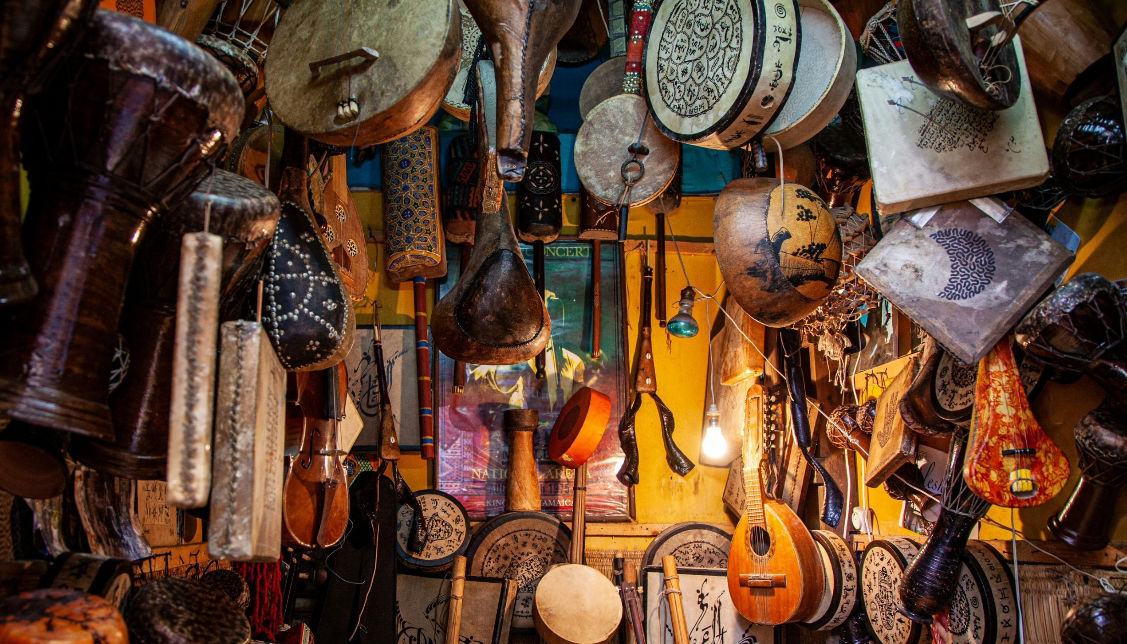
Music and
Culture
🎶 TRADITIONAL MUSIC AND IDENTITY
Music is part of every culture.
Reflects traditions, history, and lifestyle.

Slide 2
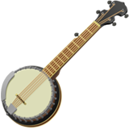
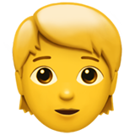

Music Shows Who We Are
🎶 MUSIC AND CULTURE
Identity
Tradition
Community
Tells us where we come from.
Keeps stories alive across generations.
Brings people together.
Sindhi, Punjabi, Balochi, and Pashtun music.
At weddings, Eid celebrations, and festivals.
Passes stories and traditions to future generations.

Slide 3
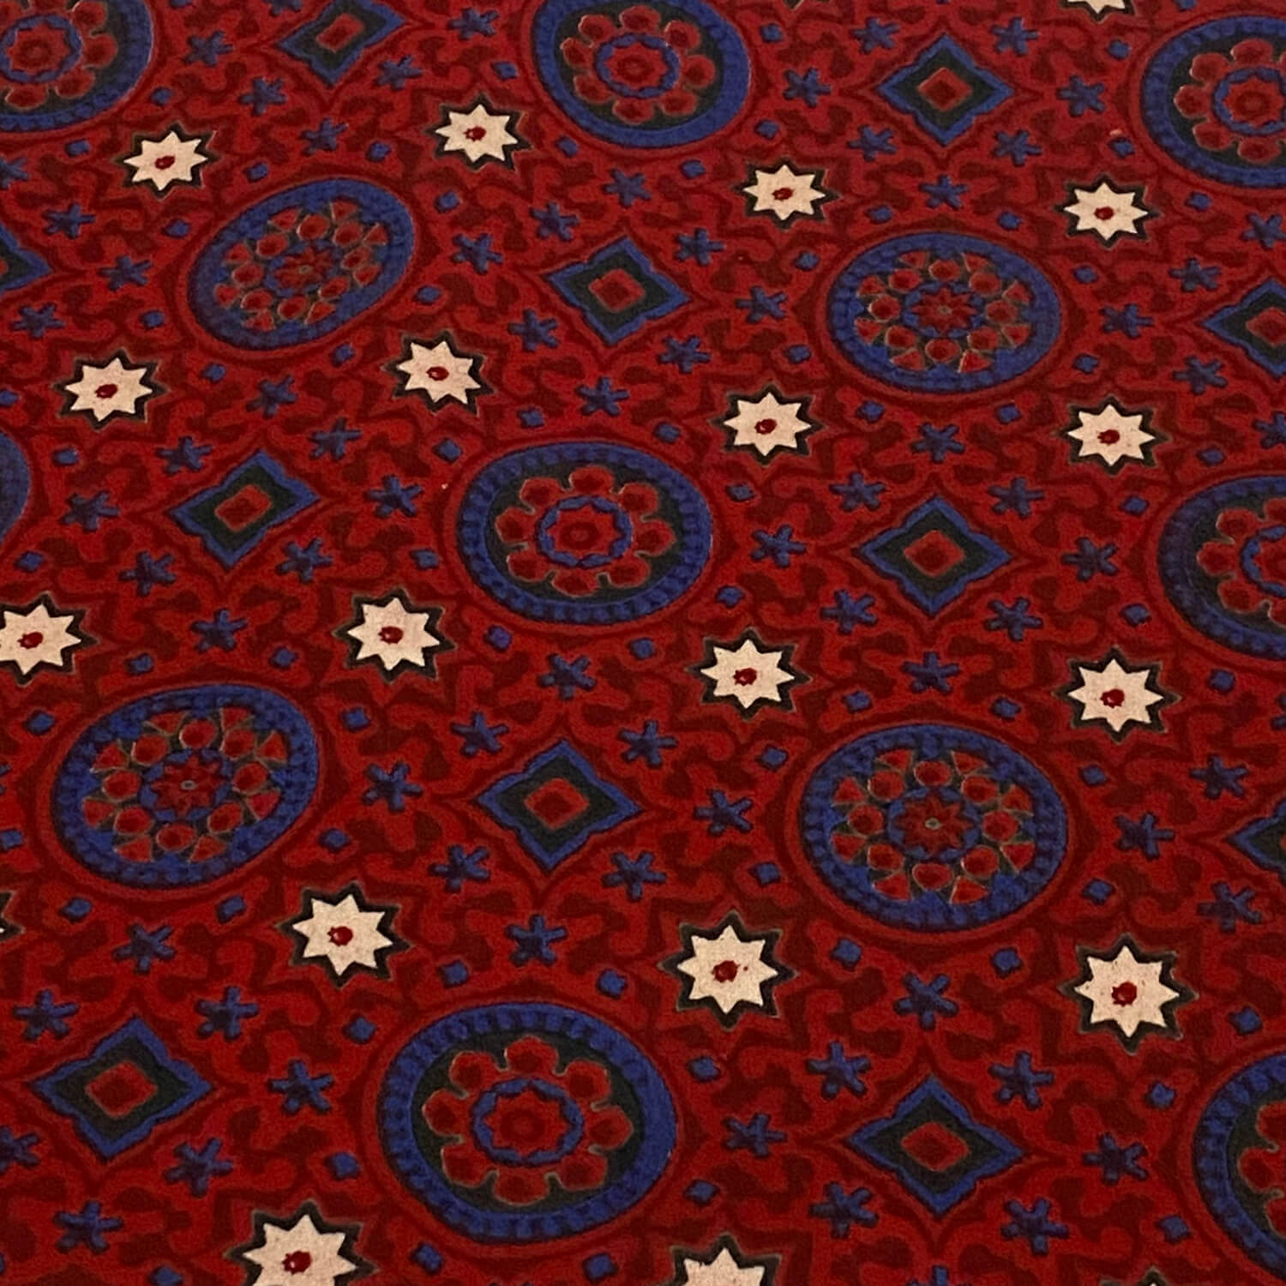
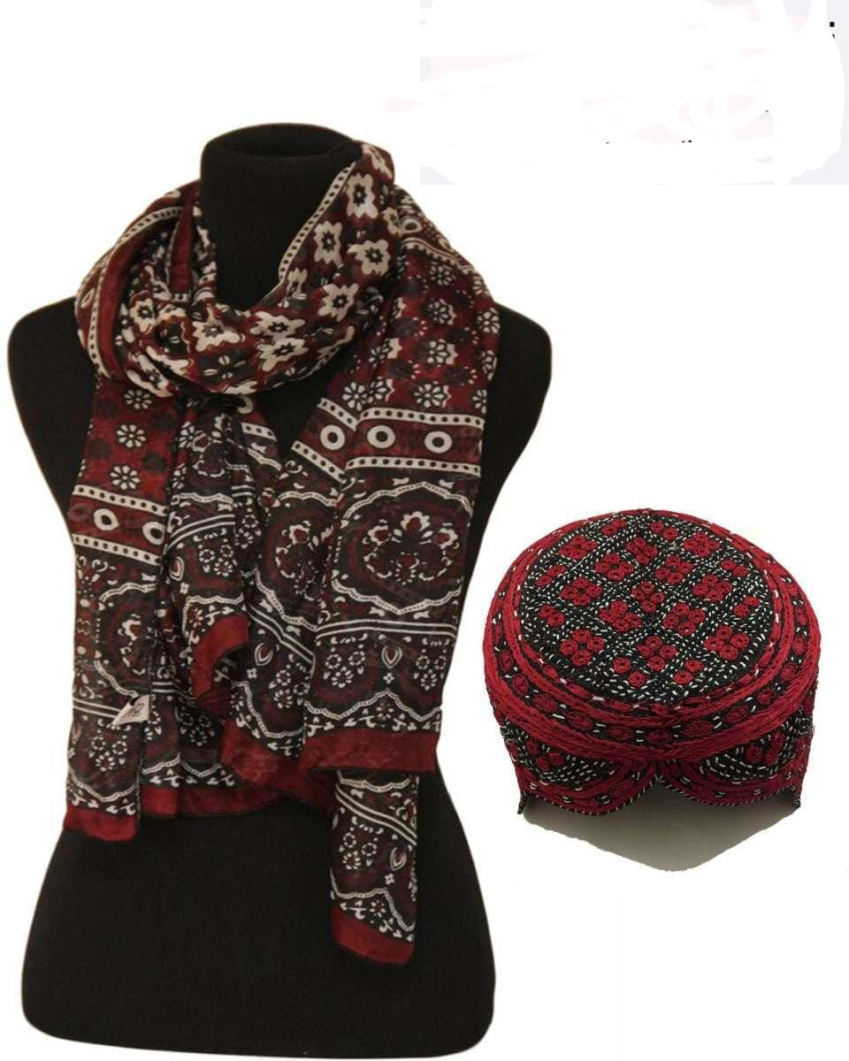
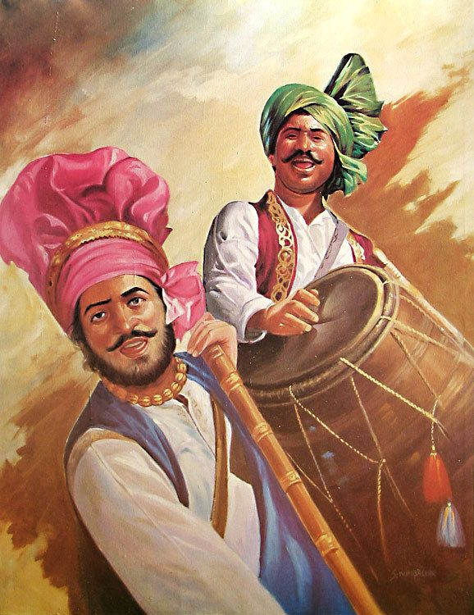
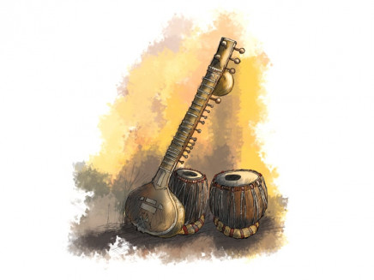
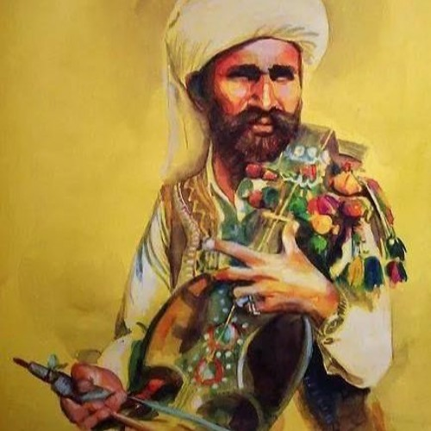
Symbols of Our Regions
👀 CULTURE YOU CAN SEE
👳
🧢
👗
Sindhi
Punjabi
Pashtun
Balochi
Ajrak
Pagri
Pakol
Embroidered dress
Block-printed shawl
Traditional turban
Woolen cap
Detailed needlework
Sindhi topi
Phulkari
Peshawari chappal
Mirror work
Embroidered cap
Colorful embroidery
Leather sandals
Shisha designs

Slide 4
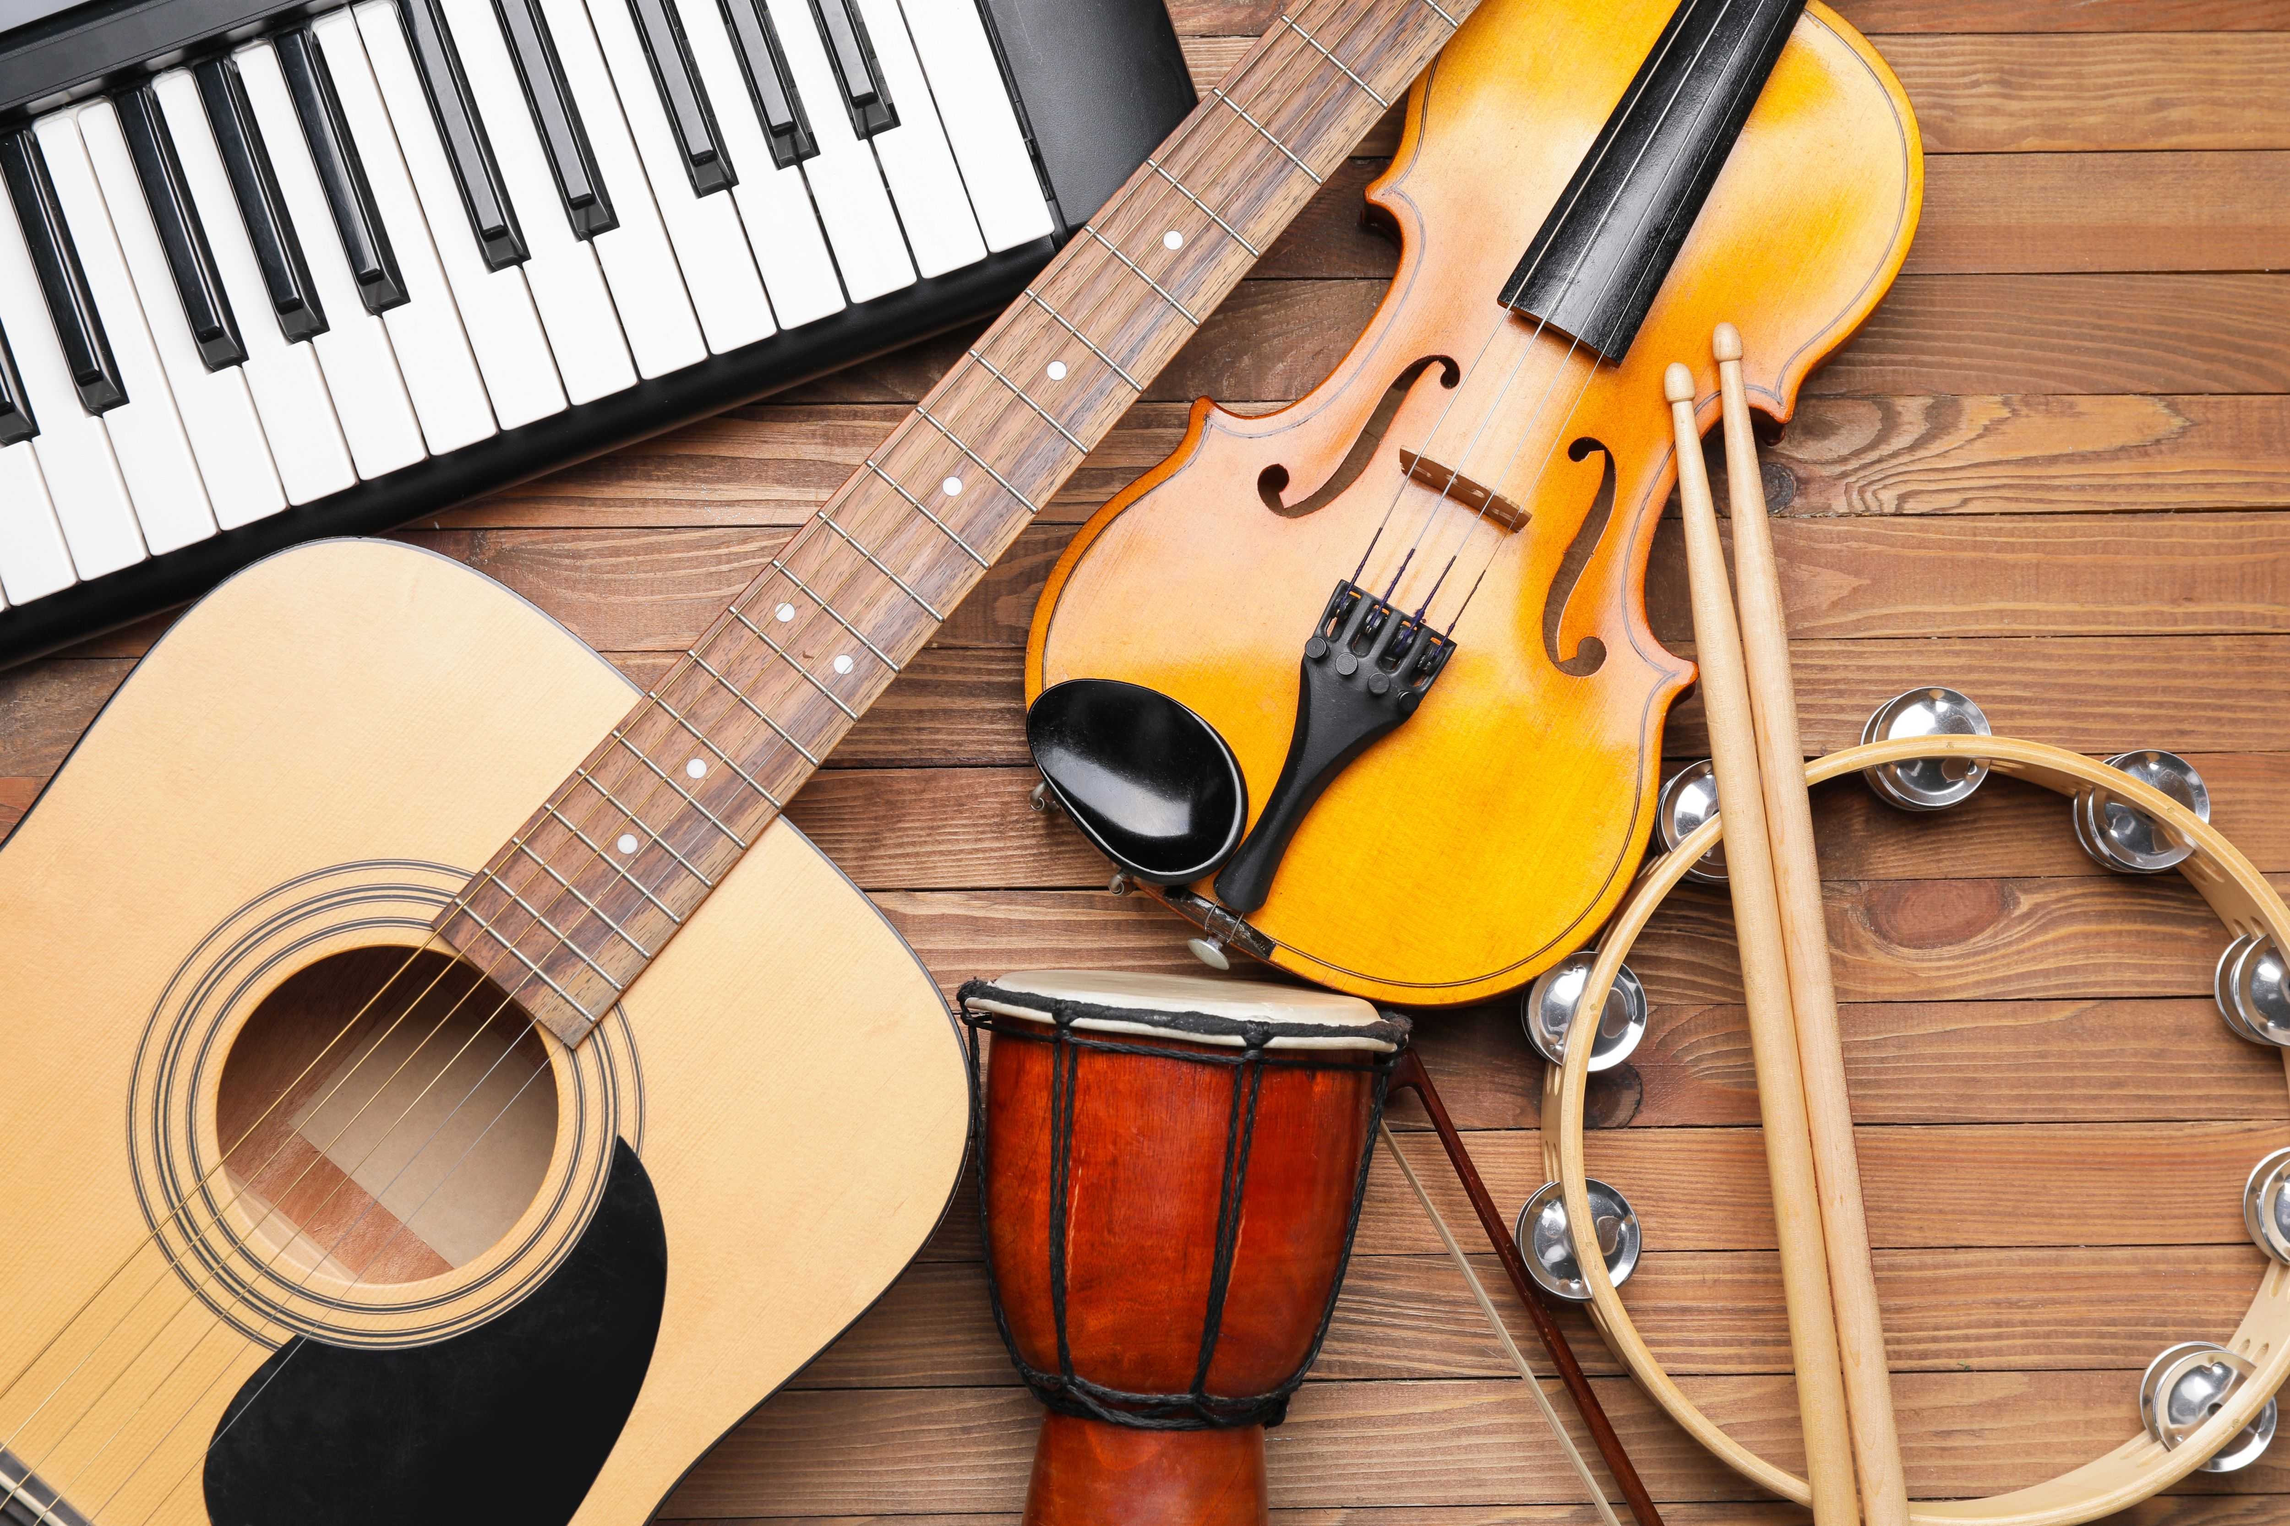
Music Keeps Culture Alive
Reflects traditions and daily life.
Connects generations.
Respect our own and other cultures.
🎧 Listen
🧭 Explore
🤝 Respect

Slide 5
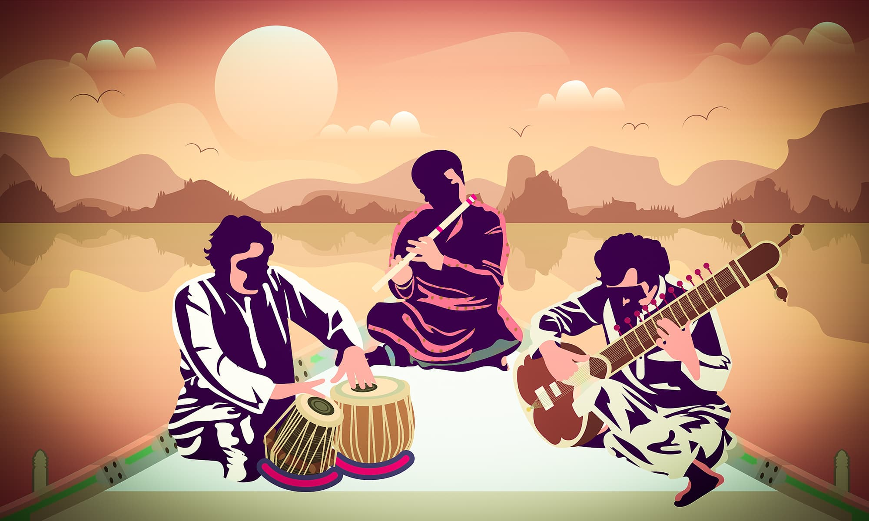
Music in
Pakistan
🎶 DIFFERENT STYLES, SOUNDS AND CULTURAL TRADITIONS
🎼 Classical
🪘 Folk
🌙 Sufi & Qawwali
🎧 Modern

Slide 6
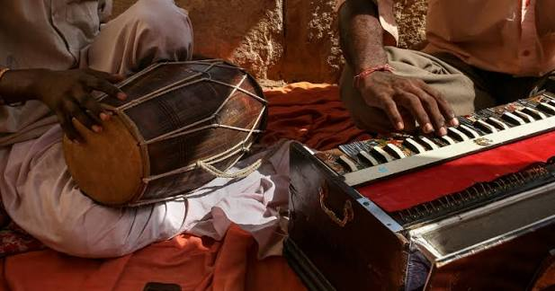
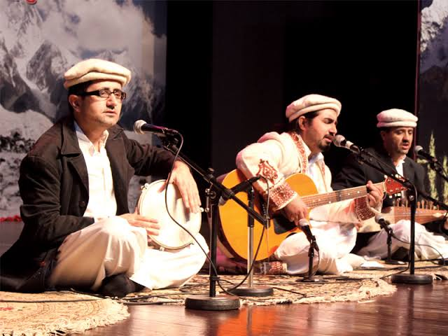
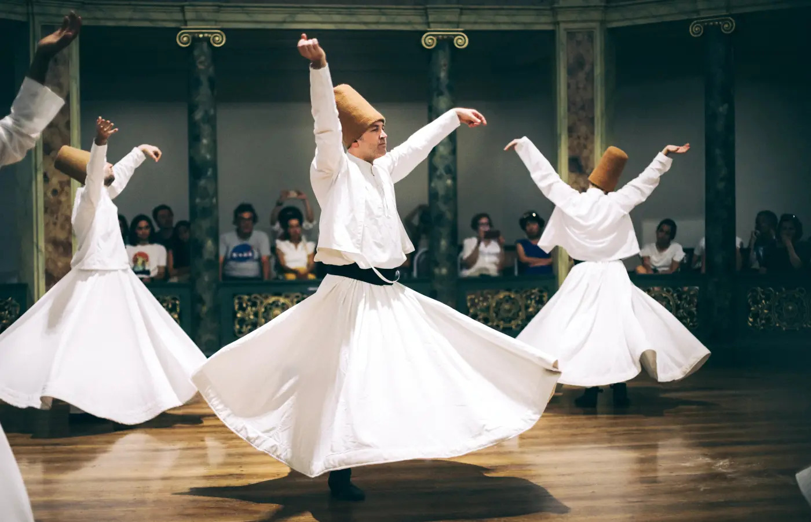
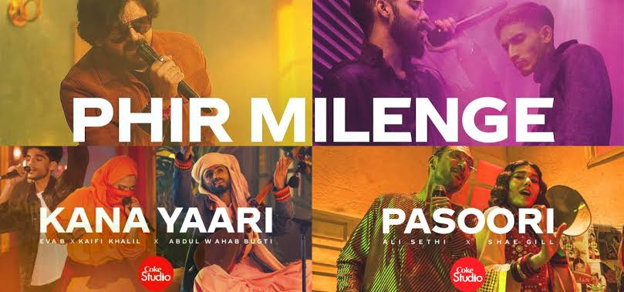
Genres of Music in Pakistan
🎶 DIFFERENT STYLES, SOUNDS AND CULTURAL TRADITIONS
🎼 Classical Music
🪘 Folk Music
Traditional melodies and singing.
Music connected to regional cultures and traditions.
Famous artists: Mehdi Hassan, Ustad Amanat Ali Khan
Famous artists: Alam Lohar, Reshma
Pakistan has many different types of music. Each type has its own sound, instruments and cultural importance.
🌙 Sufi & Qawwali Music
🎧 Modern Music
Pop, rock and rap music popular among young people.
Spiritual music expressing love and devotion.
Famous artists: Nusrat Fateh Ali Khan, Abida Parveen
Famous artists: Nazia Hassan, Atif Aslam
🎵 Some music is traditional, while other styles are modern.

Slide 7

Traditional Music of Pakistan
Classical Music
Regional Folk Music
Traditional singing based on ragas and rhythm. Instruments include sitar and tabla.
Every region has its own musical traditions:
Sindhi music: Alghoza
Balochi music: Soroz
Qawwali
Pashto music: Rabab
A spiritual style of music performed by groups of singers, often accompanied by harmonium and tabla.
Kashmiri music: Traditional folk instruments and songs
Punjabi Folk Music
Popular traditional music featuring instruments such as dhol and tumbi.
🎶 Traditional music keeps Pakistan’s culture and heritage alive.

Slide 8

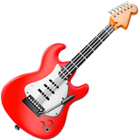


Modern Music in Pakistan
🎧 MUSIC TODAY
Pop Music
Rock Music
Hip-Hop and Rap
Music Fusion
Catchy songs with modern beats and melodies
Music featuring electric guitars, drums and energetic performances
A combination of traditional Pakistani instruments and modern music styles
Music based on rhythm, poetry and spoken lyrics
Famous artists: Young Stunners
Famous artist: Abida Parveen
Famous artist: Atif Aslam
Famous artist: Ali Azmat

Slide 9

References
Sources for the genres, history and artists covered in this presentation.
🪘 CLASSICAL, FOLK & REGIONAL TRADITIONS
Parvez, A. (2016, October 16). The evolution of subcontinental music. Dawn.
https://www.dawn.com/news/1290329/the-evolution-of-subcontinental-music
🌙 SUFI & QAWWALI MUSIC
Qawwali. (n.d.). In Encyclopaedia Britannica.
https://www.britannica.com/art/qawwali
🎧 MODERN MUSIC: POP, ROCK & HIP-HOP
Yusuf, A. (2025, June 8). From Vital Signs to Young Stunners: The ever-evolving sound of Pakistan. The
News on Sunday.
https://www.thenews.pk/tns/detail/1318758-from-vital-signs-to-young-stunners-the-ever-evolving-sound-of-pakistan

Slide 10

The Evergreen
Evolution
🎵 A GENERATIONAL & PSYCHOLOGICAL EXPLORATION
How Generations Relate to Music
From the complex storytelling of the golden era to the repetitive, vibey hooks of Gen Z, and why timeless classics still bridge every gap.
🕰️ Golden Era
🎼 Timeless Classics
📱 Gen Z

Slide 11


Understanding Music Listening: Then & Now
🎧 A GENERATIONAL & PSYCHOLOGICAL EXPLORATION
Classic Listening
vs
Modern Listening
Boomers & Gen X
Gen Z & Modern
Appreciates deep, long-form stories
Enjoys complex & layered music
Connects with personal memories
Loves catchy & instant hooks
Prefers simple & repetitive beats
Connects with vibes & relatable moods
🎶 Both find deep joy in music, just in different ways!

Slide 12
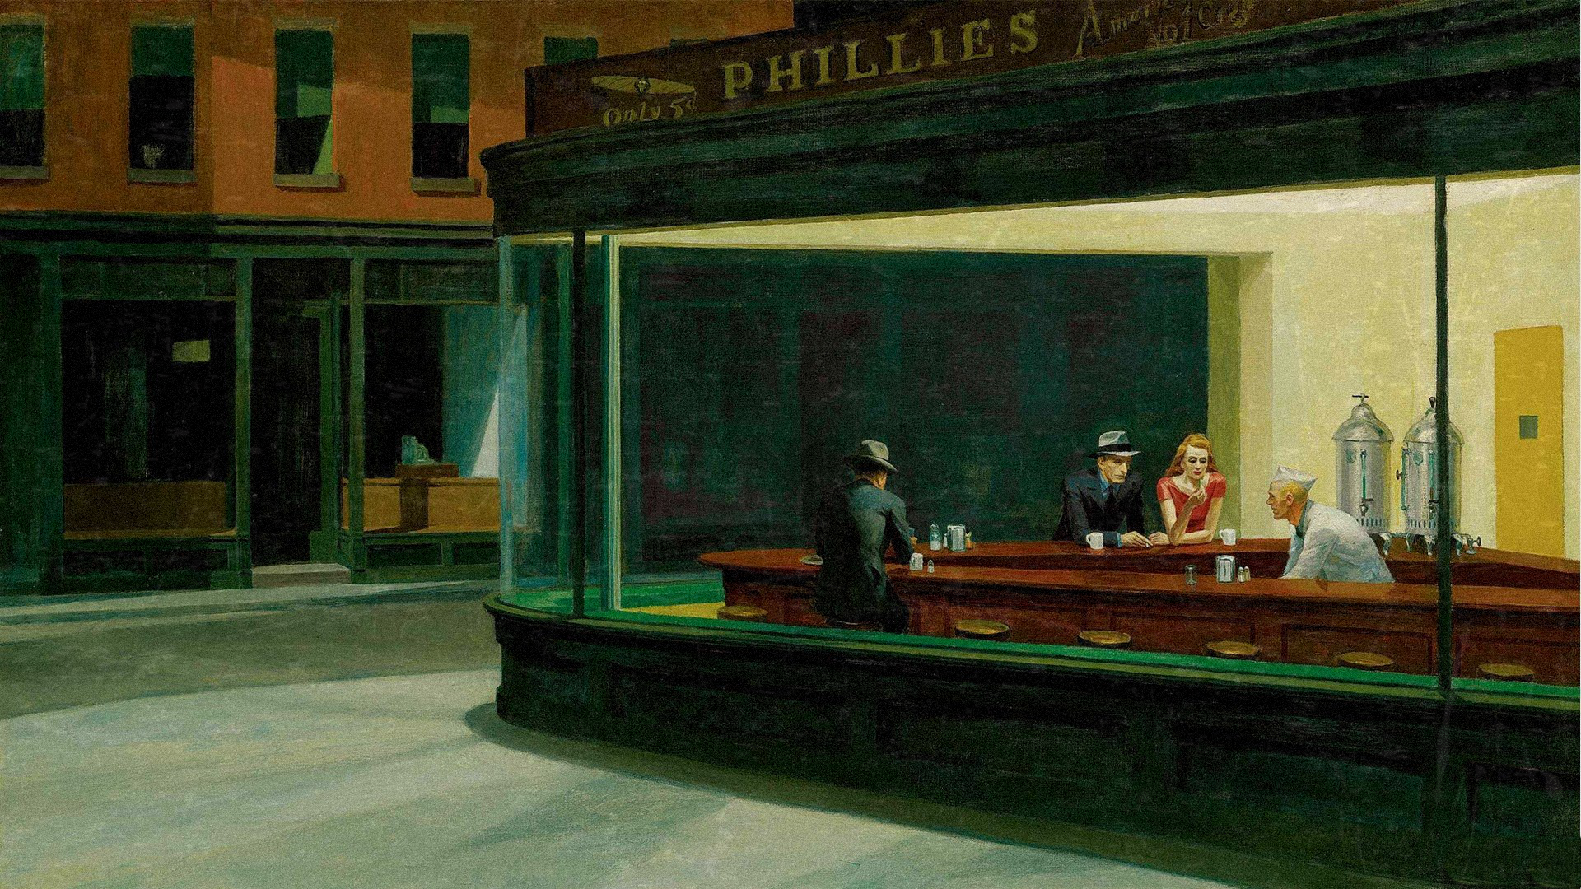
How Pakistani Music Evolved
MUSIC THROUGH THE DECADES · 1950S–90S
1950s–70s
1980s–90s
The Golden Foundation
Bands & Pop Explosion
Ghazals, pop & PTV
Rebellion and Sufi Rock
Poetry and vocal artistry on Radio Pakistan, then youthful pop and PTV.
Disco Deewane (1981) and Dil Dil Pakistan (1987). Junoon fused Sufi poetry with rock.
Noor Jehan, Mehdi Hassan, Lata Mangeshkar
Nazia Hassan, Vital Signs, Junoon, Nusrat Fateh Ali Khan
2000s–10s
2020s
Studio & Ballads
Indie & TikTok
Atif Aslam and Coke Studio (2008) set the blueprint. Streaming made ballads like “Tum Hi Ho” easy to reach.
A Gen Z wave
Indie artists and short-form video drive new hits, including global viral “Pasoori” (2022).
Atif Aslam, Arijit Singh
Abdul Hannan, Hasan Raheem

Slide 13
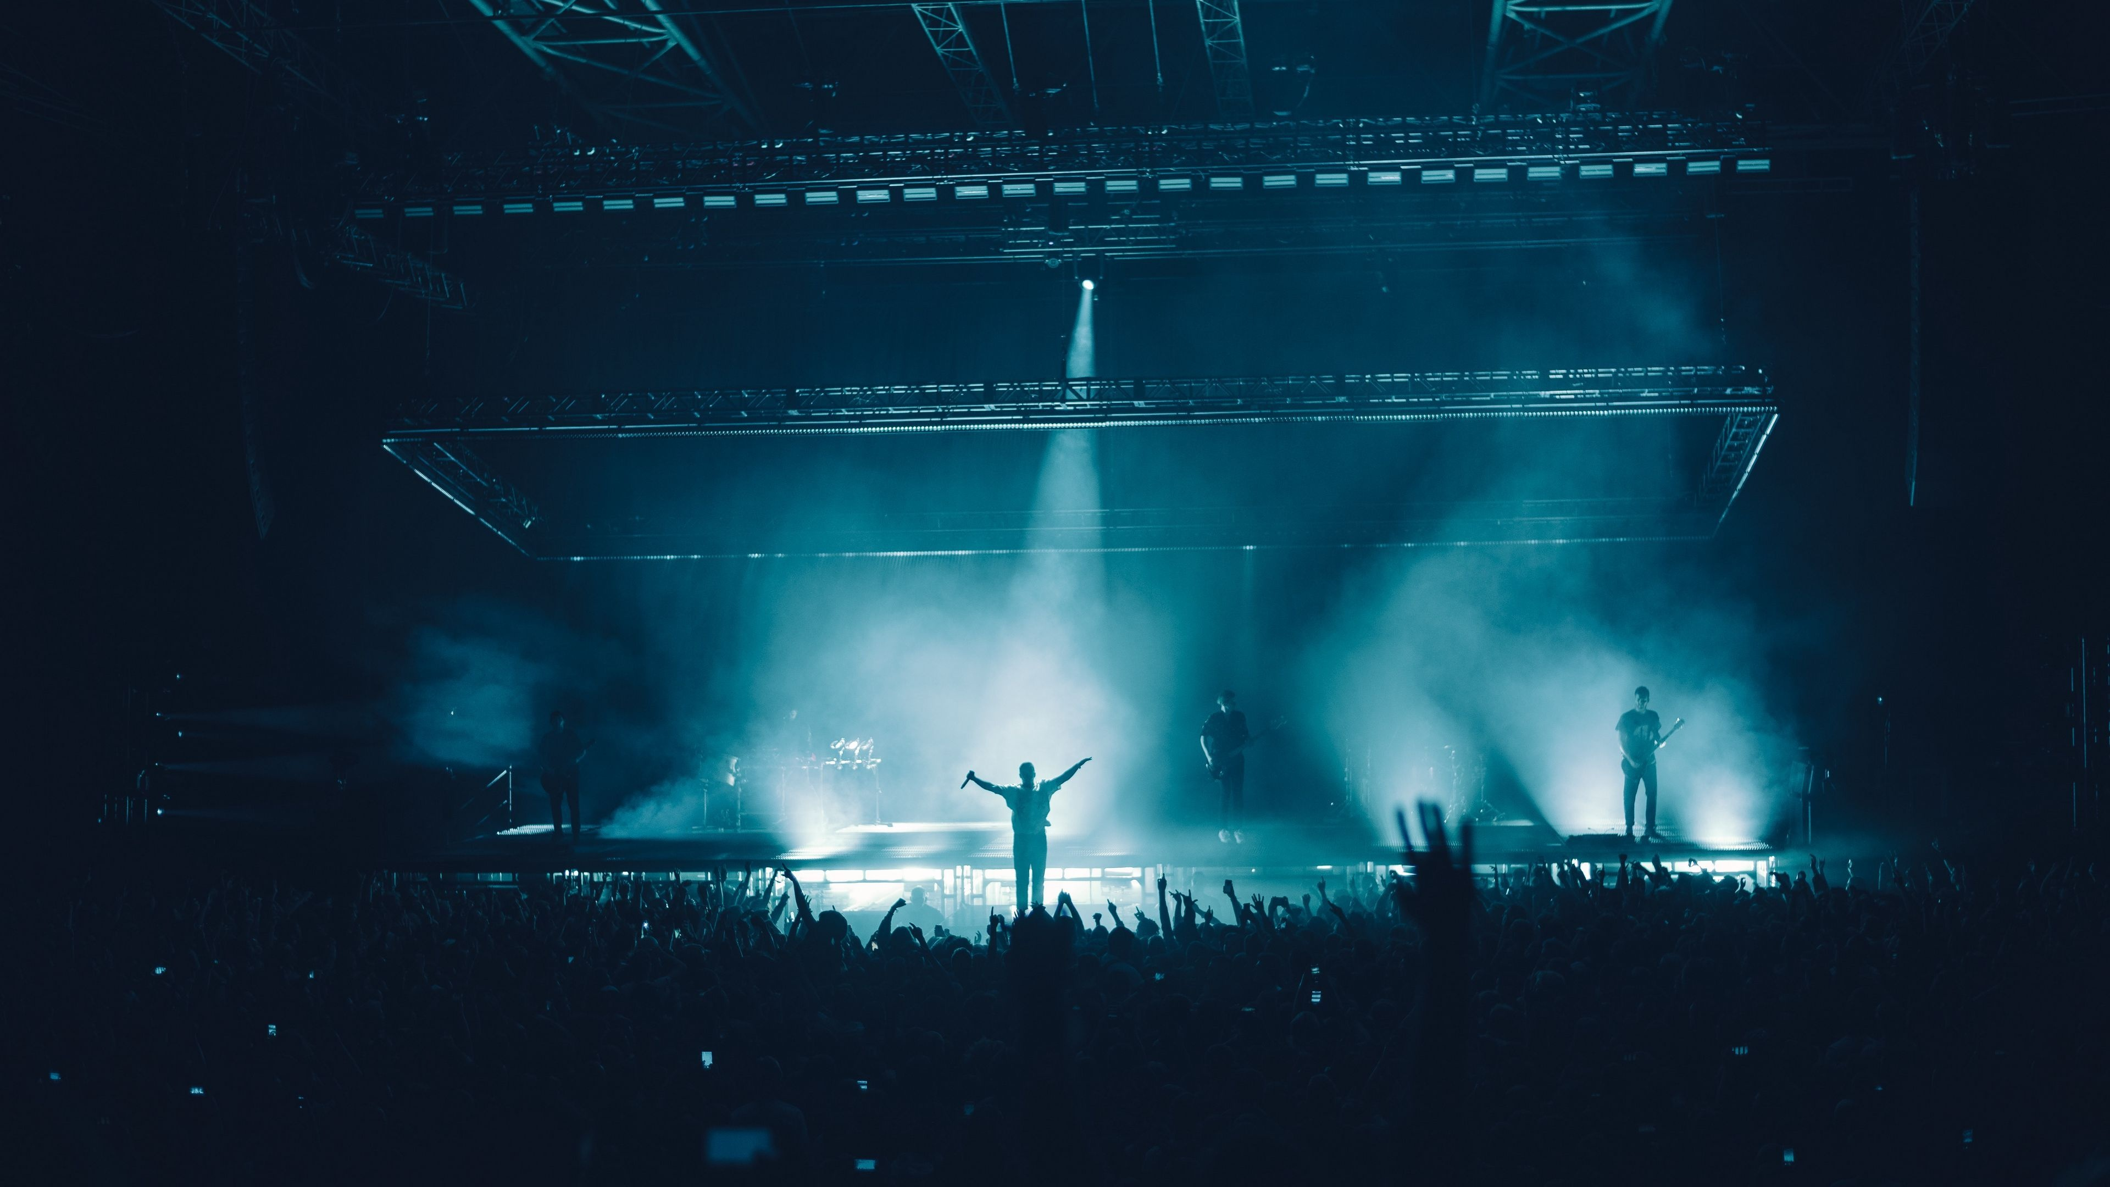
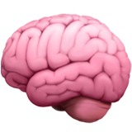
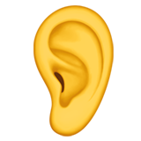
Why Simple & Repetitive Music Connects Easily
🧠 COGNITIVE SCIENCE
Processing Fluency
Mere Exposure Effect
Repetition Dynamics
Listeners form positive feelings toward music that requires lower cognitive effort to process.
→
→
Repeated exposure to catchy chorus lines rapidly increases liking and earworm retention.
Musical repetition pulls listeners in, making tracks easy to sing along with immediately.
🎶 The easier music is to process, the more we love it!

Slide 14
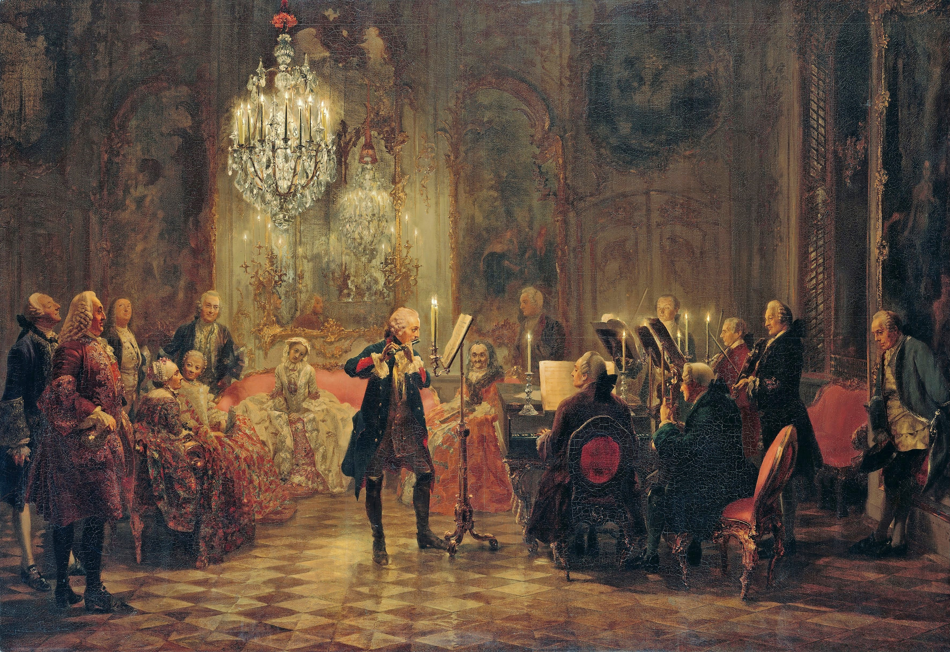
Scientific Findings on Song Evolution
📊 EMPIRICAL DATA
📉 Linguistic Complexity
🔁 Structural Repetitiveness
🌍 Readability & Vocabulary
Falling
Rising
Simpler
IMPACT ON LISTENING
IMPACT ON LISTENING
IMPACT ON LISTENING
Low cognitive effort for passive multitasking.
Optimized to become instant earworms.
Global accessibility for non-native listeners.
✨ Simpler songs mean easier listening and a bigger reach!

Slide 15
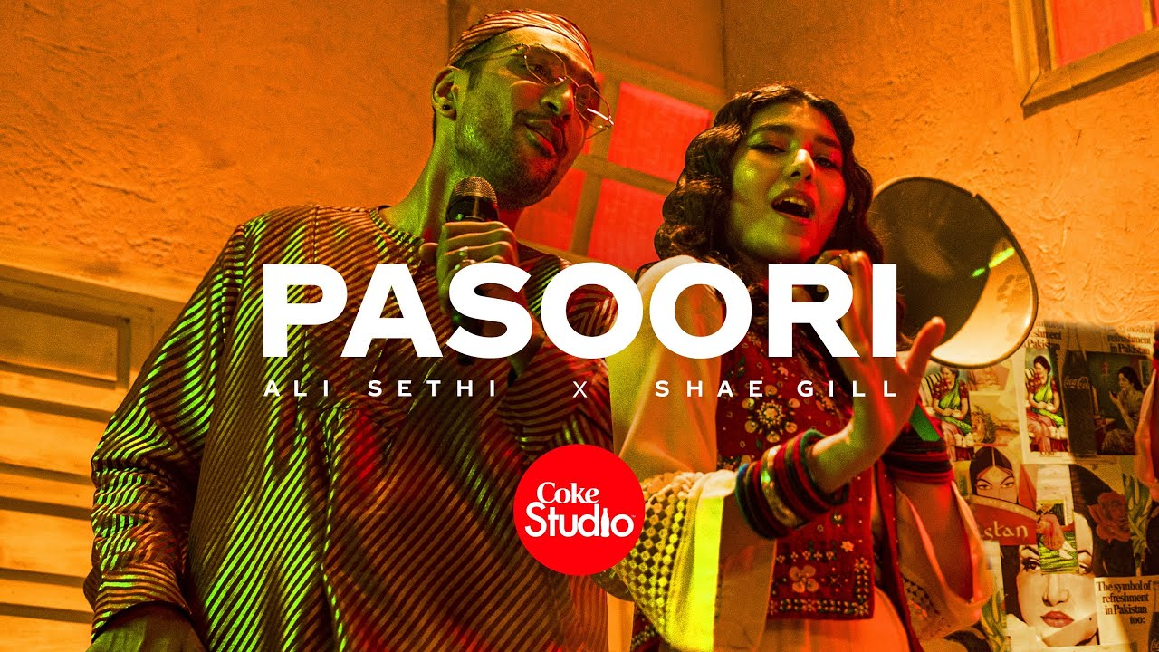
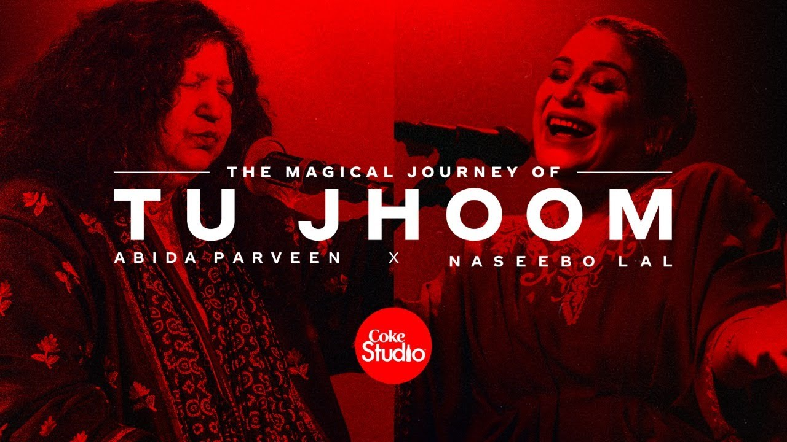
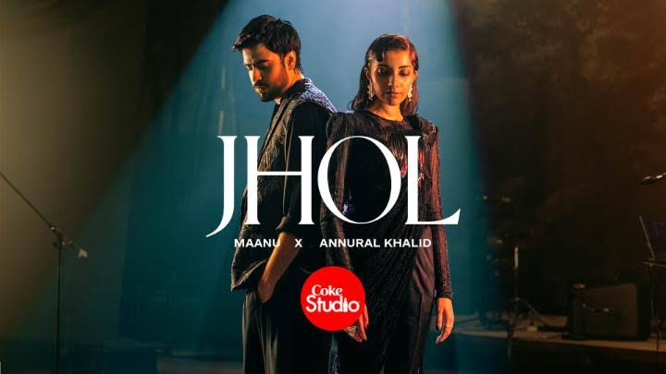
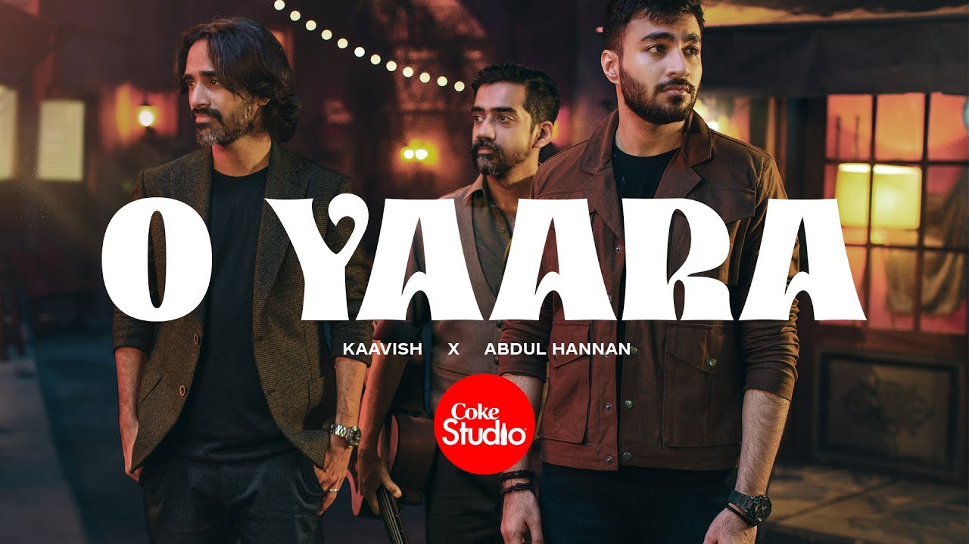
Two Eras, One Shared Love of Music
🎼 CONCLUSION & SYNTHESIS
The Symphony of Innovation & Memory
“Old music isn’t forgotten. It holds memories and soul that younger generations actively seek out.”
While Gen Z listens to modern repetitive music for fast moods, they turn to older classics for emotional depth and ancestral nostalgia.
Old Is Gold
Modern Is Adaptive
Old songs offer a rich, full-course meal of lyricism and nostalgia, keeping generations connected to heritage.
Gen Z music serves a fast, digital world, offering immediate relatability, ambient vibes and catchiness.
Survivorship Bias: Only the absolute best old songs survived, making the past look exceptionally rich.
Simple Is Not Shallow: Plain words in modern songs carry deep personal emotion without complex poetry.

Slide 16
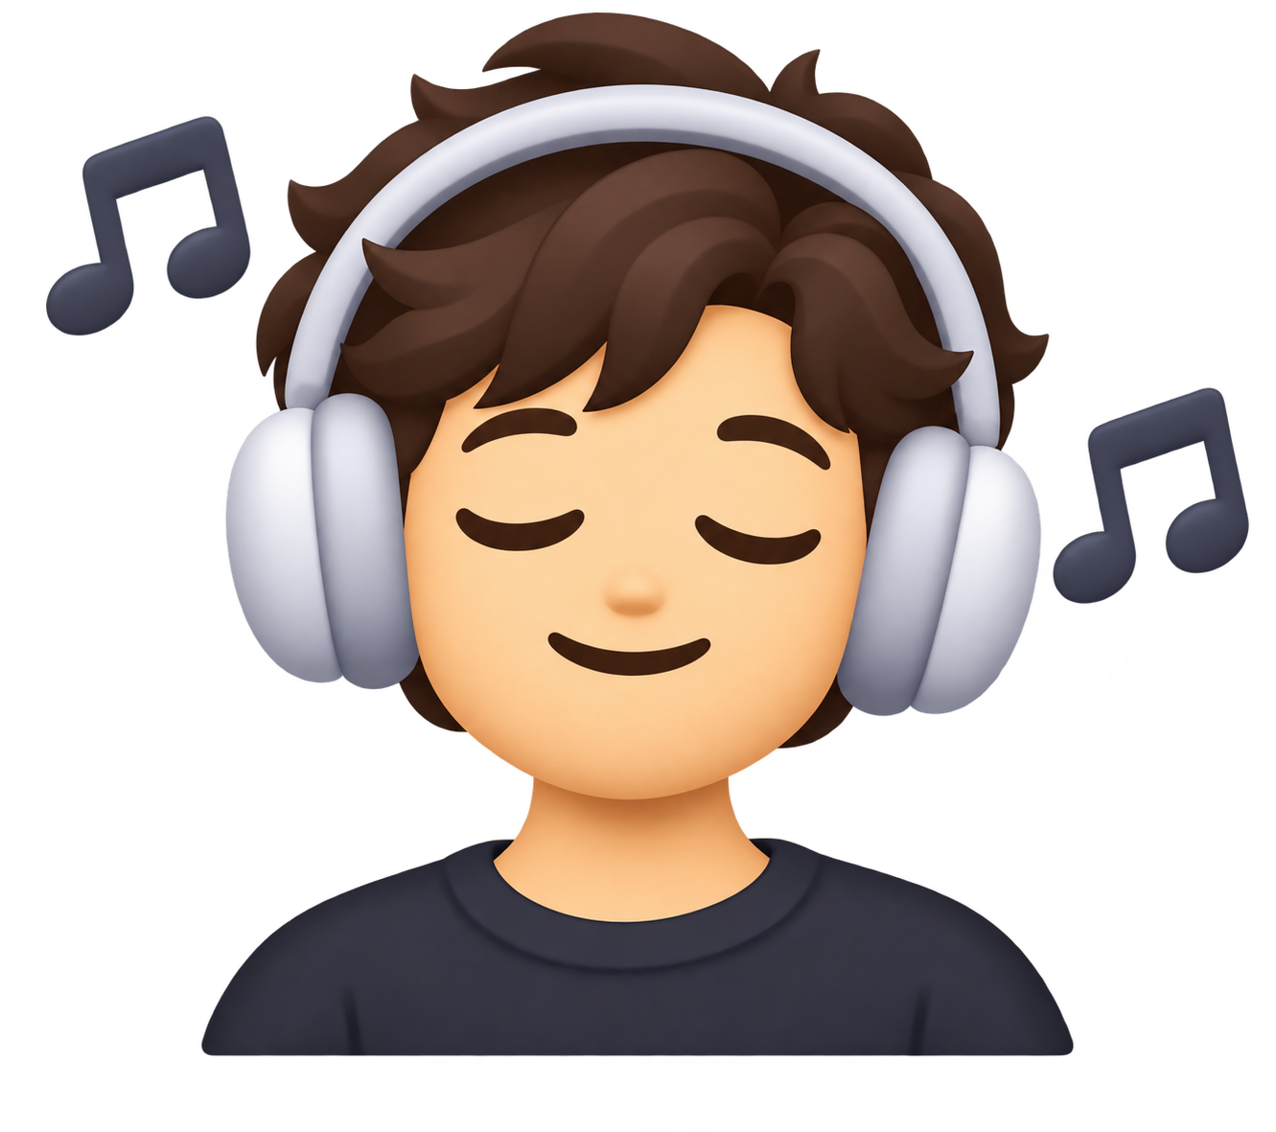
Effects of Music
on the Human Brain
🎧 MUSIC & THE BRAIN
Why music feels good, takes us back in time, and moves our bodies
✨ Feels good
⏰ Time machine
🫀 Hijacks your body

Slide 17
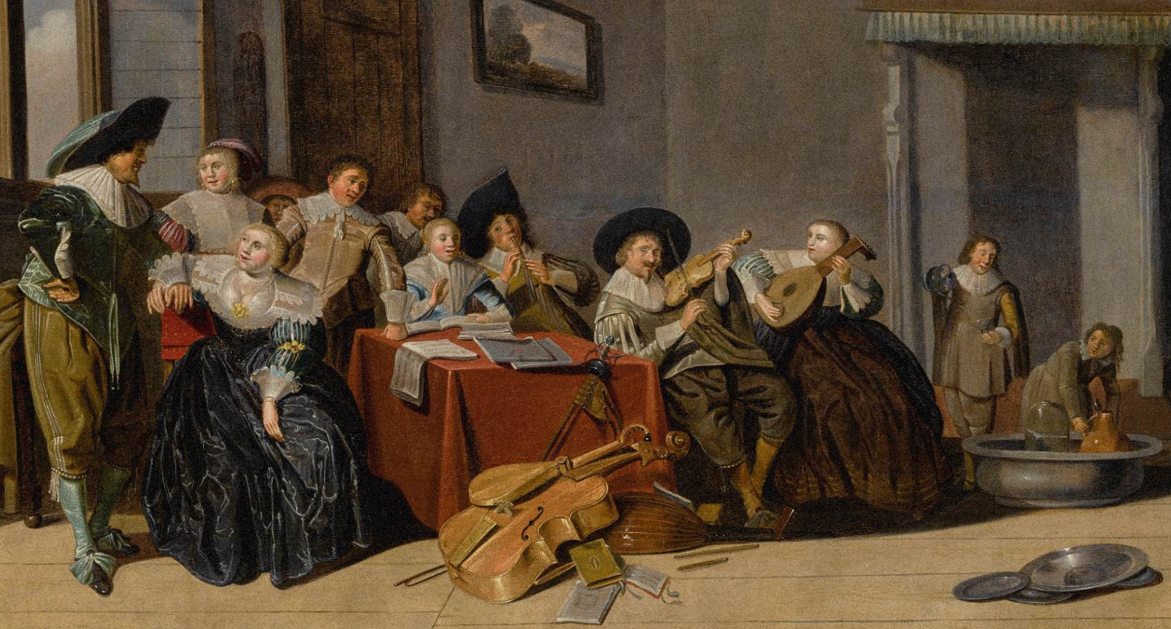
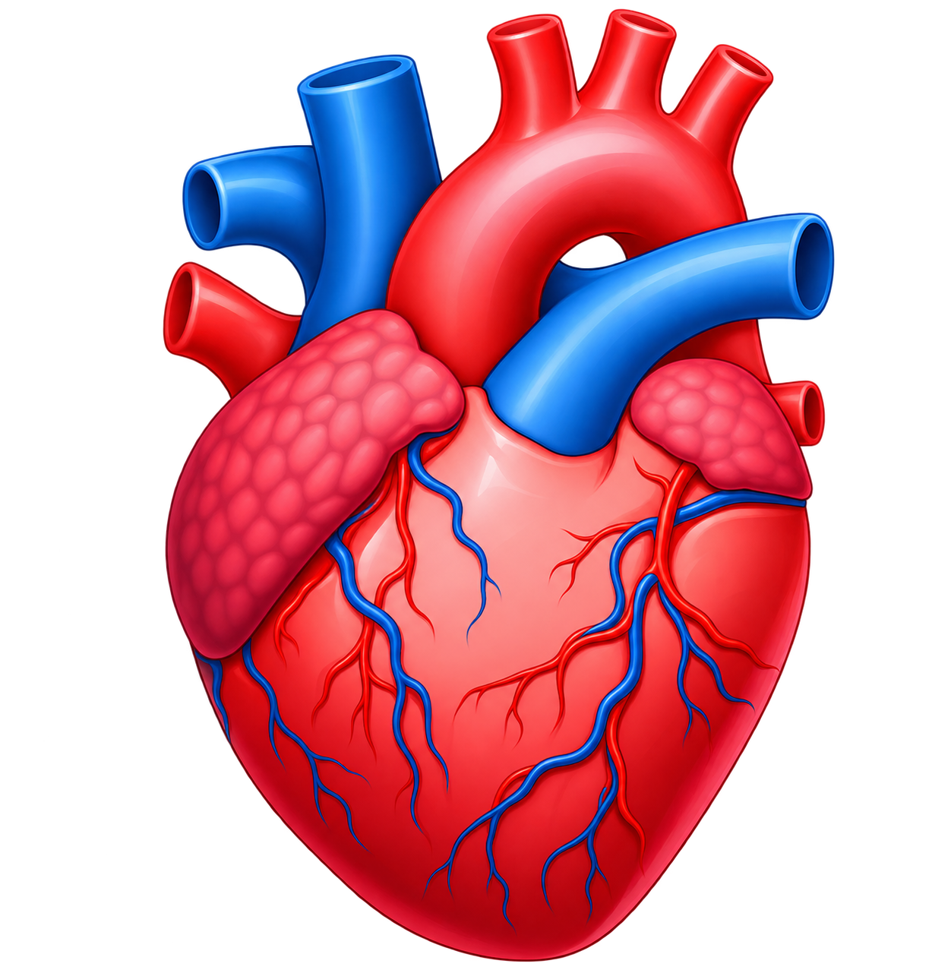
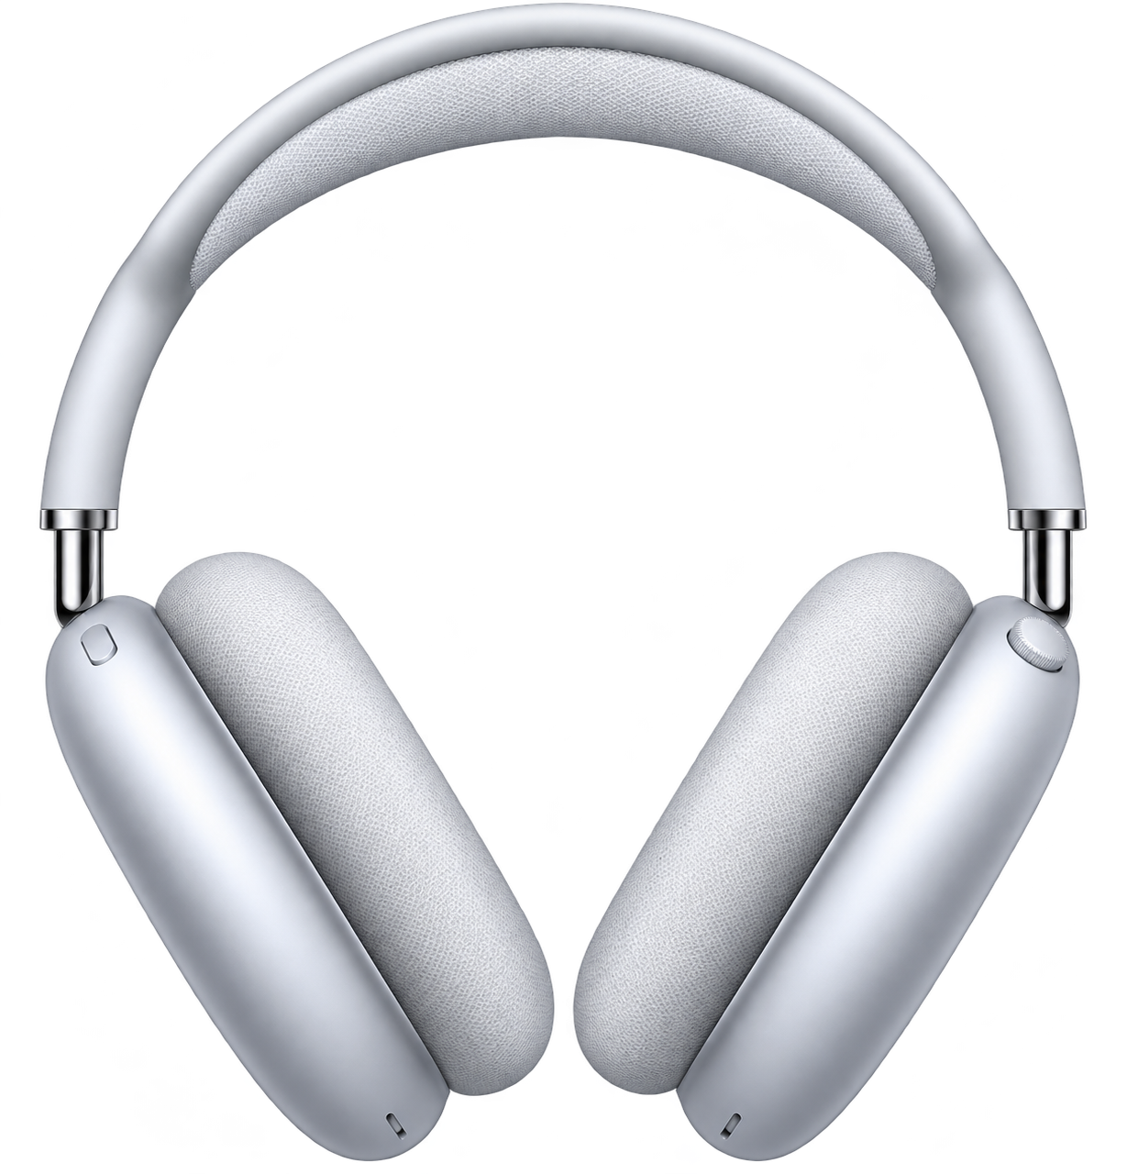
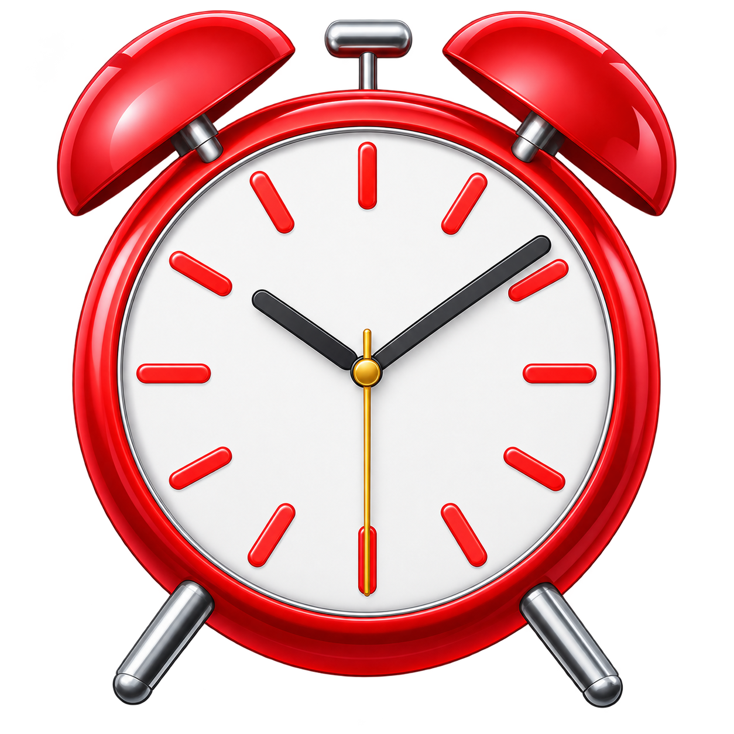
KEY POINTS
MUSIC & THE BRAIN
01
02
03
Why Music feels good to listen to
Why Music acts as a time machine
Why Music physically hijacks your body

Slide 18
Why Music feels good to listen to
✨ WHY IT FEELS GOOD
The Anticipation
Your brain is a pattern prediction machine. When a song is being played, your brain constantly tries to predict the next beat or drop. This anticipation releases dopamine in the brain, which gives you pleasure. This is why when you repeatedly listen to the same song, it doesn’t hit the same anymore. This is because your brain has already learnt all the patterns, and there is nothing left to predict.
Brain Activation
Most activities (such as reading or solving math problems) use only one region of the brain. Music is an activity that engages every part of your brain, including auditory processing, emotion centers, motor regions and memory networks.

Slide 19

Why Music acts as a time machine
💭 MEMORY & EMOTION
The Amygdala
The Amygdala is a part of your brain that handles emotional responses such as sadness, fear, anxiety as well as feelings of reward & pleasure. Different songs make you feel emotional in different ways. Because music is so closely linked to emotional feelings, it causes you to remember whatever feelings you had back when you listened to the song for the first time.
Instant Snapshot Recovery
Because the melody, rhythm and beats of a song remain identical throughout the years, even if you listen to it years later it will instantly take you back to those moments.

Slide 20
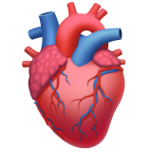
Why Music physically hijacks your body
🫀 BODY & MOVEMENT
Subconscious Movements
Normally, when you move, your brain has to think about it first and then send electrical signals to your body to complete the action. However, music bypasses this “thinking barrier” and goes straight to your brain’s movement control center. This causes you to perform involuntary movements according to the music’s tempo, such as bobbing your head or tapping your foot.
Heart Beat
When your ears hear a rhythmic beat, your body automatically aligns itself to the beat’s tempo. Fast beats speed up your heart and force your nervous system to move. Slow beats pull your heart rate down, and force your muscles to relax.

Slide 21
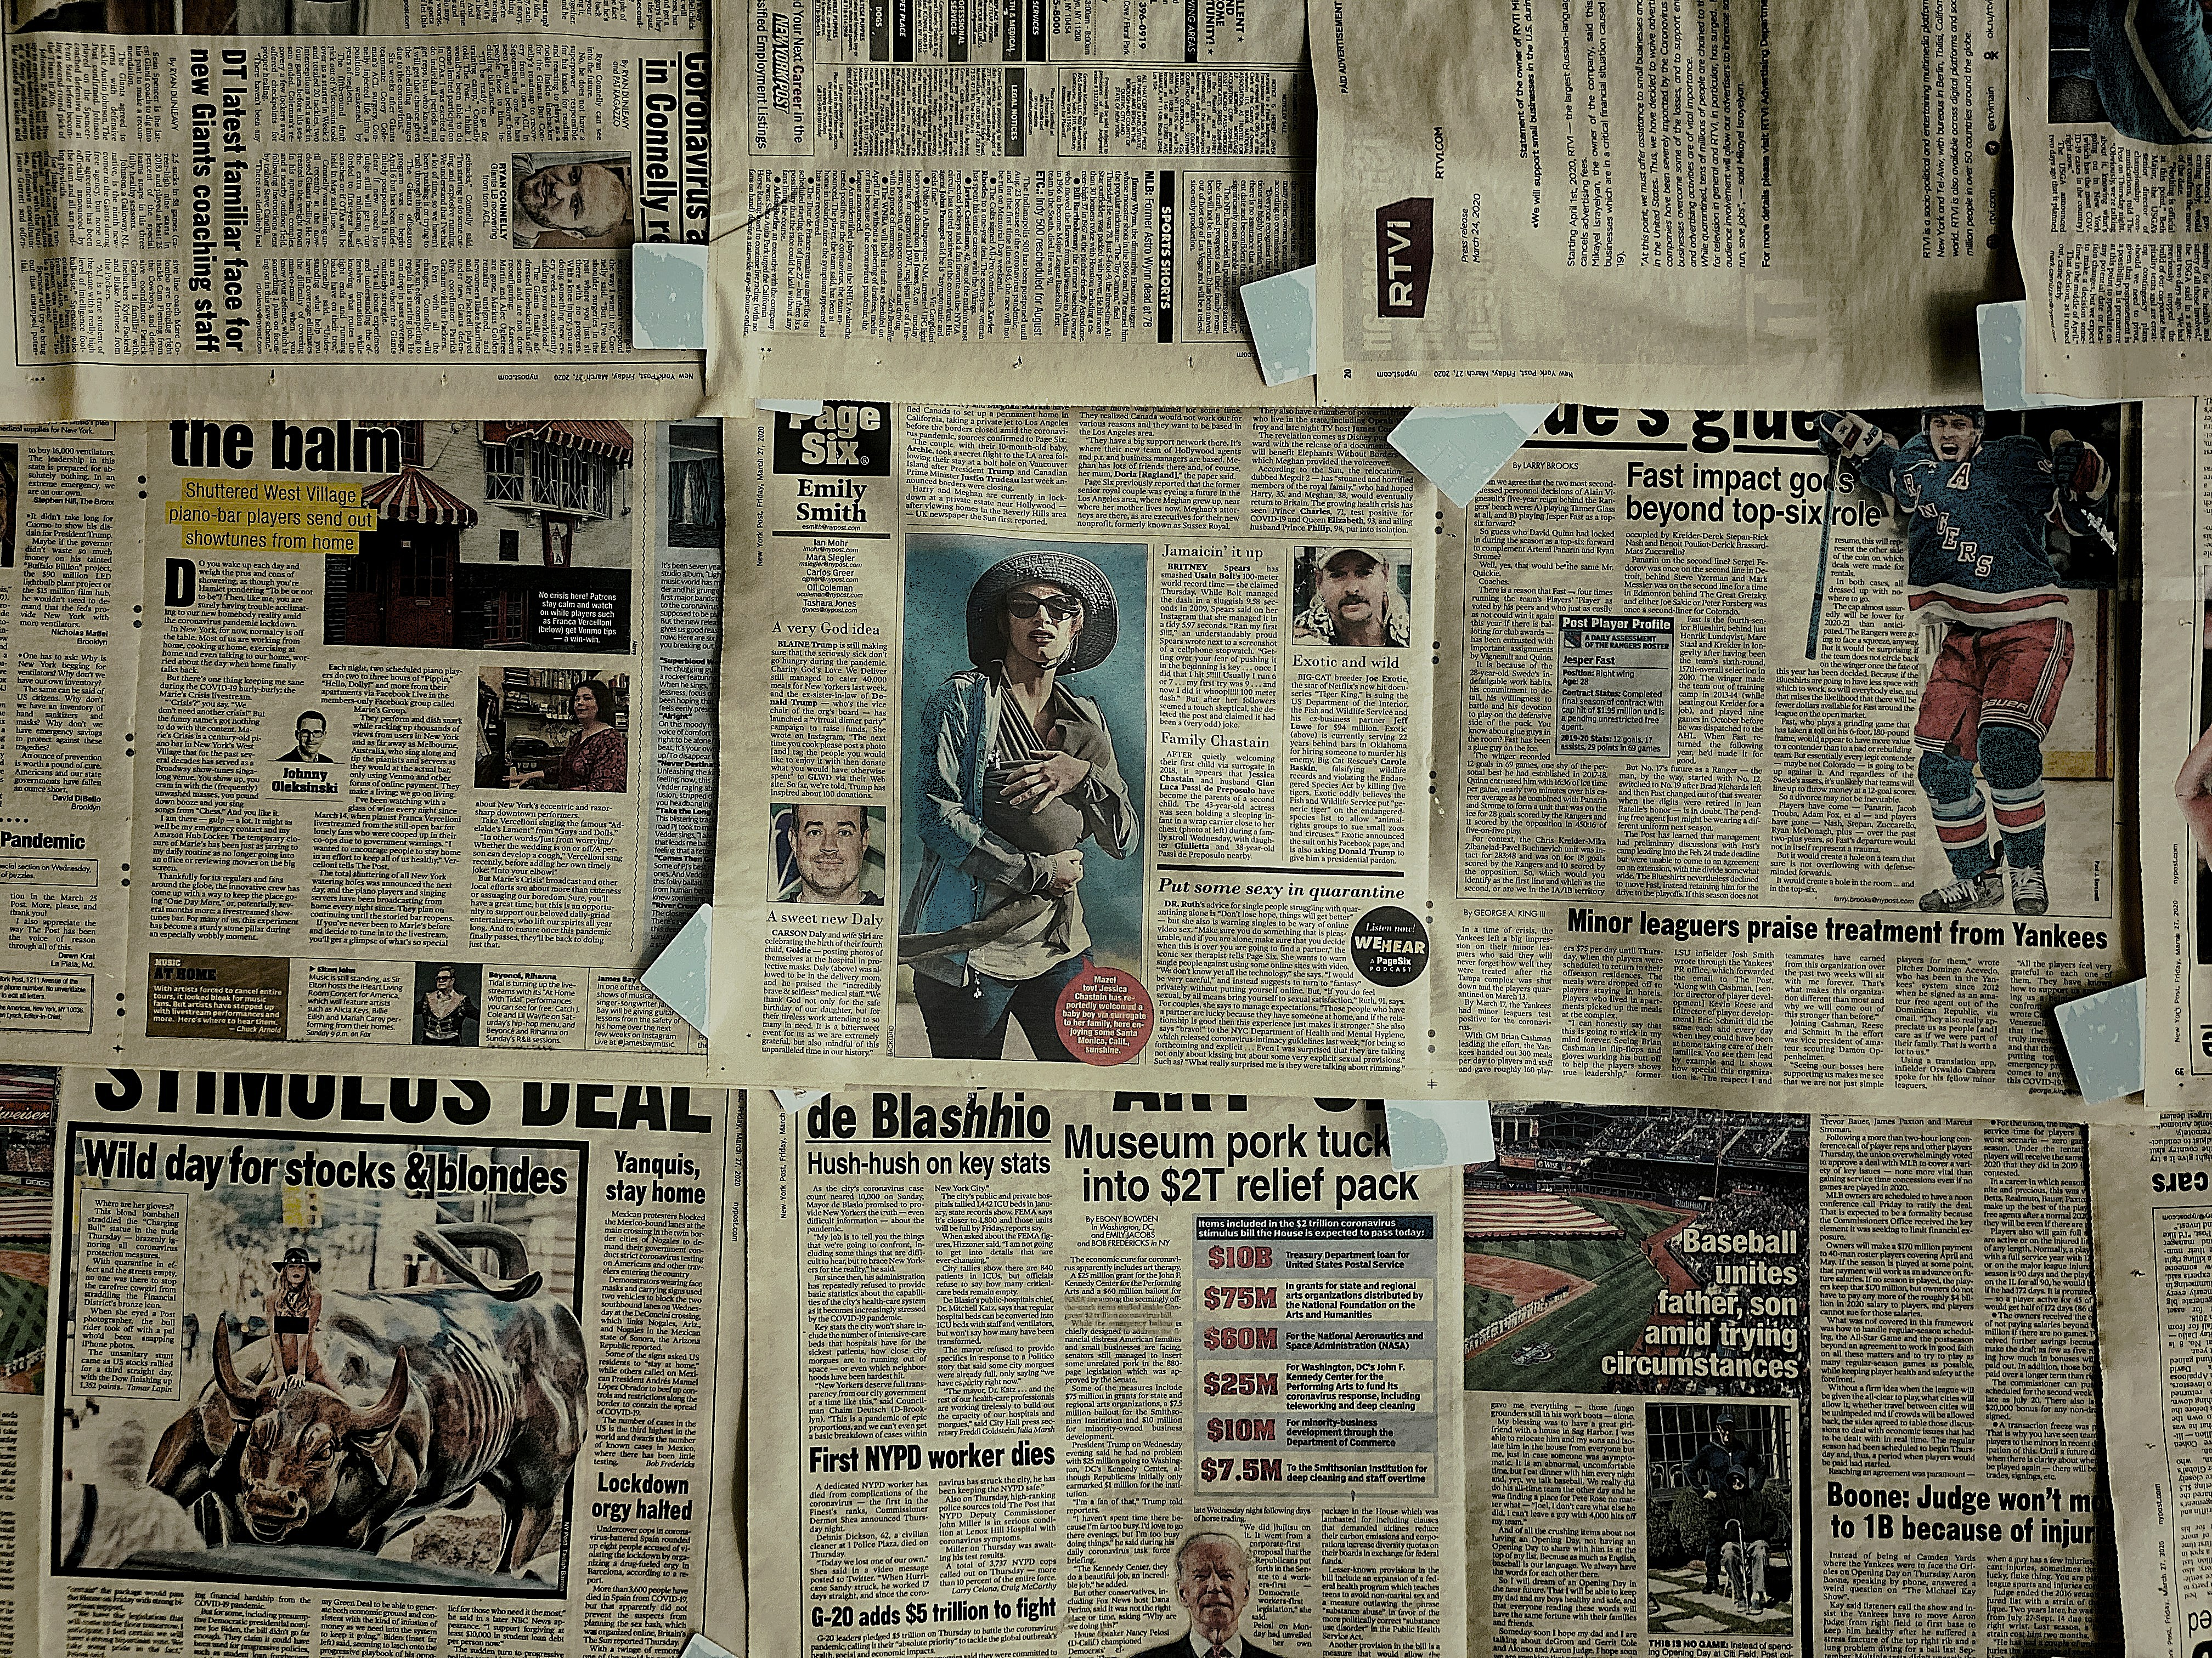
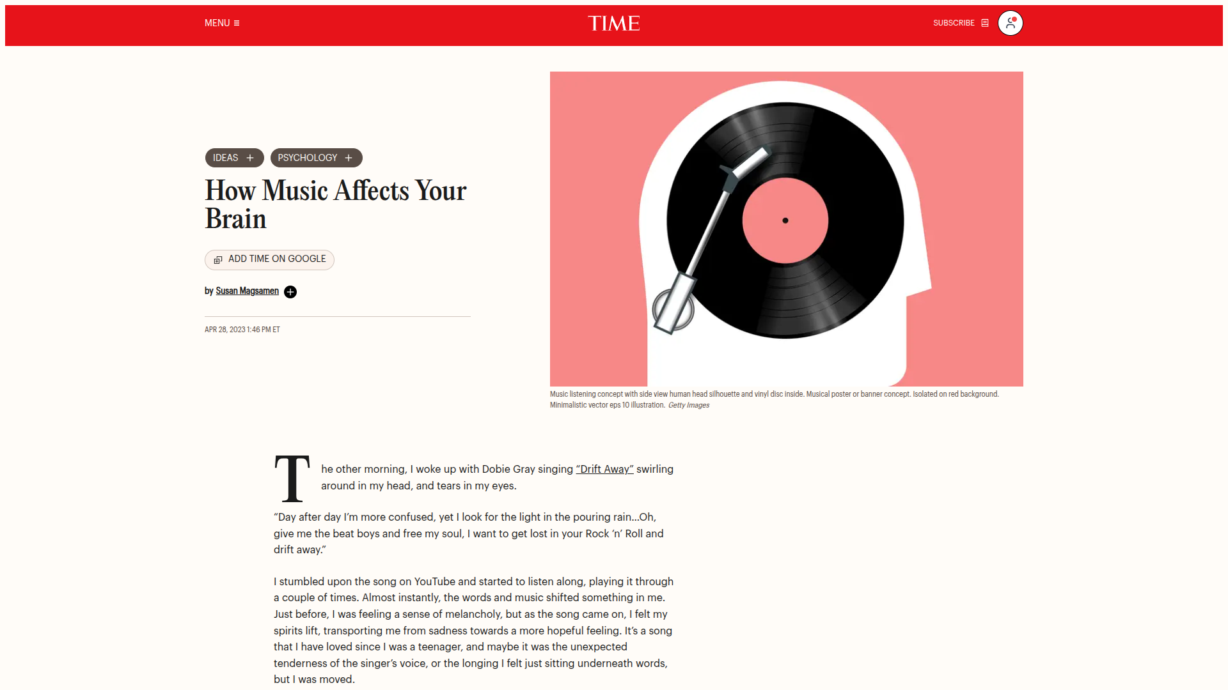
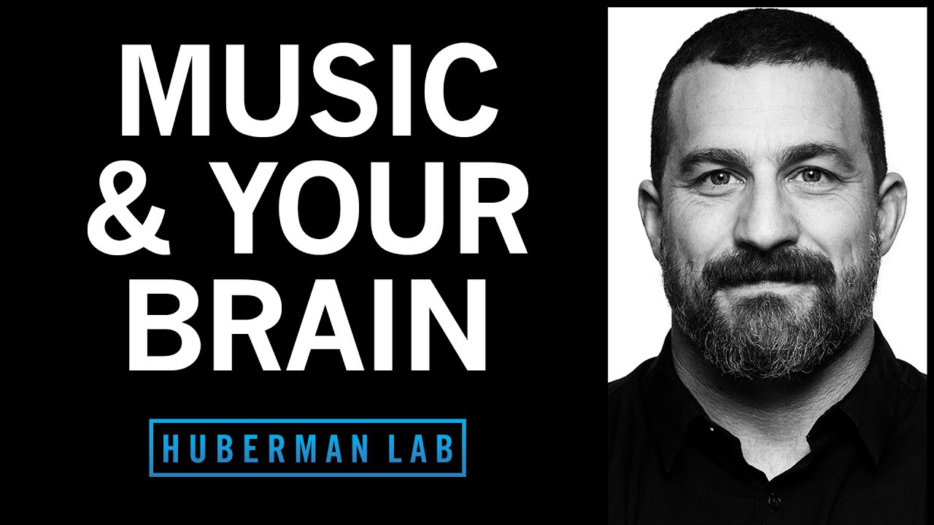
Sources
How Music Affects Your Brain
Music and Your Brain
https://time.com/6275519/how-music-affects-your-brain/
https://www.youtube.com/watch?v=gveDhZW-rUk&t
An article by Time Magazine on the effects of music on the brain.
A podcast episode by neuroscientist Andrew Huberman on how music affects human beings, and how to use it to your advantage.

Slide 22
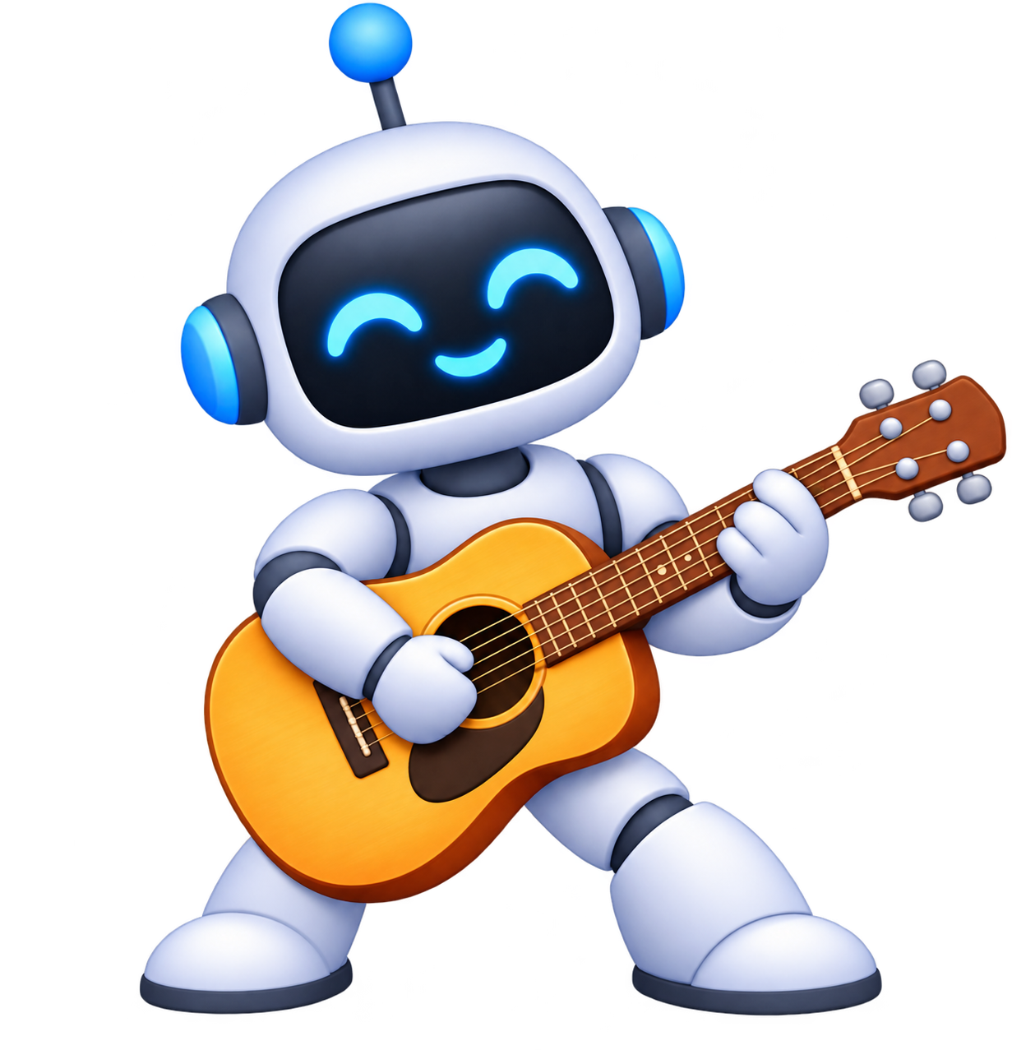
Music and
Technology
📝 HOW MUSIC EVOLVED
From vinyl to streaming to AI

Slide 23
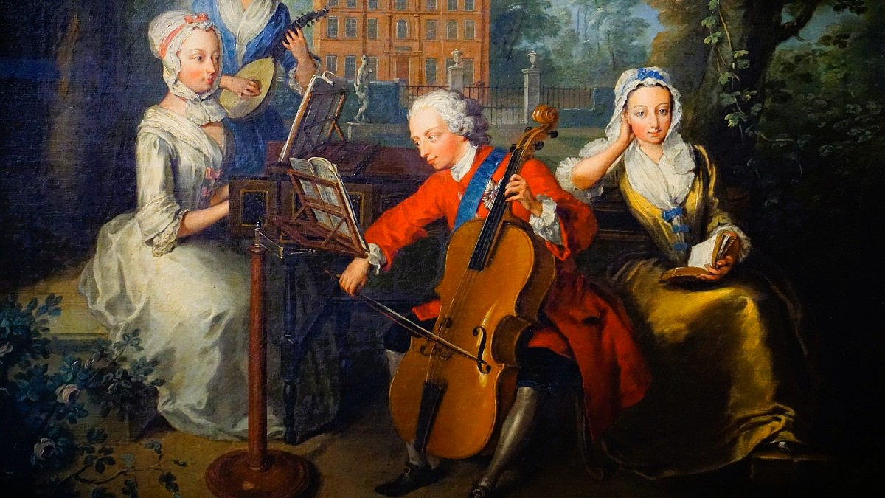


Technology Shapes Music
Every new invention changes how music is made, shared, and heard.
01
02
03
Made
Shared
Heard
Studios, synthesizers, and software create the sound.
Records, files, and the internet move songs around the world.
Turntables, Walkmans, and phones decide where we listen.

Slide 24
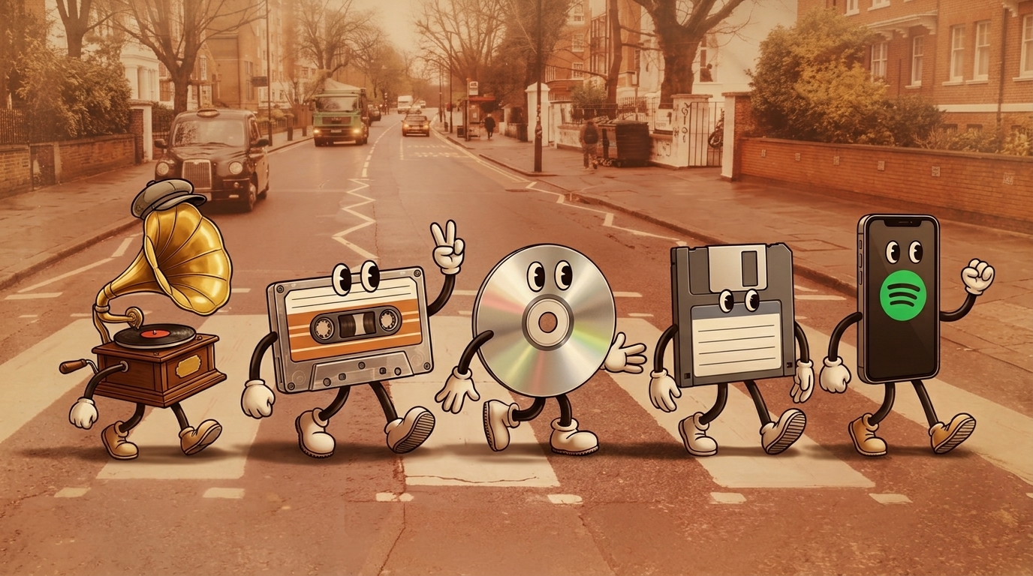
From Vinyl to Streaming
From Vinyl to Streaming
Cassette
CD
MP3
Portable and recordable.
Digital sound on
a disc.
Songs become files.
Vinyl
Spotify
Long-playing records arrive.
A whole library in your pocket.
Each step made music easier to carry and easier to get.

Slide 25



Streaming Changed the Deal
$10B
1,000
~70%
Paid out by Spotify in 2024, up from $1B in 2014.
Streams a year a track needs to earn royalties on Spotify.
Of surveyed European artists were unhappy with streaming income.
Great for listeners. For many artists, the pay is a real concern.
Sources: Spotify; International Artist Organisation survey

Slide 26

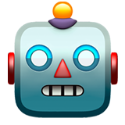

AI Generated Music
→
→
STEP 1
STEP 2
STEP 3
Prompt
Model
Song
Describe the genre, mood, and lyrics in text.
A generative model trained on huge collections of recordings.
A full track with vocals in under a minute.
🛠️ Tools: Suno, Udio, ElevenLabs Music
Spotify allows AI music, encourages labeling it, and removes unauthorized voice clones.

Slide 27


What It Means for Artists
Opportunity
Concern
Quick demos and new ideas
Music tools open to beginners
Licensed AI models built with label deals
Models trained on songs without permission
Voice clones and fake tracks
A flood of uploads shrinks each artist’s share
⚖️ In 2024, major labels sued Suno and Udio. Some have since signed licensing deals, but the rules are still unsettled.

Slide 28
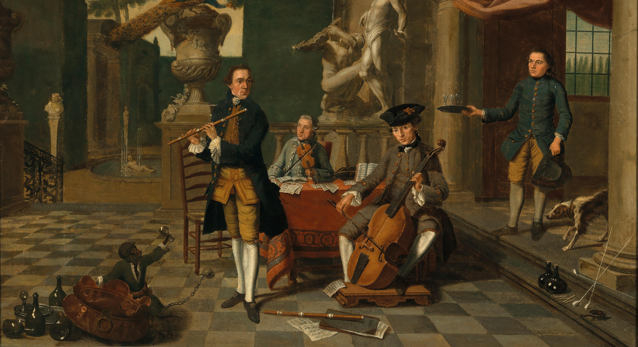
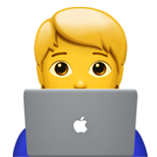


Music Keeps Evolving
Embrace
Think
Support
Use new tools to create and discover.
Ask how AI music is trained and who gets paid.
Credit and pay the human artists we love.
Thank you for listening!

