Slide 1
MASTER'S RESEARCH PROJECT
Smart Search
Semantic Code Search Engine for VS Code
Find code by what it does — not what it's called
Nawfal Jalloul
May 2026

Slide 2
THE PROBLEM
Traditional Search is Broken
You search for...
The function exists — it's just named differently:
"fetch product from database"
getProductInfo()
retrieveItem()
0
fetchFromDatabase()
RESULTS
loadProductById()
Traditional search: 0 matches. Smart Search: finds them all.

Slide 3
THE SOLUTION
Search by Meaning, Not Words
embed via Voyage AI
cosine similarity (HNSW)
"fetch product from database"
1,536-float vector
getProductInfo()
Natural Language Query
Semantic Vector Space
Code Function
82% similarity match — even with zero shared words between query and function name

Slide 4
ARCHITECTURE
Three-Layer Design
VS Code Extension
Python Backend
Cloud Services
TypeScript / Node.js
localhost:8000
External APIs
• File watcher
• ThreadingHTTPServer
• OpenAI GPT-4o-mini
• Code chunker (12 langs)
• GPT summarizer (parallel)
• Voyage AI voyage-code-2
• Hash store — index.json
• Voyage AI embedder
• Pinecone (HNSW)
HTTP
API
• Two-phase batch indexer
• Pinecone client
• namespace: {projectId}::{userId}
• Search UI webview
• Normal search (regex)
• Status bar
• /config

Slide 5
INDEXING PIPELINE
From File Save → Pinecone Vector
1
2
3
4
5
6
File Saved
Hash Check
Chunk Functions
GPT Summary
Embed 1,536 floats
Pinecone Upsert
onDidSave event
MD5 file + function
brace/indent 12 langs
parallel 50 at once
voyage- code-2
namespace isolation
🔒 Crash-safe: index.json saved after every batch — if interrupted, next run resumes from last checkpoint

Slide 6
KEY INNOVATION
GPT Summaries Bridge the Vocabulary Gap
CODE
GPT PLAIN-ENGLISH SUMMARY
public function getProductInfo($id) { $sql = "SELECT * FROM products WHERE id = ?"; $result = $db->query($sql, [$id]); error_log("Fetching: " . $id); return $result->fetch_assoc(); }
"Fetches a single product's full details from the database by its numeric ID. Executes a parameterized SQL SELECT query on the products table. Includes error logging of the requested product ID."
GPT-4o-mini summarizes
EMBEDDING SCORE IMPACT
Query
Without Summary
With Summary
Gain
"fetch product from database by id"
46%
82%
+36%
"check if user is authenticated"
38%
71%
+33%
"write product data to database"
41%
68%
+27%
"log error to file"
52%
74%
+22%

Slide 7
AI SEARCH PIPELINE
How a Query Becomes a Result
User Query
Voyage AI Embed
Pinecone HNSW
Threshold Filter
GPT Line Locator
Open File
"fetch product from DB"
1,536-float vector
top-10 nearest
≥ 35% score
exact line per result
line 47 highlighted
Both layers validate query length (frontend + backend safety net)
HNSW approximate nearest-neighbour sub-millisecond at any scale
All GPT line-locator calls fire in parallel — total ≈ one GPT call

Slide 8
UNDER THE HOOD
What a Vector Actually Is
ONE STORED FUNCTION
COSINE SIMILARITY
[0.21, −0.54, 0.87, 0.13, −0.92, 0.45, 0.71, −0.33, 0.58, 0.19, ··· −0.23, 0.67, 0.42, −0.88, 0.15]
sim(A, B) = A · B |A| × |B|
Measures the angle between two vectors. 1.0 = identical direction (perfect match) 0.0 = perpendicular (completely unrelated) Magnitude-independent — a 2-line function and a 50-line function can score equally.
← 1,536 floats total
Encodes ALL of:
Function name label
GPT plain-English summary
Why not Euclidean distance?
Raw code syntax & structure
Vector magnitude reflects text length, not meaning. Cosine ignores magnitude — only direction matters.

Slide 9
RESULTS
What It Actually Does
6/6
0.92
80%
82%
semantic queries found (0 by text search)
MRR — correct result almost always #1
Precision@5 — 4 of 5 returns are relevant
best cosine score (vs 46% without summary)
CONCEPTUAL QUERIES — NO KEYWORD OVERLAP WITH FUNCTION NAMES
Query
Traditional
Smart Search
Score
"fetch product from database"
0 results
getProductInfo()
82%
"check if user is authenticated"
0 results
assert_logged_in()
74%
"calculate total order price"
0 results
computeLineItemTotal()
68%
"delete item from cart"
0 results
removeCartItem()
73%

Slide 10
ENGINEERING
4 Key Technical Decisions
ThreadingHTTPServer
Two-Phase Batched Indexing
→ Search + indexing run in parallel threads
→ Phase 1: scan all files (local, no network)
→ One-line change — Python stdlib, no dependencies
→ Phase 2: send in batches of 50 to backend
→ Thread-safe: handlers share no mutable state
→ 50× faster than sequential approach
/config Endpoint
Relative Path Chunk IDs
→ backend/config.py is single source of truth
→ ID format: src/auth.py::verify_token
→ MIN_AI_QUERY_LENGTH fetched by extension at startup
→ Portable — works after folder moves
→ Frontend + backend always enforce the same value
→ Consistent across developer machines

Slide 11
CHALLENGES
Problems Faced & How They Were Solved
!
Null IDs crashing Pinecone
!
30+ min first-run indexing
!
Class chunks polluting results
Filter at both TS + Python layers: id is string and id.length > 0
Two-phase batching: 200 s → 4 s for 100 functions (50× speedup)
Filter c.type !== 'class' before embedding — methods indexed, not wrappers
!
Progress lost on crash
!
Search blocked by indexing
!
Config drift across layers
Save index.json after every batch → resume from last checkpoint
ThreadingHTTPServer: one thread per request, search + index run in parallel
/config endpoint: single number in config.py, all layers read from it

Slide 12
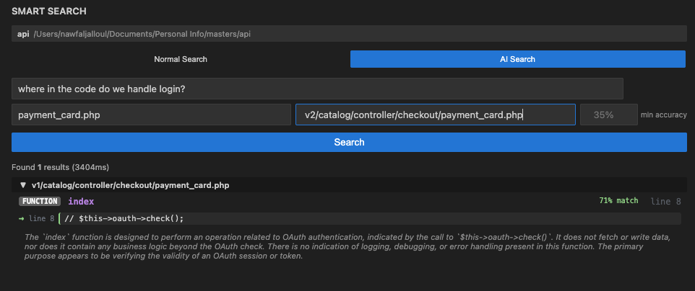

Slide 13
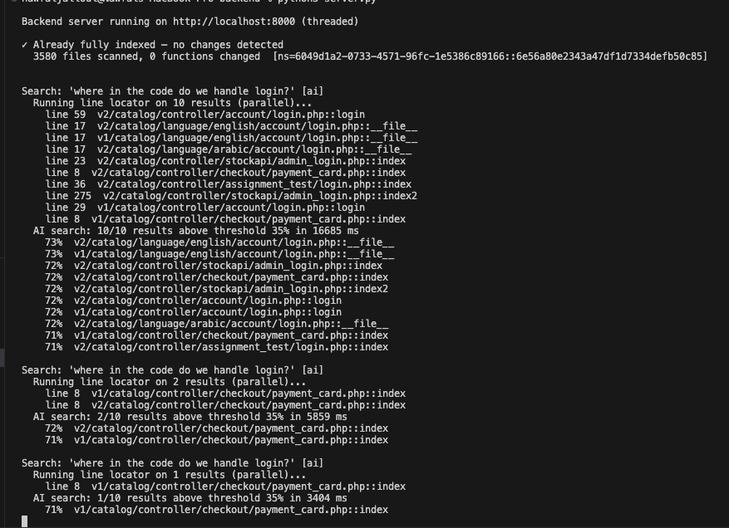

Slide 14
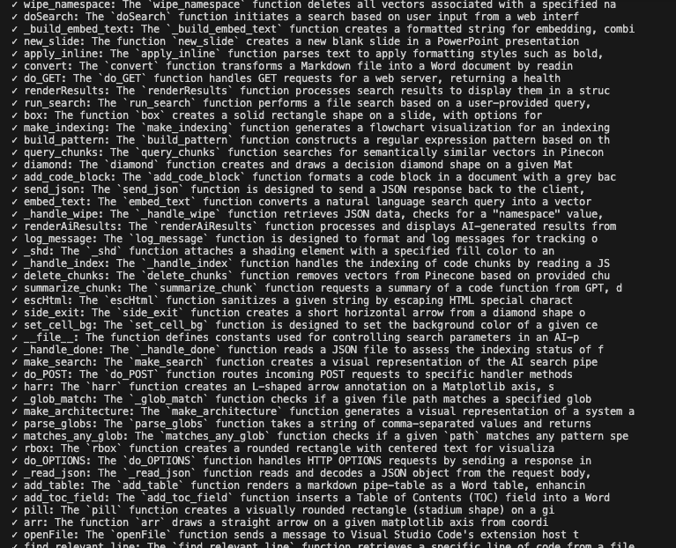

Slide 15
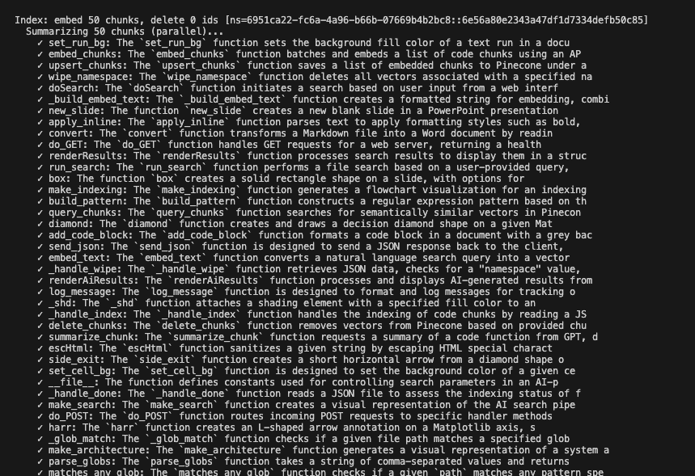

Slide 16
FUTURE WORK
What Comes Next
1
Remote Backend Hosting
Eliminate local Python setup. One config change (backendUrl) points extension at cloud.
2
Git Branch-Aware Indexing
Detect branch switches via VS Code Git API, compare changed files between branches.
3
Cross-Function Semantic Linking
Build call graph at index time. Boost scores of connected functions for flow queries.
4
Local Embedding Models
nomic-embed-code or CodeBERT via Ollama — offline/air-gapped use, only embedder.py changes.
5
Feedback-Based Ranking
Track clicks and skips locally. Adjust threshold and weights per developer over time.

Slide 17
What Was Built
Smart Search
Semantic code search inside VS Code — finds functions by what they do
Two-phase batching made first-run indexing 50× faster
GPT summaries improved cosine scores from ~46% to ~82%
MRR 0.92 — correct result is first in 5 of 6 conceptual queries
Crash-safe, concurrent, configuration-consistent production architecture
Nawfal Jalloul · Master's Research Project · May 2026
Thank you

