Slide 1
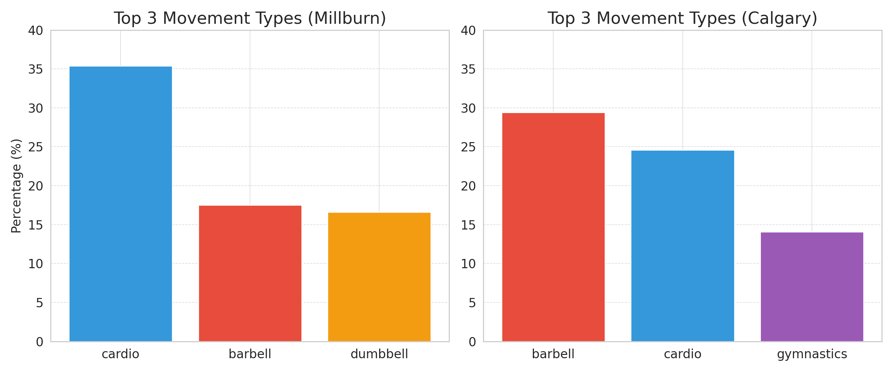
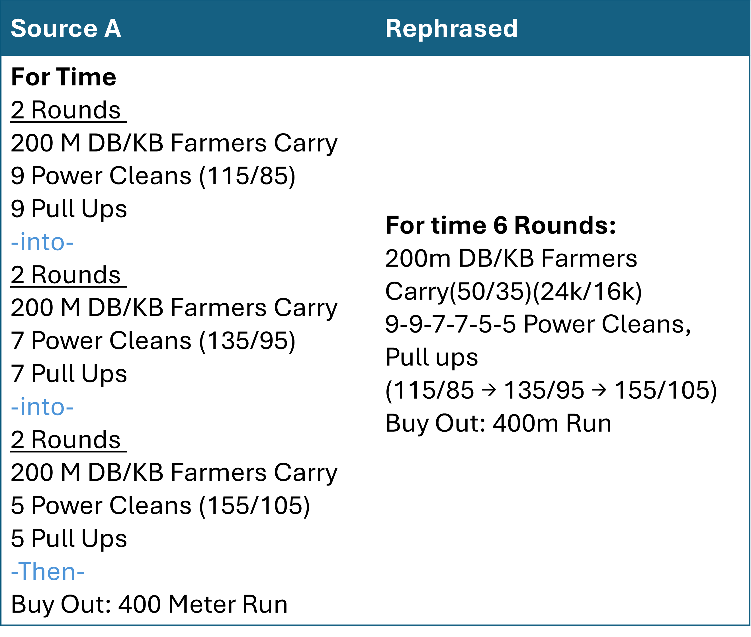
CSE304 Term Project
Box to Box: Analyzing CrossFit WOD Variability
with Structured Embeddings
Sehyun Yun (20231233), nawhji@unist.ac.kr
Background
What is Crossfit?
CrossFit is a high-intensity training system built on varied functional movements.
Workouts (WODs) combine gymnastics, weightlifting, and cardio under time or repetition constraints.
Challenges in WOD(Workout of the Day) Analysis
1. Crossfit gym(Box) level Variation
Each CrossFit box exhibits a unique WOD programming style. - Millburn prefers cardio based workouts. - Calgary emphasizes heavy barbell movements and strength training.
2. Textual Variability
Cardio
Barbell
Dumbbell
Barbell
Cardio
Gymnastics
The same workout can be described in multiple ways, depending on the box or coach.
→ Difficult to parse and compare WODs systematically
Objective
This study aims to analyze the variability of CrossFit WODs by:
Structuring raw WOD texts into a unified JSON format
Generating semantically meaningful WOD vectors using fine-tuned Sentence-BERT
Clustering WODs to reveal box-level programming tendencies and movement biases

Slide 2
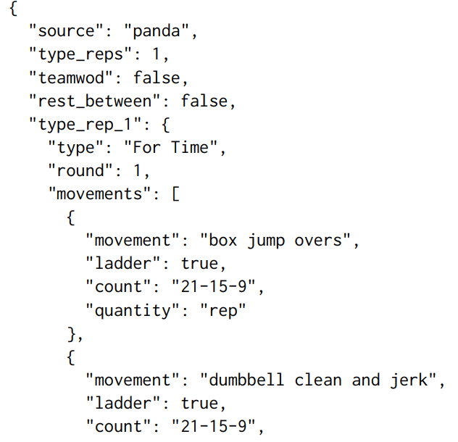
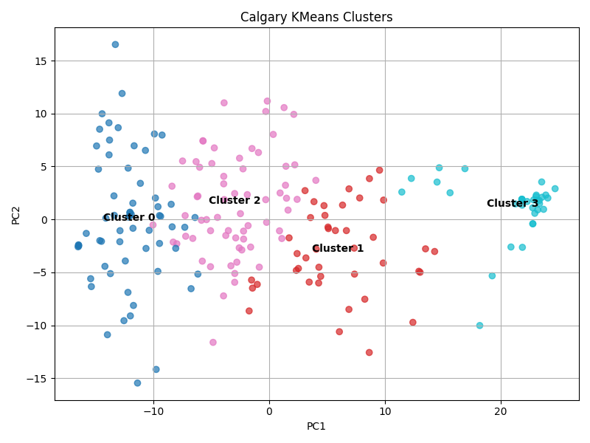
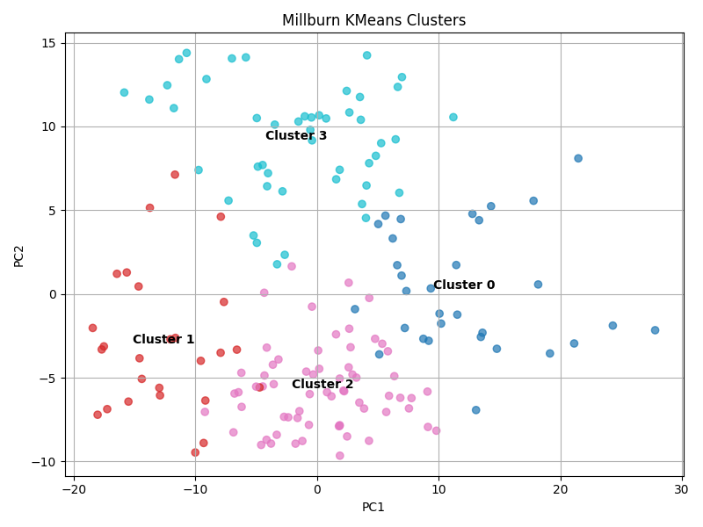
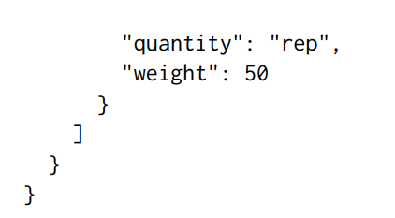
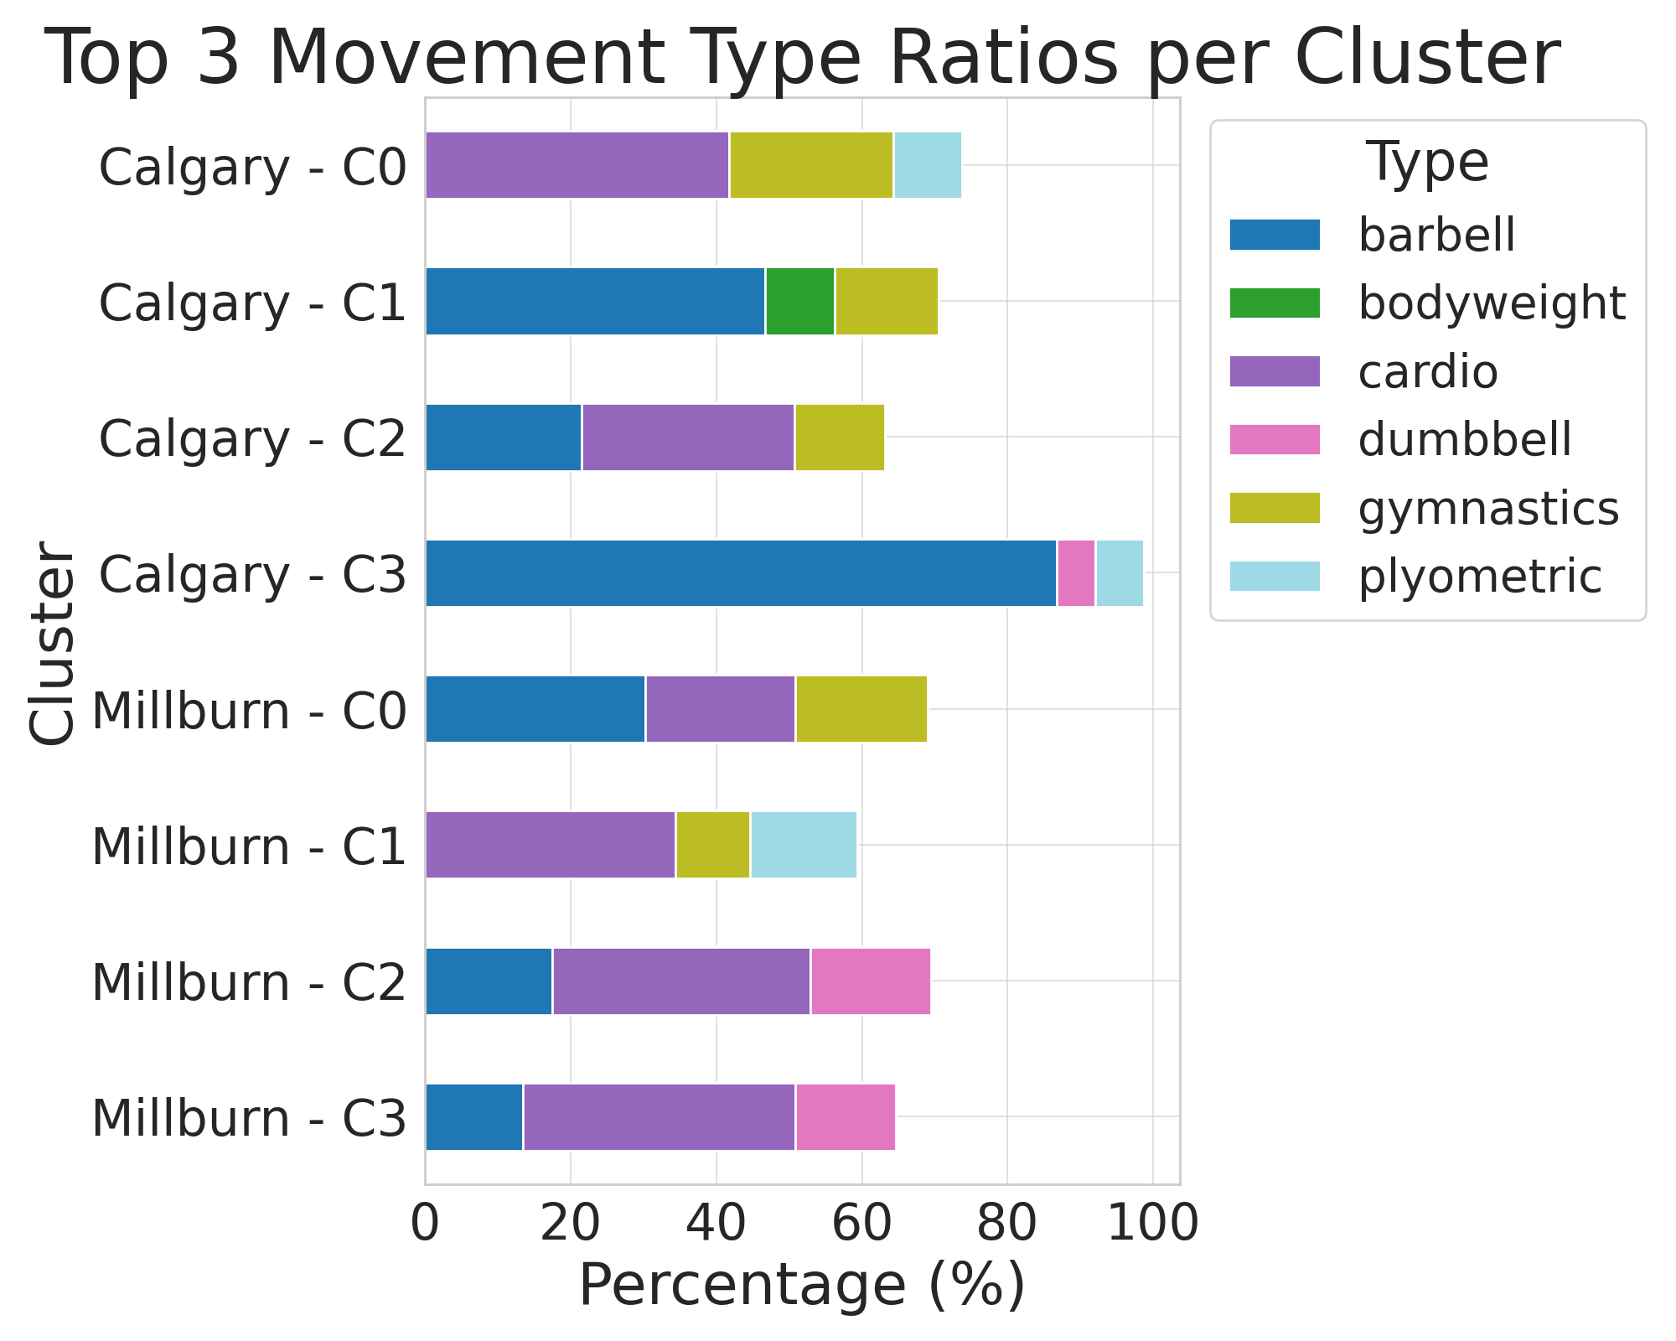
Methodology + Experiment
1. Data Collection
• 887 WODs crawled from six CrossFit box websites • Accessed posts via date-based URL generation using Selenium WebDriver • Applied site-specific parsing rules with BeautifulSoup to extract only WOD content
3. Vectorization
• Fine-tuned Sentence-BERT with triplet loss to embed movement names • Built 397D WOD vectors using: – Weighted average of embeddings (log-scaled by reps) – Structured features: workout type, rounds, rest, etc. – Weight scaling for heavy equipment
➤ Each vector reflects both movement meaning and program structure
2. Text Normalization
• Raw WOD texts were converted into a structured JSON format using GPT-4 API
4. Clustering
• Applied KMeans++ clustering to 397D WOD vectors • Used PCA for dimensionality reduction + visualization • Fixed k = 4 across all boxes for interpretability
Clustering Results for Calgary and Millburn
5. Cluster Analysis
• For each cluster, analyzed: – Dominant movement type – Top 15 movements – Average barbell weight – Movement type distribution
Conclusion
• Proposed a pipeline that converts raw CrossFit WOD texts into structured vectors • Fine-tuned embedding + structured features enabled meaningful WOD clustering • Box-level analysis revealed distinct programming styles (e.g., strength vs. cardio bias) • This method supports scalable comparison of unstandardized workouts
Future Work
• Add features for pacing, progression, and scaling options • Develop WOD similarity search or recommendation systems

