Slide 1


Team Details
  Team name: Aura Bros
  Team leader name: Mari Raja
  Problem Statement: BFSI: Intelligent Risk, Fraud & Financial Experiences \u2014 build an AI-powered solution addressing meaningful challenges in banking, financial services, insurance or related industries: detecting/mitigating fraud or risk, automating complex processes, improving customer interactions, or more personalised financial experiences: FundTrace, an AI-assisted investigation workspace for bank payment disputes.
Team members: Mari Raja, Nawin Viswajith, Venkataraman

Slide 2
Brief about the idea
When a customer says “I didn’t make this ₹50,000 payment,” an investigator has hours, not days, before the money moves again. FundTrace reconstructs the observable downstream trail from ledger records, works out how much of each onward transfer could or must be the disputed money, shows the evidence behind every fraud signal, and has Gemini write a cited investigation report — with every claim fact-checked and the hallucination rate measured.
A customer portal lets the account holder raise the dispute themselves — by guided chat, form, or free text that Gemini reads — and it lands as a ready case in the bank’s queue, with no re-keying. The investigator always decides; the AI never calculates money or liability.

Slide 3
Opportunities
How different is it from other ideas? Most tools stop at “the amounts match.” FundTrace computes four tracing conventions (clean-first, FIFO, pro-rata, tainted-first) for a derived lower bound and an inferred upper bound on every onward transfer — and Gemini proposes hypotheses about the trail that deterministic code checks, and can reject outright as “invented.”
How will it solve the problem? It turns hours of manual statement-reading into a cited AI report in about 3 minutes, flags accounts that may still hold disputed money within the golden hour, and lets the customer raise a dispute that maps straight into the bank’s workflow — no re-keying.
USP: a rules + AI + ML system that never lets AI calculate money or decide liability. Every number is deterministic code, every AI claim is fact-checked and measured, and the one ML model is evaluated on a genuine synthetic hold-out — not scenarios the team wrote itself.

Slide 4
List of features offered by the solution
Investigation
Time-ordered money trail · 4 attribution methods with ranges · 15 rule-based warning signs (R1–R15) · evidence checklist & strength scores · hold recommendations · calculation record with replay
Generative AI
LangGraph investigation agent · cited report with validator + judge · AI hypotheses checked by code · multimodal evidence reading · Ask Demo Bank customer assistant · copilot & translation
Machine learning
Unsupervised Isolation Forest behaviour model, no labels, evaluated on a synthetic hold-out (ROC-AUC ≈ 0.78) — a separate signal, never a 16th rule
Customer side
Portal: dispute by guided chat, form, or free text · plain-language status tracking and uploads · safety-check insights · disputes mapped straight into the bank’s queue
Workflow & security
Case queue with SLA clocks · roles & case-level access · shared-account recovery split · hash-chained audit · field encryption (Cloud KMS) · DLP masking · MFA
Operations
Ledger ingest via Pub/Sub (ISO 20022 camt.053, CSV, JSON) · AI cost/latency/error tracking · deterministic + hold-out evaluation · demo-data generator

Slide 5
Process flow diagram or Use-case diagram
1. Customer
Raises a dispute: chat, form or free text
2. Case created
Lands in the bank’s queue, SLA set
3. Gather + trail
Ledger records → hashed snapshot
4. Gemini explores
5 fixed tools; reads evidence
5. Gemini drafts
Cited report · Pro model
6. Validate + judge
Code checks claims; Gemini fact-checks
7. Investigator
Reviews, approves holds, decides
Gemini never calculates money, balances or rules — those stay deterministic code throughout.

Slide 6
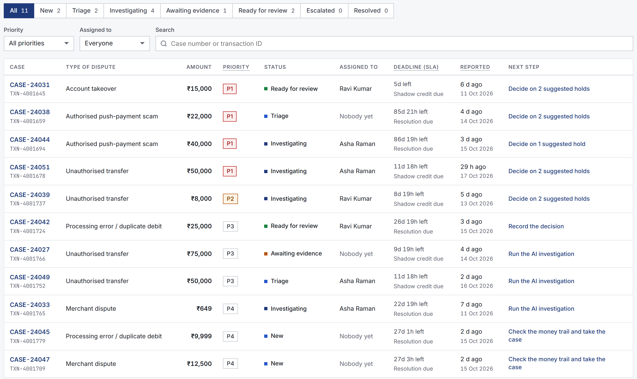
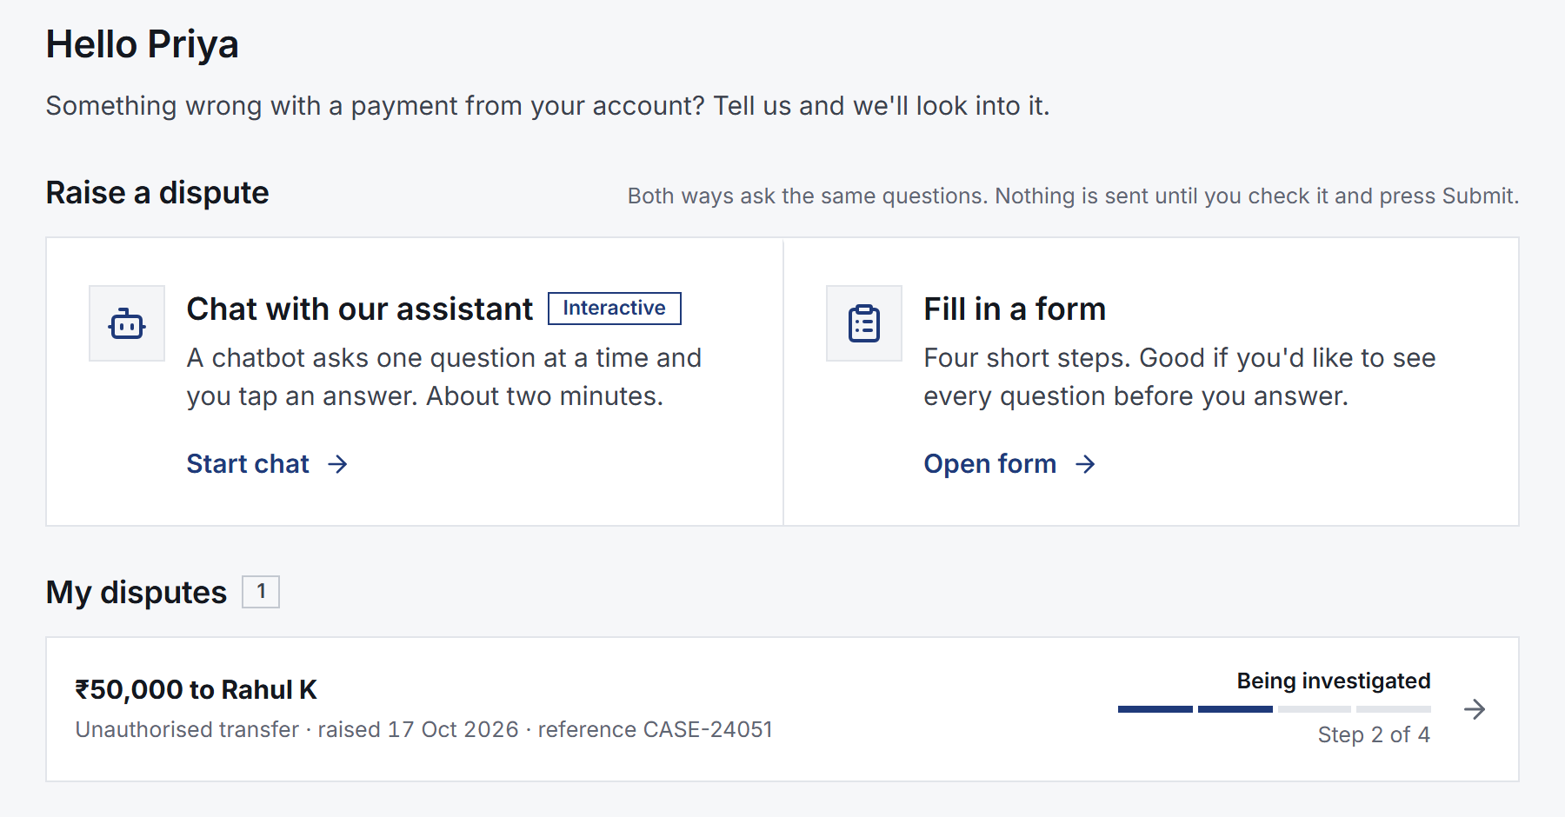
Wireframes/Mock diagrams of the proposed solution (optional)
Customer portal: raise a dispute, track progress
Bank view: case queue with SLA and priority

Slide 7
Architecture diagram of the proposed solution
Vertex AI
Gemini Pro · Flash · Flash-Lite
Investigator UI
& Customer portal
React, TypeScript, React Flow
Cloud Run
FastAPI · LangGraph agent · rules R1–R15 · ML model · validator
Cloud SQL
MySQL 8 · source of truth
Cloud Storage
write-once evidence
KMS · Secret Mgr · DLP
encryption, secrets, masking
Pub/Sub
ledger ingest, dead-letter
Observability: OpenTelemetry → Cloud Trace; redacted logs → Cloud Logging/Monitoring. Path to bank scale: Dataflow on the same Pub/Sub feed, BigQuery history, Spanner Graph behind the same graph interface — one container, deployed by a single script (infra/deploy.sh).

Slide 8
Technologies to be used in the solution
Frontend: React, TypeScript, React Query, React Flow, Vitest/RTL, axe-core
Backend: FastAPI, SQLAlchemy 2, Alembic, LangGraph, scikit-learn, pytest
Generative AI: Gemini (Pro / Flash / Flash-Lite) on Vertex AI
Data: Cloud SQL (MySQL 8), Cloud Storage, SQLite (local dev)
Security: Cloud KMS, Secret Manager, Cloud DLP, bcrypt + JWT, TOTP MFA
Infra & ops: Cloud Run, Pub/Sub, OpenTelemetry, Cloud Trace/Logging/Monitoring

Slide 9
Estimated implementation cost (optional)
Cloud Run scales to zero between requests, so a pilot costs little when idle. Rough monthly figures for a single-branch / low-volume pilot (not full bank scale):
• Cloud SQL (db-f1-micro, always on): roughly $10–$15/month
• Cloud Run, Cloud Storage, Pub/Sub, KMS, Secret Manager at pilot traffic: a few dollars/month combined
• Gemini (Vertex AI): measured at about $0.20 per full AI investigation; routine chat/FAQ answers now use Flash-Lite, a fraction of a cent each
A pilot handling a few hundred disputes a month is estimated at roughly $50–$150/month, dominated by Cloud SQL and Gemini usage — scaling close to linearly with investigation volume after that. Full bank scale would add Spanner Graph, BigQuery and Dataflow (see the architecture slide).

Slide 10
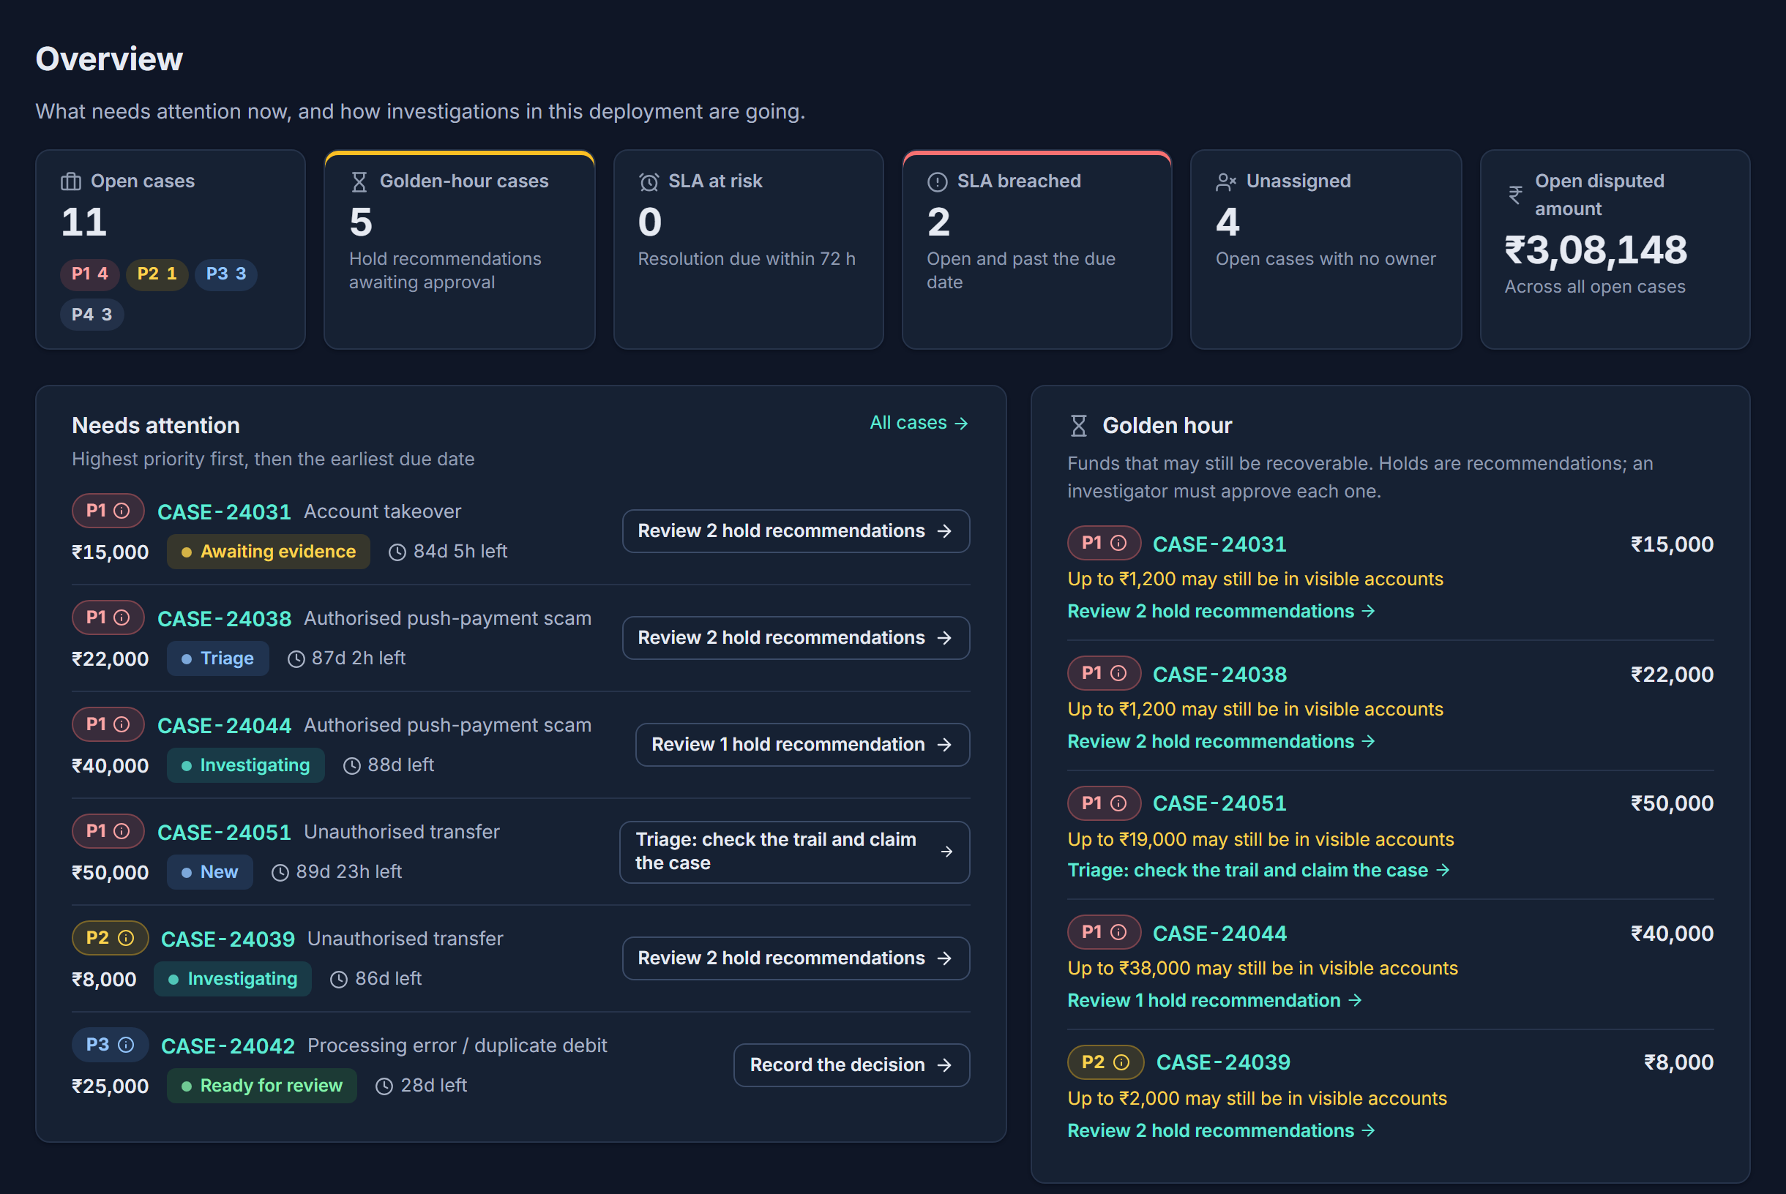
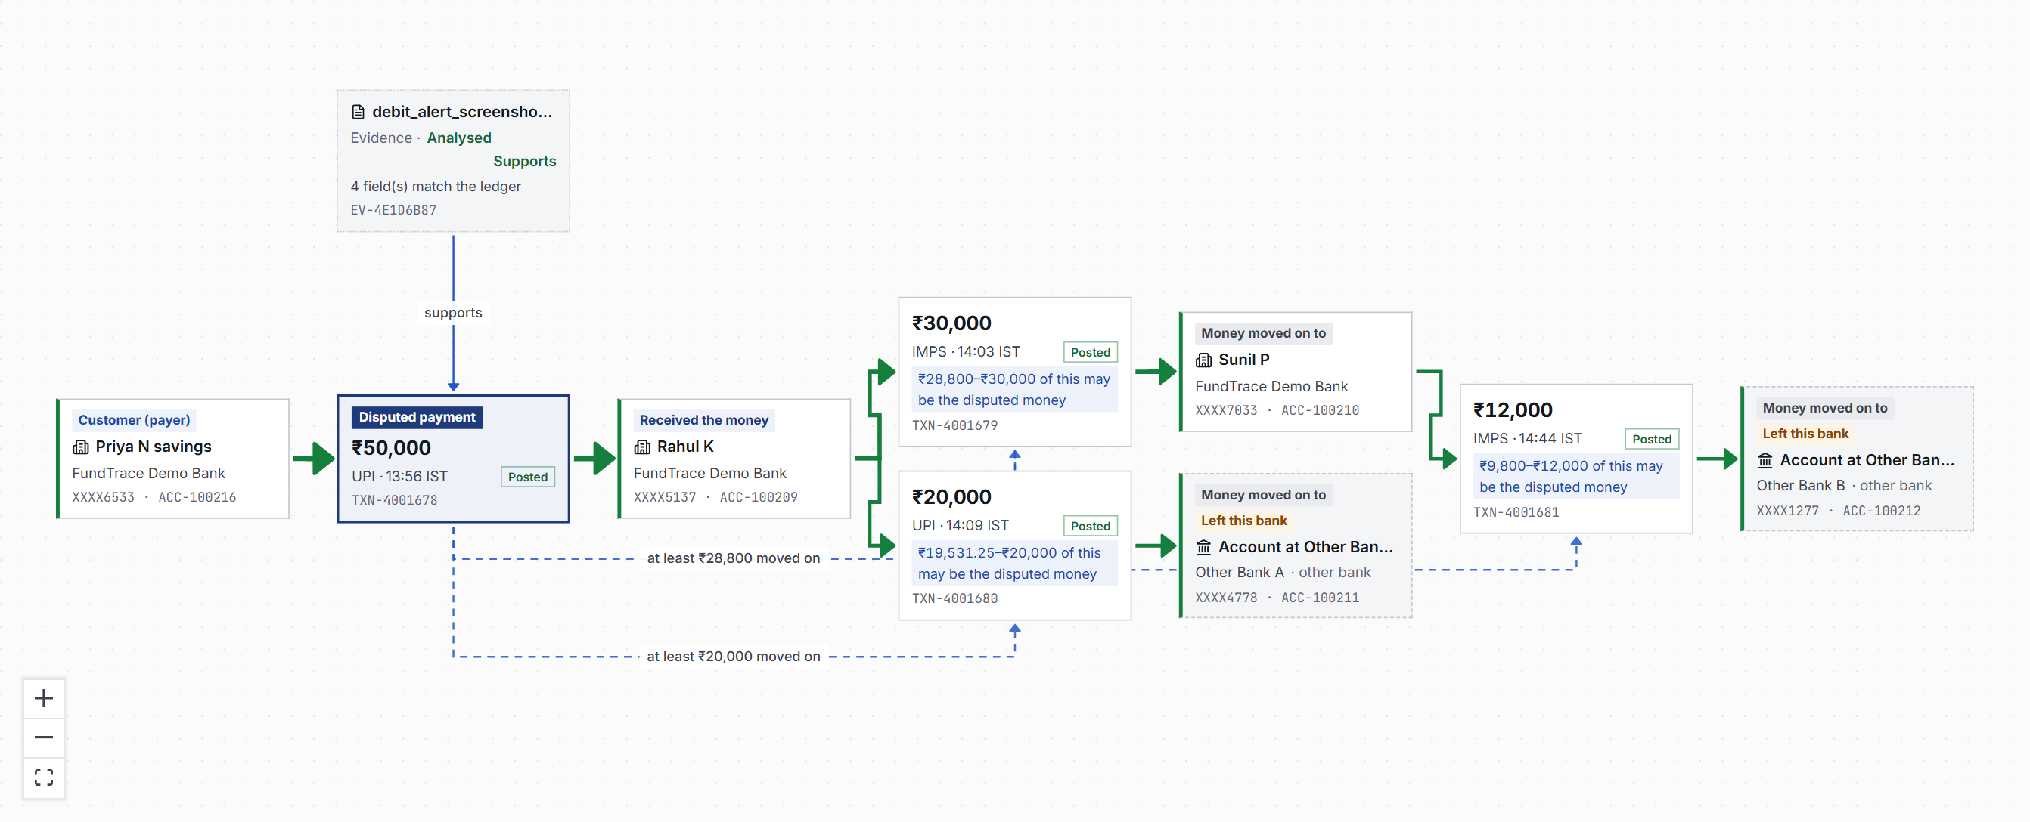
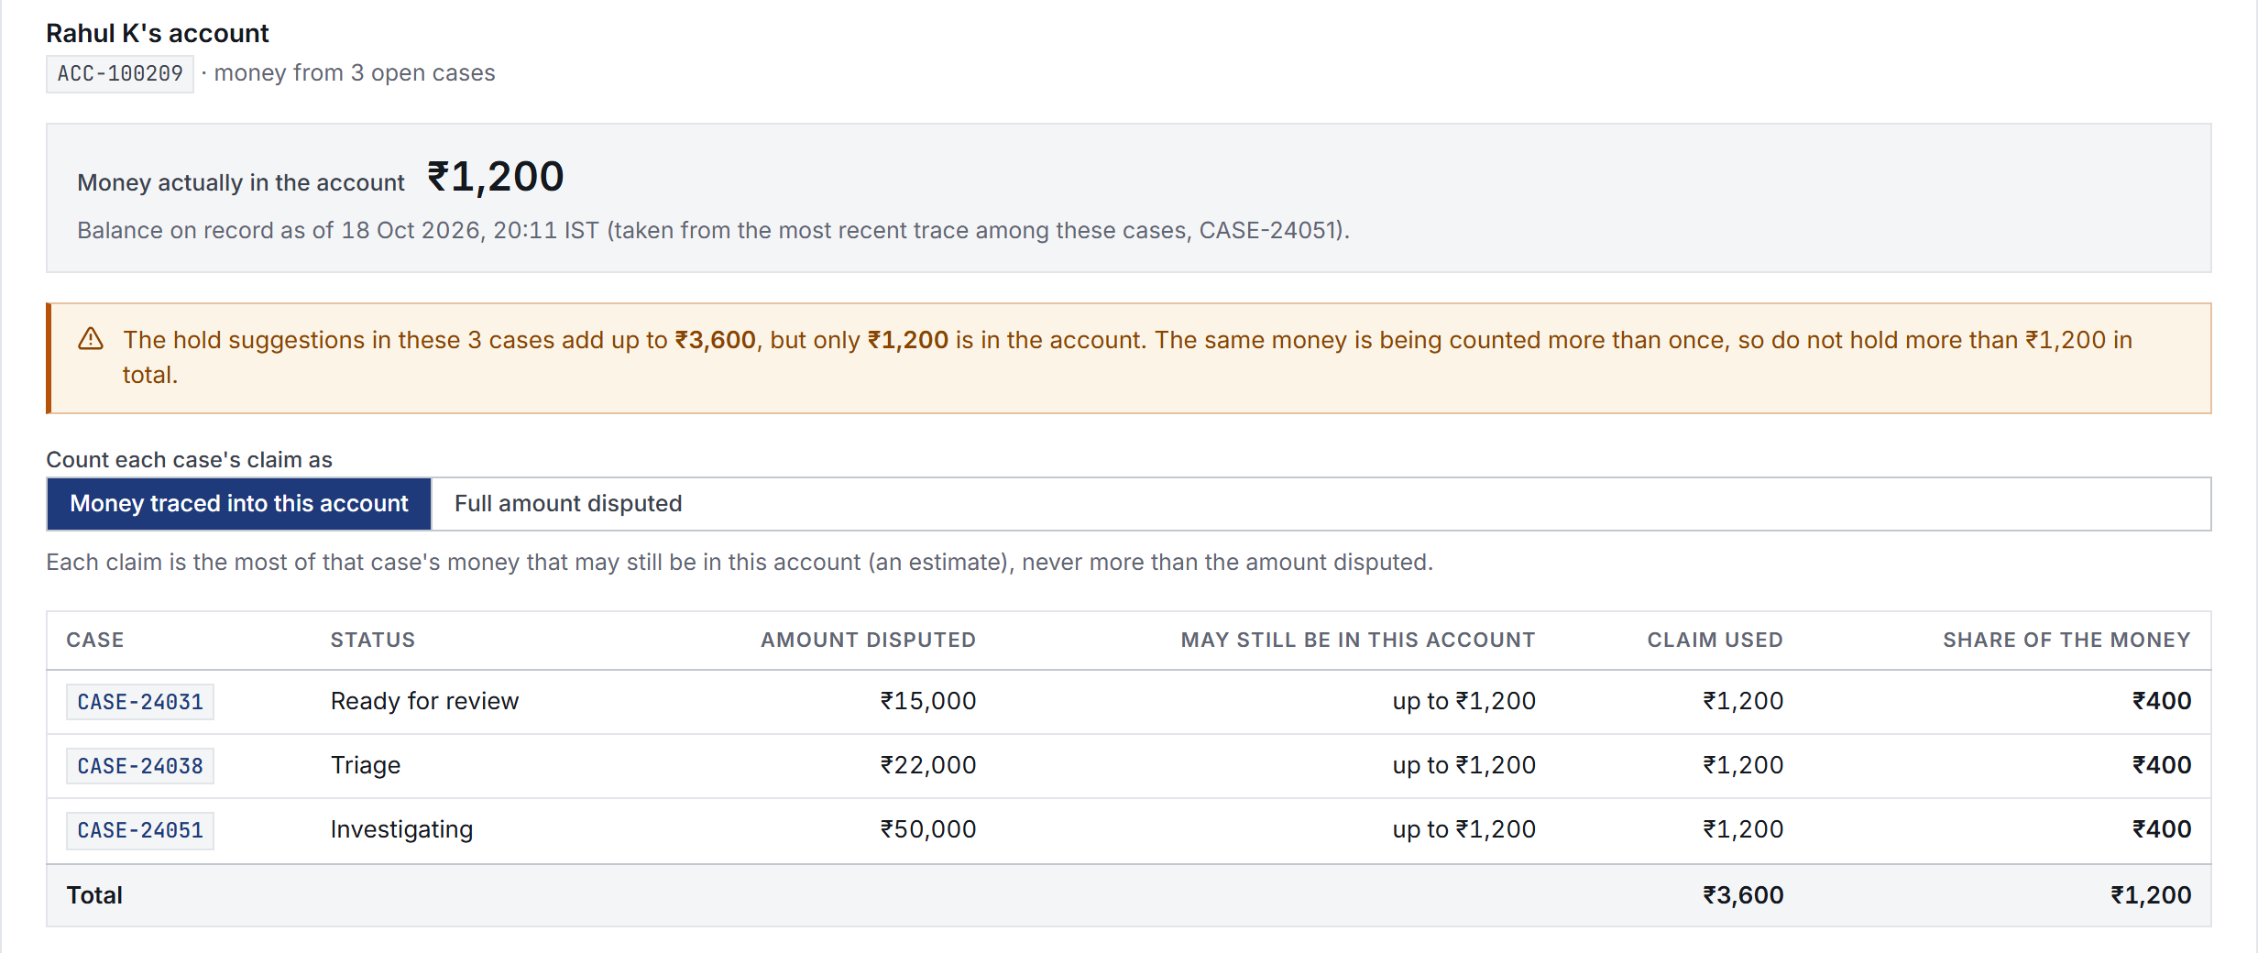
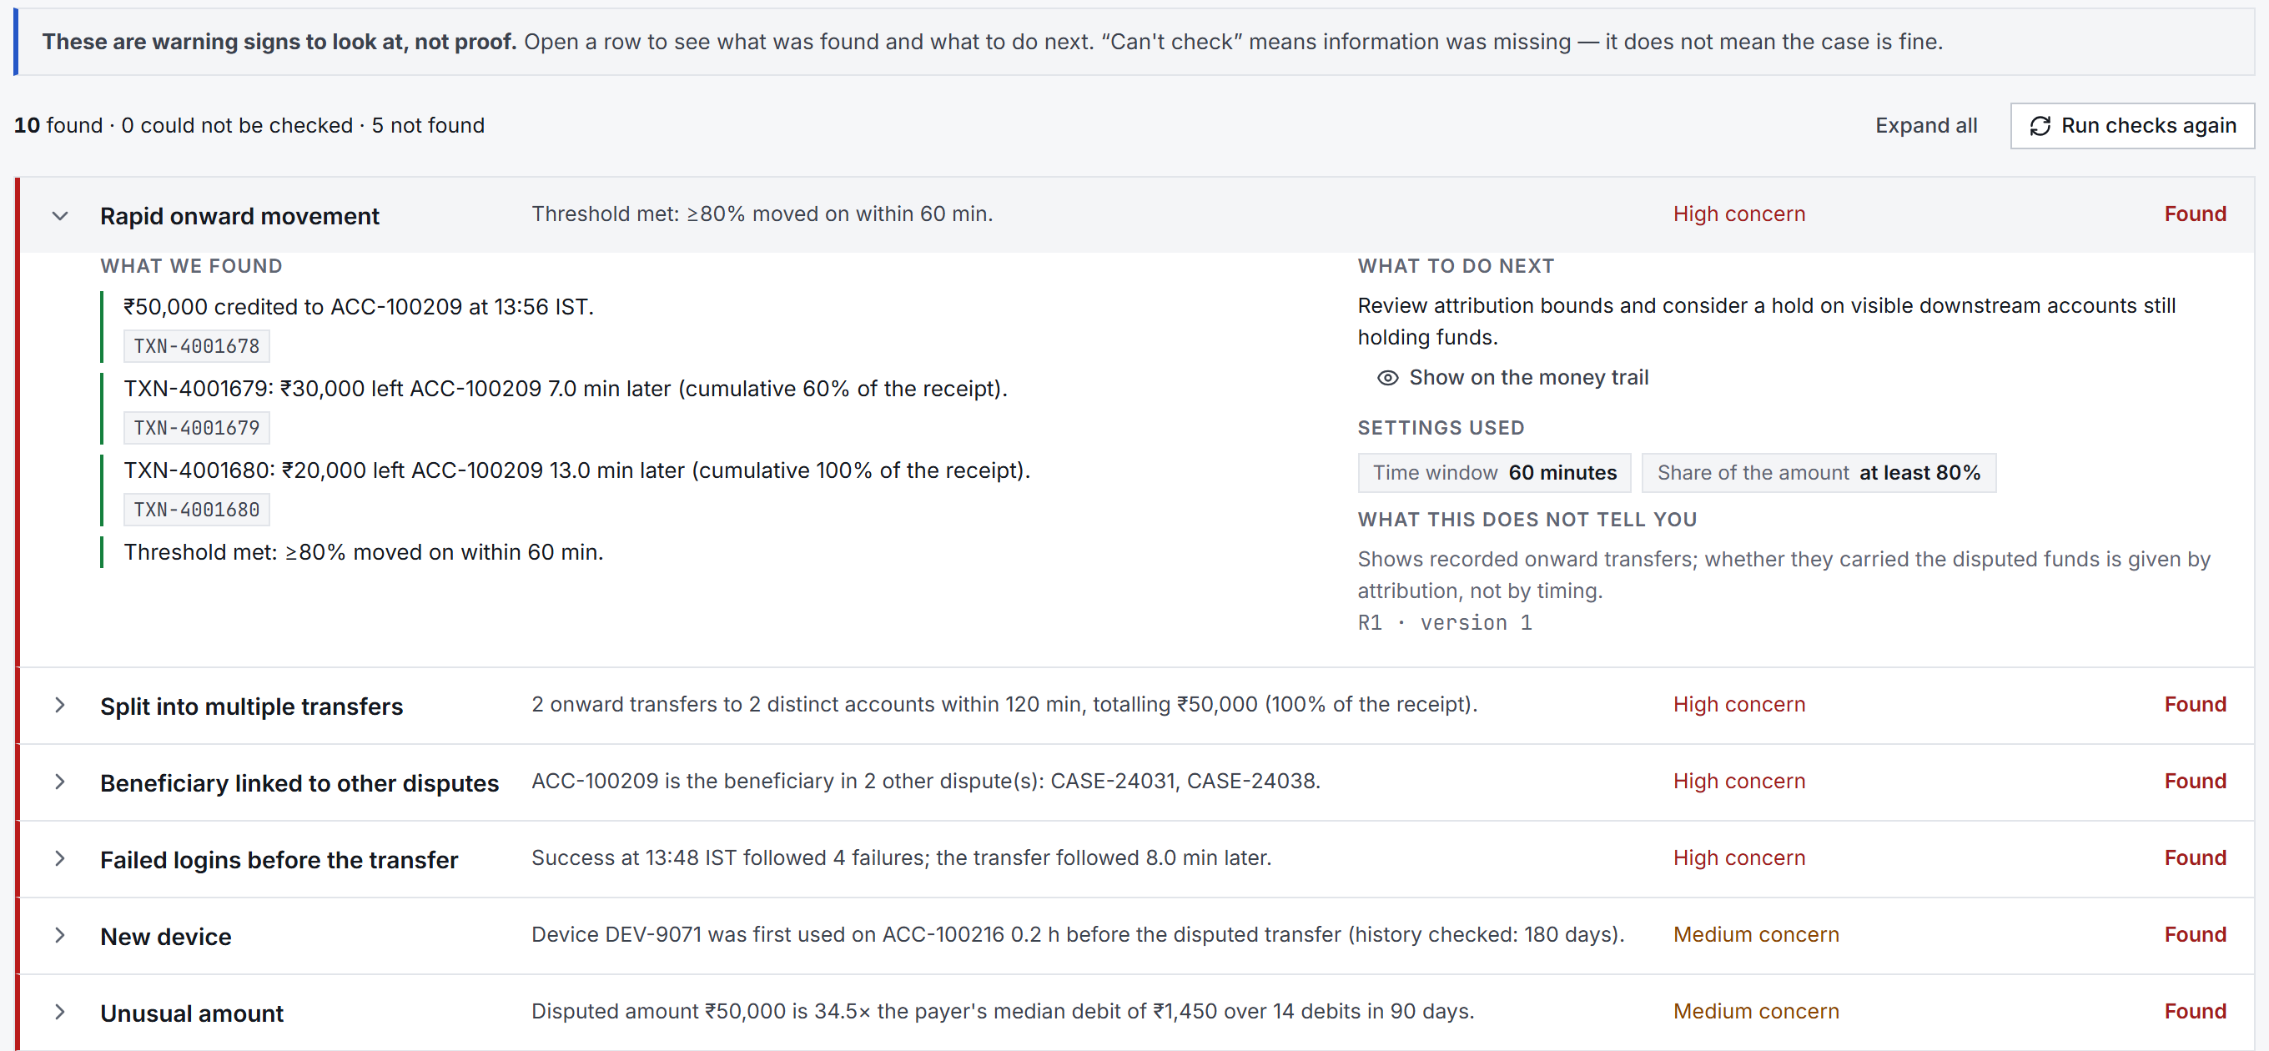
Snapshots of the prototype
Case overview — six separate checks
Money trail with attribution ranges
Shared-account recovery split
Warning signs with record-level evidence

Slide 11
Prototype Performance report/Benchmarking
• 104/104 deterministic ground-truth checks pass; rule precision and recall 1.0 on labelled scenarios
• 251 backend tests, 113 frontend tests, all passing; TypeScript, lint and build all clean
• Behaviour model (ML): synthetic hold-out on fresh random seeds, never the hand-written scenarios — mean ROC-AUC ≈ 0.78, precision@k ≈ 0.41, labelled honestly as a synthetic result
• Live Gemini report: 35/35 claims confirmed by the fact-check on the first live run; cost ≈ $0.20 per full investigation, measured per call
• Chat latency: a greeting now answers in about 0.2s (code, no AI call); a real question answers in a few seconds on a Flash-Lite model instead of up to ≈ 60s on the general-purpose chain

Slide 12
Additional Details/Future Development (if any)
• Live bank feeds on the existing Pub/Sub ingest, and Spanner Graph for production trail volumes
• Cross-bank trail and hold requests through national cyber-fraud reporting channels
• Supervised models trained on investigator-labelled outcomes, with the rules kept as explanations
• An investigator feedback loop on claim reviews, to tune prompts and the judge
• Scheduled evidence-retention runs and live bank connections on the ingest path

Slide 13
Provide links to your:
GitHub Public Repository https://github.com/nawin-viswajith/fundtrace
Demo Video Link (3 Minutes) https://www.youtube.com/watch?v=KNB5TJZJ1Qw
Final Product Link https://fundtrace-541805214490.asia-south1.run.app/login

Slide 15


