Slide 1
Clustering of High-Achieving Students Using Fuzzy C-Means
Pycon ID 2025
Nawindah
Universitas Budi Luhur
E-mail : nawindah@budiluhur.ac.id
Dec 13th-14th,2025
Trilogi University,Jakarta

Slide 2
Basic Concepts Fuzzy C Means
Data is located in more than one cluster.
Each data in a cluster has a weight.
The concept used are fuzzy logic and fuzzy set.
Fuzzy logic was first developed by Lotfi Zadeh through his writing in 1965 entitled “Fuzzy Set”.
A fuzzy set is a mathematical model derived from vague qualitative or quantitative data, often generated through natural language. Its membership value is between 0 and 1.

Slide 3
Fuzzy C Means Algorithm
Enter the data to be grouped X, in the form of an nxm matrix
Determine: number of cluster, bobot, maximum iteration, expected smallest error, initial objective function, initial iteration.
Generate random numbers with and are the elements of the initial partition matrix .
Calculate the k cluster center:
Calculate the objective function in the iteration
Calculate the change of partition matrix

Slide 4
Fuzzy C Means Algorithm
Select an initial fuzzy pseudo-partition, e.e., assign values to all Wij
Repeat
compute the centroid of each cluster using the fuzzy partition
Update the fuzzy partition i.e. the Wij
Until the centroid don’t change
There’s alternative stopping criteria. Ex.” change in the error is bellow a specified threshold”, or “absolute change in any Wij is below a given threshold”

Slide 5
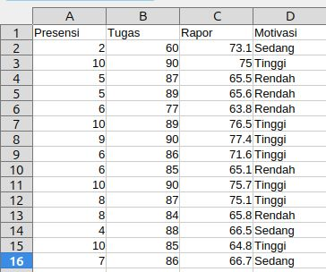
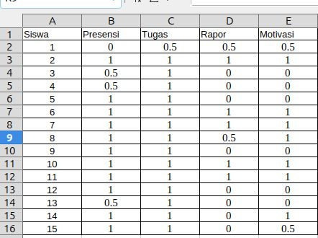
Data
Convert numbers to a set of fuzzy numbers by determining
the upper and lower limits

Slide 6
Libraries used
import numpy as np
import skfuzzy as fuzz
import matplotlib.pyplot as plt
import pandas as pd

Slide 7
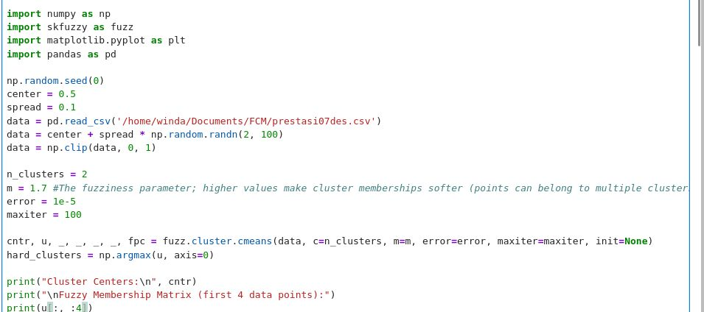
Implementation

Slide 8
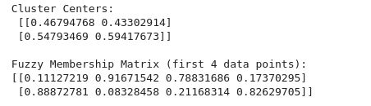
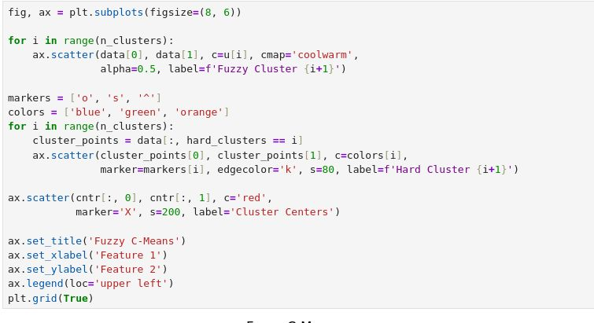
Implementation

Slide 9
Implementation

Slide 10
Implementation

Slide 11
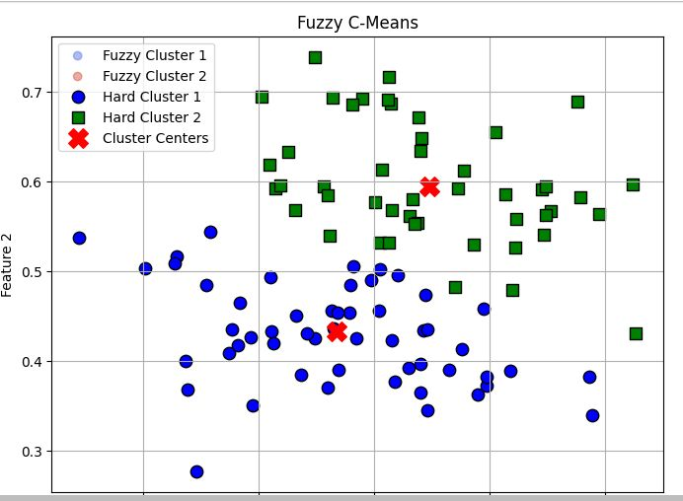
Implementation

Slide 12
Reference
]L. A. Zadeh, "Fuzzy sets," Information and Control 8, pp. 338-353, 1965.
Timothy, J.Ross, 2006, “Fuzzy Logic With Engineering Application”, John Wiley &. Sons, Chichester, England.
Kusumadewi, Sri dan Hari, Purnomo. (2010). Aplikasi Logika Fuzzy Untuk Mendukung. Keputusan. Yogyakarta : Graha Ilmu
Bezdek, J. C.., Robert Ehrlich., & William Full (1981). FCM: The Fuzzy c-Means. Clustering Algorithm. Bieniawski, Z.T., (1989)
#https://www.kaggle.com/code/engrshabir/fuzzy-c-mean-clustering-algorithm

Slide 13
Thank You
Link slide :
https://github.com/nawindahx/light_talk_2025

