Slide 1

DeePref: Deep Reinforcement Learning For Video Prefetching In Content Delivery Networks
Nawras Alkassab, Chin-Tser Huang (University of South Carolina), Tania Lorido Botran (Roblox)

Slide 2
Outline
Introduction
Motivation
Background
System Architecture
Experimental Results
Concluding Remarks
References

Slide 3
Introduction
Video streaming service providers rely heavily on Content Delivery Networks (CDNs) to distribute their video content to end users.
According to Cisco [1], around 64% of the entire Internet traffic will cross CDNs in 2020, up from 45% in 2015.
There exists an increased trend in the popularity of video content as a major internet traffic.
According to Cisco [1], Internet video traffic will be 79% of all Internet traffic in 2020, up from 63% in 2015.

Slide 4
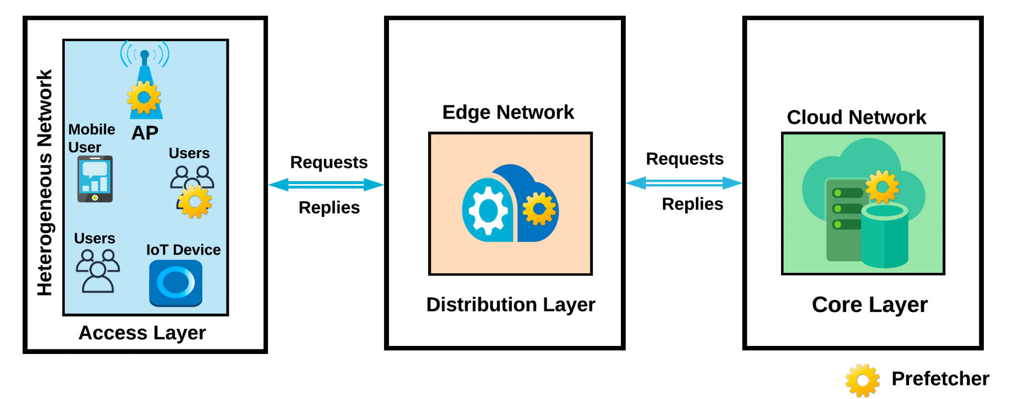
Motivation (1)
This rapid growth of video content has accelerated the implementation and design of prefetching algorithms in CDNs.
Prefetching is a speculation technique that aims to make data available in the cache before the requester places their request.
Fig. 1. Prefetching methods implemented at different layers in CDNs.

Slide 5
Motivation (2)
Prefetching in CDNs has many advantages, such as preventing bandwidth under-utilization, optimizing server load, and reducing access latency.
On the other hand, prefetching increases system resource demands in order to improve response time, which increases the incurred bandwidth consumption and storage resources [7].
Prefetching in CDNs leads to two difficult challenges that can be addressed by the following questions:
What items should be prefetched ?
When should a prefetching action occur?
Notes:
What items should be prefetched, considering the large volume of video content residing on video streaming platforms (e.g., Netflix) and millions of end users connected to thousands of edge devices? This question is similar to what items to suggest to end users by the recommendation system.
And, when should a prefetching action occur? This question needs to be answered because prefetching items very frequently indicates more eviction actions to be taken by the edge network which increases cache pollution, network traffic, and server load on the cloud network, thereby reducing the overall system performance. On the other hand, prefetching items on rare occasions reduces the prefetching coverage, which reduces the overall prefetching efficacy.

Slide 6
Motivation (3)
There is a trade-off between prefetching coverage and prefetching accuracy, since aggressive approaches may increase accuracy, but also reduce coverage simultaneously due to the increased number of sent prefetches, in case of a cache miss.
Therefore, it's critical for a prefetching algorithm to be auto-aggressive to decide when and what to prefetch.
In this work, we build, DeePref, an auto-aggressive prefetcher that maximizes both prefetching coverage and prefetching accuracy by adapting to sudden variations or randomization in workloads.

Slide 7
Motivation (4)
DeePref is a deep reinforcement learning agent for prefetching video content from cloud networks to edge networks in CDNs.
DeePref is agnostic to hardware design, operating system, and application where it takes only the request ID of the user request as input to make future prefetching decisions online.
DeePref DRQN, using a real-world dataset, achieves 17% increase in prefetching accuracy and 28% increase in prefetching coverage on average compared to baseline approaches that use video content popularity as a building block to statically or dynamically make prefetching decisions.

Slide 8
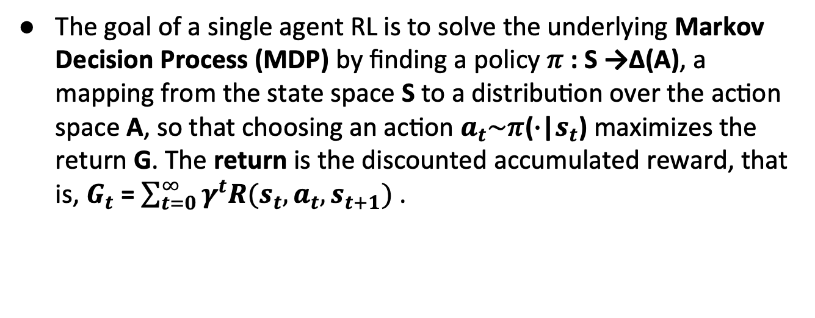
Background (1)
The goal of a single agent RL is to solve the underlying Markov Decision Process (MDP) by finding a policy 𝜋 : S →Δ(A), a mapping from the state space S to a distribution over the action space A, so that choosing an action $a_{t}\sim \text{π}$($∙$|$s_{t}$) maximizes the return G. The return is the discounted accumulated reward, that is, $G_{t}$ = $\sum_{t=0}^{∞}{γ^{t}R(s_{t},a_{t},s_{t+1})}$ .

Slide 9
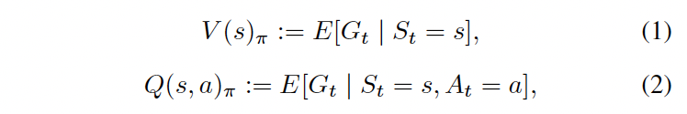
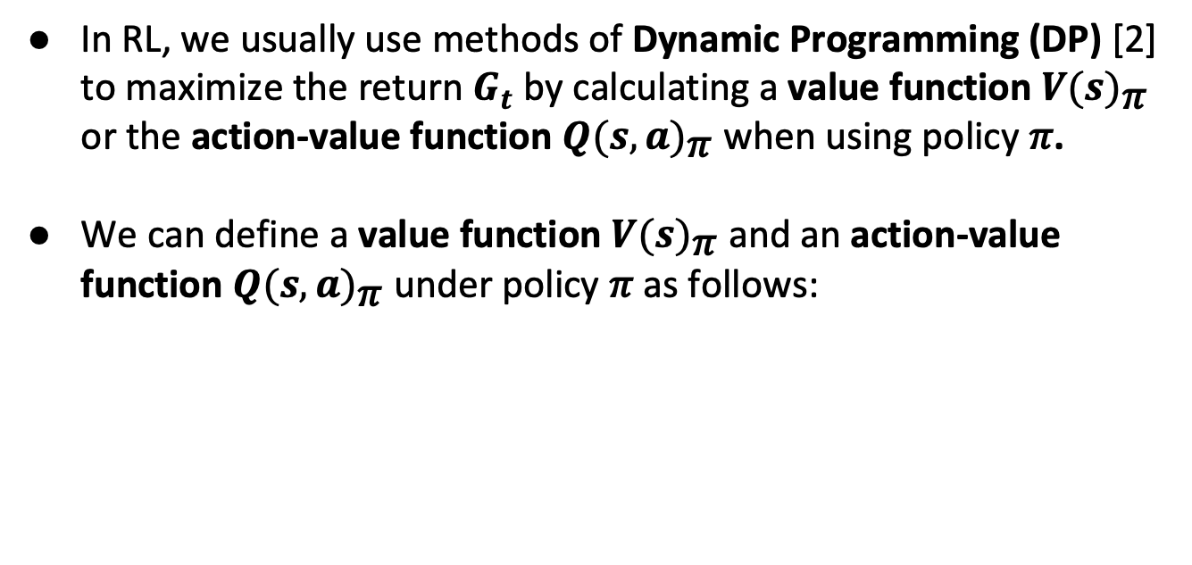
Background (2)
In RL, we usually use methods of Dynamic Programming (DP) [2] to maximize the return $G_{t}$ by calculating a value function ${V(s)}_{\text{π}}$ or the action-value function ${Q(s,a)}_{\text{π}}$ when using policy 𝜋.
We can define a value function ${V(s)}_{\text{π}}$ and an action-value function ${Q(s,a)}_{\text{π}}$ under policy 𝜋 as follows:

Slide 10
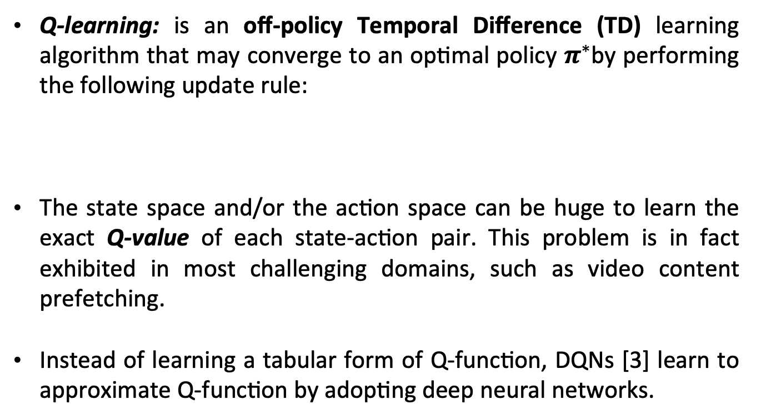
Background (3)
Q-learning: is an off-policy Temporal Difference (TD) learning algorithm that may converge to an optimal policy $π^{∗}$by performing the following update rule:
The state space and/or the action space can be huge to learn the exact Q-value of each state-action pair. This problem is in fact exhibited in most challenging domains, such as video content prefetching.
Instead of learning a tabular form of Q-function, DQNs [3] learn to approximate Q-function by adopting deep neural networks.

Slide 11
Background (4)
Unfortunately, many real-world problems do not directly exhibit the Markovian property and/or the agent can only partially observe the underlying states of the environment, prohibiting it from discovering the true states of the environment. Thus, a generalization of MDPs, which is called Partially Observable Markov Decision Processes (POMDPs), allows an agent to learn decision policies if it is assumed that the underlying environment is Markovian.
Deep Recurrent Q-Network (DRQN) [4] leverages the use of Recurrent Neural Networks (RNNs) such as Long Short-Term Memory (LSTM) [5] and Gated Recurrent Unit (GRU) [6] to tackle the partial observability of the environment by storing history of previous observations in the replay memory of the agent.

Slide 12
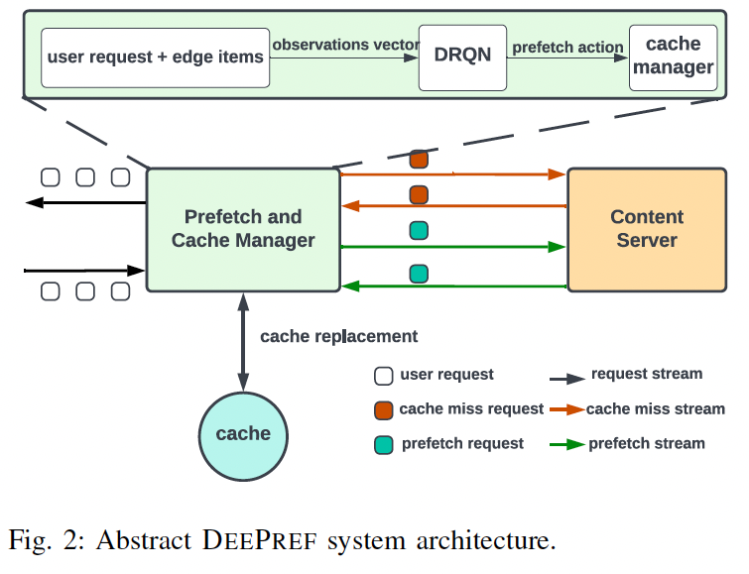
System Architecture (1)
Prefetching requests are synchronous to user requests.
Decouple the functionality of cache management system from the prefetching head.
RTT from edge to cloud networks is 100 ms.
RTT from access to edge networks is 10 ms.
Notes:
System assumptions

Slide 13
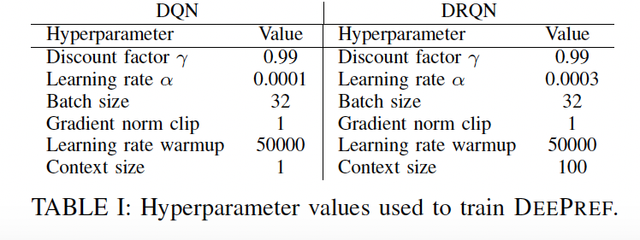
System Architecture (2)
We trained DeePref using both DQN and DRQN.
DeePref DQN does not capture the inter-sample dependencies among user requests.

Slide 14
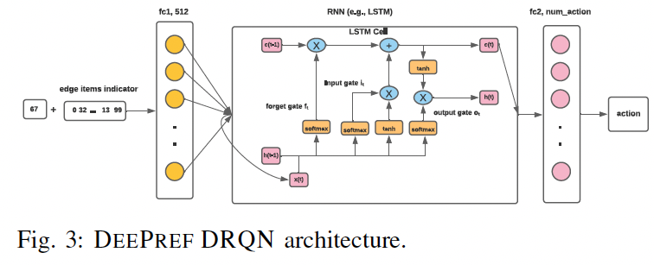
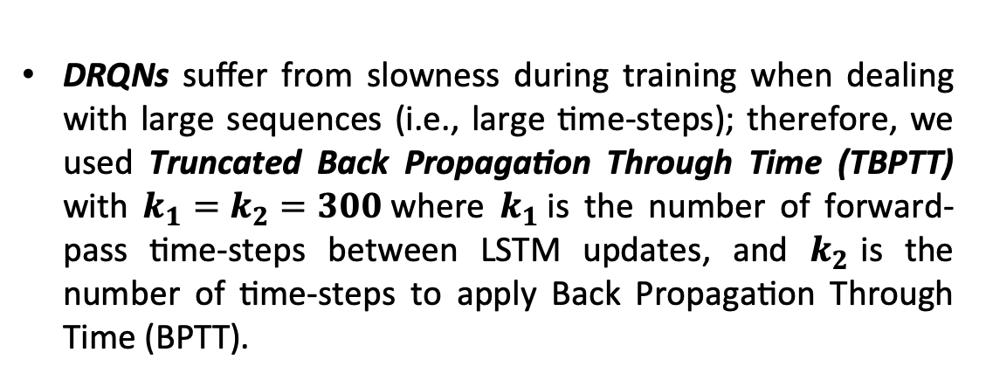
System Architecture (3)
DRQNs suffer from slowness during training when dealing with large sequences (i.e., large time-steps); therefore, we used Truncated Back Propagation Through Time (TBPTT) with $k_{1}=k_{2}=300$where $k_{1}$is the number of forward-pass time-steps between LSTM updates, and $k_{2}$is the number of time-steps to apply Back Propagation Through Time (BPTT).
Notes:
we designed the replay memory to be random access instead of sequential, since user requests are coming from different heterogeneous networks that are in nature representing a non-i.i.d. distribution.

Slide 15
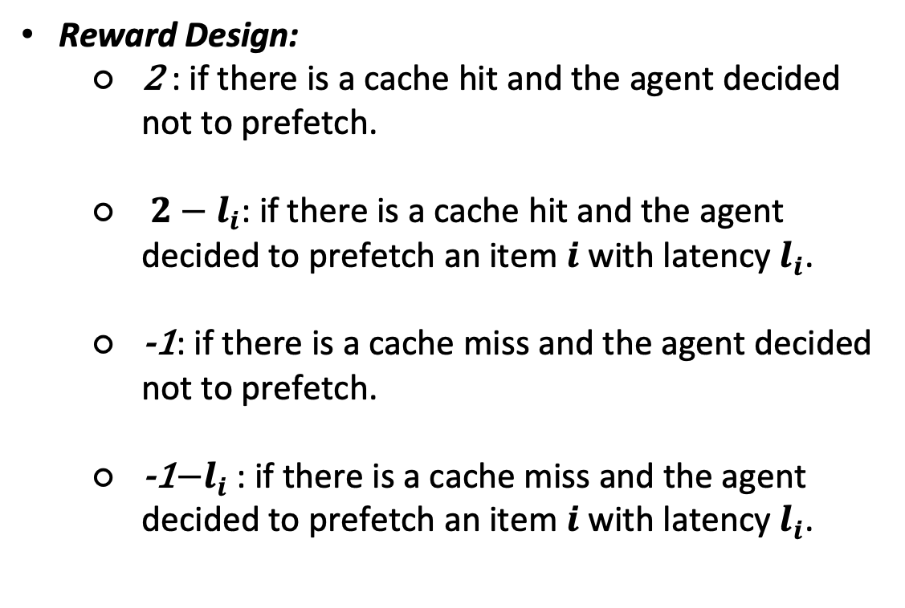
System Architecture (4)
Reward Design:
2 : if there is a cache hit and the agent decided not to prefetch.
$2−l_{i}$: if there is a cache hit and the agent decided to prefetch an item $i$ with latency $l_{i}$.
-1: if there is a cache miss and the agent decided not to prefetch.
-1$−l_{i}$: if there is a cache miss and the agent decided to prefetch an item $i$ with latency $l_{i}$.
Notes:
The simplicity of our reward design lies behind the fact that normalized latency is sensitive to both network throughput and content size. When DeePref makes a prefetching decision that yields a cache miss, it gets punished more if the content that caused a cache miss is large. This allows DeePref to carefully prefetch large files, since they are associated with an increased cost in an uncertain environment.

Slide 16
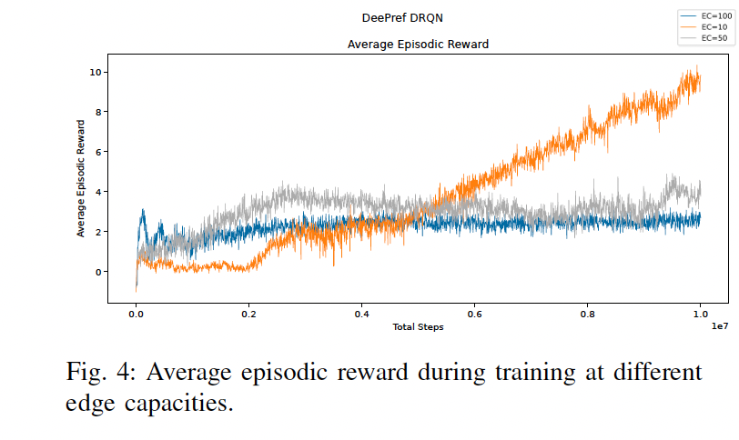
Experimental analysis (1)
Notes:
To observe how DeePref learns an auto-aggressive prefetching policy, we trained DeePref using different edge capacities EC = (10,50,100).
DeePref learns how to minimize end-to-end latency at different edge capacities by leveraging the trade-off between prefetching accuracy and prefetching coverage through fine-tuning its aggressiveness. When edge capacity is relatively small (i.e., EC = 10), DeePref makes prefetching decisions more frequently (i.e., plays aggressively) in order to minimize end-to-end latency and compensate for limited storage. In contrast, when the edge capacity is moderately large $EC=50$ or relatively large $EC = 100$, DeePref prefetches items more conservatively (i.e., less aggressively) from the cloud network, since there is an abundance of storage at the edge network/.

Slide 17
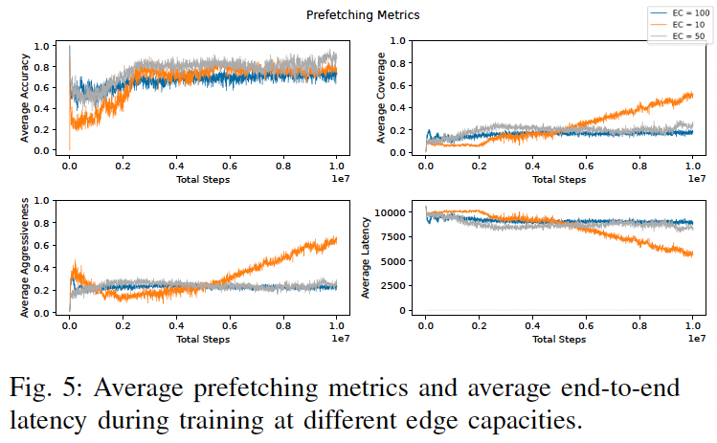
Experimental analysis (2)
Notes:
DeePref learns how to minimize end-to-end latency at different edge capacities by leveraging the trade-off between prefetching accuracy and prefetching coverage through fine-tuning its aggressiveness. When edge capacity is relatively small (i.e., EC = 10), DeePref makes prefetching decisions more frequently (i.e., plays aggressively) in order to minimize end-to-end latency and compensate for limited storage. In contrast, when the edge capacity is moderately large EC=50 or relatively large EC = 100, DeePref prefetches items more conservatively (i.e., less aggressively) from the cloud network, since there is an abundance of storage at the edge network.

Slide 18
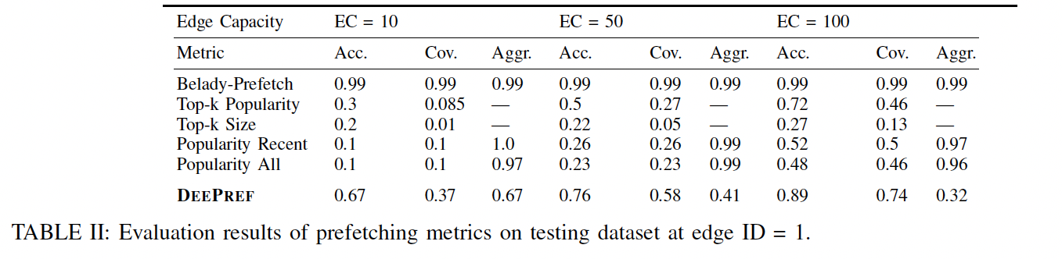
Experimental analysis (3)
We split each cluster’s dataset into 80% training and 20% testing.
DeePref outperforms baseline approaches by [17%, 28%] in terms of prefetching accuracy and coverage, respectively.
Notes:
We split the dataset of each cluster (i.e., edge network) into a training set 80% and a test set 20. Using the test set, we evaluate the performance of DeePref on unseen user requests that are received from multiple users on the same edge network. DeePref outperforms traditional prefetching schemes such as Top-k Popularity and Popularity Recent in terms of prefetching accuracy and prefetching coverage. DeePref outperforms baseline approaches with an increase of at least [17%, 28%] in terms of prefetching accuracy and coverage, respectively.

Slide 19
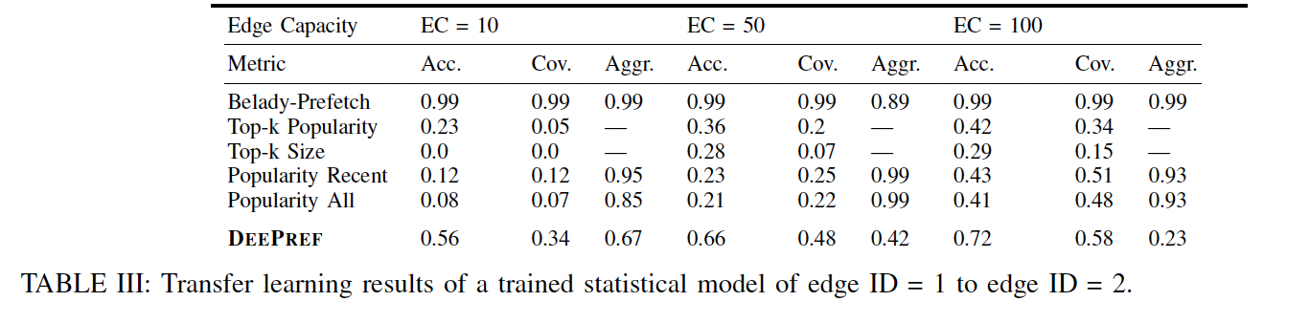
Experimental analysis (4)
Using transfer learning, DeePref improves both prefetching accuracy and coverage compared to the baseline approaches with an increase of [30%, 10%] in terms of prefetching accuracy and coverage, respectively.
Notes:
We study distribution shift where the user requests received are sufficiently different from what DeePref was trained on. We apply transfer learning methods to transfer the statistical model of DeePref from a trained edge network (e.g., Edge ID = 1) to an entirely new edge network (e.g., Edge ID = 2). This exposes DeePref to unseen data that are sufficiently different from the training dataset, which represents a different statistical distribution. DeePref improves both prefetching accuracy and coverage compared to the baseline approaches with an increase of [30%, 10%] in terms of prefetching accuracy and coverage, respectively.

Slide 20
Concluding Remarks
DeePref is an auto-aggressive prefetcher that is sensitive to different edge capacities.
DeePref makes prefetching decisions more aggressively when the edge capacity is small, and more conservatively when the edge capacity is large.
DeePref is agnostic to hardware design, operating system, and application where it utilizes only the video ID and entirely ignores user information when making prefetching decisions.
Using an evaluation dataset, DeePref outperforms baseline approaches by [17%, 28%] in terms of prefetching accuracy and coverage, respectively.
Using transfer learning, DeePref improves both prefetching accuracy and coverage compared to the baseline approaches with an increase of [30%, 10%] in terms of prefetching accuracy and coverage, respectively.

Slide 21
Reference
[1] VNI Cisco. Cisco visual networking index: Forecast and trends, 2017– 2022. White Paper, 2018.
[2] Martin L Puterman. Markov decision processes: discrete stochastic dynamic programming. John Wiley & Sons, 2014.
[3] Volodymyr Mnih, Koray Kavukcuoglu, David Silver, Alex Graves, Ioannis Antonoglou, Daan Wierstra, and Martin Riedmiller. Playing atari with deep reinforcement learning. arXiv preprint arXiv:1312.5602, 2013.
[4] Matthew Hausknecht and Peter Stone. Deep recurrent q-learning for partially observable mdps. arXiv preprint arXiv:1507.06527, 2015.
[5] Sepp Hochreiter and J ̈urgen Schmidhuber. Long short-term memory. Neural computation, 9(8):1735–1780, 1997.
[6] Kyunghyun Cho, Bart Van Merri ̈enboer, Caglar Gulcehre, Dzmitry Bah- danau, Fethi Bougares, Holger Schwenk, and Yoshua Bengio. Learning phrase representations using rnn encoder-decoder for statistical machine translation. arXiv preprint arXiv:1406.1078, 2014.
[7] Arun Venkataramani, Praveen Yalagandula, Ravindranath Kokku, Sadia Sharif, and Mike Dahlin. The potential costs and benefits of long term prefetching for content distribution. Computer Communications, 25(4):367–375, 2002.

Slide 22
Questions?

