Slide 1
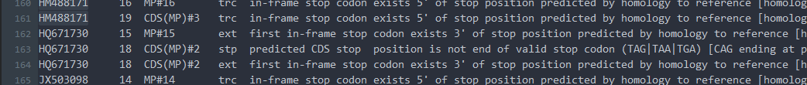
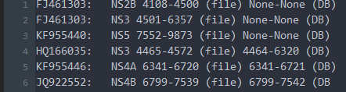
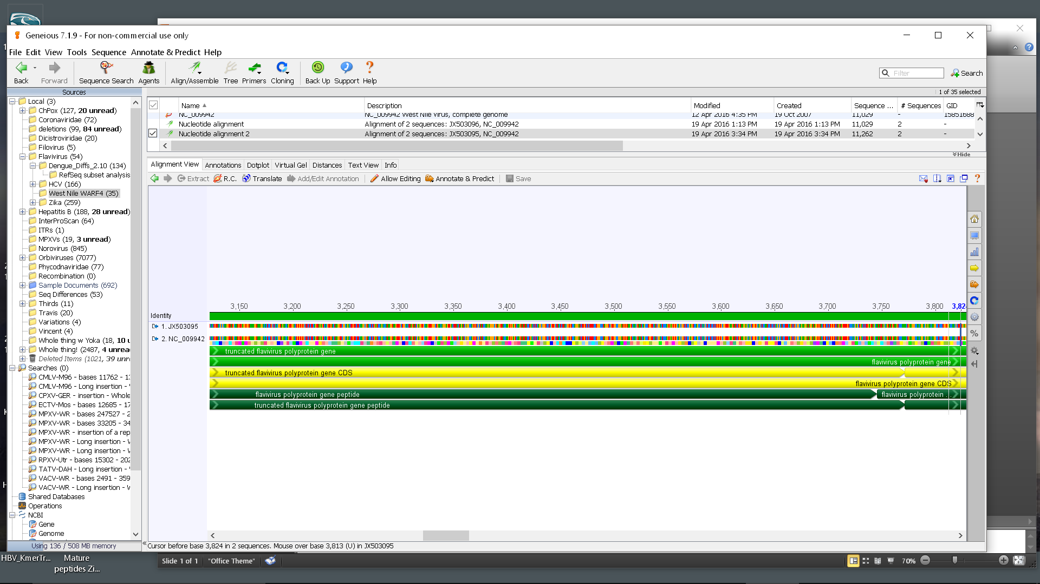
Annotation Review Process
1. Randomly select sequences with and without errors from the pipeline output OR list of differences between annotation output and Virus Variation Resource database
OR
2. Use alignments of the RefSeq(s) and the selected sequences to verify or correct each error, and identify errors that may have been missed.
NC_009942 MP#16 (NS1’)
HM488171 MP#16 trc in-frame stop codon exists 5' of stop position predicted by homology to reference [homology search predicted 3553..3681 revised to 3553..3603 (stop shifted 78 nt)]
3. Rodney’s group provides Alejandro and Eric with a list suggesting improvements that should be made in the code.
slide created by Eneida Hatcher

Slide 2
Identifying Rare Errors
West Nile virus, lineage 1
3 typical translations
1
3
6
7
8
9
10
11
12
13
14
2
4
5
1
3
6
7
8
9
10
11
12
15
2
4
5
NS4B-WARF4 truncated polyprotein
1
3
6
16
NS1’ truncated polyprotein
2
4
5
slide created by Eneida Hatcher

Slide 3
Identifying Rare Errors
West Nile virus, lineage 1
3 typical translations
1
3
6
7
8
9
10
11
12
13
14
2
4
5
1
3
6
7
8
9
10
11
12
15
2
4
5
NS4B-WARF4 truncated polyprotein
1
3
6
16
NS1’ truncated polyprotein
2
4
5
HM488171 errors:
#16 truncated, correct error, leads to
#15 not translated due to an earlier truncation, incorrect error
Code was edited, removing the incorrect error
slide created by Eneida Hatcher

Slide 4
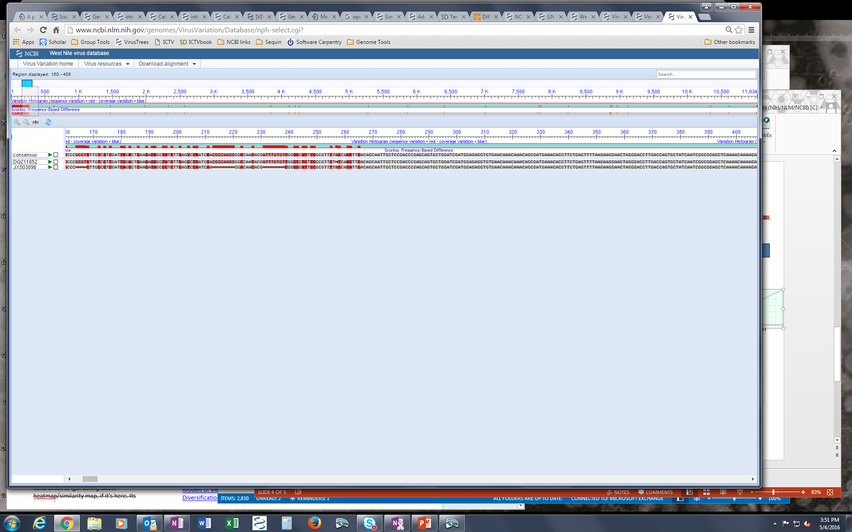
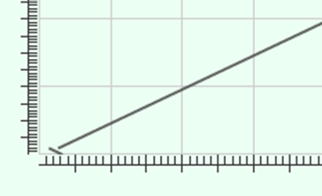
Identifying Rare Errors
West Nile virus, lineage 1
1
3
6
7
8
9
10
11
12
13
14
2
4
5
JX503096 errors:
#1 olp feature does not overlap with same set of features as in reference [-(1.1,2.1)]
__
#2 olp feature does not overlap with same set of features as in reference [-(2.1,1.1)]
__
#2 trc in-frame stop codon exists 5' of stop position predicted by homology to reference [homology search predicted 228..1 revised to 228..175 (stop shifted 174 nt)]
__
CDS str predicted CDS start position is not beginning of ATG start codon [ATT starting at position 51 on strand +]
Poor alignment:
Code searches for homology in forward and reverse directions, and found that JX503096 has a reverse-complement section
slide created by Eneida Hatcher

Slide 5
Identifying Rare Errors
West Nile virus, lineage 1
1
3
6
7
8
9
10
11
12
13
14
2
4
5
JX503096 errors:
#1 does not overlap
#2 does not overlap
#2 truncated
CDS start position is not ATG
Poor alignment:
Code searches for homology in forward and reverse directions, and found that JX503096 has a reverse-complement section
slide created by Eneida Hatcher

