Slide 1
SK하이닉스 기계학습 프로그램 Uncertainty prediction, adversarial examples and explainable learning
Jongheon Jeong (jongheonj@kaist.ac.kr)
KAIST ALIN Lab. (Prof. Jinwoo Shin)
July 25, 2019

Slide 2
Overview
This tutorial consists of 5 parts:
Part 1. TensorFlow를 활용한 역전파 알고리즘 수행
Part 2. 적대적 샘플 만들어 보기: ImageNet 분류기에 대한 FGSM 공격
Part 3. 적대적 공격 기법 설계하기
Part 4. 적대적 방어 기법 설계하기
Part 5. 모델 해석을 통해 적대적 샘플 이해하기

Slide 3
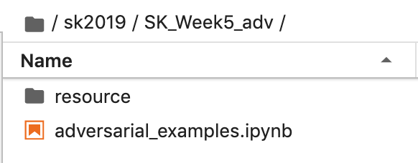
Overview
Please download the material in the following link:
https://bit.ly/2K38Zxn
The tutorial is mainly driven in Jupyter-notebook
Make sure the material is accessible by Jupyter console
Please read & follow the instructions inside the project file
Main project

Slide 4
Overview
Dependencies
python3
numpy
tensorflow == 1.14.0
jupyter-notebook
matplotlib
“SK_Week1_py3” environment met the dependencies:
Download link: https://bit.ly/2K38Zxn
$ source activate SK_Week1_py3 (SK_Week1_py3) $ jupyter-notebook

Slide 5
Overview
Please submit 2 files in archived form
skhynix_<이름>_0726.zip
<이름>_notebook.ipynb
<이름>_report.pdf
Send a mail to: jongheonj@kaist.ac.kr
Download link: https://bit.ly/2K38Zxn
$ source activate SK_Week1_py3 (SK_Week1_py3) $ jupyter-notebook

