Slide 1
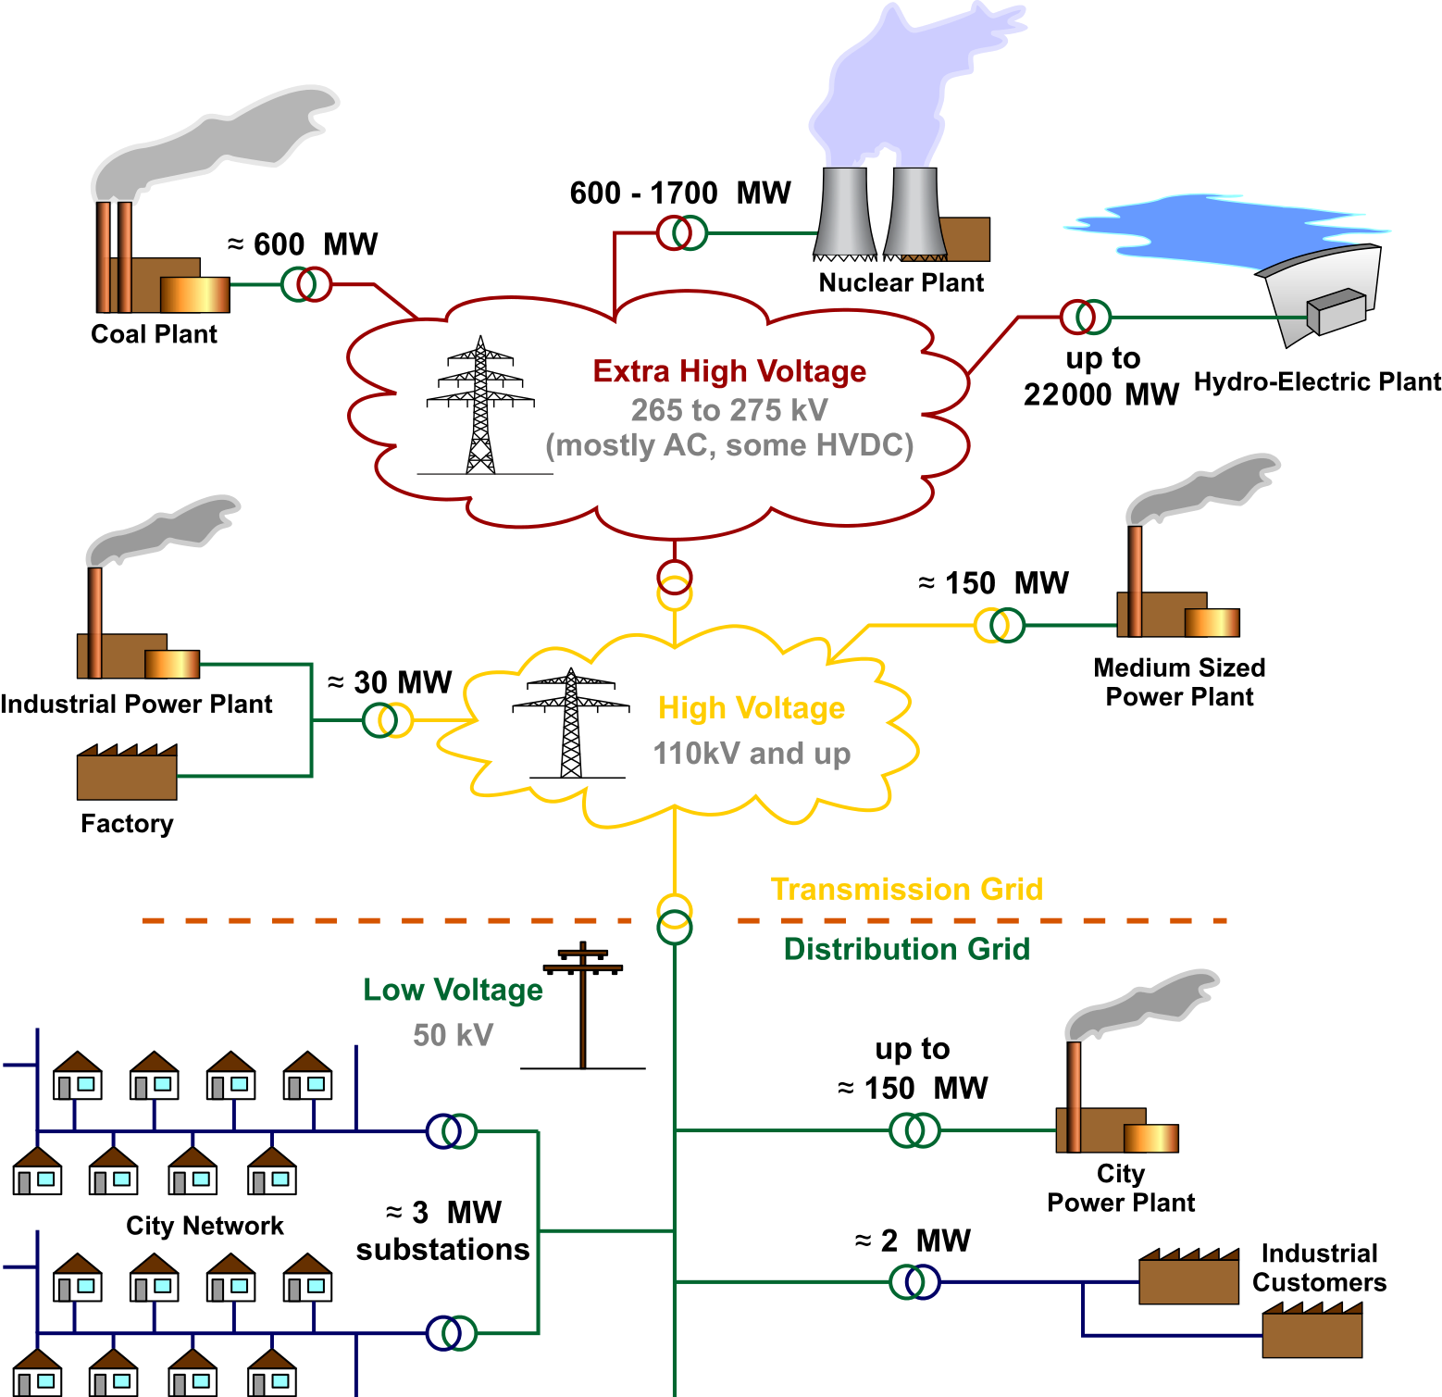
Explainable Voltage Prediction using NAMs in Power Grids
Modern electrical distribution networks are experiencing significant transformations due to the integration of distributed energy resources such as photovoltaic (PV) systems.

Slide 2
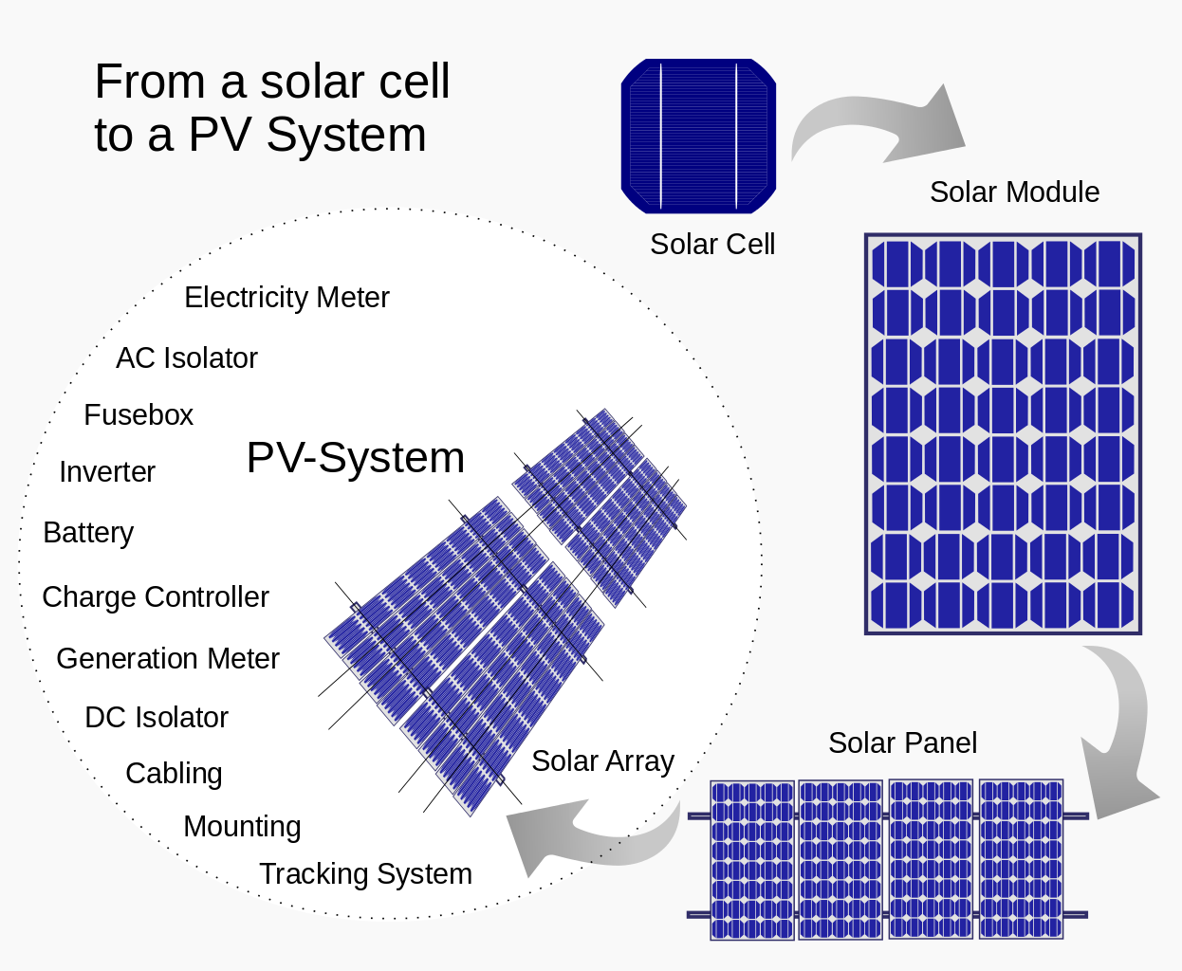
PV-Based Scenario
The aim is to analyze how different DER configurations influence the network's voltage profile and identify reconfiguration strategies that can improve voltage regulation and minimize active power losses. To achieve this, develop surrogate models to approximate the network behavior, evaluate their performance using test scenarios, and apply explainable AI (XAI) techniques.

Slide 3
Features Definition
Tap1, Tap2 are the tap settings of two on-load tap changers,
PV1loc – PV5loc are the bus IDs (integers from 2 to 33) where photovoltaic (PV) units are placed,
PV1size – PV5size are the active power injection levels of each PV unit (e.g., in kW or normalized units).
File: verilerPV.mat ---------> input.csv + output.csv
Input.csv : shape (2000, 12) — input features: [Tap1, Tap2, PV1loc,…,PV5loc, PV1size, . . . , PV5size] ∈ 𝑅12
Output.csv : shape (2000, 33) — outputs: |V1|, |V2|, ..., |V33|∈ 𝑅33
Preprocessing:
Normalized input features using StandardScaler
80/20 split: 1600 samples for training, 400 for testing

Slide 4
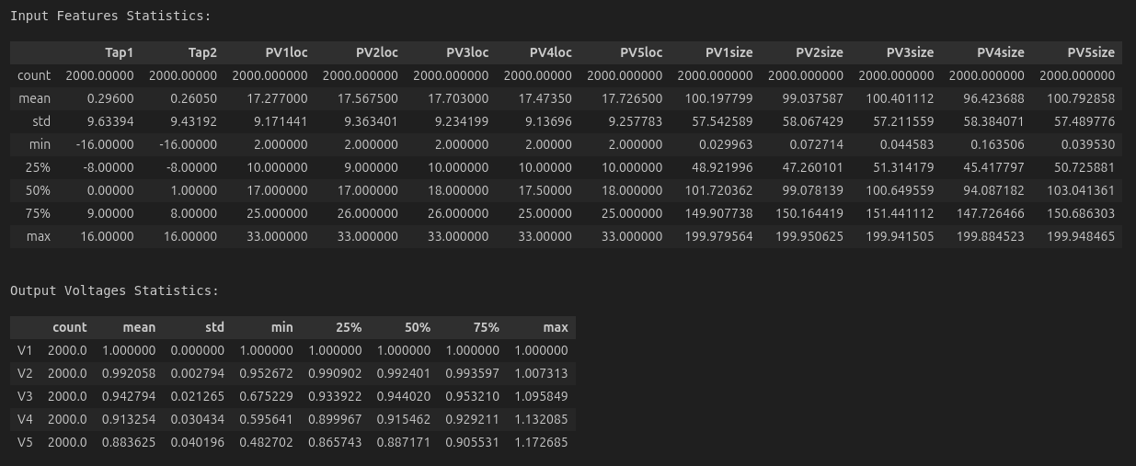

Slide 5
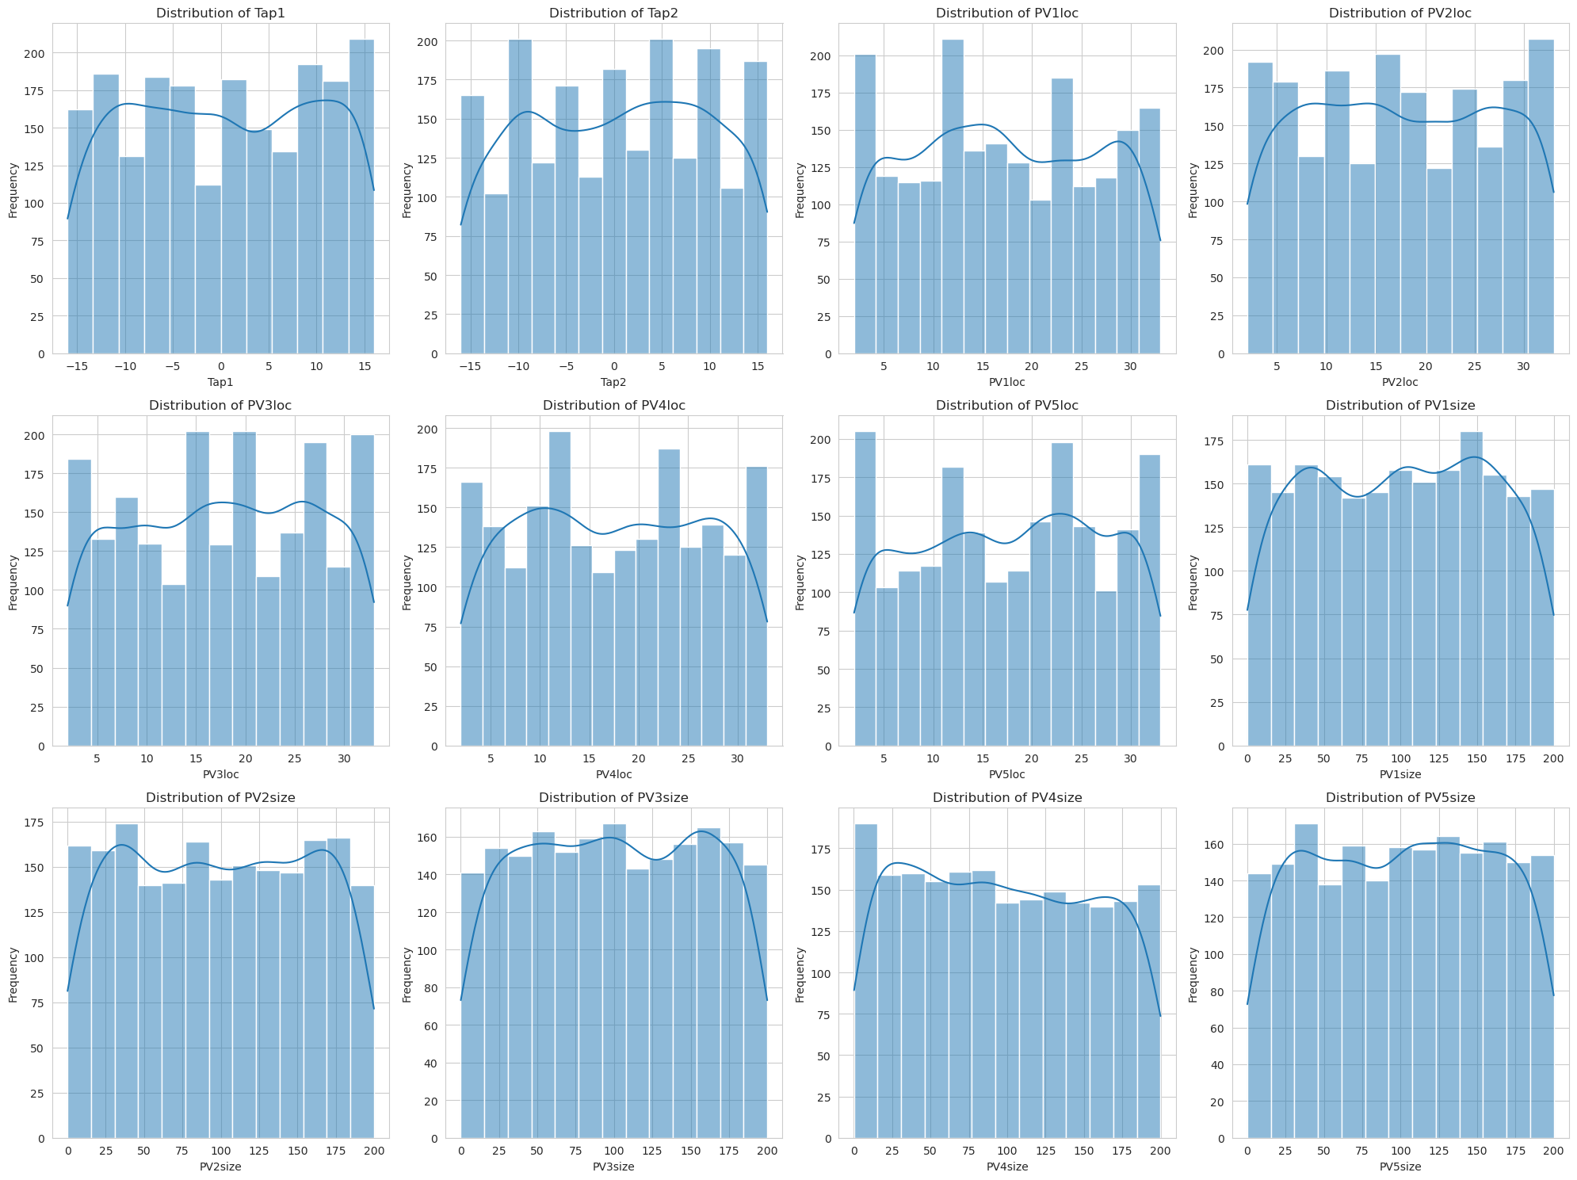

Slide 6
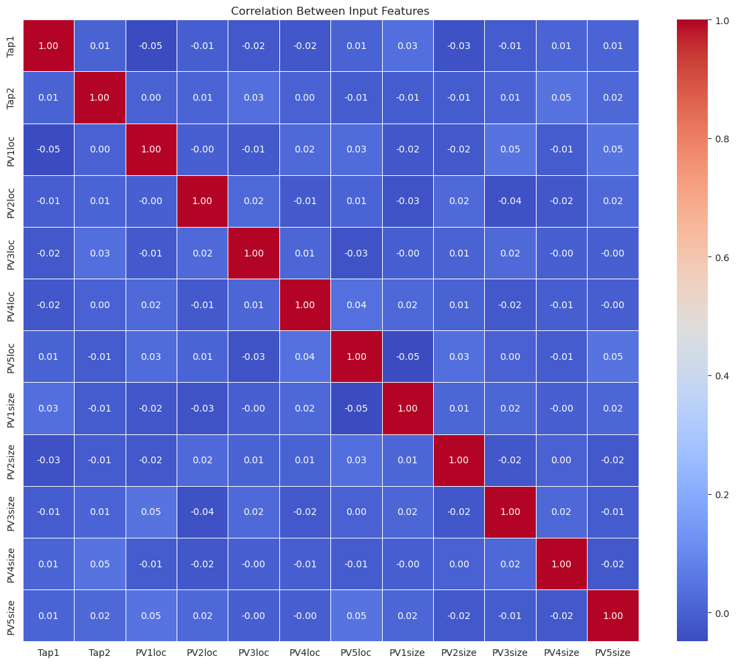
Input Features Correlation
There is not any correlation between input features.
Any input features are not redundant or highly collinear.

Slide 7
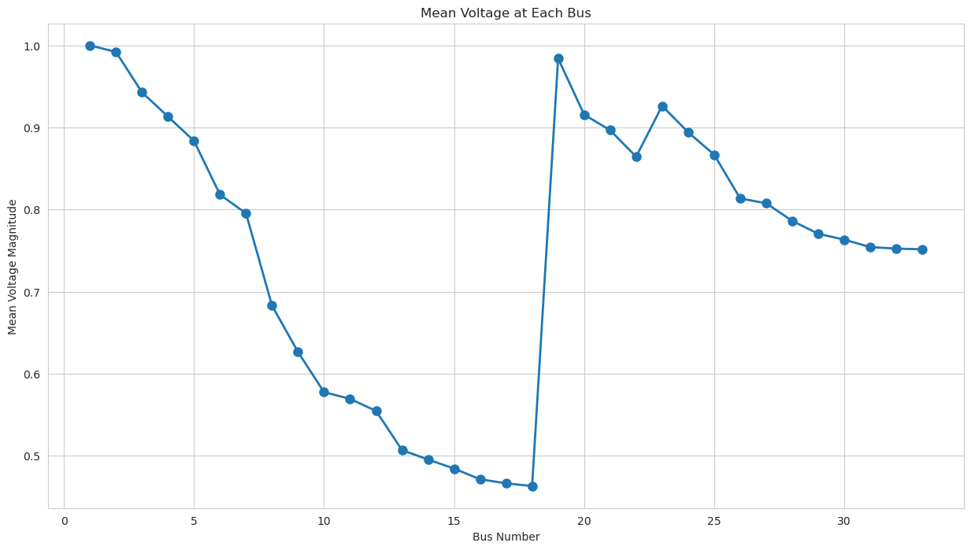

Slide 8
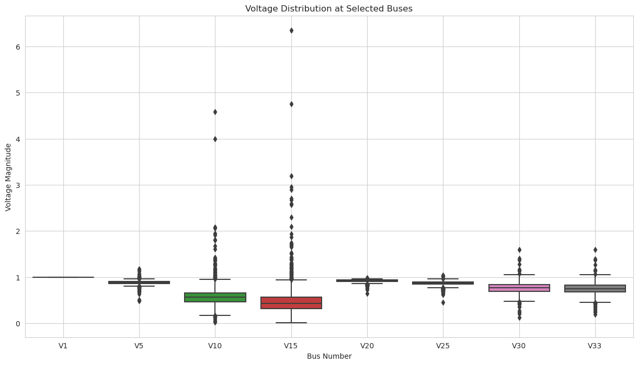
Selected Voltage Buses Distribution
It resembles a piecewise signal:
First segment: Almost exponential or quadratic And Jump At one specific index
Second segment: A slightly noisy decreasing trend

Slide 9
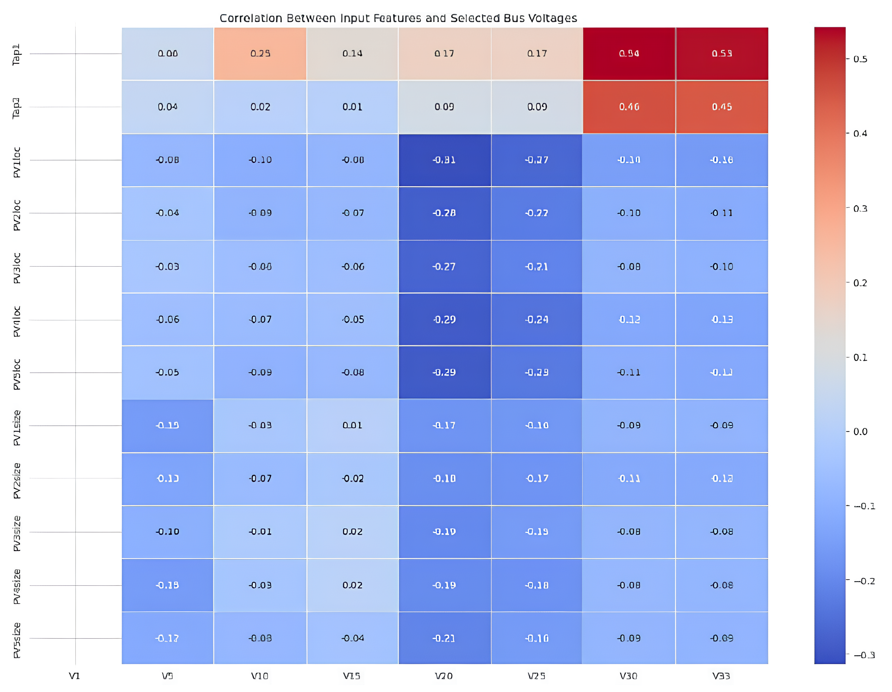

Slide 10
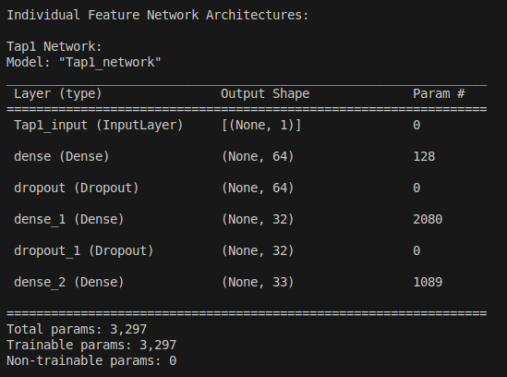
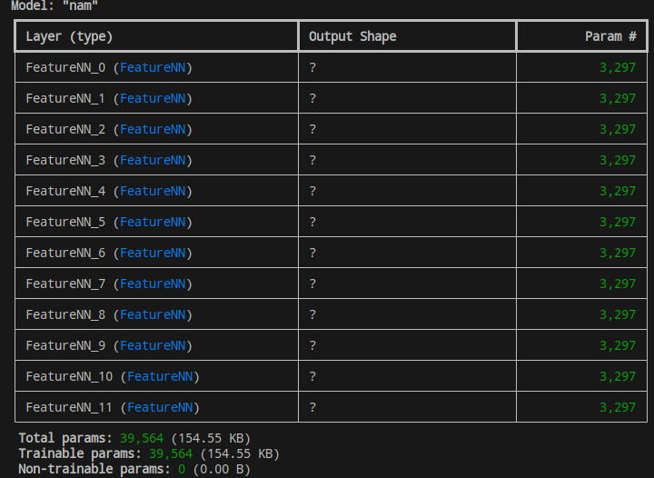
Training process

Slide 11
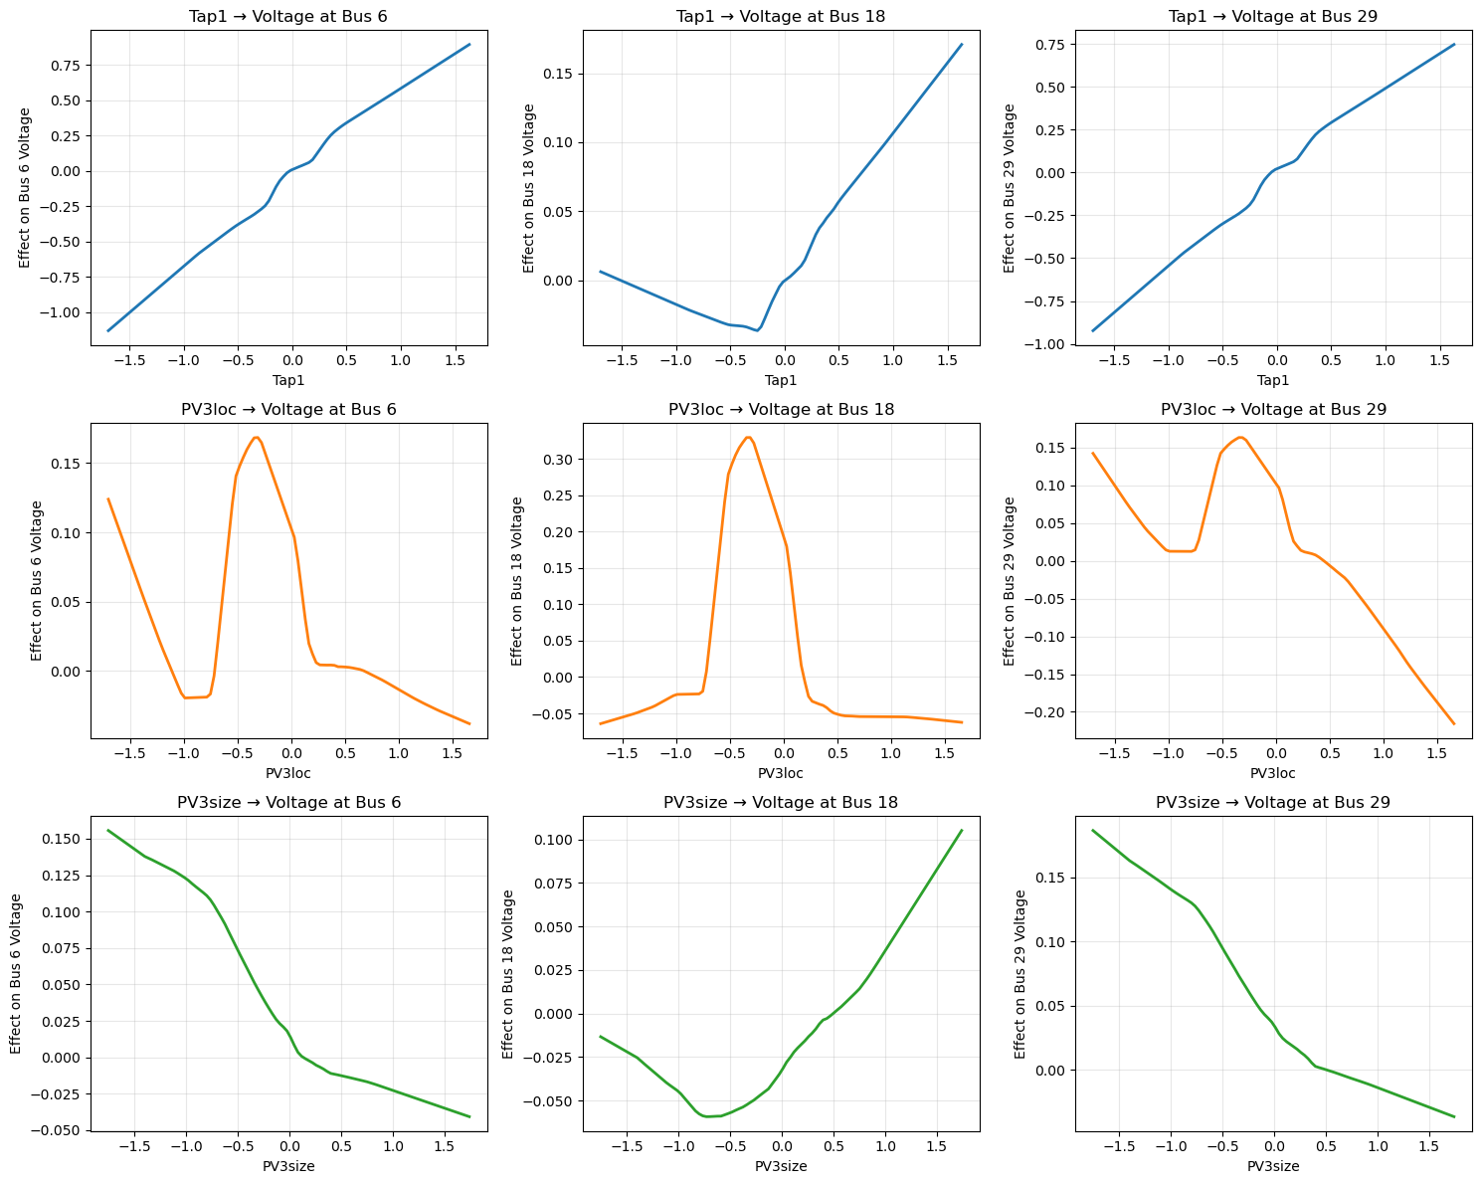
=== NAM Feature Effect Analysis ===
Tap1:
Bus 6: positive relationship (slope: 0.6095)
Bus 18: positive relationship (slope: 0.0495)
Bus 29: positive relationship (slope: 0.5031)
PV3loc:
Bus 6: negative relationship (slope: -0.0483)
Bus 18: minimal effect (slope: 0.0005)
Bus 29: negative relationship (slope: -0.1066)
PV3size:
Bus 6: negative relationship (slope: -0.0562)
Bus 18: positive relationship (slope: 0.0339)
Bus 29: negative relationship (slope: -0.0638)

Slide 12
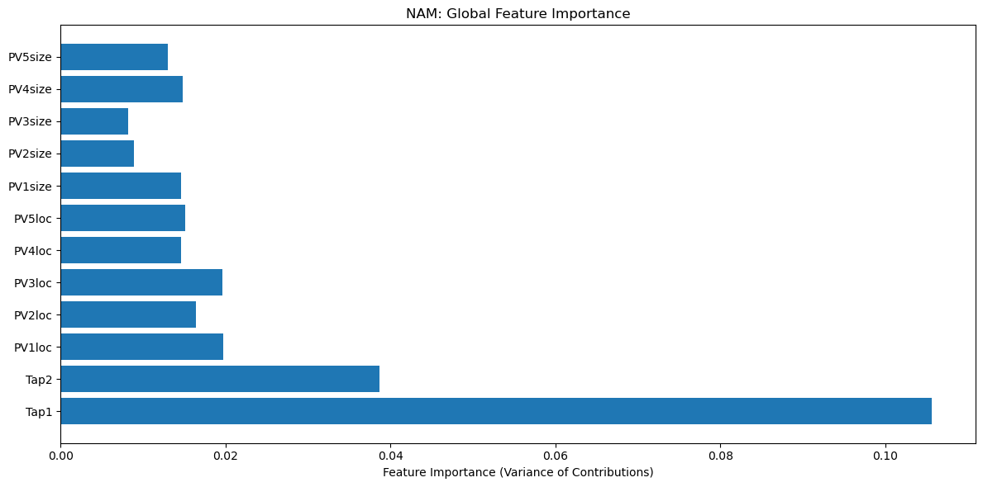
NAM

Slide 13
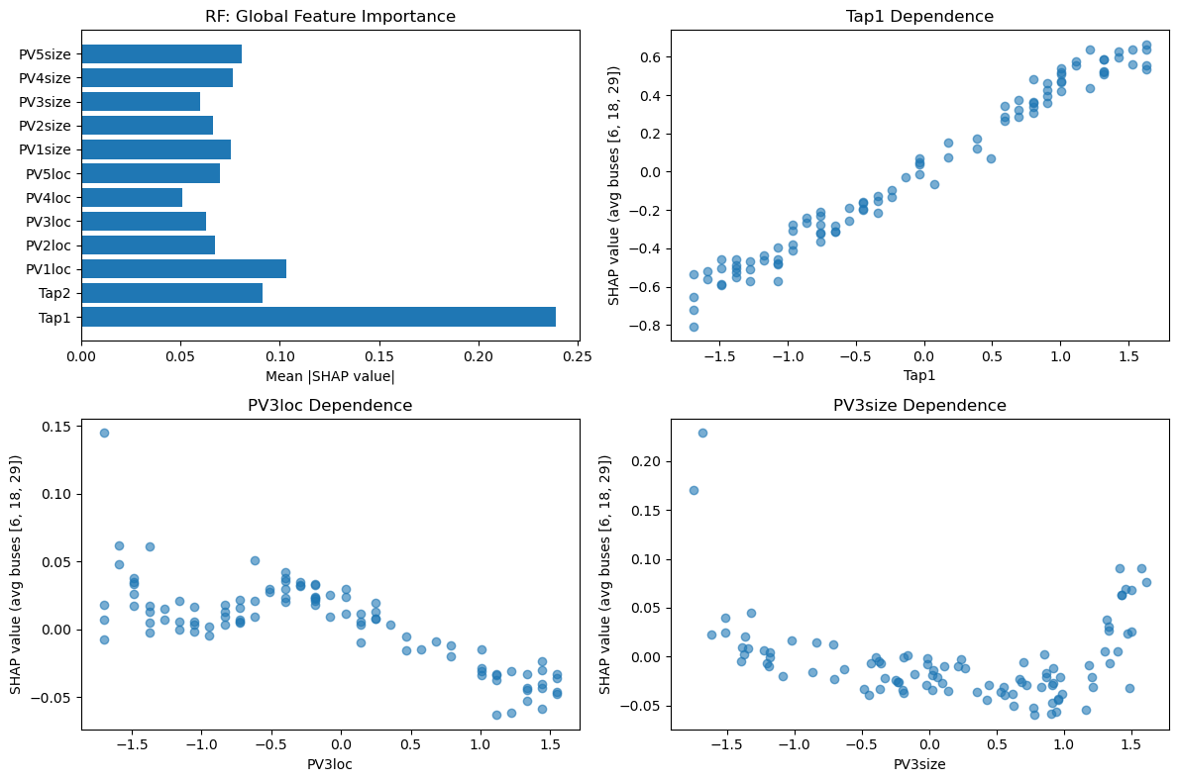
Random Forest

Slide 14
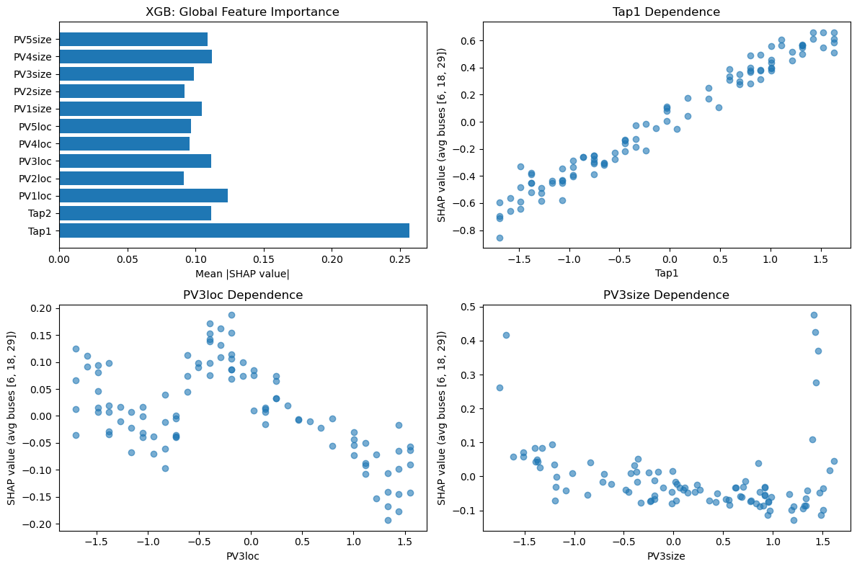
XGBOOST

Slide 15
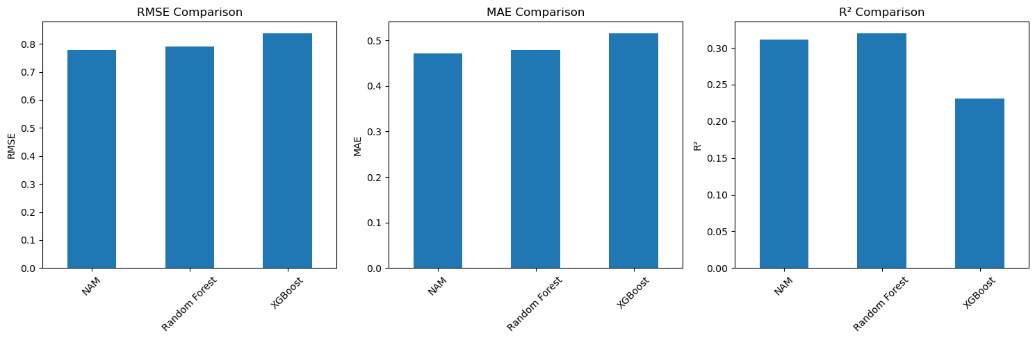
=== Model Performance Comparison ===

Slide 16
Conclusion
• Which method provided more actionable insights for your task?

Slide 17
• Was SHAP able to recover similar patterns to the NAM plots?

Slide 18
• Are there any discrepancies between the importance values or direction of effect?

Slide 19
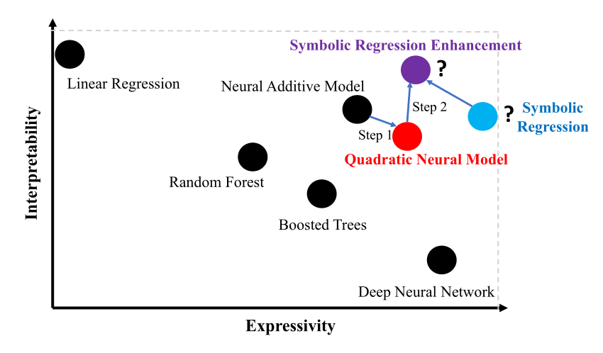
^{General Evaluation}
Thanks to the NAM model, a “white box” model that is easy for humans to understand has been obtained.
“If I increase PV generation by 20%, what will be happen to the voltage on a specific node?”
NAM model is suitable for use as a decision support system in critical infrastructures such as distribution networks, as it provides output that human experts can easily interpret.
Other approaches may provide more detailed explanations for this case.

Slide 20

Thanks for Listening
Nazif ÇELİK 090200712

Slide 21
Reference
https://www.sciencedirect.com/science/article/pii/S2352012422007688
Neural Additive Models: Interpretable Machine Learning with Neural Nets. NeurIPS 2021
Scikit-Learn Documentation. MultiOutputRegressor
ApX Machine Learning. SHAP Summary & Dependence Plots – Model Interpretability Course.
SHapley Additive exPlanations or SHAP : What is it ?

