Slide 1
Hackathon
<<Idea Submission Template>>
CLICK HERE

Slide 2
Hackathon - template
Business Problem:
In the present condition, we are spending good amount of time & effort in making a associate getting deployed. Most of the effort goes towards resource identification, skill assessments and skill update(prep and deploy)
If there is a factor/ranking for a given associate against him/her primary skill cluster, then it will be easy for the LnD team to upskill/Cross Skill the associates.
Opportunity for Virtusa
Faster matching resource identification, Improvement in Re-Skilling and Upskilling efficiency
Solution brief
Our Solution is to analyze by the employee data and come out with an Deploy ability index that will indicate employee current snapshot on skill possessed. The Rank we are talking about will look like
DI://X1.EE.STD@XXL.A+.2CERT.HO@R.W.W
Adv & benefits
Faster Deployment
Reduced Failure Rate
Re/Upskilling - Catch them young strategy
Core Modules

Slide 3
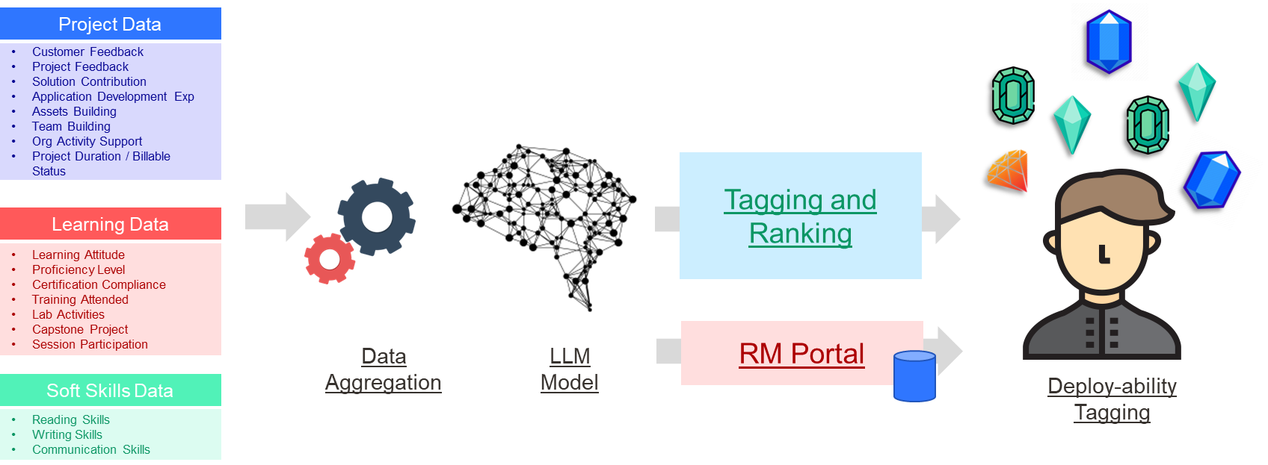
Solution Design / Approach

Slide 4
Benefits
Improved Customer delight
On Time Project Kickstart
Right skilled resources
Lower Bench Cost
Faster deployment
Shift Left Strategy
Making associate project ready
Transparent and improved Associate experience.
Benefits to customers
Benefits to Virtusa
Lower Bench Cost
Faster Project Onboarding
Calculated Skill Set measurement against the demand
Target all Customer Segment
Improves Customer experience
Resource level traceability and source attribution
Deployment speed
Potential revenue/pipeline/cost benefits
Expected result/impact of solving the problem

Slide 5
TEAM behind this
XXX
Designation
Team Lead
VVV
Architect
HHH
AD

Slide 6
Thank You
Notes:
Leading industry analysts and awards organizations have recognized Virtusa for our exceptional quality in digital engineering and transformational IT capabilities.
Highlights:
Virtusa's vLife™ platform in the Best New Product or Service of the Year - Health & Pharmaceuticals - Product category. vLife™ is a ready-to-use collaborative platform, built on a large clinical data lake that models disease progression or population-level risk categorization. By unifying data, AI, and IoT, Virtusa is helping the healthcare market address key pain points.

