Slide 1
RTC(Real Time Clock)
A real-time clock (RTC) is a computer clock (most often in the form of an integrated circuit) that keeps track of the current time. Although the term often refers to the devices in personal computers, servers and embedded systems, RTCs are present in almost any electronic device which needs to keep accurate time.
Although keeping time can be done without an RTC using one has benefits:
Low power consumption
Frees the main system for time-critical tasks
Sometimes more accurate than other methods

Slide 2
RTC(Real Time Clock)
Power source
RTCs have an alternate source of power, so they continue to keep time while the primary source of power is off . This alternate source of power is normally a lithium battery in older systems, but some newer systems use a supercapacitor because they are rechargeable and can be soldered.
Timing
Most RTCs use a crystal oscillator. In many cases, the oscillator's frequency is 32.768 kHz. This is the same frequency used in quartz clocks and watches.
Many integrated circuit manufacturers make RTCs, including Epson, Intersil, IDT, Maxim, NXP Semiconductors, Texas Instruments and STMicroelectronics. The RTC was introduced to PC compatibles by the IBM PC/AT in 1984, which used a Motorola MC146818 RTC. Later, Dallas Semiconductor made compatible RTCs, which were often used in older personal computers, and are easily found on motherboards because of their distinctive black battery cap and silkscreened logo. In newer systems, the RTC is integrated into the southbridge chip
Some microcontrollers have a real-time clock built in, generally only the ones with many other features and peripherals.

Slide 3
RTC(Real Time Clock)
The controls that a programmer have w.r.t a RTC are as follows:
1.Select Frequency of the clock
2.Select the type of Interrupts for exampe whether periodic interrupt or not
3.selects the mode in which data to be stored in register ex: BCD or Binary
4.selects type of time format ex:24 hours time format or 12 hours time format and many more...
All the above stated controls will be discussed again at the register level

Slide 4
Terminology
Update Cycle: time taken from enabling UIP
updating values like sec,sec alarm,min...etc and
disabling UIP is called an update cycle
High Precision Event Timer (HPET).It is a successor to RTC,has 10Mhz (higher freq) & (64-bit counter & can also be used as 32-bit counter)...used with latest O.S
Enhanced Alarm:If the RTC is alarming not only based on sec,hr,min but also day,month & year then such an alarm is called as an Enhanced Alarm

Slide 5
Terminology
Oscillator: An electronic oscillator is an electronic circuit that produces a periodic, oscillating electronic signal, often a sine wave or a square wave
Control Registers:controls the functionalities of the device i.e; can enable or disable certain functionalities of that particular device
Flag Registers:Shows the status of the device i.e; helps to know whether a particular functionality is enabled or not

Slide 6
RTC Internals
Frequency Divider
OSC
/2
/4
16x1 MUX
32 KHZ
REGISTERS
Power Supply
Control/status registers
Clk,calender,alarm & control bytes
User buffer registers

Slide 7
RTC memory mapping
RAM
RTC
Extended Bank
128 bytes
Standard Bank
128 bytes

Slide 8
Comparision b/w Registers set & Header File
RAM
RAM Standard Bank
RAM
OFFSET | REGISTER | Programming Name
0D | Flag Register | RTC_REG_D
0C | Flag Register | RTC_REG_C
0B | GeneralConfiguration | RTC_REG_B
0A | RTC index register | RTC_REG_A
09 | year | RTC_YEAR
08 | month | RTC_MONTH
07 | Date of month | RTC_DAY_OF_MONTH
06 | Day of week | RTC_DAY_OF_WEEK
05 | Hours alarm | RTC_HOURS
04 | hours | RTC_HOURS
03 | minutes alarm | RTC_MINUTES_ALARM
02 | minutes | RTC_MINUTES
01 | Seconds alarm | RTC_SECONDS_ALARM
00 | seconds | RTC_SECONDS
0E
0D
0C
0B
0A
09
08
07
06
05
04
03
02
01
00

Slide 9
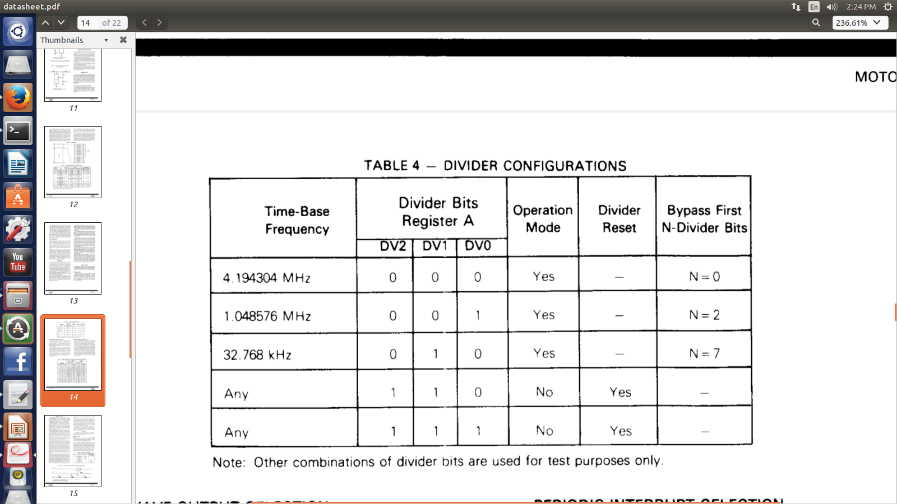
Comparision b/w Registers set & Header File REGISTER-A (RTC_FREQ_SELECT)
Division Chain
Rate Select
UIP
7 | 6 | 5 | 4 | 3 | 2 | 1 | 0
Note: RTC_FREQ_SELECT is the name used in program. refer mc146818rtc.h
UIP:Update In Progress==>Whenever one needs to update all vaues of clock
Ex:sec,hr,..etc we first need to set the UIP & after updating values need to clear the
UIP to indicate that update is not in progress now

Slide 10
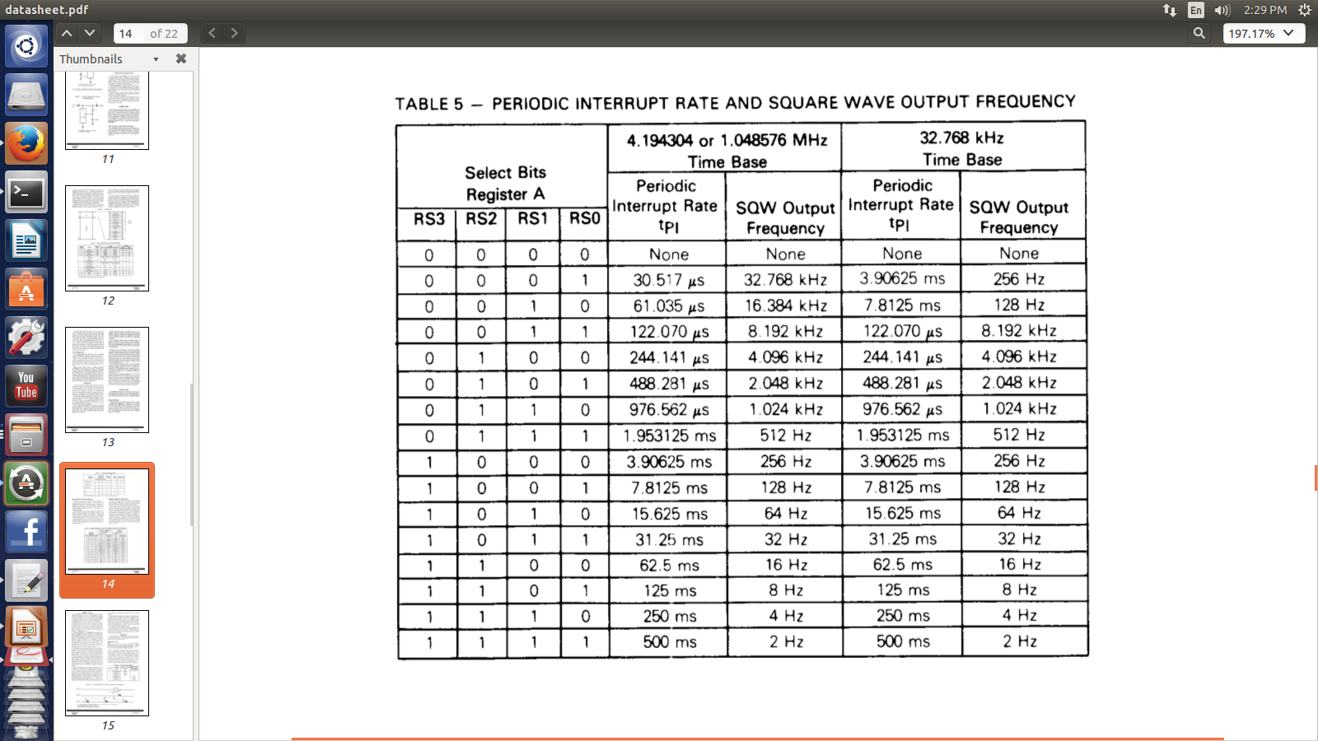
Comparision b/w Registers set & Header File

Slide 11
REGISTER-B (RTC_CONTROL)==>control register
SET | PIE | AIE | UIE | SQWE | DM | HF | DSE
7 | 6 | 5 | 4 | 3 | 2 | 1 | 0
DSE=1==>Daylight Savings enable
DSE=0==>Daylight Savings disable
HF(Hour Format)=1==> 24 hours format
HF(Hour Format)=0==> 12 hours format
DM(Data Mode)=1==> binary
DM(Data Mode)=0==> BCD
SQWE(Square Wave Enable)=1==>Square Wave is Enabled
SQWE(Square Wave Enable)=0==>Square Wave is disabled
SET=1==>Update cycle once a second
SET=0==>Update cycle aborted
NOTE:remaining bits will be discussed later

Slide 12
REGISTER-C (RTC_INTR_FLAGS)==>flag register
Default 0 & not used
IRFQ | PF | AF | UF | 0 | 0 | 0 | 0
7 | 6 | 5 | 4 | 3 | 2 | 1 | 0
UF(Update Flag)=1==>Update is going on
if(UF==1&&UIE==1)==>Interrupt for update is generated
AF(Alarm Flag)=1==>Alarm is enabled
if(AF==1&&AIE==1)==>Interrupt for an Alarm is generated
PF(Periodic Flag)=1==>Periodic interrupt enabled
if(PF==1&&PIE==1)==>Interrupt for a periodic update is generated
IRFQ(Interrupt Request Flag)=1==>interrupt is asserted & that interrupt can be any of the below
1.Alarm Interrupt
2.Periodic Interrupt
3.Interrupt

Slide 13
REGISTER-D (RTC_VALID)==>flag register
VRT | RSV1 | DA | DA | DA | DA | DA | DA
7 | 6 | 5 | 4 | 3 | 2 | 1 | 0
VRT: Valid RAM Time
RSV1=0 by default
DA=Date Alarm
NOTE:
1.Before writing into any bit of a register,need to enable VRT
2.Date Alarm stores date of a particular month

Slide 14
Reading & Writing(Registers)
#define CMOS_READ(addr) ({ \
outb_p((addr),RTC_PORT(0)); \ /* goto a particular register address */
inb_p(RTC_PORT(1)); \ /*read from the above specified register address*/
})
#define CMOS_WRITE(val, addr) ({ \
outb_p((addr),RTC_PORT(0)); \ /* goto a particular register address */
outb_p((val),RTC_PORT(1)); \ /*write into the above specified register address*/
})
Outb here b ==> byte

Slide 15
CMOS_WRITE()
Calls to CMOS_READ and CMOS_WRITE must be done with interrupts disabled that can be acheived by using spinlocks(that holds global lock rtc_lock),so that no interrupt can interrupt while reading & writing operations), holding the global rtc_lock, to exclude those other drivers and utilities on correctly configured systems.
CMOS_WRITE(src,dst) basically helps in writing status of src(source) bit into the dst(destination) bit location inside a particular register
#include <asm-generic/rtc.h> has the declarations of CMOS_READ & CMOS_WRITE
Example: /* updating alarm */
CMOS_WRITE(hrs, RTC_HOURS_ALARM);
CMOS_WRITE(min, RTC_MINUTES_ALARM);
CMOS_WRITE(sec, RTC_SECONDS_ALARM);

Slide 16
CMOS_READ( )
CMOS_READ(dst) basically helps in reading status from the dst(destination) bit location inside a particular register
Example:
CMOS_READ(RTC_SECONDS_ALARM);
CMOS_READ(RTC_MINUTES_ALARM);
CMOS_READ(RTC_HOURS_ALARM);

Slide 17
CMOS_READ( )
CMOS_READ(dst) basically helps in readinging status from the dst(destination) bit location inside a particular register
Example:
CMOS_READ(RTC_SECONDS_ALARM);
CMOS_READ(RTC_MINUTES_ALARM);
CMOS_READ(RTC_HOURS_ALARM);

Slide 18
File Operations
File Operations performed on the RTC device are as follows:
read_time (using this function can read clock time in the user-app)
set_time (using this function can set clock time in the user-app)
read_alarm (using this function can read alarm time in the user-app)
set_alarm (using this function can set alarm time in the user-app)
Proc (using this function to display logs in the user-app)
alarm_irq_enable (using this function to enable IRQ in the user-app)

Slide 19
File Operations
static const struct rtc_class_ops cmos_rtc_ops = {
.read_time = cmos_read_time,
.set_time = cmos_set_time,
.read_alarm = cmos_read_alarm,
.set_alarm = cmos_set_alarm,
.proc = cmos_procfs,
.alarm_irq_enable = cmos_alarm_irq_enable,
};

Slide 20
User-side program
Using the above file operations the user can create a simple RTC application as stated below
set_time() //sets clock time
set_alarm() //sets alarm time
if(clk_time==alarm_time)
{
An interrupt occurs that in turn generates an alarm
}

Slide 21
Explanation of above file operations
cmos_read_time:
static int cmos_read_time(struct device *dev, struct rtc_time *t)
{
get_rtc_time(t);
return 0;
}
NOTE:getting rtc time means getting the time stored in actual registers which can be read using function CMOS_READ & store the values read from registers like sec,min,hr,day,date,year..etc are stored in the structure called struct rtc_itme
For further clarification please refer <asm-generic/rtc.h>

Slide 22
Explanation of above file operations
cmos_set_time:
static int cmos_set_time(struct device *dev, struct rtc_time *t)
{
return set_rtc_time(t);
}
Note:
setting rtc time means writting the time to the registers using function CMOS_WRITE() & setting the time we require in the struct rtc_time ,We pass the reference of above stated structure and using this reference we set the time but before setting the time we check for any possible errors for example :Sec<60,hrs<60month<12.....etc and after checking for all possible errors it updates the time present in out time struct to the registers at the hardware level
For further clarification please refer <asm-generic/rtc.h>

Slide 23
Explanation of above file operations
cmos_read_alarm:
Read alarm means to read alarm time from the registers and store it into our time structure
Alarm time is periodically read(or compared to clk time) by periodic interrupts and hence before reading the alarm time checks if the IRQ No. Is valid or not by the code below
if (!is_valid_irq(cmos->irq))//checking if the IRQ NO. is Non-negative No.
return -EIO;
If above condition is not satisfied it continues with alarm reading but before actually reading alarm values we have to acquires a spinlock thereby avoiding a NMI to interrupt the process of reading alarm values from the registers & this is done by
spin_lock_irq(&rtc_lock);
After the completion of the reading alarm values spin lock is released by following code lines
spin_unlock_irq(&rtc_lock);

Slide 24
cmos_read_alarm:
t->time.tm_mday = -1;//1 to 31
t->time.tm_mon = -1;//1 to 12
t->time.tm_year = -1;
Where t is pointer to structure ( struct rtc_wkalrm) which has a strtucture(struct rtc_time) apart from 2 more elements & time is a reference(variable) to the structure rtc_time
The above are set to -1 because the alarm used here is not an Enhanced Alarm(refer terminology) but if the alarm is set as an Enhanced Alarm then even the day_of_a_month,month,year is read from the register(using CMOS_READ) & stored in our time structure(struct rtc_time)
While reading from registers the values can be either in BCD or binary and hence if values in BCD can also be converted to binary using function
bcd2bin( )
NOTE:For further clarification refer the driver code

Slide 25
cmos_set_alarm
Set alarm means writing alarm values into the registers(take from our structute rtc_time)
Example:
CMOS_WRITE(hrs, RTC_HOURS_ALARM);
CMOS_WRITE(min, RTC_MINUTES_ALARM);
CMOS_WRITE(sec, RTC_SECONDS_ALARM);
We have acquire a spin-lock before writing & release spinlock after writing as dicussed previously

Slide 26
cmos_procfs
cmos_procfs is a file operation on RTC device used to display the log's(or status) of the RTC device
For example:tells us whether periodic_IRQ,update_IRQ,HPET_emulated,BCD...etc are enabled or not

Slide 27
cmos_alarm_irq_enable
unsigned int enabled
if (enabled)
cmos_irq_enable(cmos, RTC_AIE);
else
cmos_irq_disable(cmos, RTC_AIE);
where
static void cmos_irq_enable(struct cmos_rtc *cmos, unsigned char mask)
{
rtc_control |= mask;
CMOS_WRITE(rtc_control, RTC_CONTROL);
hpet_set_rtc_irq_bit(mask);
}
static void cmos_irq_disable(struct cmos_rtc *cmos, unsigned char mask)
{
rtc_control &= ~mask;
CMOS_WRITE(rtc_control, RTC_CONTROL);
hpet_mask_rtc_irq_bit(mask);
}

Slide 28
File operations
There are another set of file operations to be performed on the RTC device which is similar to the above discussed FOP's & hence please go through the driver code for more clarification
static struct pnp_driver cmos_pnp_driver = {
.name = (char *) driver_name,
.id_table = rtc_ids,
.probe = cmos_pnp_probe,
.remove = __exit_p(cmos_pnp_remove),
.shutdown = cmos_pnp_shutdown,
/* flag ensures resume() gets called, and stops syslog spam */
.flags = PNP_DRIVER_RES_DO_NOT_CHANGE,
.suspend = cmos_pnp_suspend,
.resume = cmos_pnp_resume,
};

