Slide 1
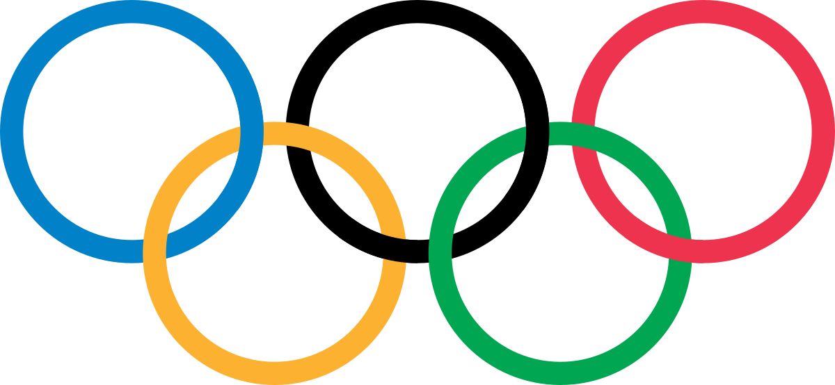
OLYMPICS
NAYAB ANWAR

Slide 2
ABOUT OLYMPICS
The Summer Olympics games are a major international multi-sport-event normally held once every four years. T he games were first held in 1896 in Athense,Greece,and were most recently the 2020 Summer Olympics held in 2021 in Tokyo,Japan.The International Olympics Committee(IOC) organises the games and oversees the host city's preparation. T he WInter Olympics created after the success of the summer olympics. It is regarded as the greatest and largest multi-sport international events in the world. The 2024 Summer Olympics will be held in Paris, France for a third time.

Slide 3
AGENDA
Data Gathering
Exploratory Data Analysis(EDA)
Power BI Dashboard Creation
Publishing Dashboard

Slide 4



Gathering Dataset
I have taken this dataset from kaggle
In this dataset records are available for 2016 Rio Olympics

Slide 5
Exploratory Data Analysis Steps(EDA)
Loading the dataset : Load the data and import libraries.
Redundant columns
Renaming the columns.
Dropping duplicates.
Some transformation.

Slide 6
Data Visulization in jupyter notebook through different plots
Top 10 countries from where most athletes participated.
Contribution of Male and Female athletes.
Athletes Age distribution.
Which games are played in Summer Season & which are in Winter Season.
Olympics wise growth in Female athletes.
Which country have won most Gold Medal.
Country wise medal wins in recent Olympics(2016).
Comparison of Height and Weight of Male and Female Participant .

Slide 7
DASHBOARD CREATION ON POWER BI
Creating a dashboard to see relevant information regarding Olympics data like which country have participated much.
which city have hosts how many of games.
which are the most popular games across world.
Most medal won by an individual.
Female and Male Participants and their ration in winning medal.
Participation of athletes in each Olympics games.

Slide 8
CONCLUSION
35 Olympics have played till 2016 .
Ratio of male and female participants is 72% & 28% respectively.
Female athelets starts participating in year 1904.
US,France,GreatBritain,Italy,Germany,Canada are the coutry from where more athletes have participated till 2016.
Top medal win countries are respectively USA,Russia,Germany,UK,Italy, Framce,Sweden,Canada
Most of atheles participate in Summer Seasons Winter Seasons are not that much popular among athete.
Michel Fillipe(Swimming),Larysa Seminiune(Gymnastics),Nikloy Yefimovich(Gymnastics) aremost medal winning individual

