Slide 1

G2M Case Study
Virtual Internship
20-May-2023
Presenter : Nayab Fatema Aftab Sulemani

Slide 2
Background –G2M(cab industry) case study
XYZ is a private equity firm in US. Due to remarkable growth in the Cab Industry in last few years and multiple key players in the market, it is planning for an investment in Cab industry.
Objective : Provide actionable insights to help XYZ firm in identifying the right company for making investment.
The analysis has been divided into four parts:
Data Understanding and Cleaning
Calculating Price Charged using Regression Models
Forecasting profit and number of rides for each cab type
Finding the most profitable Cab company & giving recommendations for investment
Finding the Cheapest Cab Company
Segmenting the Customers and identifying the characteristics for each segment
Performing Multiple Hypothesis

Slide 3
Data Exploration
12 Features( including 3 derived features)
Timeframe of the data: 2016-01-31 to 2018-12-31
Total data points :355,032
Assumptions:
Profit of rides are calculated keeping other factors constant and only
Price Charged and Cost_of_Trip features used to calculate profit.
Users feature of city dataset is treated as number of cab users in the city.
Transaction_ID
Transaction ID
Customer ID Payment_Mode
Customer_ID
Customer ID Gender Age Income (USD/Month)
Cab_Data
Transaction ID
Date of Travel Company
City
KM Travelled
Price Charged
Cost of Trip
City
City
Population Users
Relationship between the Tables
Highlighted yellow value indicates the primary Key
Highlighted pink value indicates the secondary Key

Slide 4
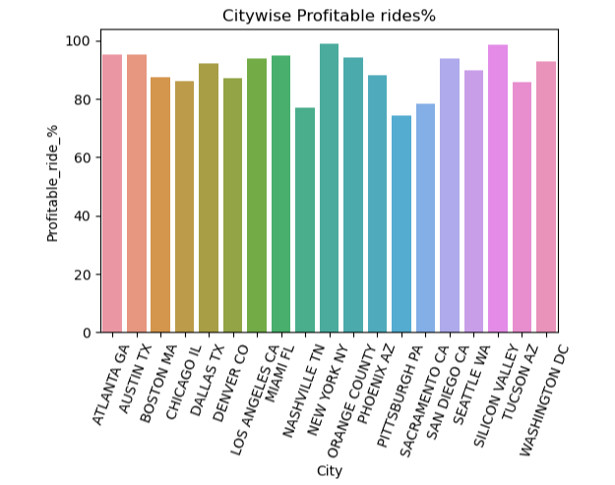
Profit Analysis
Profit Analysis
Company | Profit in ‘000 | Total trips | Profit per ride
Pink Cab | 5313.35 | 84795 | 62.66
Yellow Cab | 54228.56 | 355539 | 152.52

Slide 5
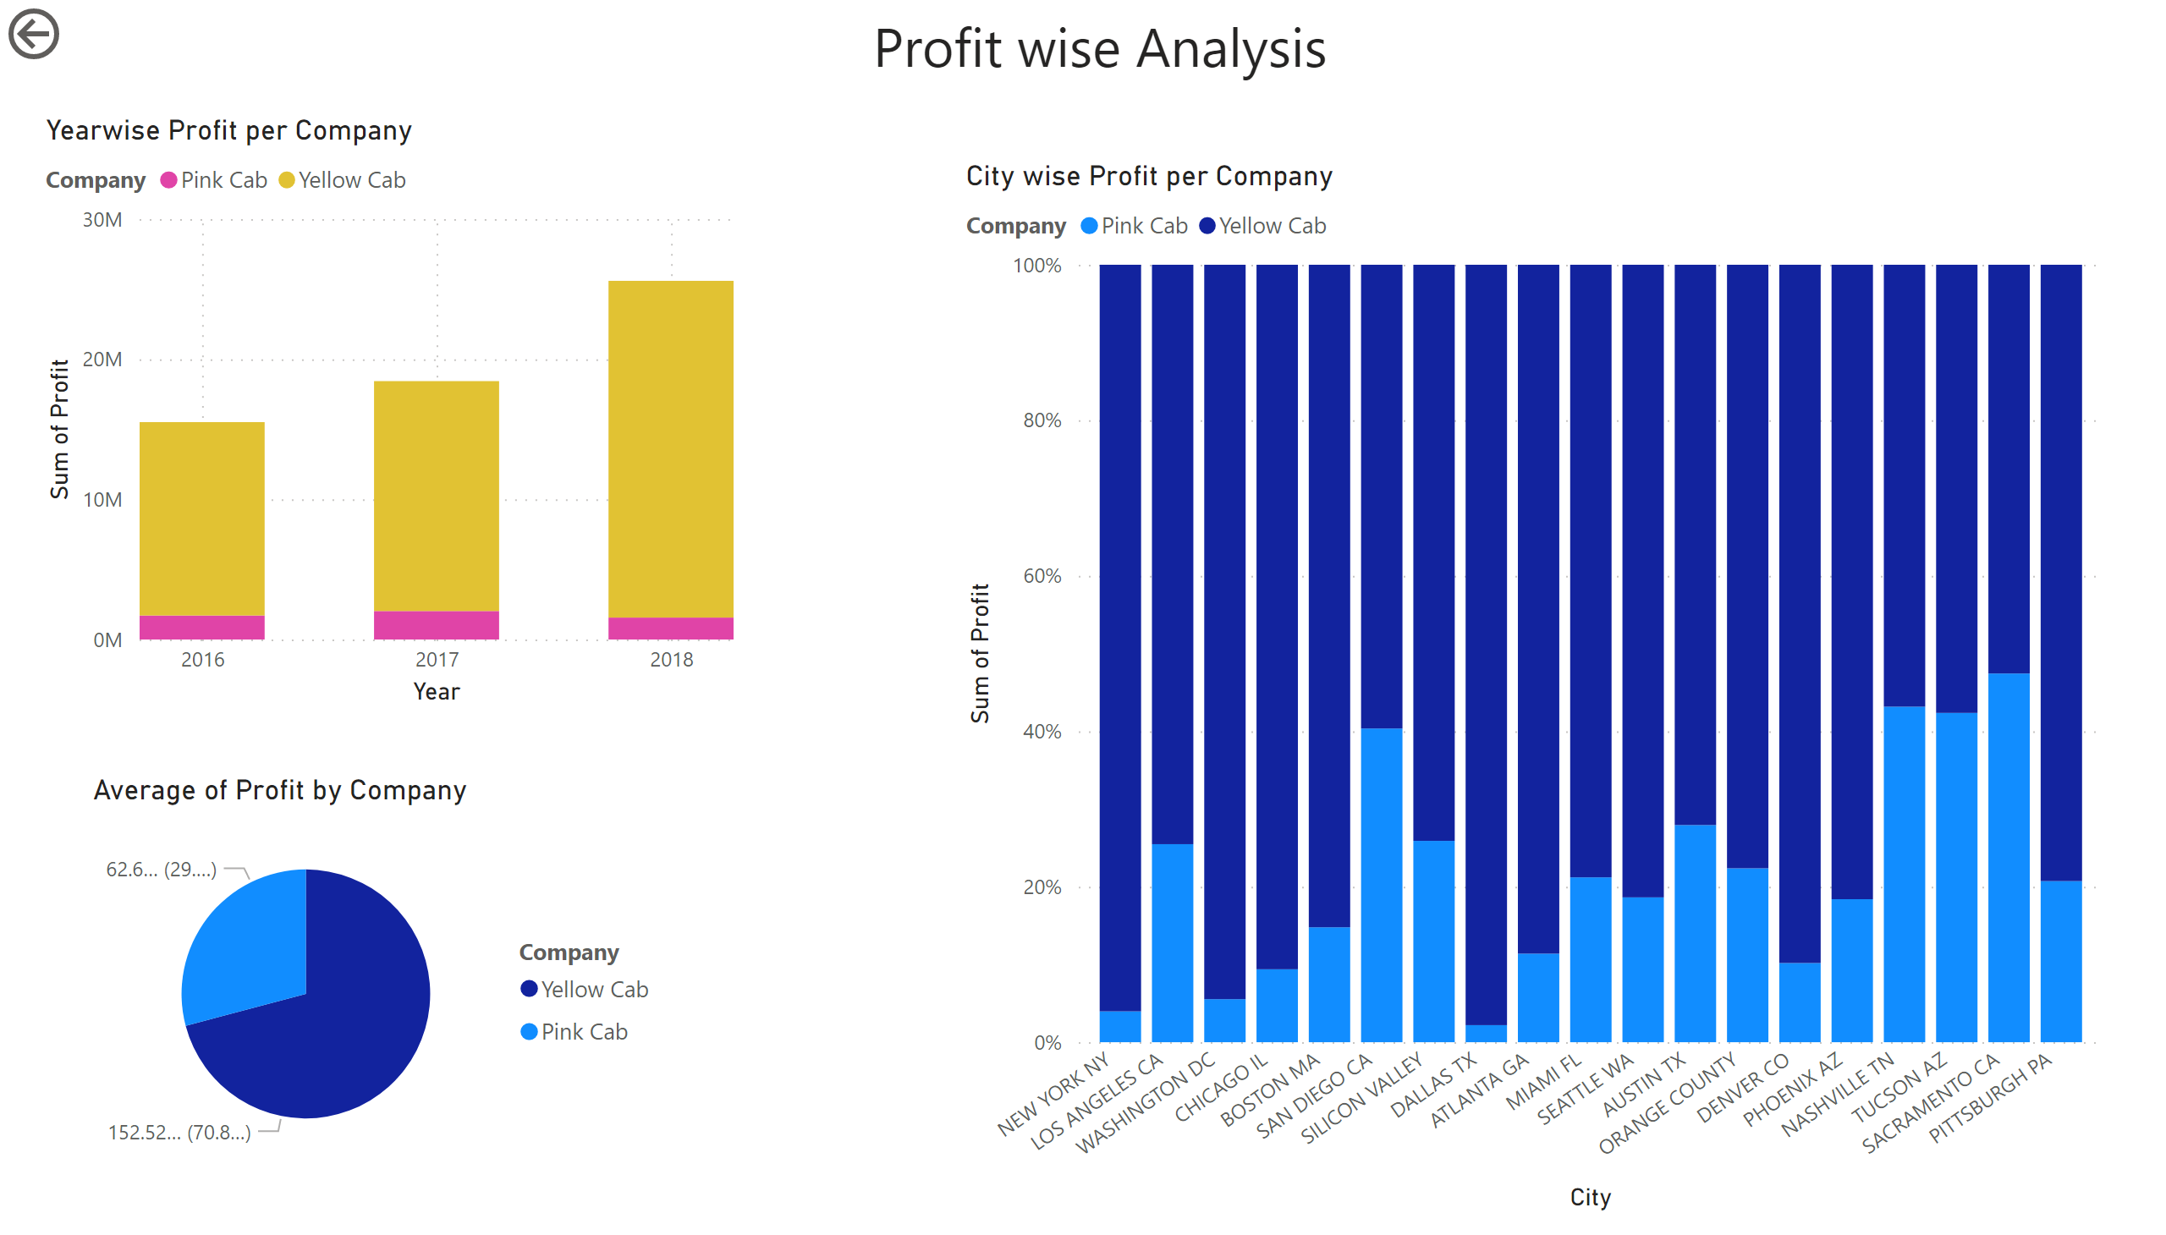
Page 1
Notes:
Yearwise Profit per Company
No alt text provided
textbox
No alt text provided
City wise Profit per Company
No alt text provided
actionButton
No alt text provided
pieChart
No alt text provided

Slide 6
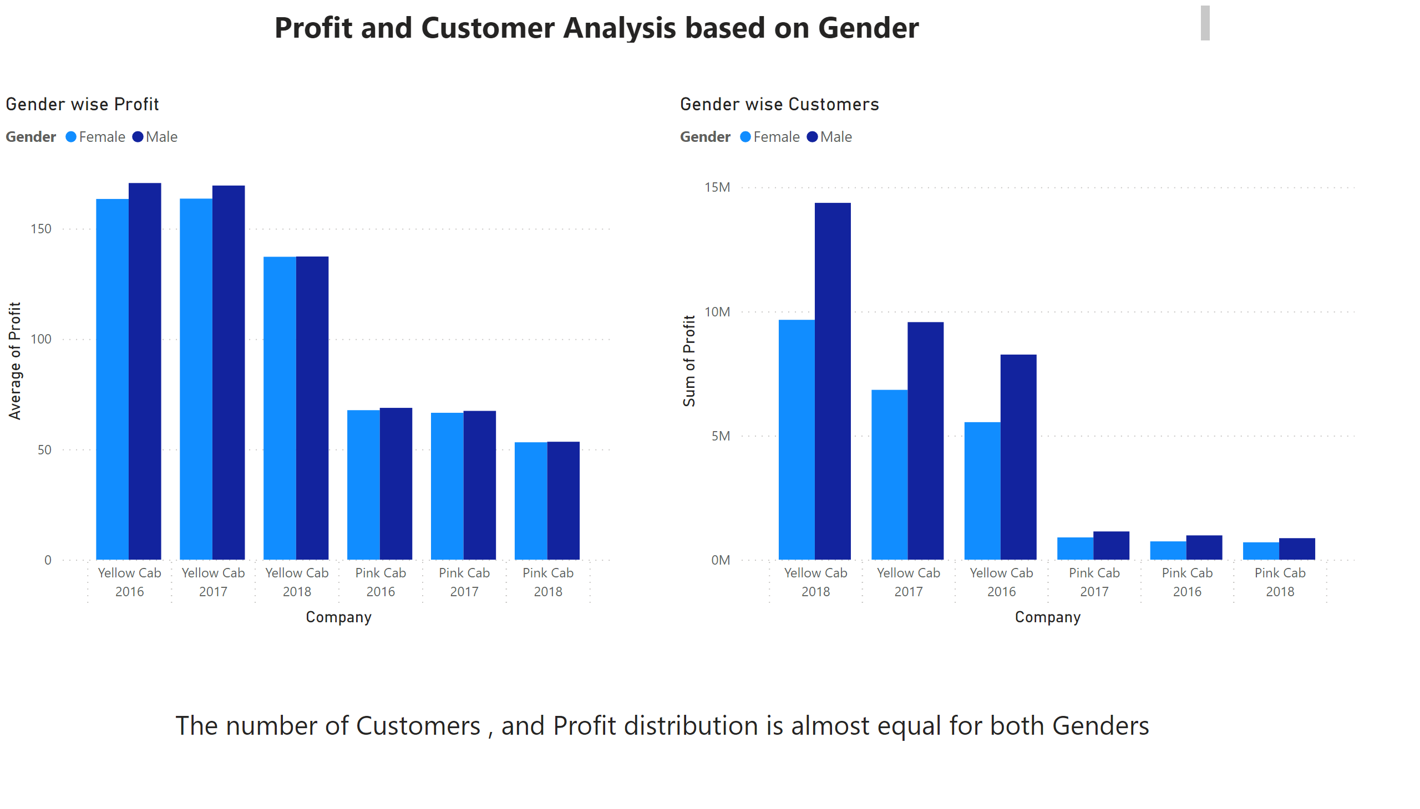
Page 2
Notes:
textbox
No alt text provided
Gender wise Profit
No alt text provided
Gender wise Customers
No alt text provided
textbox
No alt text provided

Slide 7
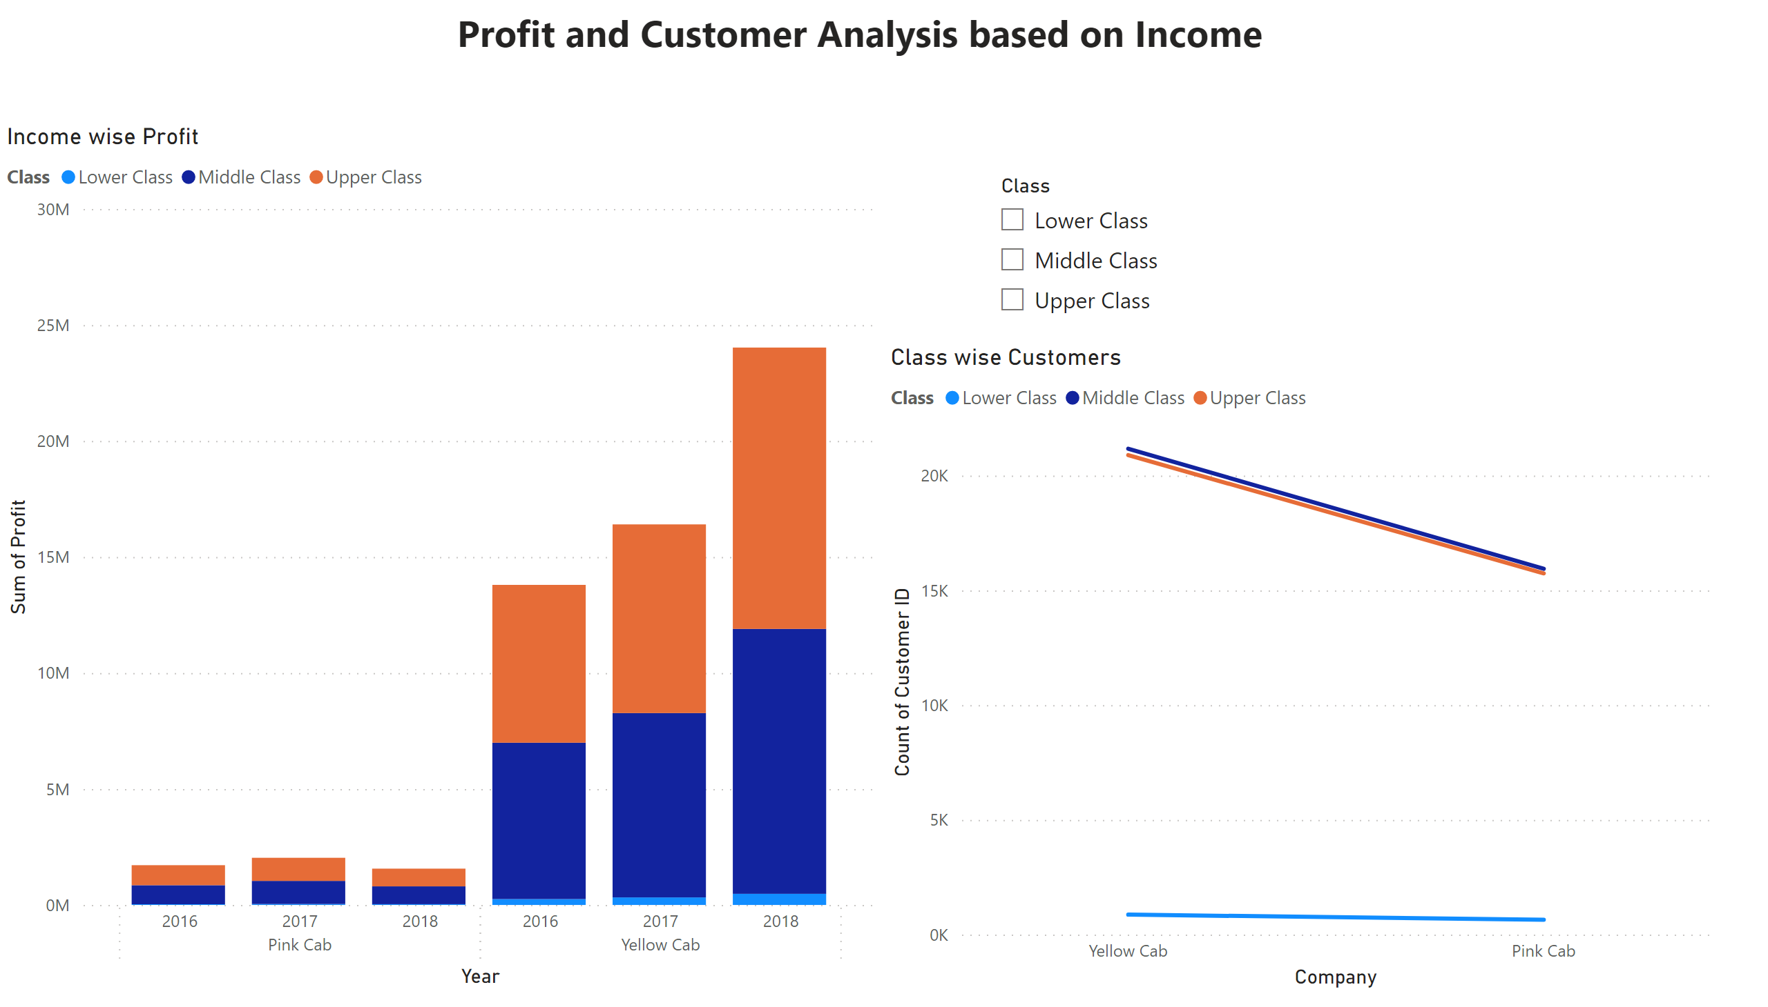
Page 3
Notes:
textbox
No alt text provided
Income wise Profit
No alt text provided
slicer
No alt text provided
Class wise Customers
No alt text provided

Slide 8
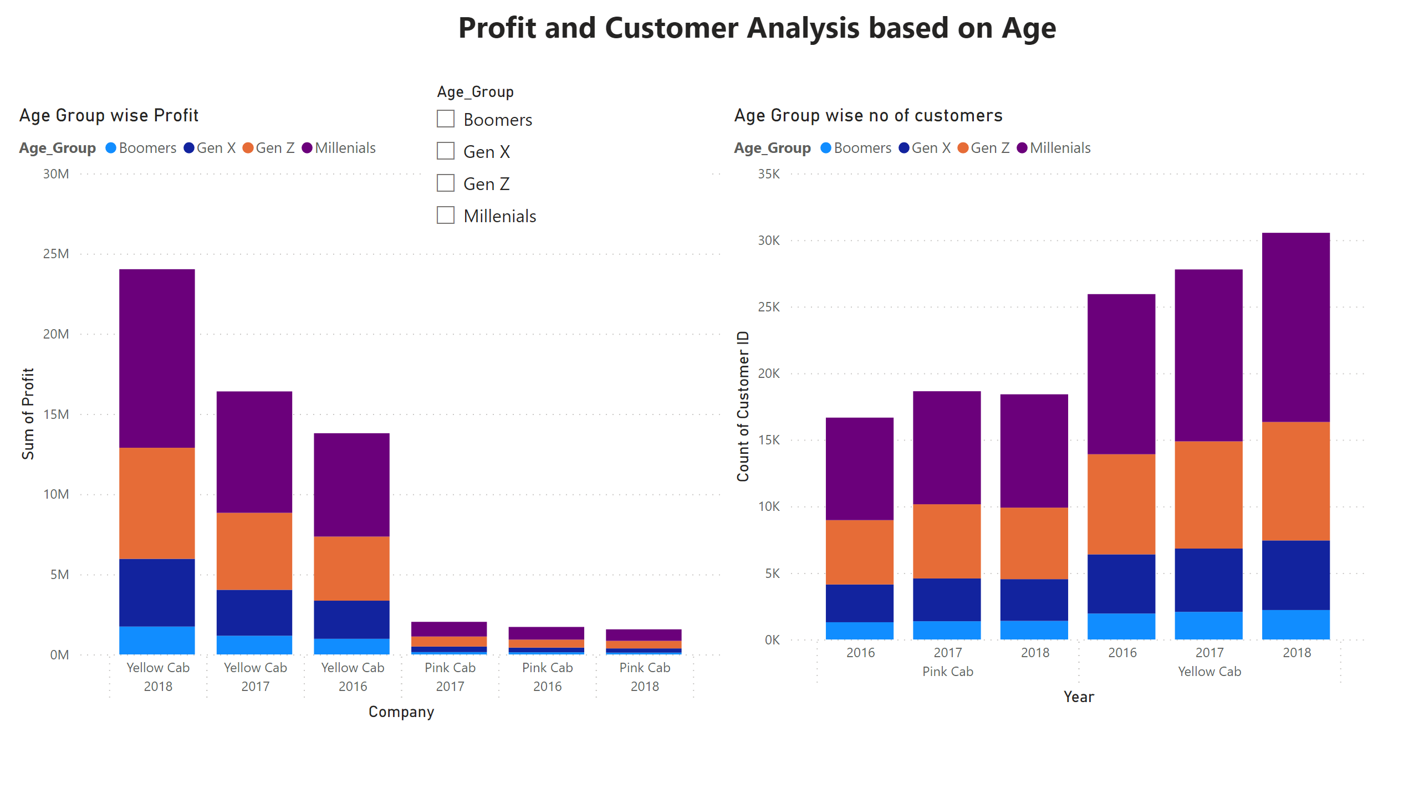
Page 4
Notes:
textbox
No alt text provided
Age Group wise Profit
No alt text provided
Age Group wise no of customers
No alt text provided
slicer
No alt text provided

Slide 9
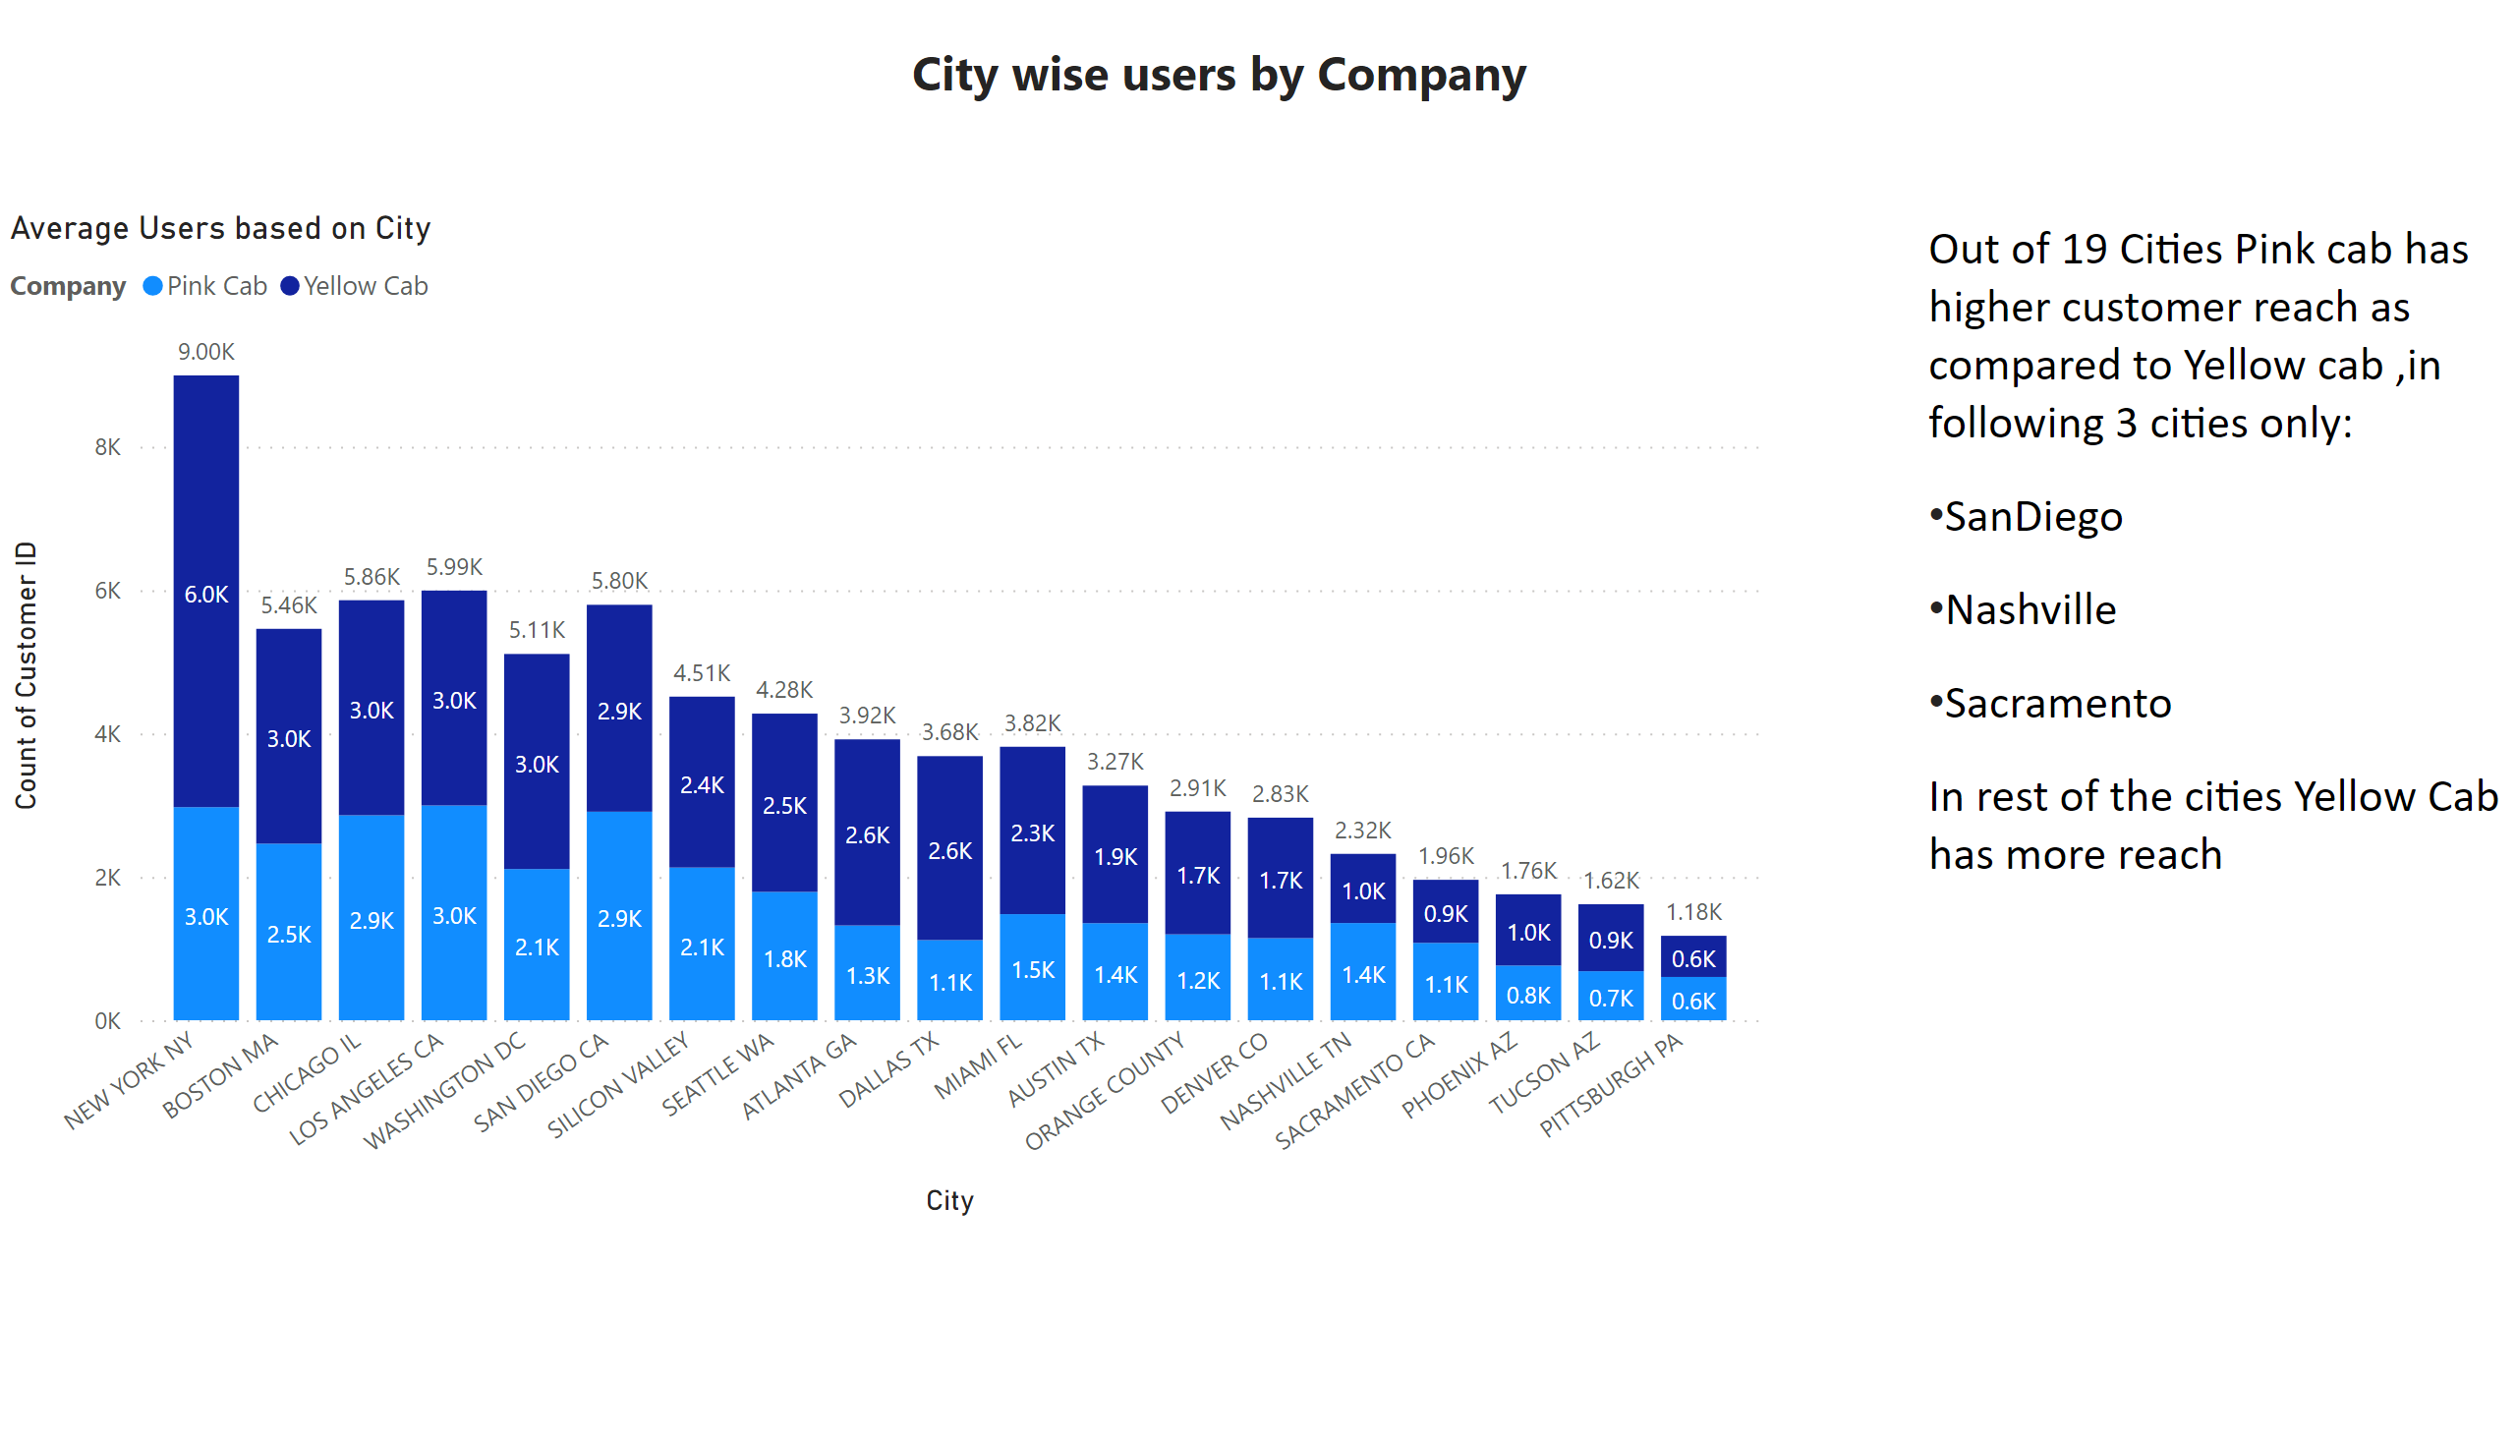
Page 5
Notes:
textbox
No alt text provided
Average Users based on City
No alt text provided
textbox
No alt text provided

Slide 10
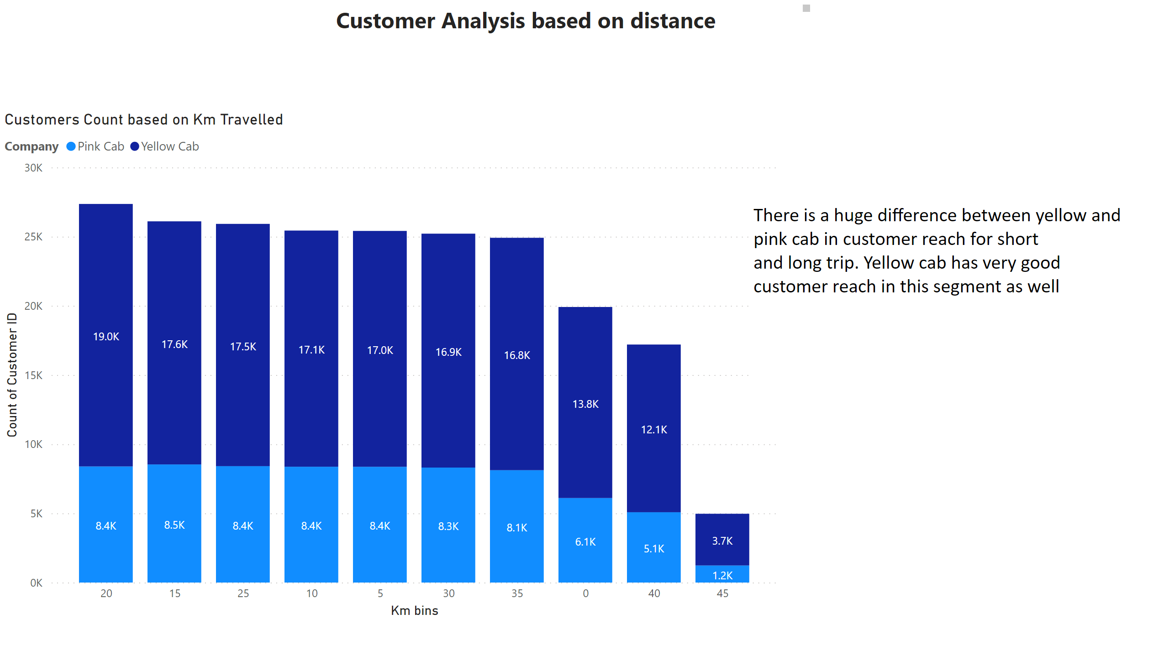
Page 6
Notes:
textbox
No alt text provided
Customers Count based on Km Travelled
No alt text provided
textbox
No alt text provided

Slide 11
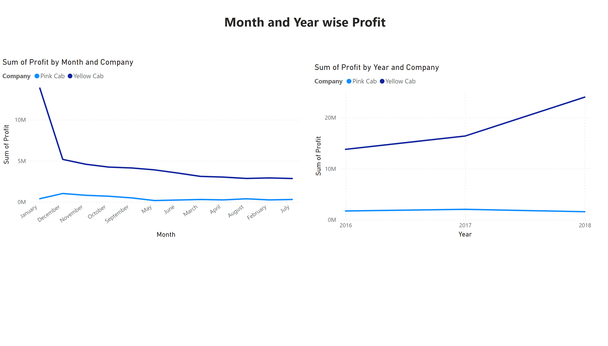
Page 7
Notes:
lineChart
No alt text provided
lineChart
No alt text provided
textbox
No alt text provided

Slide 12
Recommendations
We have evaluated both the cab companies on following points and found Yellow cab better than Pink cab:
Customer Reach : Yellow Cab is more popular than Pink Cab in terms of Customers
Age wise Reach : Yellow cab has customer in all age group and it’s been observed that it’s even popular in 60+ age group as equally as its in 18-25 age group.
Average Profit per KM: Yellow cab’s average profit per KM is almost three times the average profit per KM of the Pink cab.
Income wise Reach :Both the cabs are very popular in high and medium income class but here also Yellow cab is performing better than Pink cab.
Profit: In terms of Profit, profit of Yellow Cab is a lot higher than compared to Pink Cab
On the basis of above point , we will recommend Yellow cab for investment.

Slide 13
Thank You

