Slide 1

AIRA
Artificial Intelligence Requirement Analyzer
Final Year Project Presentation

Slide 2

AIRA - Artificial Intelligence Requirement Analyzer
The University of Chakwal
Department of Computer Science & Information Technology
Nayab Nazir - SRS Generation, Backend APIs, Database Integration
Laiba Arshad - AI Analysis, Documentation, Export Testing
Alishba Rustam - UML Generation, UI Screens, Presentation Testing
Supervisor : __________________

Slide 3
Contents
Introduction
Existing System
Problem Statement
Proposed Solution
Project Scope
Project Objectives
Functional Requirements
System Diagrams
Task Distribution
Tools and Technologies
Screenshots and Demonstration
Department of Computer Science & Information Technology, University of Chakwal

Slide 4
Screenshots and Demonstration
AIRA is a web-based Artificial Intelligence Requirement Analyzer that helps users create Software Requirements Specification documents, generate UML diagrams, analyze SRS ambiguity, describe UML diagram images, and download professional reports from one workspace.
Department of Computer Science & Information Technology, University of Chakwal
Department of Computer Science & Information Technology, University of Chakwal

Slide 5
Project Objectives
Generate complete SRS documents from project details or uploaded files.
Create professional UML diagrams and allow editing.
Detect ambiguous SRS statements and provide recommendations.
Describe uploaded UML diagrams in structured tables.
Provide downloads, history, settings, language options, and usage plans.
Department of Computer Science & Information Technology, University of Chakwal

Slide 6
Problem Statement
Manual requirement documentation is time-consuming and error-prone. Ambiguous requirements, missing actors, weak UML diagrams, and inconsistent formatting can reduce software quality. Users need a single system that can generate, analyze, edit, and export SRS and UML outputs professionally.
Department of Computer Science & Information Technology, University of Chakwal

Slide 7
Proposed Solution
AIRA provides an integrated web application where users can enter a project idea or upload files, generate a structured SRS, create editable UML diagrams, analyze requirement ambiguity, describe UML images, save history, manage account settings, and download PDF, Word, and TXT outputs.
Department of Computer Science & Information Technology, University of Chakwal

Slide 8
Project Scope
The scope includes user authentication, SRS generation, UML generation and editing, UML image description, SRS ambiguity analysis, download/export options, history management, settings, premium access control, and admin-free access for selected accounts.
Department of Computer Science & Information Technology, University of Chakwal

Slide 9
Project Objectives
Manage the details of different public use vehicles
Department of Computer Science & Information Technology, University of Chakwal

Slide 10
Functional Requirements
The system shall allow users to register and log in securely.
The system shall generate SRS documents from text, files, or diagrams.
The system shall generate and edit UML diagrams.
The system shall analyze SRS ambiguity and show recommendations.
The system shall describe UML images and export reports.
The system shall store user history and enforce free/premium limits.
Department of Computer Science & Information Technology, University of Chakwal

Slide 11
Diagrams - Use Case Diagram
Actors: User, Admin
Main use cases: Sign Up, Login, Generate SRS, Generate UML, Analyze SRS Ambiguity, Upload UML Image, View History, Download Output, Manage Users, Manage Premium Access.
Department of Computer Science & Information Technology, University of Chakwal

Slide 12
Diagrams - ERD
Main entities: Users, UML Requests, Uploaded Files, UML Outputs, History, Usage Limits, Premium Plans.
Relationships: user creates requests, request may include uploaded files, request generates outputs, and outputs are saved in user history.
Department of Computer Science & Information Technology, University of Chakwal

Slide 13
Diagrams - Class Diagram
Core classes: User, Admin, SRSGenerator, UMLGenerator, AIAnalysisService, UMLDescriptionService, FileUpload, ExportManager, HistoryManager, DatabaseService.
The design separates authentication, generation, analysis, storage, and export responsibilities.
Department of Computer Science & Information Technology, University of Chakwal

Slide 14
Diagrams - Database Design
Database: MySQL.
Key tables include users, uploaded files, UML requests, UML outputs, saved history, usage records, and plan/subscription information. Data is used for login, account display, history retrieval, usage limits, and downloadable outputs.
Department of Computer Science & Information Technology, University of Chakwal

Slide 15
Diagrams - Architecture Design Diagram
Frontend: HTML, CSS, JavaScript pages.
Backend: Node.js and Express APIs.
Database: MySQL.
AI layer: Gemini/OpenRouter-based generation and analysis fallback.
Exports: PDF, Word, and TXT report generation.
Department of Computer Science & Information Technology, University of Chakwal

Slide 16
Diagrams - Sequence Diagram
Typical flow: User enters a prompt or uploads a file, frontend sends request to backend, backend validates input, AI service generates SRS/UML/analysis output, output is saved in database/history, and user downloads or edits the result.
Department of Computer Science & Information Technology, University of Chakwal

Slide 17
Tasks Distribution
Group Members | Responsibilities
Name | Creating Database, Defining Tables in Database Designing Interfaces- Designing and Coding for Contact Us and Feedback Page Connection Establishment Documentation
Name | Defining Stored Procedures for Insert, Update, Delete SQL Queries Designing Interfaces- Designing Template/Master Page Coding-front page interfaces
Name | Defining Views in Database for Filling Gridview, ComboBox Designing Interfaces- SignUp Form and SignIn Form Documentation
Group Members
Responsibilities
Nayab Nazir
SRS generation module, backend API routes, MySQL integration, authentication flow, and integration testing.
Laiba Arshad
AI ambiguity analysis module, SRS content review, documentation, export checking, and requirement quality testing.
Alishba Rustam
UML generation module, UML image description testing, frontend page validation, presentation content, and user testing.
Department of Computer Science & Information Technology, University of Chakwal

Slide 18
Tools & Technologies
Frontend: HTML, CSS, JavaScript
Backend: Node.js, Express.js
Database: MySQL, MySQL Workbench / XAMPP MySQL
AI Services: Gemini API with OpenRouter fallback
Documents: PDF, DOC/Word, TXT export handling
Development Tools: VS Code, PowerShell, Browser testing
Department of Computer Science & Information Technology, University of Chakwal

Slide 19
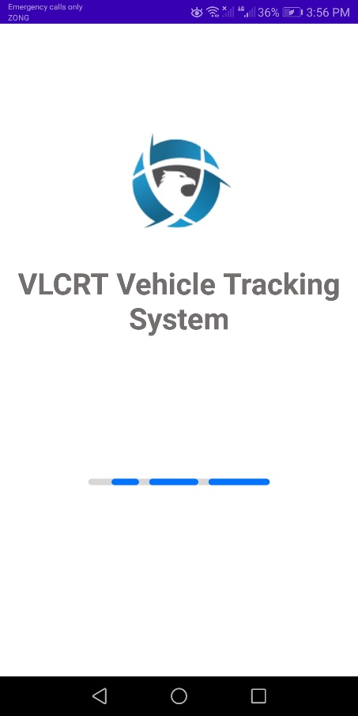
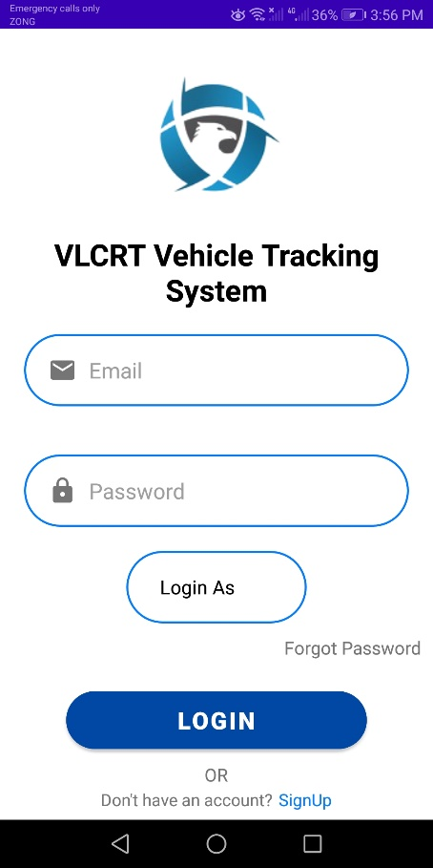
Screenshots
Demonstration screens include:
1. Dashboard and navigation sidebar
2. SRS generation and download preview
3. UML generation and editable canvas
4. AI ambiguity analysis
5. UML image description report
6. User settings, pricing, and premium access
Department of Computer Science & Information Technology, University of Chakwal

Slide 20

Thank You
Thank You
AIRA - Artificial Intelligence Requirement Analyzer
AIRA - Artificial Intelligence Requirement Analyzer
Nayab Nazir | Laiba Arshad | Alishba Rustam

