Slide 1


Slide 2

AIRA - Artificial Intelligence Requirement Analyzer
The University of Chakwal
Department of Computer Science & Information Technology
Nayab Nazir
Laiba Arshad
Alishba Rustam
Supervisor: ____________________

Slide 3
Contents
Introduction
Existing System
Problem Statement
Proposed Solution
Project Scope
Project Objectives
Functional Requirements
UML and Database Diagrams
Tools and Technologies
Screenshots
Tasks Distribution
Conclusion
Department of Computer Science & Information Technology, University of Chakwal

Slide 4
Screenshots
AIRA is a web-based Artificial Intelligence Requirement Analyzer that helps users generate Software Requirements Specification documents, create UML diagrams, analyze SRS ambiguity, and describe uploaded UML images in a structured way.
Department of Computer Science & Information Technology, University of Chakwal
Department of Computer Science & Information Technology, University of Chakwal

Slide 5
Project Objectives
Generate structured SRS documents from project names, descriptions, uploaded files, or diagrams.
Produce editable UML diagrams and downloadable diagram outputs.
Analyze SRS documents for ambiguity and requirement quality.
Describe UML images with diagram-specific interpretation.
Provide secure user accounts, history, pricing plans, and admin privileges.
Department of Computer Science & Information Technology, University of Chakwal

Slide 6
Problem Statement
Students and developers often face difficulty converting project ideas into complete SRS documents and professional UML diagrams. Manual writing can miss requirements, introduce ambiguity, and require repeated formatting work.
Department of Computer Science & Information Technology, University of Chakwal

Slide 7
Proposed Solution
AIRA provides one integrated platform where users can generate SRS documents, create UML diagrams, analyze ambiguities, describe UML images, save history, and download outputs in usable formats. The system also supports premium access and admin-level unrestricted usage.
Department of Computer Science & Information Technology, University of Chakwal

Slide 8
Project Scope
The scope includes SRS generation, UML diagram generation, UML image description, SRS ambiguity analysis, user authentication, history management, document export, multilingual support, premium billing, and admin access control.
Department of Computer Science & Information Technology, University of Chakwal

Slide 9
Project Objectives
Manage the details of different public use vehicles
Department of Computer Science & Information Technology, University of Chakwal

Slide 10
Functional Requirements
The system shall allow users to sign up and log in securely.
The system shall generate SRS documents based on user input or uploaded files.
The system shall generate UML diagrams from SRS or system descriptions.
The system shall analyze SRS ambiguity and provide recommendations.
The system shall describe uploaded UML diagram images.
The system shall allow users to download results and view history.
Department of Computer Science & Information Technology, University of Chakwal

Slide 11
Diagrams - Use Case Diagram
Main actors: User and Admin.
User functions: sign up, log in, generate SRS, generate UML, upload UML image, check ambiguity, view history, and download output.
Admin functions: manage users and access premium features without usage limits.
Department of Computer Science & Information Technology, University of Chakwal

Slide 12
Diagrams - ER Diagram
Core entities: users, uml_requests, uploaded_files, uml_outputs, srs_outputs, analysis_history, and subscription records.
Relationships connect users with generated requests, uploaded files, saved outputs, and billing/access status.
Department of Computer Science & Information Technology, University of Chakwal

Slide 13
Diagrams - Class Diagram
Major classes include User, Admin, BackendController, SRSRequest, UMLRequest, UploadedFile, UMLOutput, AnalysisResult, BillingPlan, and HistoryRecord.
Classes are linked through request ownership, uploaded input, generated output, and account access.
Department of Computer Science & Information Technology, University of Chakwal

Slide 14
Diagrams - Database Design
The database stores registered users, generated SRS records, UML requests, uploaded file metadata, output paths, history entries, premium plan status, and admin access flags.
Department of Computer Science & Information Technology, University of Chakwal

Slide 15
Diagrams - Architecture Design Diagram
Architecture layers include Frontend UI, Node.js/Express backend, Python AI modules, MySQL database, optional Gemini/OpenRouter AI services, and PlantUML/Kroki rendering for professional UML output.
Department of Computer Science & Information Technology, University of Chakwal

Slide 16
Diagrams - Sequence Diagram
Typical flow: user enters a project idea or uploads a file, frontend sends a request to backend, backend extracts content, AI service generates SRS/UML/analysis, result is saved in MySQL, and the output is returned for preview and download.
Department of Computer Science & Information Technology, University of Chakwal

Slide 17
Tasks Distribution
Group Members | Responsibilities
Nayab Nazir | Backend development, database integration, AI services, SRS generation, UML generation, billing/access control, and frontend integration.
Laiba Arshad | Documentation, SRS content review, requirement validation, test cases, and report support.
Alishba Rustam | Presentation preparation, UI testing, sample data collection, screenshots, and final demonstration support.
Department of Computer Science & Information Technology, University of Chakwal

Slide 18
Tools & Technologies
Frontend: HTML, CSS, JavaScript
Backend: Node.js, Express.js, Python AI modules
Database: MySQL with MySQL Workbench
AI/ML: scikit-learn, joblib, TF-IDF, rule-based ambiguity detection
OCR/Vision: OpenCV, Tesseract OCR, Pillow
Documents: PDF.js, DOCX extraction, PDF/DOC/TXT exports
External/Optional: Gemini API, OpenRouter fallback, PlantUML/Kroki rendering
Department of Computer Science & Information Technology, University of Chakwal

Slide 19
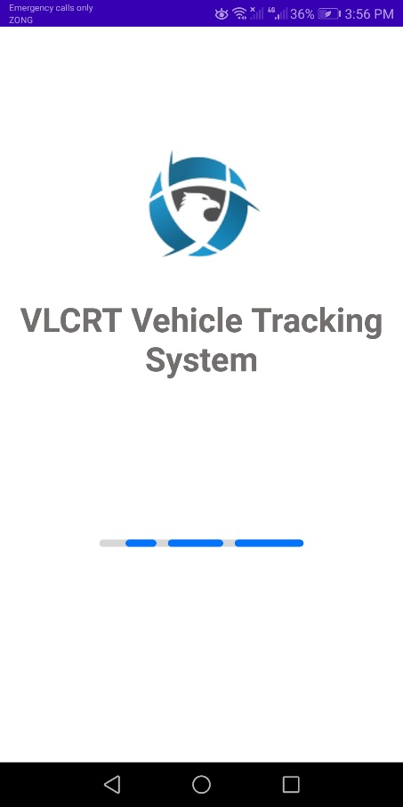
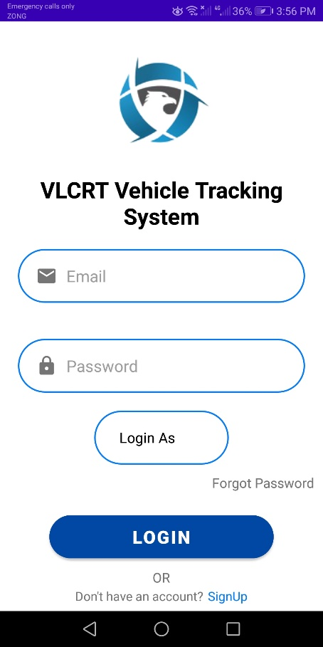
Screenshots
Key application screens include Home Dashboard, SRS Generation, UML Diagram Generation, AI Analysis, UML Image Description, My History, Settings, and Premium Plans.
Department of Computer Science & Information Technology, University of Chakwal

Slide 20


