Slide 1


PAPEWORK
CURP
RFC
NSS

Slide 2

WHAT IS….?
CURP is the abbreviation for Clave Única de Registro de Población (translated into English as Unique Population Registry Code or else as Personal ID Code Number). It is a unique identity code for both citizens and residents of Mexico.
The RFC is your Tax Identification Number, needed if you are selling or providing services that create revenues. It is issued by SAT, Secretary of Hacienda and Public Credit
NSS Social Security Number (NSS Número de Seguridad Social) 11-digit number for identification purposes before the Mexican Social Security Institute and, accordingly, is used to access the service provided by the Institute

Slide 3
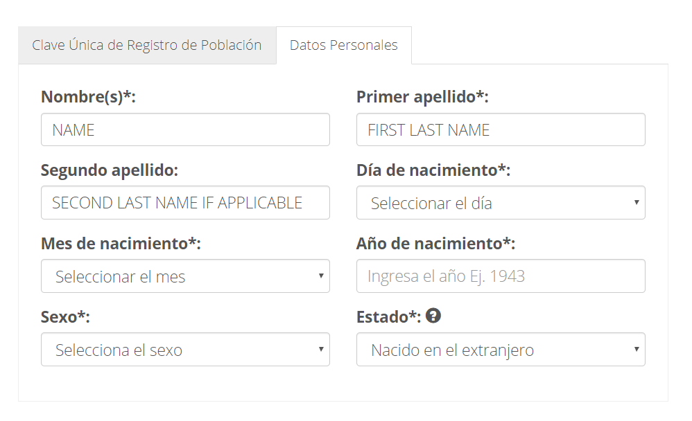
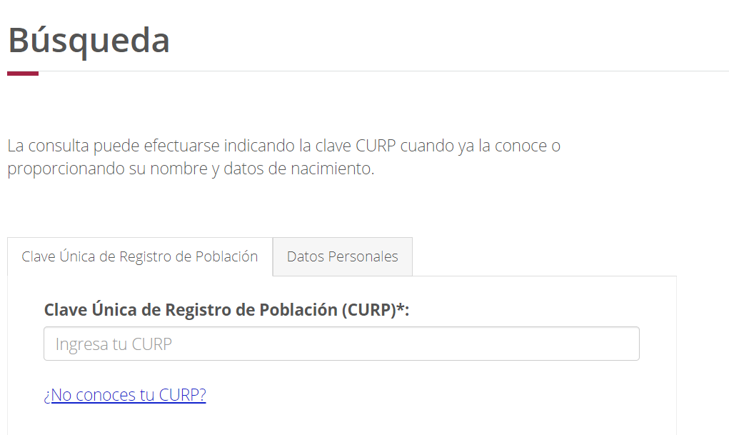
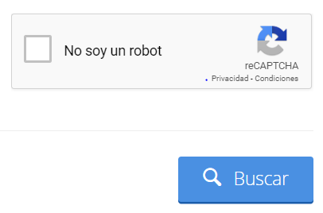
HOW TO GET YOUR CURP?
1.
3.
Go to https://www.gob.mx/curp/
Fill out this information
2.
Click on No conoces tu CURP?
It means Don’t you know your CURP?
DAY OF BIRTH
This is the last option. It means born in other contry
MONTH OF BIRTH
YEAR OF BIRTH
GENDER
MUJER/FEMALE
HOMBRE /MALE
4.
Click here

Slide 4
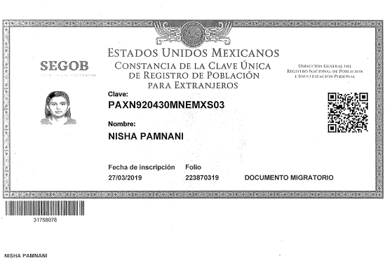
CURP
PHOTO
5.
Save this file, you may use it later for Mexican process.
THIS IS THE CURP
XXXX

Slide 5
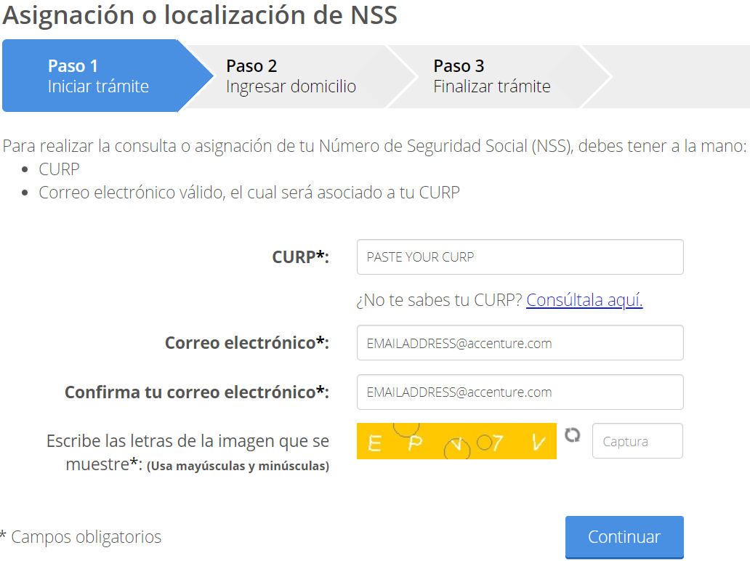
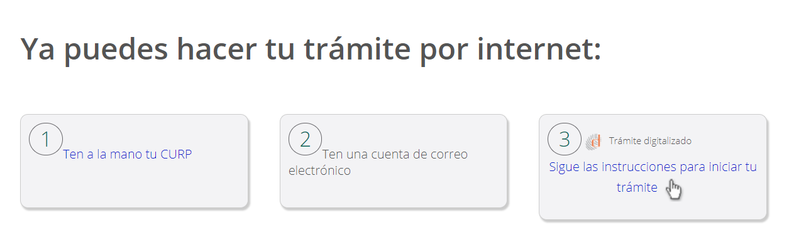

HOW TO GET YOUR NSS?
1.
3.
Go to http://www.imss.gob.mx/tramites/imss02008
Complete your information as below:
2.
Click on Inicia tu tramite. It means iniciate your Papework
Write the show images or numbers
4.

Slide 6
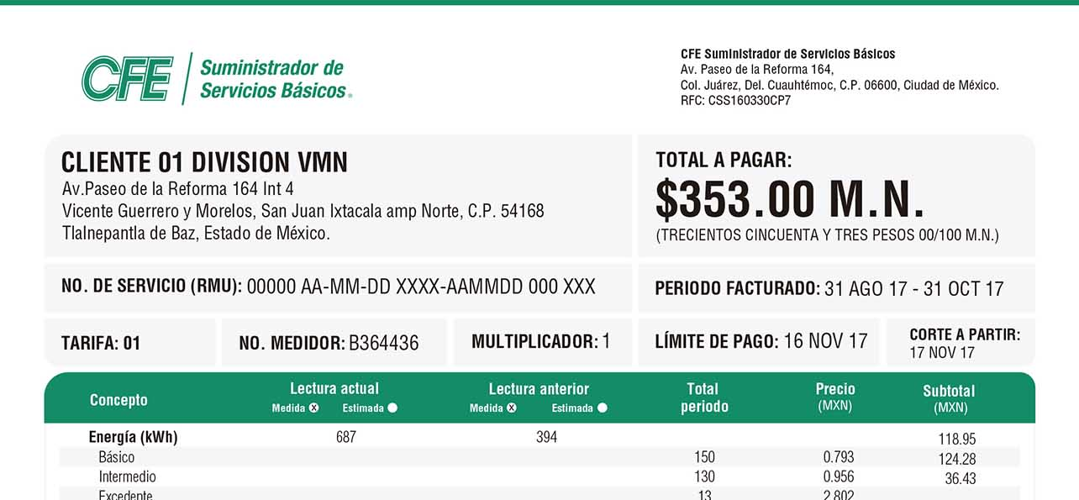
4.
Address translation.
SPANISH | ENGLISH
Calle | Street
Colonia/Delegación | Neighborhood
Numero | Number
Estado | State
Municipio | City
CP | Zip Code
Entre Calle | Cross Street
Tipo de Calle | Type of Street
5.
Example:
Cross Street
Street
Number
Zip Code
CLIENT XXXXX XXXX XXXX
Av. Paseo de la Luz #456
Vicente Guerrero y Morelos C.P. 38729
Monterrey, Nuevo Leon
City
State

Slide 7
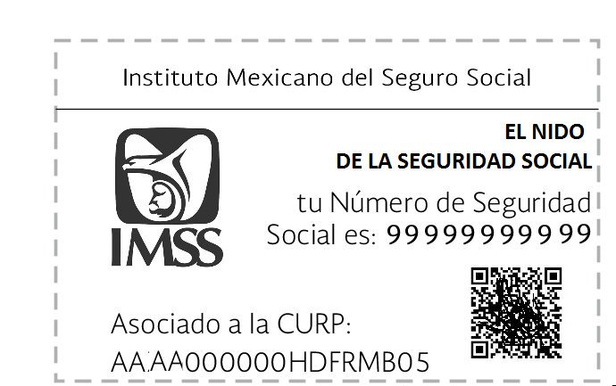
5.
Save this document

Slide 8
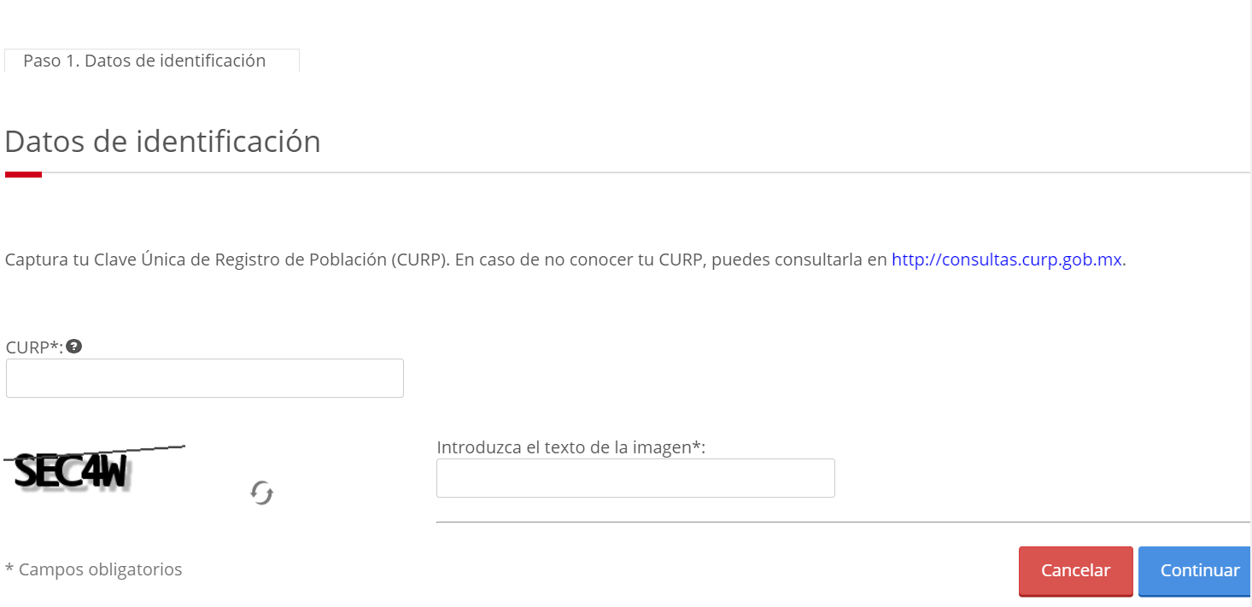
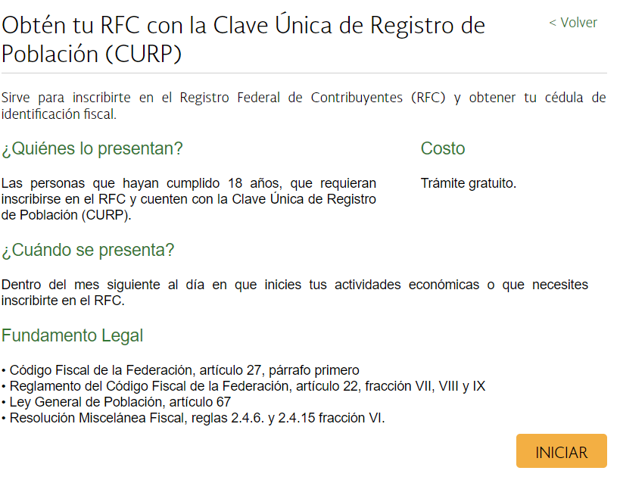
HOW TO GET YOUR RFC ?
1.
Go to https://www.sat.gob.mx/tramites/28753/obten-tu-rfc-con-la-clave-unica-de-registro-de-poblacion-(curp)
3.
Paste the CURP you got before, enter the code in the left and click ¨Continuar¨.
2.

Slide 9
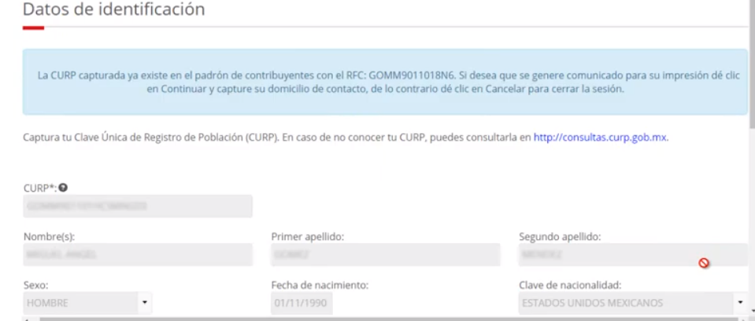
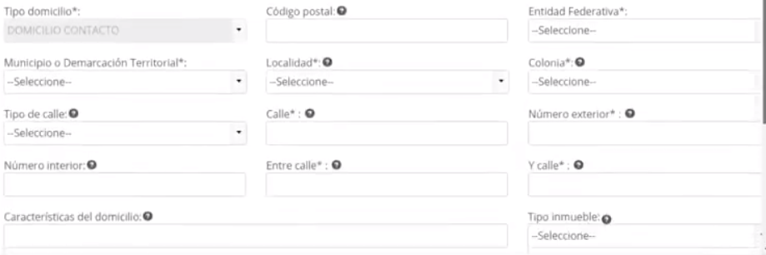
4.
Complete your information.
NAME
LAST NAME
SELECT ¨ZONA NEUTRAL¨
GENDER
DAY OF BIRTH
NATIONALITY
5.
To complete address information use Slide 6

Slide 10
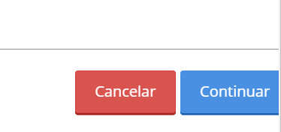
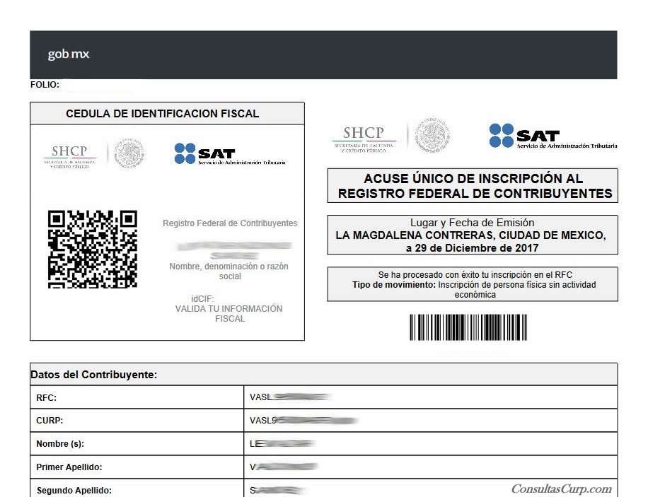
5.
Everytime you complete your information select ¨Continuar¨
6.
Save this document

Slide 11
FINAL STEPS
PRINT OUT YOUR DOCUEMENTS
CONTACT MELANNY.MONSIVAIS FOR FURTHER QUESTIONS

