Slide 1
Authentication: Part II
15-421/08-731 and 08-761/46-861 -- Fall 2013 – Lecture 6
Information Security & Privacy
Norman M. Sadeh
School of Computer Science
Carnegie Mellon University

Slide 2
Practical Info
Full Semester Students
Team Projects – to be posted on BB by this evening
Examples of final project reports to be posted on BB
Sept 24: Early Project Presentations (NSH1305)
5 minutes per team + Q&A
Content: What are the objectives, what is the approach, what is the timeline, who will do what
Mini Semester Students:
Homework Assignment #1 due by Sept 22
Midterm exam: Sept 24 – closed book- 219 Scaife Hall
Everything covered in class – at the level at which it was covered

Slide 3
Overview
Brief recap of previous lecture
Authentication: Part II
References
Guest presentation: John Lerchey (CMU Emergency Response Team/Information Security Office) will come and discuss the recent compromise of a Windows password DB at CMU and CMU’s response

Slide 4
Recap of Previous Lecture
Certificates and PKI
Decentralized Trust Management
Authentication – Part I
Authentication factors
Password composition policies
Cracking password
Online and offline attacks
Salting

Slide 5
Authentication Protocols
Hard to design
Typically combine multiple authentication protocol elements
Need to protect against:
Eavesdropping
Replay
Spoofing
etc.

Slide 6
Kerberos
Based on symmetric cryptography
Originally using DES, now AES
Authentication of clients to host servers and vice versa
Every client and every server share a (different) symmetric key with an authentication server
Developed at MIT

Slide 7

Kerberos in Slow Motion (simplified)
Authentication
Server
Ticket – includes timestamp, lifetime,
random shared secret Session Key for client and target server –encrypted for client and server
Ticket
Request
1
2
Client forwards (part of) ticket
to Target Server
Client
3
Target
Server
4
Client’s
Secret Key
Secret Session Key Shared
By Client and Target Server
Server’s
Secret Key

Slide 8
Kerberos Messages
Authentication Service exchange:
Relies on client’s secret key
Often part of login session
Client receives ticket from authentication server
Ticket granting service
Client uses ticket received specifically for interactions with ticket granting server
Client receives ticket for target server
Typically part of the login session too
Client Server Authentication
Server authenticates client (and possibly client the server), using key provided along with ticket for their interaction

Slide 9
Kerberos’s Pros and Cons
Provides good level of protection, using relatively inexpensive technology
Symmetric keys
Requires physically secured authentication and ticket granting servers with high availability
These servers are potential bottlenecks: scalability issue
Reliance on timestamps for replay protection requires secure and synchronized time clocks between clients and servers.
Used mainly at universities
Modern solution: digital signatures

Slide 10
Single Sign-On (SSO)
Log in once and gain access to a diverse set of systems/services, possibly subject to additional access control policies
e.g. Role-Based Access Control (RBAC)
Enhances usability
…but authentication servers become a possible target of attacks (e.g. DOS)

Slide 11
Active Directory Federation Services
Generalized SSO to federated security domains:
e.g. multiple organizations across a supply chain
Federation Server in home domain authenticates user: user receives a token with a collection of claims, incl. identity
When user crosses to another domain, that domain’s Federation Server examines the user’s token and issues a local token for access to local servers

Slide 12
Security Assertion Markup Language (SAML)
XML-based assertion and authorization language (OASIS)
Communication between an identity provider in one security domain and a service provider in another
When a user attempts to access a Web service in another domain
His home domain’s identity provider passes an assertion to the service provider
The service provider makes an access control decision

Slide 13
SAML Assertions
Authentication Statements
Asserts that the principal did authenticate with the identity provider at a particular time
Attribute Statements: Asserts that certain attributes are associated with a subject (e.g. employee of accounting dept.) – used for access control decisions
Authorization Decision Statements
A subject is permitted to perform an action A on a resource R given evidence E
Complemented by XACML language

Slide 14
Other Solutions
Open ID (e.g. PayPal, Google, Paypal, etc.)
Register an OpenID with an OpenID provider
“Relying party” (i.e. service provider) does service discovery to identify relevant OpenID provider and authenticate users
Oauth (e.g. Facebook, Google, Microsoft)
Complements Open ID
Allows users to hand out tokens instead of credentials to their data hosted by a service provider (e.g. a specific video or picture for 2 hours) – tokens granted to 3rd parties
Potential abuse – downloading large amounts of data for mining – used to circumvent API call limits

Slide 15
Personal Tokens
User demonstrates possession of a small hardware device
Typically used in combination with a PIN (or password)
Attacker would not only have to know the PIN but also have the token in his/her possession

Slide 16
Examples of Personal Tokens
Storage Token: Secret value (e.g. private key) is stored on the token and unlocked with a PIN for use in an authentication protocol
Challenge Response Token: Includes required logic. Token operates client-end of a challenge-response protocol using secret key
e.g. SIM based authentication on GSM phones
Digital Signature Token: Token holds private key along with the logic to generate a digital signature

Slide 17
GSM SIM-Based Authentication
Mobile
Switching
Center
Home
Location
Register
SIM
Card
Mobile
Station
Authentication
Center
Mobile
Network
Base
Station
SIM Card
Authentication Center
User
Authentication
Key
User
Authentication
Key
Randomly generated
number sent as challenge
Randomly
Generated
Number
Challenge
Authentication
Algorithm (A3)
Authentication
Algorithm (A3)
Mobile Switching Center
Signed Response
Do They Match?
Signed Response

Slide 18
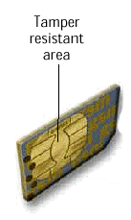
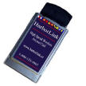
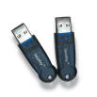
Personal Token Implementations
Smartcards
Memory and processing
Cheap
PCMCIA card
Significantly more powerful than a typical smartcard
USB Token
Powerful processing and large memory capacity

Slide 19
Biometrics
Based on biological characteristics or behavioral traits of principals
General view: Can supplement authentication infrastructure but they are no substitutes
Very similar to using passwords
Fingerprint, voice, handwriting, face recognition, retinal scan, hand geometry, etc.
Biometric devices have to be implemented as trusted components
Secure data and communication

Slide 20
Biometrics: A Word of Caution
Industry and government are increasingly relying on biometrics
Biometrics are not full-proof
Inherent inaccuracy of fingerprints, facial recognition, retinal scans, voice recognition, gait, etc.
System security
Privacy issues
e.g. small changes in retinal scans for a given individual can be used to diagnose diabetes or strokes – invasion of medical privacy
High costs – devices & their maintenance – though not always (e.g. iPhone 5S)
Performance & scalability

Slide 21
Roaming Protocols
Objective: Support roaming users as they try to authenticate from different terminals
Challenge: Client terminal holds no long-term state about the user
e.g. can’t assume that the terminal stores the user’s private data such as private keys, passwords, etc

Slide 22
Possible Solutions
Smartcards or other personal token on which private data is stored
Requires smart card readers – costs & interoperability issues
Use a Private Data Server to hold a copy of the user’s private data
User authenticates to the server (e.g. password)
Server downloads the private data to the client for the duration of the session
Encrypted communication
Server is a potential vulnerability point
Possible solution: split the data across multiple servers

Slide 23
Address-Based Authentication
Assumes authenticity of the user based on originating address
Variation: call back the user
Not extremely reliable:
Easy to modify the calling address seen by the host or spoof an IP address
Address may change
Call forwarding creates additional vulnerabilities
Can be useful supplement to other mechanisms

Slide 24
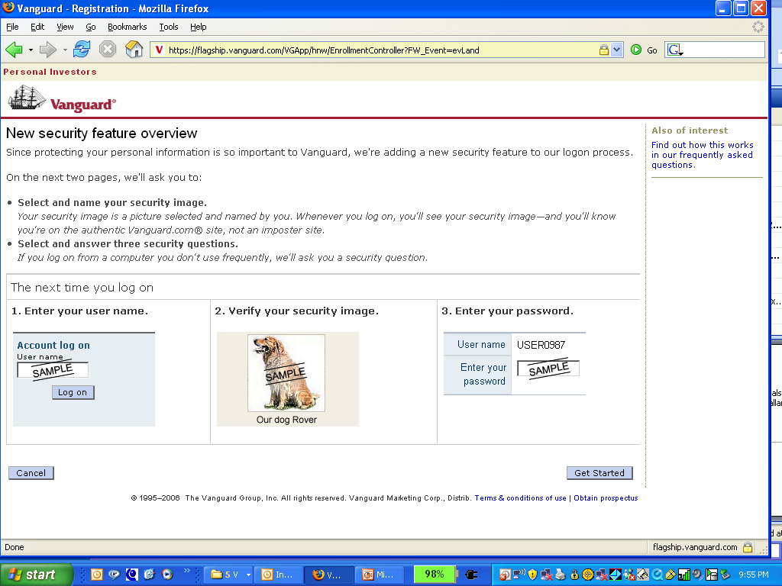
Augmented Password Login – Combating Phishing Attacks: Does this Work?

Slide 25
Augmented Password Login
Usability issues
Will the users notice when the picture is not there?
Technical issues
Image is presented based on cookie
What about man-in-the-middle attacks?
Cookies can be hijacked unless encrypted
Packet sniffing to steal cookies

Slide 26
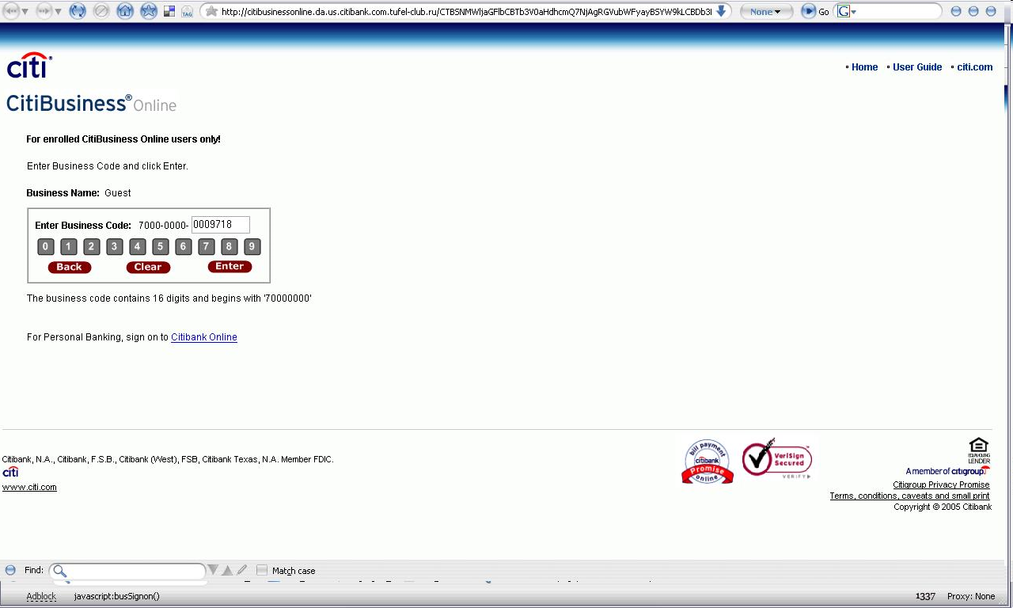
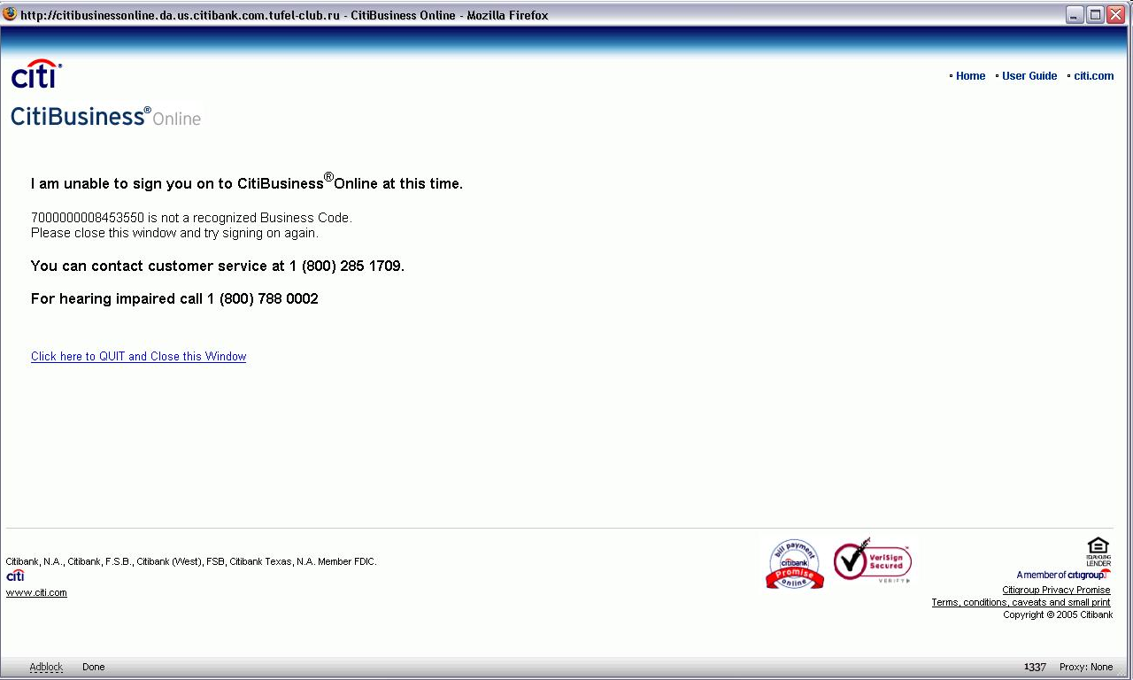
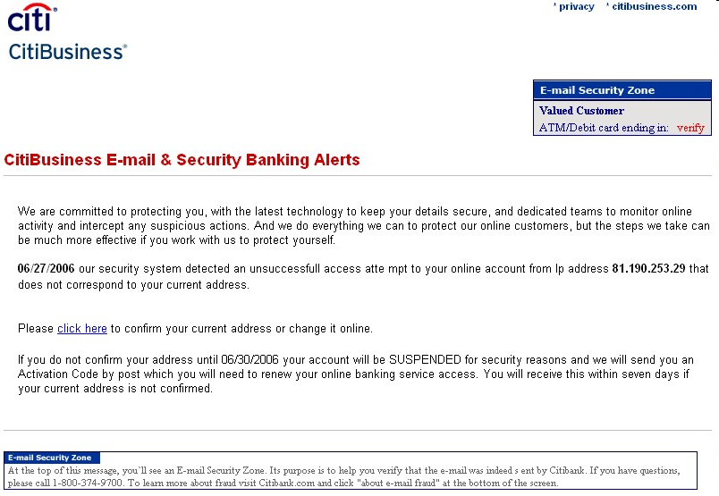
Two-factor Authentication can be Phished Too! 2006 Man-in-the-Middle Attack on CitiBusiness
Token generates new password every minute
Man-in-the-Middle Attack: Ask user for the password generated by his/her token & pass it on the authentic website
If suspicious user enters wrong
password to verify that this is
the genuine site, the malicious
server is not fooled since it passes
it on to the authentic server
Phishing email

Slide 27
Summary
Authentication is central to Web Security
Multi-factor authentication tends to be more secure
But it’s really hard to know how secure a system really is
Attackers are very creative
Offline attacks on passwords can be extremely efficient – especially when using botnets
Don’t underestimate the power of social engineering

Slide 28
References for this Lecture
Required Reading:
Ch. 6 in “Web Security, Privacy and Commerce”, Garfinkel, O’Reilly, 2002
Optional Readings:
“Citibank phish spooks 2-factor authentication”, http://blog.washingtonpost.com/securityfix/2006/07/citibank_phish_spoofs_2factor_1.html
Bank of America SiteKey - http://www.bankofamerica.com/privacy/sitekey/
Password cracking – Wikipedia - http://en.wikipedia.org/wiki/Password_cracking
Stuart Schechter, Rachna Dhamija, Andy Ozment, Ian Fischer (May 2007). "The Emperor's New Security Indicators: An evaluation of website authentication and the effect of role playing on usability studies" IEEE Symposium on Security and Privacy, May 2007. Retrieved on February 5, 2007. http://people.seas.harvard.edu/~rachna/papers/emperor-security-indicators-bank-sitekey-phishing-study.pdf

Slide 29
Q&A

