Slide 1

by ANAMIKA NAYAK
How I would reduce
decision fatigue
on Netflix
For shared households
Helping two people find a film
they both want to start
Independent product case study. Not affiliated with Netflix.
01
Notes:
PRESENTER SCRIPT (approximately 30–45 seconds)
Two people sit down to relax, but first they have to make a shared decision. A film that appeals to one person may be an immediate no for the other. My proposal is an optional Choose together experience that helps two adults reach an acceptable choice quickly. I would begin with films on the household TV, where the decision is bounded and the outcome is observable. This is an independent proposal based on public research. The concept, research plan and targets are hypotheses, not work Netflix has shipped or results I have achieved.
RESEARCH AND DECISION NOTES
Research reviewed 10 September 2026. Scope: two consenting adults in one household, same TV, choosing an on-demand film. No primary interviews or Netflix internal analytics were available. “Decision fatigue” is the practical problem framing here, not a clinically measured condition. Cover art: AI-generated conceptual illustration, not research participants.

Slide 2
Finding something to watch carries a cost
Industry evidence gives this problem weight, but does not size Netflix’s household opportunity
12 min
Reported U.S. search time, minutes
Average reported search time
among U.S. streaming viewers in 2025
19%
Reported abandoning viewing
when search was unsuccessful
Gracenote 2025 survey: 3,000 consumers across six countries. Self-reported, cross-service evidence.
Independent product case study. Not affiliated with Netflix.
02
Notes:
PRESENTER SCRIPT (approximately 30–45 seconds)
Discovery friction can consume a meaningful part of an evening. Gracenote’s 2025 survey, reported by TV Tech, puts average U.S. search time at twelve minutes, compared with ten and a half in 2023. Across the six-country survey, nineteen percent reported abandoning viewing when they could not find something. These are self-reported streaming figures. They do not tell us Netflix’s abandonment rate, how many sessions involve two viewers, or whether disagreement caused the delay. I would use them to justify discovery research, then establish a Netflix-specific baseline before estimating business impact.
RESEARCH AND DECISION NOTES
Sources: Gracenote, 2025 State of Play: https://gracenote.com/insights/2025-state-of-play/
TV Tech, 5 November 2025, reports the exact 12-minute, 10.5-minute and 19% values and the sample: https://www.tvtechnology.com/news/new-data-streaming-service-users-are-wasting-more-time-looking-for-something-to-watch
The 2025 sample spans Brazil, France, Germany, Mexico, U.K. and U.S. The 19% is a respondent-reported behavior, not the share of all sessions abandoned. Cross-wave comparisons are directional context, not a controlled longitudinal result. No revenue or churn lift is inferred.

Slide 3
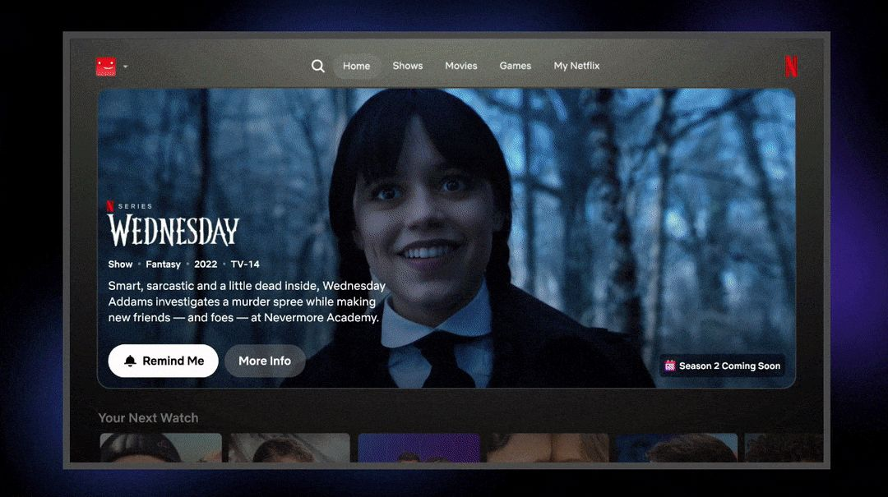
Netflix already invests in discovery
The opportunity is to make the people watching together explicit
What Netflix documents
Personal profiles
Suggestions and My List
Responsive recommendations
More visible shortcuts
Opportunity hypothesis
An explicit shared session could
help two viewers agree sooner.
Independent product case study. Not affiliated with Netflix.
03
Notes:
PRESENTER SCRIPT (approximately 30–45 seconds)
Netflix already has strong discovery capabilities. Its help center describes personal profiles and recommendations informed by viewing behavior and context. The 2025 TV redesign added more visible shortcuts and more responsive recommendations. I would build on those foundations. The opportunity I want to test is an explicit shared session that brings two consenting viewers into one decision. Public documentation does not establish that Netflix lacks every form of group inference. It gives me enough evidence to investigate whether asking who is watching together creates useful context beyond the selected profile.
RESEARCH AND DECISION NOTES
Sources: Netflix Help Center, recommendations: https://help.netflix.com/en/node/100639
Profiles: https://help.netflix.com/en/node/10421
Netflix TV announcement, 7 May 2025: https://about.netflix.com/en/news/unveiling-our-innovative-new-tv-experience
Official screenshot is a frame of Netflix’s public 2025 announcement GIF: https://downloads.ctfassets.net/4cd45et68cgf/61IUzZnwqhPnnjpf5OhOmf/400fcfd2c00744f7375bac0b584cd8b4/Wednesday-slide16.gif?w=2000
Screenshot reflects the announced 2025 design, not a claim that every device has this exact UI in September 2026. Current Help Center checked 10 September 2026. This is a public-source product audit, not an authenticated hands-on audit. No claim about undisclosed Netflix experiments.

Slide 4
Two adults choosing a film together
Job hypothesis: find a film we both accept, without one person managing the whole search
Evidence
What I would validate
A 12-person Netflix study found
choice overload alongside benefits
from recommendation lists.
Repeated vetoes restart the search.
One person carries the decision effort.
Tonight’s preferences differ from history.
Small qualitative sample. Interviews in 2023.
Published in 2024, before the TV redesign.
Proposed research
12 households, 7-day diary, then joint
and separate interviews with both viewers.
Proceed only if agreement friction recurs and is addressable. A prototype must save more time than setup adds.
Independent product case study. Not affiliated with Netflix.
04
Notes:
PRESENTER SCRIPT (approximately 30–45 seconds)
I would focus first on adults who live together and often open Netflix without a film in mind. Published Netflix interviews found overload, but also that recommendations reduced effort for many participants. That rules out assuming recommendations are fundamentally broken. My household-specific hypothesis is that repeated vetoes and unequal decision effort interrupt an otherwise useful discovery flow. I would recruit twelve households for a seven-day diary, observe a shared choice, and interview each person privately as well as together. I would pursue the concept only if negotiation is a recurring, addressable source of friction.
RESEARCH AND DECISION NOTES
Sources: Romero Meza and D’Urso, Psychological Studies (2024), 12 interviews conducted in August 2023: https://link.springer.com/article/10.1007/s12646-024-00807-0
Adjacent context only: Google/Ipsos and Google/MTM research describes social connection in YouTube co-viewing: https://business.google.com/uk/think/consumer-insights/future-of-tv-shared-experience/. This supports investigating shared experience, not a Netflix prevalence estimate.
All household pain points on this slide are hypotheses. No interviews were conducted for this case. Proposed recruitment: six couples and six adult housemate households, varied taste overlap and accessibility needs, in one initial market. Log session goal, elapsed choice time, veto reasons, fallback and each person’s satisfaction. Distinguish disagreement from enjoyable exploration, unavailable content and technical delays. Proposed qualitative gate: recurring agreement bottleneck in at least 8 of 12 households, triangulated across diaries and observed sessions. This is a prioritization rule, not statistical validation. Then counterbalance current-flow and prototype tasks and assess total time plus each person’s satisfaction.

Slide 5
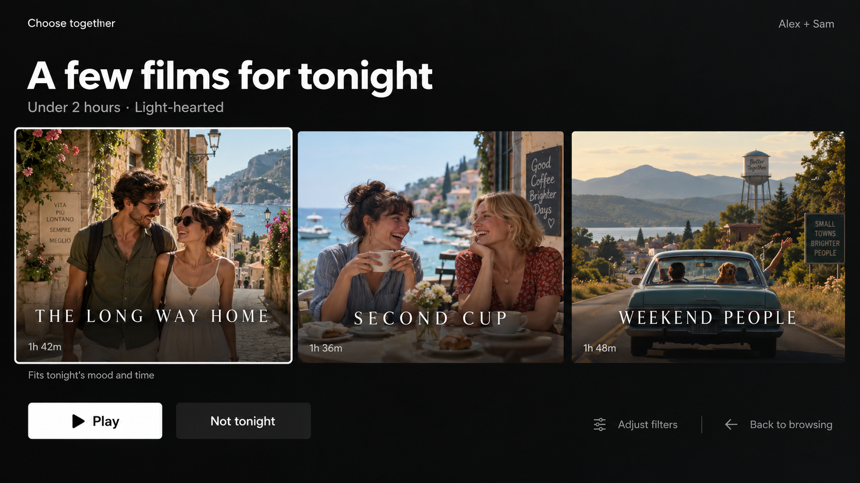
Choose together
Proposed TV experience. The interface and film artwork below are illustrative
01
Confirm the pair
Two opted-in adult profiles.
Optional mood and time limit.
02
Compare three films
A small, explainable shortlist.
Either person can say no.
Independent product case study. Not affiliated with Netflix.
05
Notes:
PRESENTER SCRIPT (approximately 30–45 seconds)
Choose together is optional from the TV home screen. Two adult profiles opt in, confirm they are watching together, and can add a mood or runtime limit. The service offers three films to compare, with an honest explanation based on the selected constraints. Three is a starting design choice to test, not a proven optimum. Either person can reject a film for tonight without creating a permanent dislike. The normal details and play actions remain familiar. Browsing is always available, because some evenings are about exploration and the product should respect that.
RESEARCH AND DECISION NOTES
Proposed concept, not a current Netflix feature. Mockup and fictional film artwork generated for this case. Names and runtimes are illustrative and make no claim about catalog availability. “Play” requires human action, never automatic selection. “Not tonight” rejects the currently focused title for this session only. After rejecting the batch, offer a new batch, with a cap of three batches before emphasizing filter adjustment or regular browsing. Profile-level consent must happen in verified profile settings before using its preferences. Respect locked profile authentication. No claim that selecting a profile proves the person is physically present. Numeric UI choices are hypotheses.

Slide 6
The MVP concentrates on the shared decision
Qualitative prioritization. Benefit, effort and feasibility require validation with Netflix teams
Option | Decision value | Relative effort | Call
Three-film shared shortlist | Tests agreement directly | Medium / high | Build first
Shared My List | Helps planning before viewing | Lower | Later
One surprise pick | Removes comparison, risks rejection | Lower | Defer
Conversational assistant | More expressive input, more interaction | Higher | Defer
MVP boundary
Two adults. TV. Films. One market. Existing recommendation candidates.
Independent product case study. Not affiliated with Netflix.
06
Notes:
PRESENTER SCRIPT (approximately 30–45 seconds)
I would choose the shared shortlist because it tests the central assumption: can the product help two people agree with less effort? A shared watchlist is useful, but mainly supports planning. A surprise pick is cheaper, yet removes the comparison and control that may build confidence. A conversational assistant adds another interaction model before we know it is necessary. The shortlist has meaningful consent and ranking dependencies, so I would validate it in a prototype first. The MVP stays within two adults, films, one TV experience and one market to keep execution and learning manageable.
RESEARCH AND DECISION NOTES
All effort levels are directional judgments, not Netflix estimates. Candidate reuse and cross-profile ranking access require engineering discovery. Excluded from MVP: children, more than two viewers, remote watch parties, cross-service discovery, live content, games, series progression, persistent combined profiles and a new foundation recommendation model. Profile consent, restrictions, accessible remote navigation and experiment instrumentation are MVP requirements, not deferred enhancements. Shared viewing means the same household and screen, consistent with the product boundary described at https://help.netflix.com/en/node/124925. Household policy is context only, not the reason for the feature.

Slide 7
Control and trust shape the implementation
Proposed logic reuses recommendation candidates, subject to feasibility and privacy review
Decision | MVP behavior
Who contributes | Use only opted-in profiles. Honor profile locks and the stricter restrictions.
What can appear | Filter by local availability, selected language and film runtime.
How to order | Combine candidate pools. Prefer films with acceptable fit for both viewers.
When confidence is low | Use stated preferences, explain limited fit, or return to regular browsing.
Session feedback stays separate
No personal history exposed. No silent individual taste updates.
Independent product case study. Not affiliated with Netflix.
07
Notes:
PRESENTER SCRIPT (approximately 30–45 seconds)
The implementation should make the feature feel dependable. Only consenting profiles contribute, and existing locks and viewing restrictions still apply. I would filter eligible films, combine the two candidate pools, and test a conservative ranking that avoids a strong mismatch for either person. Sparse history should trigger explicit preferences, not invented confidence. Rejections stay within the session, and explanations reveal no private viewing history. If ranking is slow or the shortlist cannot meet the constraints, the flow should clearly return control to the viewers. A graceful fallback is part of the MVP.
RESEARCH AND DECISION NOTES
Design proposal, not Netflix’s internal architecture. Dependency owners: TV client, recommendations, profile/privacy services, catalog eligibility and experimentation/data science. Technical assumption: the service can obtain comparable per-profile relevance estimates. Candidate implementation: normalized per-profile relevance with a minimum-fit floor, then rerank for diversity. Validate calibration and coverage offline before exposing users. Do not display fabricated match percentages. Preserve each profile’s restrictions and never relax hard constraints silently. Runtime means film duration, with an explicit caveat for additional ads on ad-supported plans. Defer ad-supported rollout until time-budget semantics and measurement work. Proposed shortlist service p95 target: 1.5 seconds with graceful fallback. Tag co-viewing events separately, maintain session resume state, and exclude them from individual personalization updates in the experiment. This is a nontrivial dependency. If it cannot be isolated, pause the feature. Netflix’s documented signals and profile controls provide context only: https://help.netflix.com/en/node/100639 and https://help.netflix.com/en/node/10421.

Slide 8
Success is a faster start that viewers accept
All definitions and thresholds below are proposed. No baseline or result is claimed
Qualified start rate
+3 pp
A manual title start within 2 minutes,
followed by 10 minutes of content playback
in the next 15 minutes.
Illustrative minimum worthwhile lift
Guardrails
Denominator: all eligible TV home sessions
in the enrolled cohort, including non-starts.
Each viewer’s satisfaction
Early abandonment
TV latency and crashes
The clock starts before feature setup.
Independent product case study. Not affiliated with Netflix.
08
Notes:
PRESENTER SCRIPT (approximately 30–45 seconds)
My primary metric is qualified start rate: a manual title start within two minutes, followed by ten minutes of content playback in the next fifteen. The denominator includes every eligible TV home session in the enrolled cohort, including sessions that never play anything. The clock begins before setup, so we cannot hide added friction. Three percentage points is an illustrative minimum worthwhile lift to calibrate after baseline measurement. Playback is only a proxy for a good decision. I would also protect each viewer’s satisfaction, early abandonment and TV performance before calling the experiment successful.
RESEARCH AND DECISION NOTES
Proposed operational definition: session begins at interactive TV home after profile selection and before feature exposure, following at least 30 minutes of inactivity. Include eligible adult-profile sessions in enrolled households, whether solo or shared. This intentionally measures overall cohort impact and avoids conditioning on post-treatment feature usage. Primary numerator accepts any manually selected on-demand title, including ordinary browsing, to avoid penalizing viewers who choose a series outside the feature. Exclude previews, automatic next episodes and live content. Ten content minutes exclude ads, pauses and buffering.
Diagnostics: entry rate, setup completion, setup duration, shortlist latency, rejection batches, time-to-qualified-start distribution with non-starts censored, and survey-verified shared-session outcomes. Never rely on median time among successful starters alone.
Guardrails proposed for preregistration: either viewer’s positive satisfaction no worse than -3 pp, early abandonment no worse than +1 pp, p95 home-load latency no worse than +100 ms, crash-free sessions no worse than -0.1 pp. Independent sampled surveys ask both viewers privately, include non-starts, report response rate and missingness sensitivity. Positive means 4 or 5 on a 5-point accepted-choice item. Early abandonment means a manually started title stops before 2 content minutes with no qualified replacement in that session. Retention and repeat household use are secondary longer-term outcomes, not immediate launch proof.

Slide 9
A household experiment measures impact
Recruit frequent co-viewers before randomization. Keep each household in one arm
A
B
Current TV experience
Choose together
50% of enrolled households
Existing home and discovery paths
50% of enrolled households
Optional entry on the same home
Baseline and A/A
Powered A/B
Decision rule
2 weeks to validate events
and estimate variance
At least 4 weeks, plus the
precomputed sample size
Meaningful, significant lift
Guardrails within bounds
Independent product case study. Not affiliated with Netflix.
09
Notes:
PRESENTER SCRIPT (approximately 30–45 seconds)
I would enroll households that report frequent shared viewing before randomization, then assign each household consistently to control or treatment. Treatment adds the optional entry point to the existing experience. The main analysis includes all eligible sessions, whether the feature is used or not. A baseline and A/A phase checks instrumentation and estimates variance. The A/B runs for at least four weeks and until the planned sample is reached. I would pre-register the meaningful effect and guardrails, account for household clustering, and avoid stopping early just because an interim result looks promising.
RESEARCH AND DECISION NOTES
Proposed initial test market: U.S., supported TV devices and ad-free plans, with two adult profiles opted in during enrollment. It is a learning cohort, not an estimate of global demand. Do not infer adult age or household presence from profile count alone. Randomize 50/50 at account/household level to limit profile and device contamination. Stratify using pre-period activity and device family. Pre-period eligibility and sessionization remain fixed across arms.
Sample-size plan: use baseline qualified-start rate, household variance/intraclass correlation and repeat-session frequency to calculate sample at 80% power and two-sided alpha 0.05 for a +3 percentage-point effect. Unknown baseline means no invented sample size. Predefine exposure/sample cap and fixed analysis date; if underpowered at the cap, report inconclusive.
Illustrative ship rule: point estimate at least +3 pp, two-sided 95% CI excludes zero, and one-sided noninferiority bounds meet the guardrails on slide 8 with a preregistered multiplicity plan. Report household-clustered intervals and intention-to-treat effect, with exposure diagnostics separately. Safety regressions may trigger an immediate kill switch. Preserve control models and avoid treatment events retraining control during the test. Separate first-use novelty from repeat-week behavior. Corroborate with each viewer’s satisfaction; no retention claim from a four-week proxy alone.

Slide 10

A small launch with a clear stop rule
Proposed rollout, gated by evidence rather than calendar promises
1%
5%
25%
Expand
Instrument
Experiment
Broaden
Only if durable
Check consent,
events and fallback
Run the powered
household A/B
Validate more devices
and local catalogs
Keep a holdout.
Watch repeat use.
My product judgment: earn a better shared decision
with the smallest experience that can prove it.
Independent product case study. Not affiliated with Netflix.
10
Notes:
PRESENTER SCRIPT (approximately 30–45 seconds)
I would expand only when the evidence supports it. A one-percent canary checks consent, event quality and fallback behavior. A five-percent cohort supports the powered experiment, with household assignment preserved. Twenty-five percent tests more devices and catalog conditions. Broader release depends on sustained benefit, while a randomized holdout tracks whether it lasts. If setup consumes the saved time, satisfaction falls, or private preferences leak, I would pause or remove the feature. The product judgment here is to define a narrow customer problem, test the smallest useful intervention, and accept a no-ship outcome.
RESEARCH AND DECISION NOTES
All percentages are proposed shares of the eligible, pre-enrolled cohort, not all Netflix subscribers. They are rollout stages, not dates or achieved reach. At the experiment stage, eligible cohort households remain 50/50 control/treatment. Preserve assignment during ramps and retain a proposed 10% randomized holdout after broader rollout. At each ramp inspect cohort impact, device regressions, catalog coverage, either-viewer dissatisfaction and survey missingness. A kill switch removes the entry point and routes users to the standard home. Recalibrate for additional markets, languages, household sizes and ad-supported time budgets before expanding scope.
PM judgment demonstrated: explicit evidence boundaries, a focused segment, a reversible MVP, privacy-aware execution, causal measurement and stopping criteria. There are no claimed outcomes.
Original logo source: https://about.netflix.com/images/logo.png, displayed without changing proportions and captured from the official public asset.
SOURCE INDEX (sources also appear beside the relevant slide scripts)
Netflix Help Center, recommendation system: https://help.netflix.com/en/node/100639
Netflix Help Center, profiles: https://help.netflix.com/en/node/10421
Netflix Help Center, household: https://help.netflix.com/en/node/124925
Netflix, TV product announcement, 7 May 2025: https://about.netflix.com/en/news/unveiling-our-innovative-new-tv-experience
Romero Meza and D’Urso, 2024: https://link.springer.com/article/10.1007/s12646-024-00807-0
Gracenote, 2025 State of Play: https://gracenote.com/insights/2025-state-of-play/
TV Tech, report summary, 5 November 2025: https://www.tvtechnology.com/news/new-data-streaming-service-users-are-wasting-more-time-looking-for-something-to-watch
Think with Google, co-viewing research, January 2024: https://business.google.com/uk/think/consumer-insights/future-of-tv-shared-experience/
All public sources reviewed 10 September 2026. Cover and proposal interface use AI-generated illustrative imagery. Netflix’s official logo and 2025 product screenshot retain source attribution. Independent product case study. Not affiliated with Netflix.

