Slide 1


Olist Store Analysis Project
Presented By :- Group – 1
Mr.Meet Hitendra Panchal
Ms.Pooja Nithin Poojary
Mr.Yogesh Chappewar
Ms.Naziya Kouser
Mr.Abhisekh Kander
Mr.Tulu Nayak

Slide 2

Introduction
Welcome to the presentation on the Olist Store Analysis project. Our aim in this project was to extract valuable insights from the Olist store dataset by creating key performance indicators (KPIs) and informative visualizations. Through this presentation, we will walk you through the various stages of our analysis, from data cleaning to visualization in different tools.

Slide 3

Data Overview
We worked with a diverse dataset comprising 9 Excel files sourced from Olist Store. These files contained crucial information about orders, payments, delivery, and customer reviews. This rich dataset was the foundation for our analysis, enabling us to uncover meaningful patterns and trends within the ecommerce domain.

Slide 4

Data Cleaning Process
Our initial step involved meticulous data cleaning using Power Query Editor. This process included the removal of duplicate entries, rectifying erroneous values, and merging datasets to consolidate information. The resultant clean dataset laid the groundwork for accurate and reliable analysis, forming the cornerstone of our insights.

Slide 5
Key Performance Indicators (KPIs)
We defined five KPIs that allowed us to assess different aspects of Olist's ecommerce operations:
Number of Orders with Review Score 5 and Credit Card Payment
Weekday Vs Weekend Payment Statistics
Average Delivery Time for Pet Shop Orders
Average Price and Payment Values in Sao Paulo City
Relationship between Shipping Days and Review Scores

Slide 6
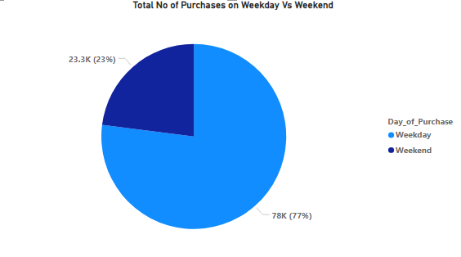
KPI 1: Weekday Vs Weekend Payment Statistics
Payment Values of Weekday(77%) is Higher compared to Weekend(23%) Payment Values.
Also we have found that the Credit Card is mostly used for Payment of orders as compare to other payment types.

Slide 7
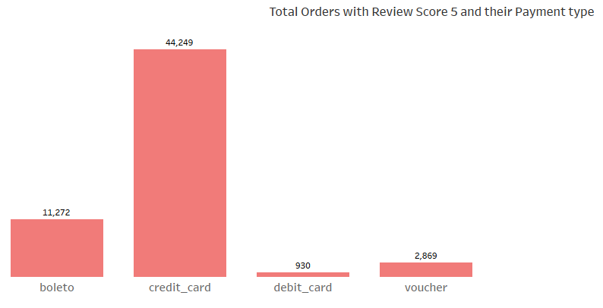
Number of Orders with Payment Type as Credit Card with Review Score 5 is Higher as compare to Other Payment Types.
The data shows that the majority i.e. 56% of the total Customers using Credit Card has given Review Score 5.
KPI 2: Number of Orders with Review Score 5 and Credit Card Payment
Number of Orders
Count of ecommerce orders with a review score of 5.
Credit Card Payment
Subgroup of orders paid for using a credit card.

Slide 8
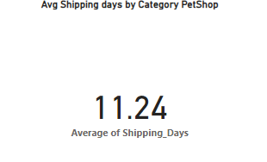
KPI 3: Average Delivery Time for Pet Shop Orders
Average Number of Shipping Days taken for Orders of Product Category Pet Shop is 11 Days.
From this we can find the efficiency of the delivery process for the pet shop and identify the areas for improvement.
Shipping days plays an important role in getting higher customer satisfaction.

Slide 9
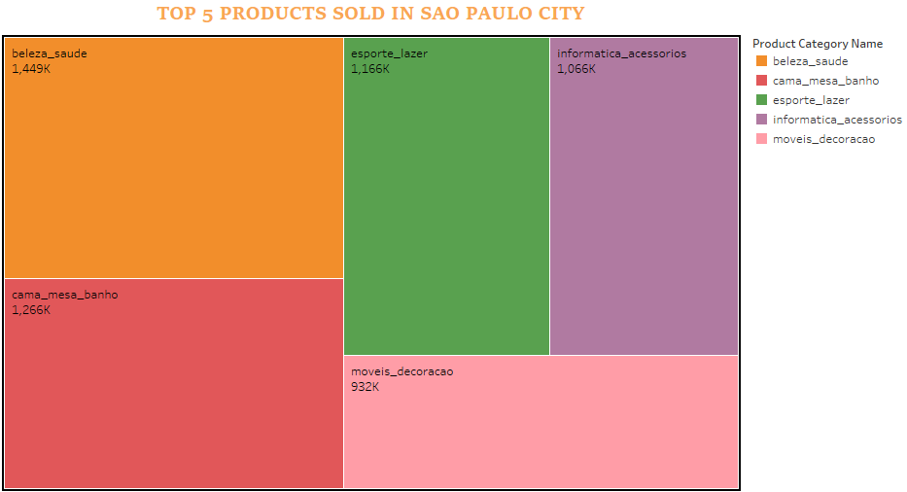
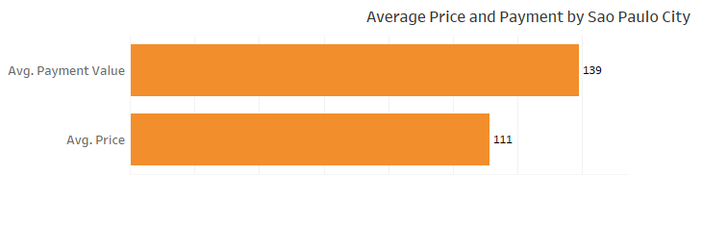
KPI 4: Average Price and Payment Values in Sao Paulo City
Average Price and Payment Values from Customers of Sao Paulo City is found to be 107 & 135.
From this we can Understand the purchasing behavior and payment patterns of customers in Sao Paulo City.

Slide 10
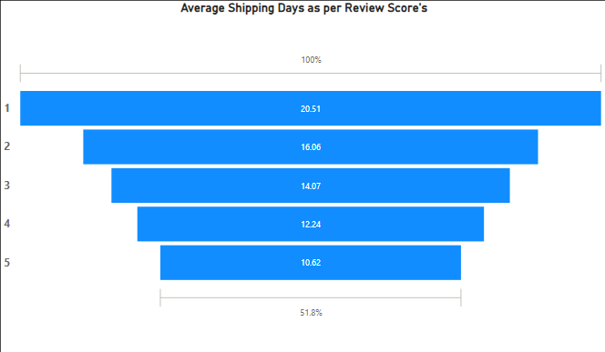
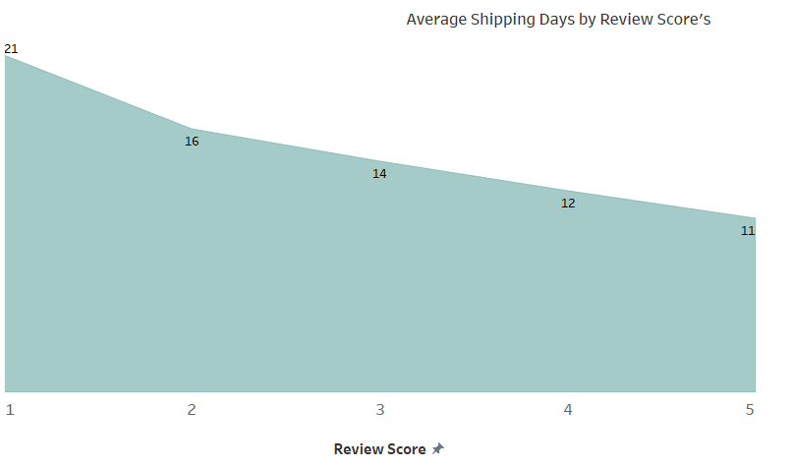
KPI 5: Relationship between Shipping Days and Review Scores
By defining relationship between Shipping Days and Review Scores we have found that with Decrease in Shipping Days will lead to an Increase in Review Scores.
From this we can determine the relation between on time or delayed shipping days which leads to customer satisfaction.

Slide 11

Conclusion and Insights
Our analysis unveiled intriguing insights into Olist Ecommerce sales. We identified trends, correlations, and patterns that hold significant implications for decision-making. The combination of Excel, Power BI, Tableau, and SQL allowed us to comprehensively explore the data and draw actionable conclusions.

Slide 12
Learnings and Challenges
Throughout the project, we learned valuable lessons in data cleaning, visualization, and effective communication of insights. Challenges like data inconsistencies were overcome through systematic approaches, reinforcing the importance of robust data preprocessing.
1
Valuable Lessons Learned
2
Challenges Overcome
Data cleaning
Data inconsistencies
Visualization
Data preprocessing
Effective communication
Dashboard design

Slide 13
Future Steps
Looking ahead, there are exciting possibilities for extending this analysis. Exploring different geographic regions, timeframes, or even employing advanced predictive models could offer deeper insights into ecommerce trends and customer behavior.
1
Exploring Different Regions
Could reveal patterns related to geography
Timeframes Analysis
2
Might unveil trends in certain timeframes
3
Advanced Predictive Models
Could provide additional insights for better decision-making

Slide 14

Acknowledgments
We extend our gratitude to our project team for their dedication and collaboration. Additionally, we appreciate the guidance of our mentors and the tools that facilitated our analysis journey.

Slide 15
Q & A
We invite you to ask any questions you may have regarding our Olist storeAnalysis project. Your inquiries will help us delve deeper into the dataset and provide further insights.

