Slide 1

STS-51-L Challenger Launch Decision Briefing
Submitted By:
Lakshmi Sravya Dama
Sudeshna Mullaguru
Nikhil Namani
Vinaya Rajaram Nayak
Gayathri Shanmuga Sundaram

Slide 2

Introduction:
As a team of senior NASA engineers, we collectively oversee the technical aspects of our missions, and today we're here to discuss the STS-51-L Challenger launch scheduled for January 28, 1986, with our primary concern being the unexpectedly cold temperatures and their potential impact on O-rings.

Slide 3

Overview of the Challenger Space Shuttle:
The Challenger shuttle, part of NASA's Space Shuttle program, has a rich history and holds great significance in our missions.
It was commissioned for a variety of critical missions, known for its 65,000-pound payload capacity, and served as a workhorse of space exploration.

Slide 4
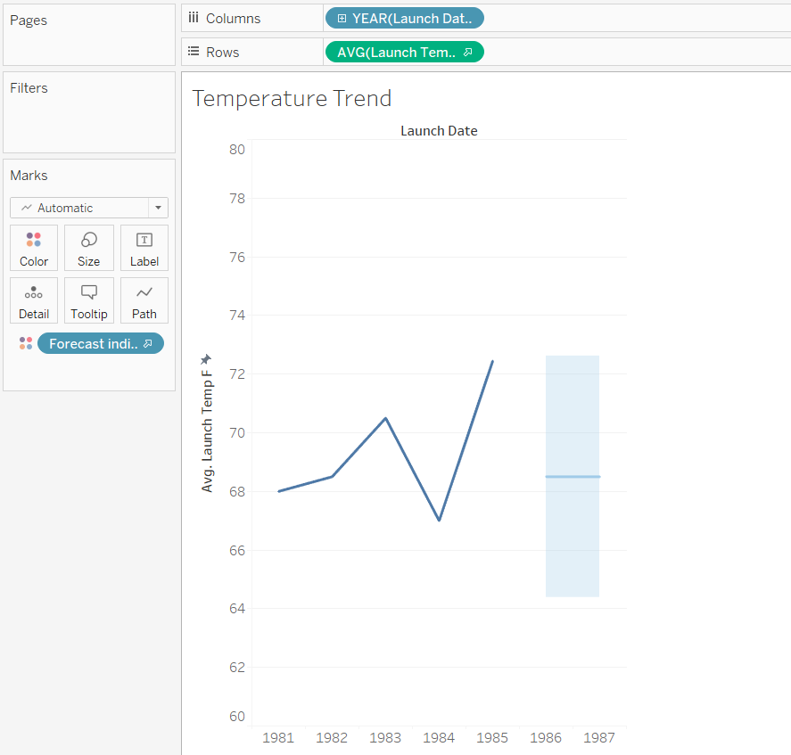
Evidence That supports Senior engineer’s decision to launch the shuttle based on the below visualizations:
From the visualization, we have determined that the average temperature recorded was approximately 68 degrees Fahrenheit, and based on our forecast, the temperature range fluctuated between 64 to 73 degrees Fahrenheit.

Slide 5
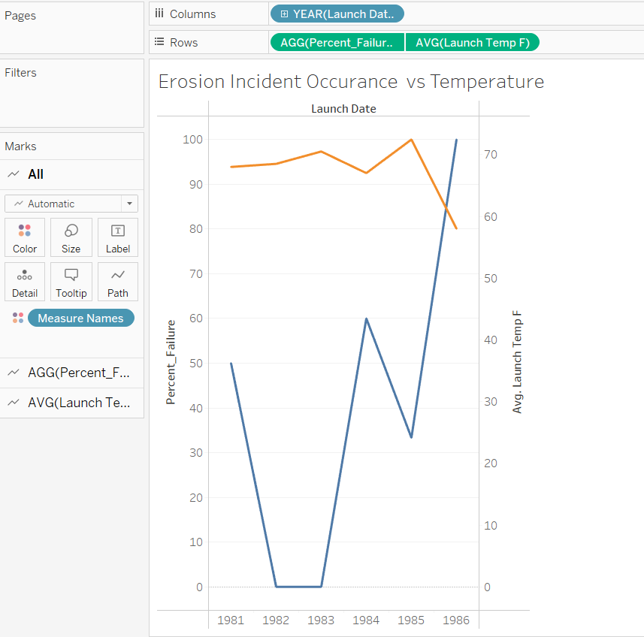
From the visualization, it is evident that the erosion failure rate demonstrates a lower percentage when temperatures are above 68 degrees Fahrenheit and below 60 degrees Fahrenheit.

Slide 6
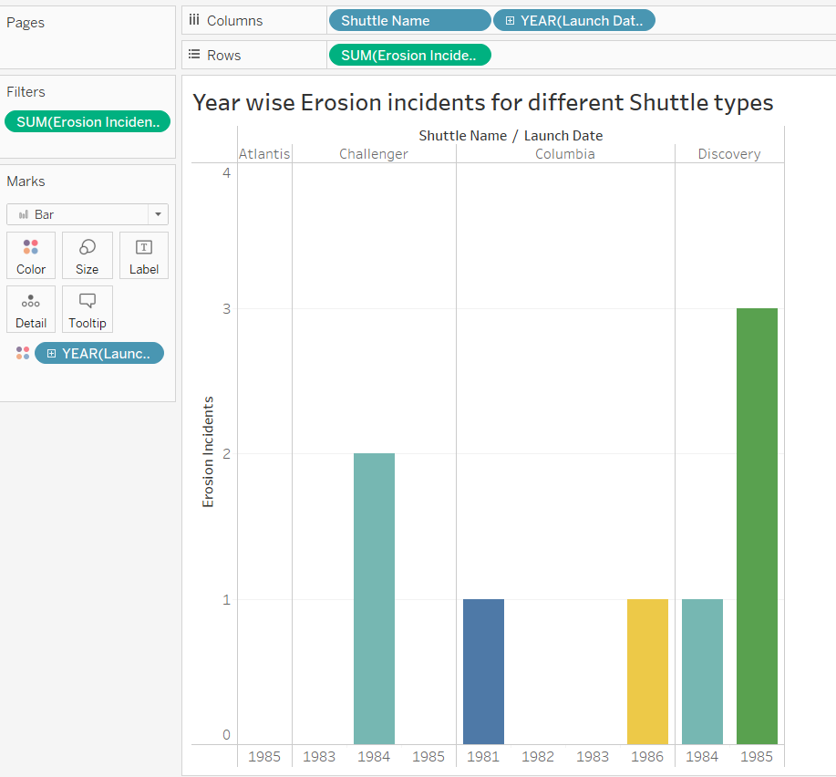
Based on our analysis, we chose the Challenger mission because the probability of erosion incidents was lower in comparison to the Discovery. The Discovery mission experienced three incidents in 1985 and one in 1984, as indicated from the visualization.

Slide 7
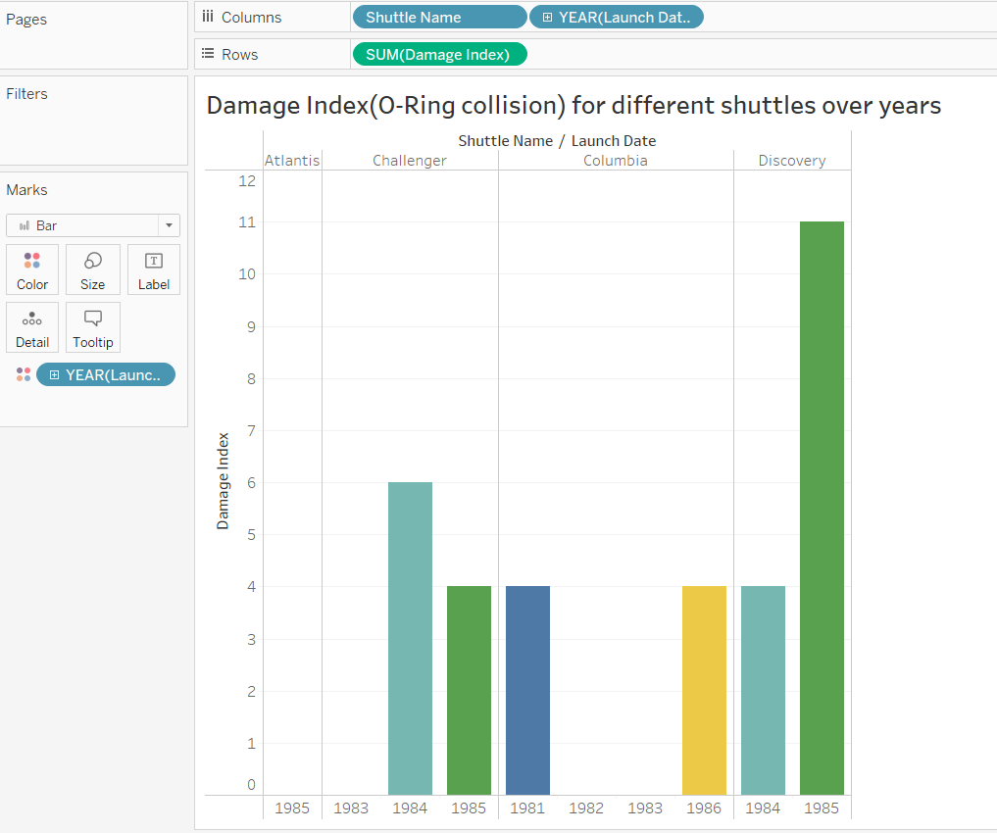
After a thorough analysis, our decision favored the selection of the Challenger mission over the Discovery mission. This choice was informed by a lower probability of O-Ring collision incidents, specifically in the context of the Damage Index, over the years. The Discovery mission encountered three incidents in 1985 and one in 1984, as evident from the visual data.

Slide 8
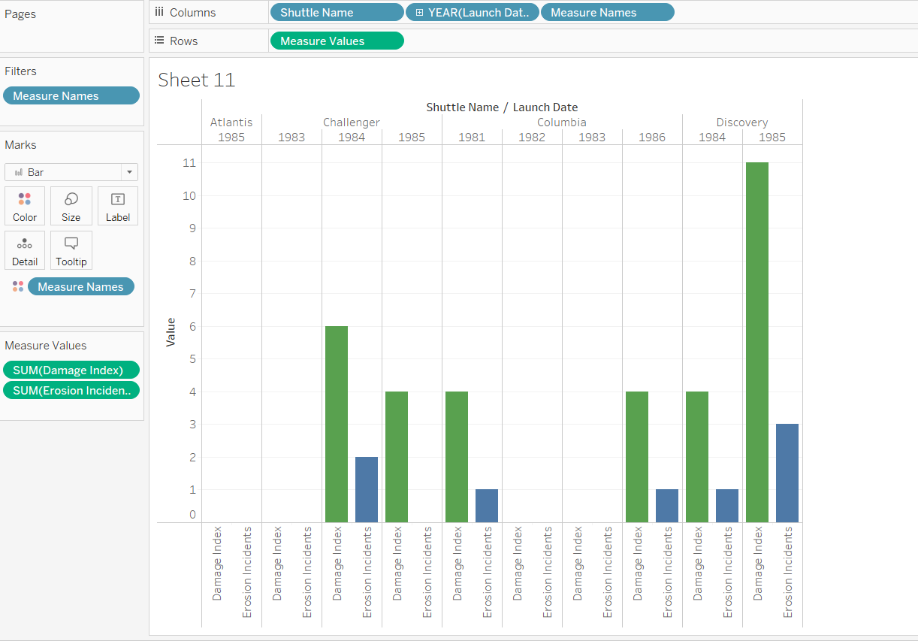
Our analysis indicates a direct correlation: when the Damage Index is high, there is a correspondingly elevated probability of erosion incidents
Conclusion :
Considering the comprehensive analyses presented earlier, the senior engineer would have likely granted clearance for the launch. This decision would be grounded in the data and insights we've examined, which collectively pointed towards a favorable outcome for the mission. However, it is essential to emphasize that this decision must always prioritize safety above all else, ensuring that all aspects, including the impact of cold temperatures on O-rings, have been rigorously evaluated to minimize risk.

Slide 9
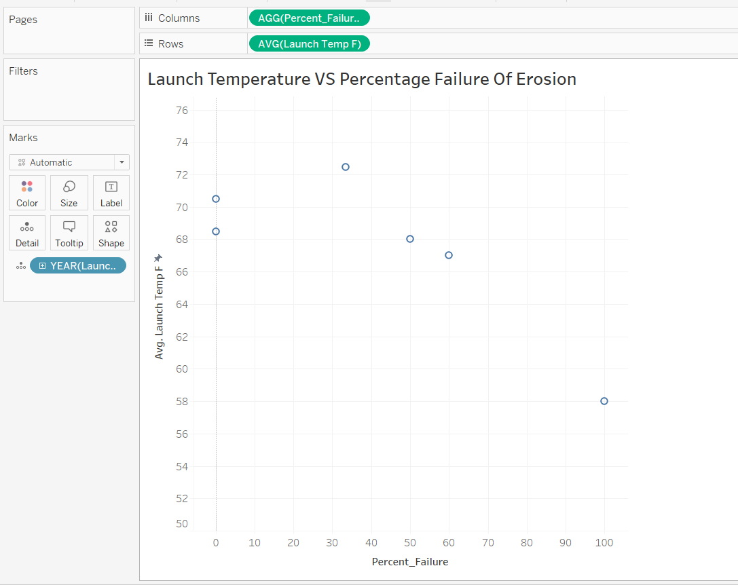
This visualization tells us that the decision of the senior engineer went wrong as there is a negative co-relation between launch temperature and failure percentage.

Slide 10

Part B:
In this presentation, we're going to explore two queries we examined in our P2 assignment. One is about stocks, and the other is about a superstore. We aim to use these queries and their pictures to discover new things.

Slide 11
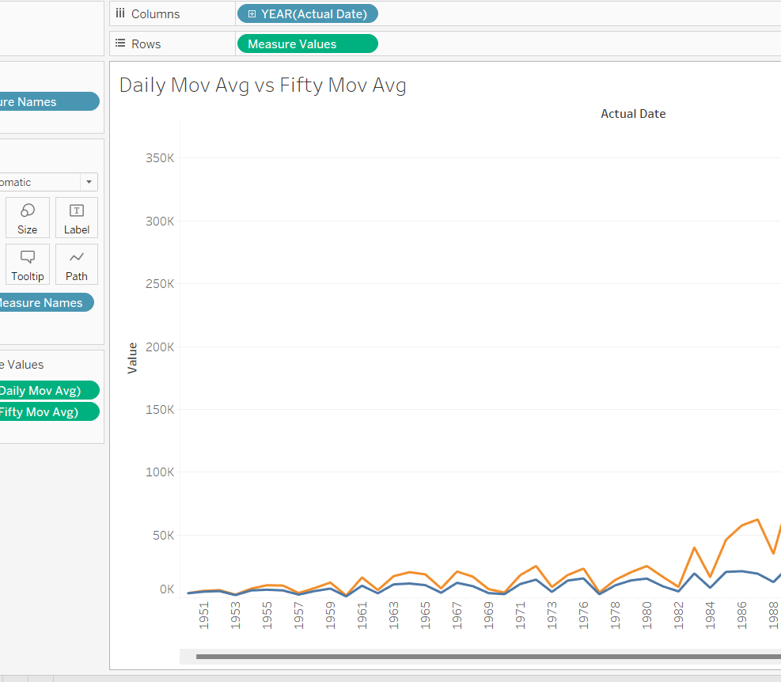
with cte as(select actual_date,close,adjusted_close,round(avg(close) over(order by actual_date),2) as daily_mov_avg,
round(avg(close) over(order by actual_date rows between 49 preceding and current row) ,2) as fifty_mov_avg,
round(avg(close) over( order by actual_date rows between 199 preceding and current row),2) as twohundred_mov_avg
from fin.sp500_eod_facts f inner join fin.sp500_dates d on f.julian_day=d.julian_day)
select * from cte
In the graph, you can see that the average value over fifty days is higher than the daily average. This suggests that there's a consistent upward trend in the data over a longer time frame, showing positive and steady progress

Slide 12
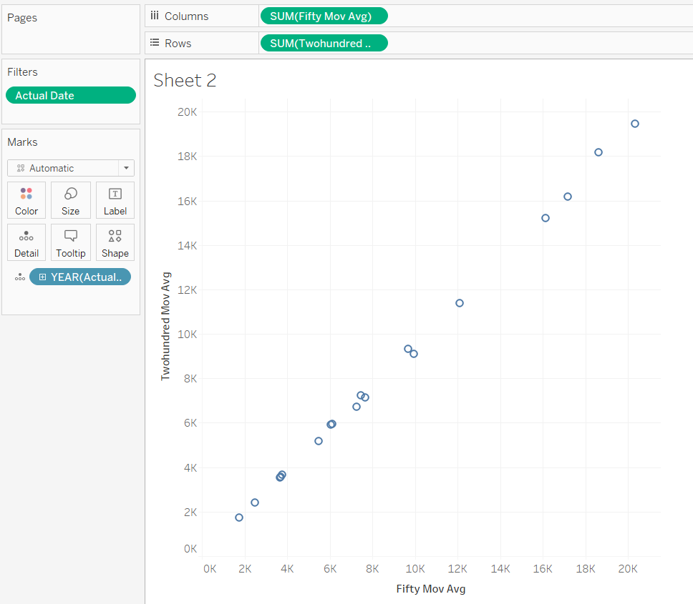
In the data, we observe a positive correlation. When the fifty-day moving average is high, it's also evident that the Two Hundred-day moving average tends to be high. This correlation indicates that as short-term performance improves, it's often followed by long-term growth. In other words, when the short-term trend is positive, it tends to be a good sign for overall stock profitability. This suggests that stocks have the potential to be profitable when we see these patterns.

Slide 13
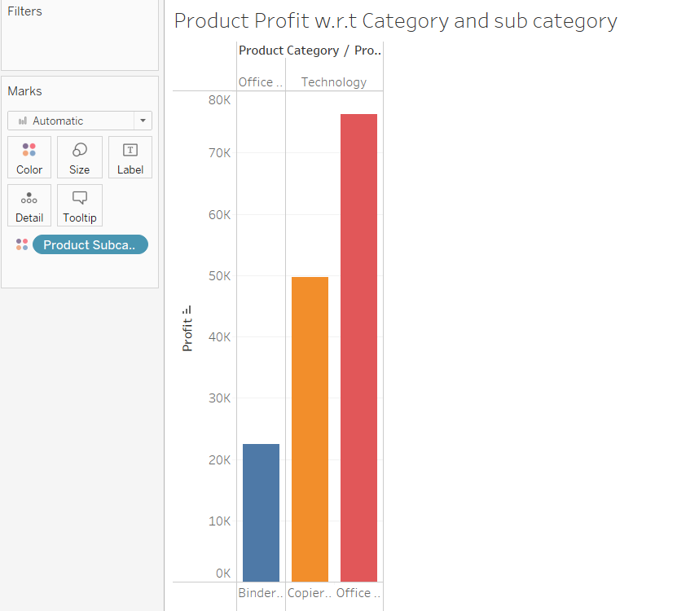
with orders_data as (
SELECT CUSTOMER_NAME,CUSTOMER_STATE,COUNT(ORDER_ID) as orders,SUM(SALES) as TOTAL_SALES
from SUPERSTORE.CUSTOMER_DIM CDM
ON CDM.CUSTOMER_KEY=SFT.CUSTOMER_KEY
GROUP BY CUSTOMER_NAME,CUSTOMER_STATE
ORDER BY ORDERS DESC)
select CUSTOMER_NAME,CUSTOMER_STATE,orders,total_sales,
RANK() OVER (ORDER BY ORDERS DESC) as SALES_RANK,
DENSE_RANK() OVER (ORDER BY ORDERS DESC) as SALES_DENSE_RANK
from orders_data
This graph displays the profits of products categorized by both category and subcategory. In the technology category, we observe that the subcategory 'Office machines' outperforms 'Copiers and fax' in terms of profit, indicating it as the highest profit-earning subcategory within the technology category.

Slide 14
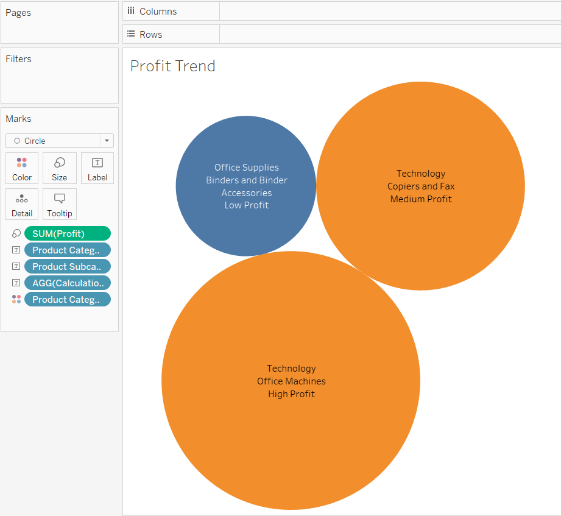
This bubble chart illustrates the profit trends across various categories and subcategories. Notably, within the Office Supplies category, profit levels appear lower when compared to the Technology category. Specifically, the 'Office machines' subcategory in the Technology category stands out with notably higher profits.

Slide 15

Thank You

