Slide 1
ITOpsOrchestrator High Level POC

Slide 2
What ITOpsOrchestrator does, and why this use case first
The problem ITOpsOrchestrator solves
Phase 1 narrowed to four AWS-only use cases
Written policy and technical enforcement drift apart over time. SharePoint says X (Dropbox is approved cloud storage). Zscaler does Y (silently blocks Dropbox after a recategorization). No human catches the disagreement because nobody owns both layers.
UC | What it detects | Status
UC-01 | Cross Domain Policy Conflicts. | Demo1
UC-02 | 0.0.0.0/0 exposure + context-aware severity | Demo2
UC-03 | SG-vs-NACL reachability conflict (Reach. Analyzer) | later
UC-04 | VPC peering route asymmetry | later
Three categories of drift
A Cross-domain conflict.
Policy and technical control disagree (e.g., SharePoint vs Zscaler).
B Intra-document conflict.
Two written policies contradict (encryption strength, retention).
C Real-time drift.
An infra change violates the policy after the fact (Config events).
ITOpsOrchestrator UC-02 · Engineering review · 15 May 2026
2 / 6

Slide 3
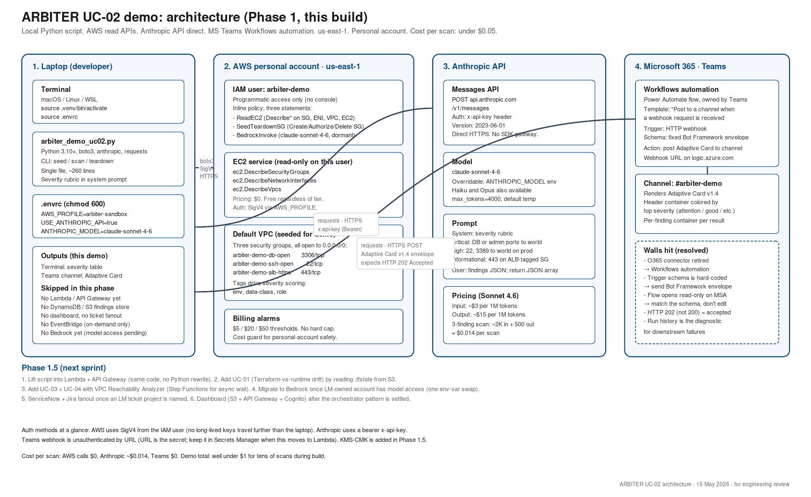
Architecture: Direct Calls to Model
3 / 6

Slide 4
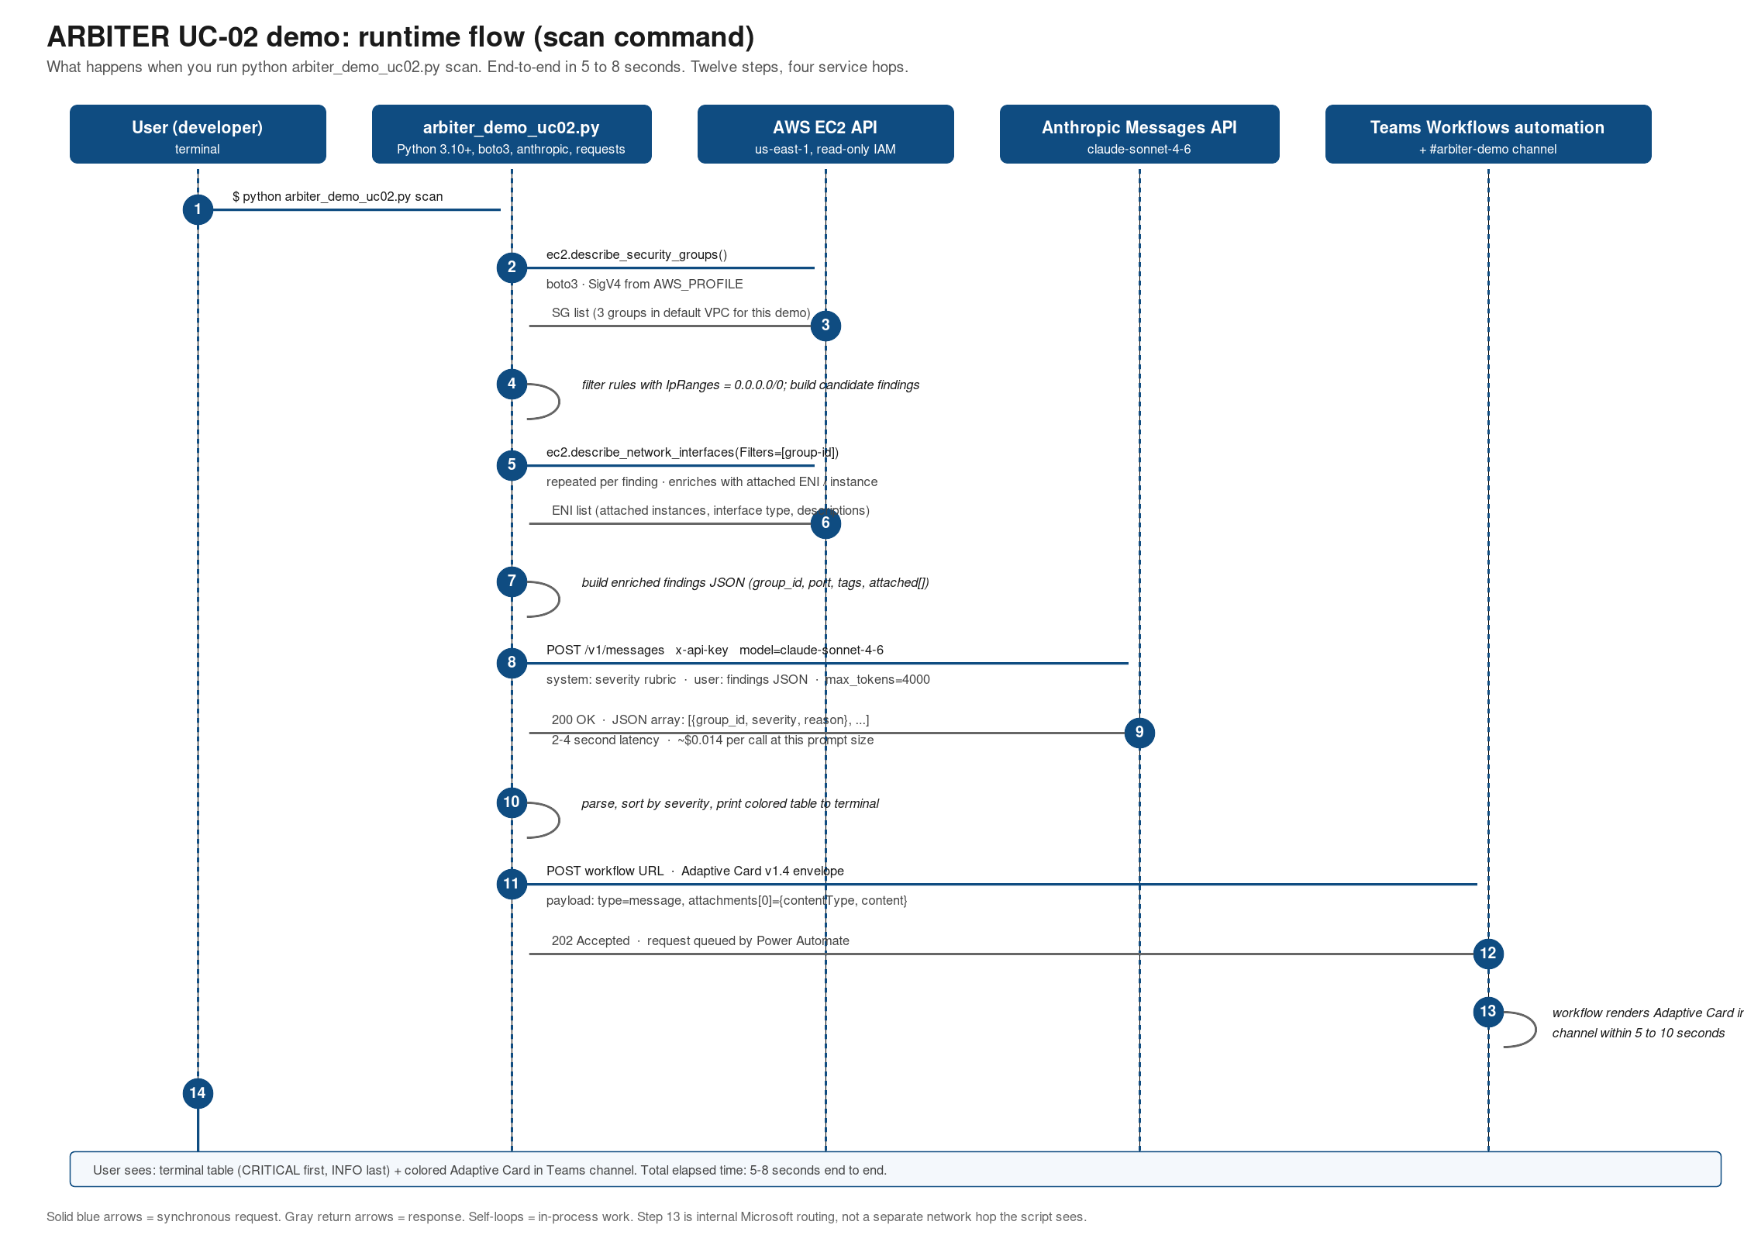
Runtime flow: what scan actually does
4 / 6

Slide 5
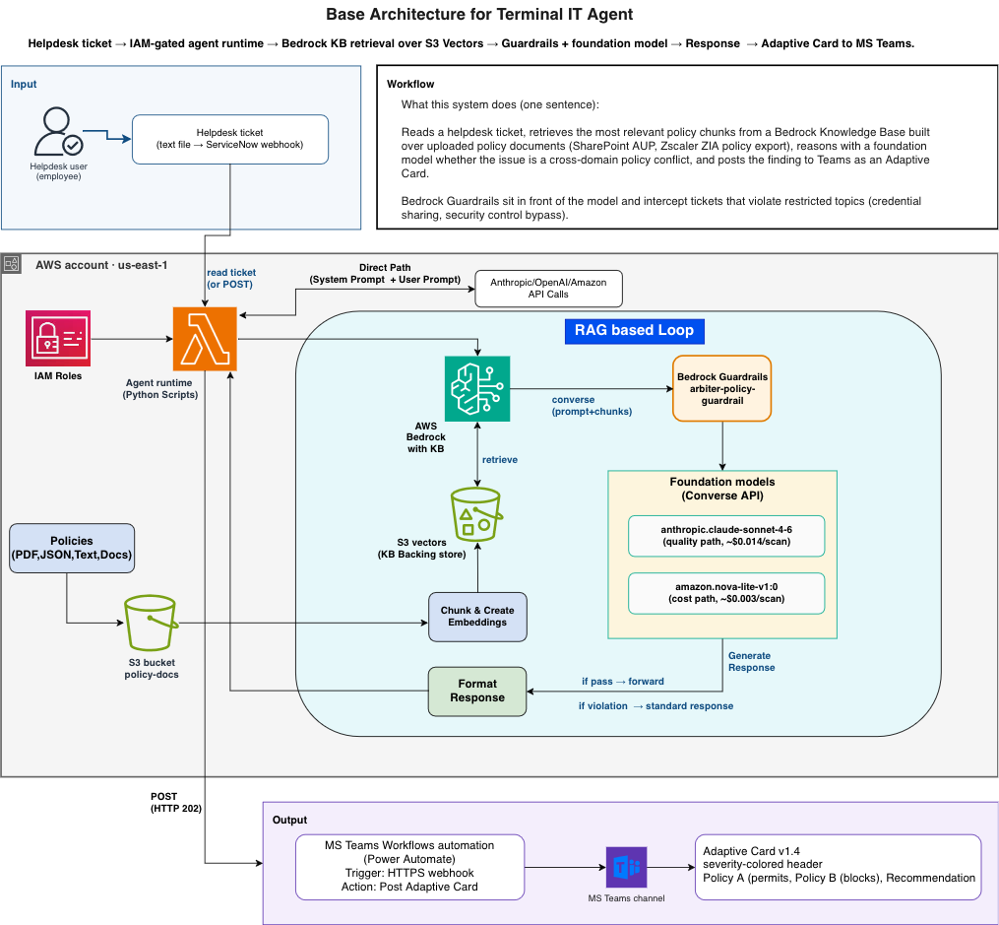

Slide 6
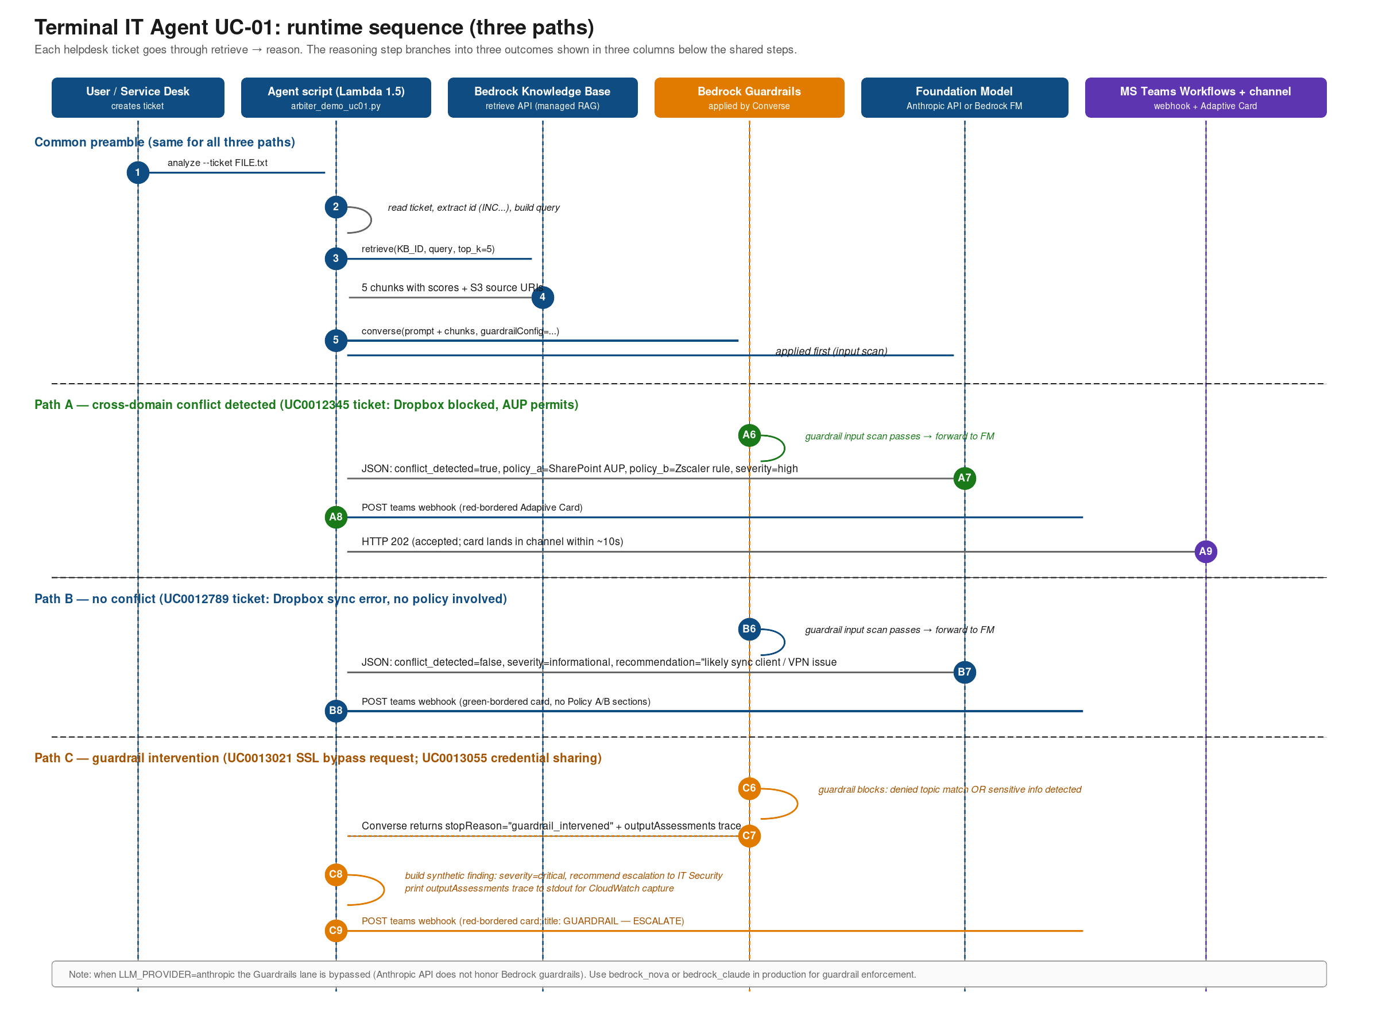

Slide 7
Walls we hit (and what we learned)
Six things cost real time tonight. Documenting so the next person skips them.
#1
Bedrock model access on a personal AWS account asks for company details.
#2
MS Teams Incoming Webhook connector was retired (late 2024-2025).
Form is mandatory for Anthropic on Bedrock. Personal accounts don't have one. Fix: Anthropic API direct. Same model, same code, USE_ANTHROPIC_API=true.
Replacement is a Power Automate workflow accessed from inside Teams: channel > three dots > Workflows. Not from make.powerautomate.com (separate licensing on MSAs).
#3
The Workflows trigger schema is hardcoded and read-only.
#4
Anthropic model snapshots move. claude-3-5-sonnet-20241022 returns 404.
It expects the full Bot Framework Adaptive Card envelope. Plain {"text": "..."} payloads return "flowbot adaptive card request is missing or invalid". The script sends the canonical envelope.
Current production model in May 2026: claude-sonnet-4-6. We made the model name an env var so future swaps don't need code edits.
#5
HTTP 202 (not 200) from the Teams workflow is success.
#6
There is no hard spend cap on AWS, only billing alerts.
Means the request was queued. If 202 returns but no card lands, look in the flow's run history. That is the diagnostic.
Set three thresholds before invoking Bedrock or any paid service: $5, $20, $50. Especially on a personal account.
ITOpsOrchestrator UC-02 · Engineering review · 15 May 2026
5 / 6

Slide 8
Phase 1.5: what we ship next
1. Lift to Lambda + API Gateway
2. Add UC-01 (Terraform-vs-runtime drift)
Same Python, same prompt, same Adaptive Card payload. Behind an authenticated endpoint. Two-day swap, no rewrite. Adds DynamoDB for findings persistence.
New tool: get_tf_baseline(state_uri). Reads .tfstate from S3, parses aws_security_group blocks, diffs against live config. Same orchestrator shape.
3. Add UC-03 + UC-04 (Reachability Analyzer)
4. Migrate to Bedrock
Async tool. Step Functions Express workflow handles the 3-5 minute wait per analysis. $0.10 per analysis. Wrapped behind the same agent loop.
When the LM account has Claude model access. One env-var swap (USE_ANTHROPIC_API=false). No code change. Same model class.
5. ServiceNow + Jira fanout
6. Simple dashboard
When the workflow has named ticket projects. Idempotency by finding_id. ServiceNow for SecOps incidents, Jira for engineering follow-ups.
S3 SPA + API Gateway + Cognito federated to IAM Identity Center. Findings list + detail view with evidence drill-down. Read-only for analysts.
Asks for this team
Owner for #1 (Lambda lift): ? · Owner for #2 (UC-01): ? · Sandbox AWS account for the team: ? · Severity rubric review: who signs off?
6 / 6

