Slide 1
Staircase Detection

Slide 2
CSE 3200 Your Presentator!
Ahsan Habib Nayan
1507082
Motasim Billah Mredul
1507070
Supervisor
Md. Milon Islam
Lecturer
Department of Computer Science and Engineering
Khulna University of Engineering & Technology

Slide 3
Objectives
A system that detects staircase in all possible cases.
Could differentiate between up and down stairs..

Slide 4
Challenges
Detection of staircase through camera in an walking stick used by a blind people.
Connecting a raspberry with the device where the object detection library would run and send data simultaneously to detect up and down stair.
A real time device which would detect stairs without any stoppage and low response time.

Slide 5
Technical Details
Raspberry Pie 3.0 model B
Intel core i3 processor
RGB-D camera
Ultrasonic sensor HY-SRF05
Buzzer
Connecting wires

Slide 6
Funtionality

Slide 7
TensorFlow Environment
Pre-trained model for staircase and ground detection.
Ultrasonic Technology
Up or down stair detection using a reference distance.

Slide 8
System Overview
Staircase detection
Camera
Up/down stair detection
Ground recognition
Ultrasonic sensor
Up/down stair detection
Buzzer is on if stair detected

Slide 9
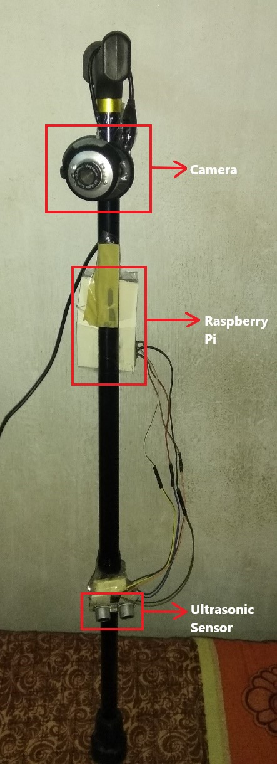
Current Prototype

Slide 10
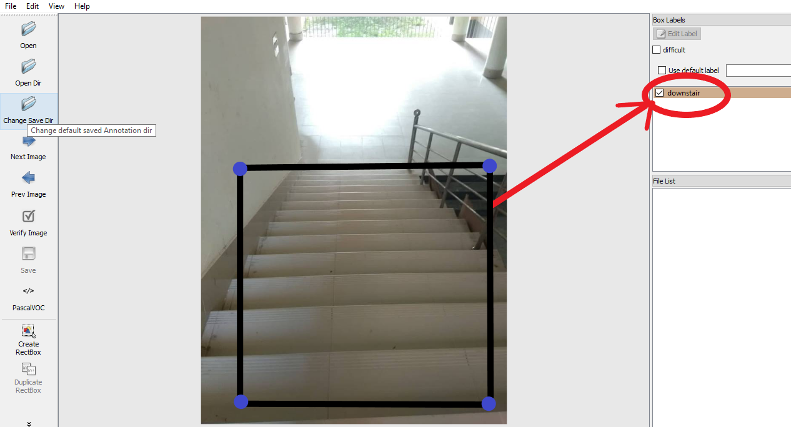
Labelling Images
“LabelImg” is used for labelling images.

Slide 11
Model Construction
Images
Labelling images
Image input
XML file with attributes
Training through
R-CNN v2 COCO model
Trained Model
Output detection mark

Slide 12
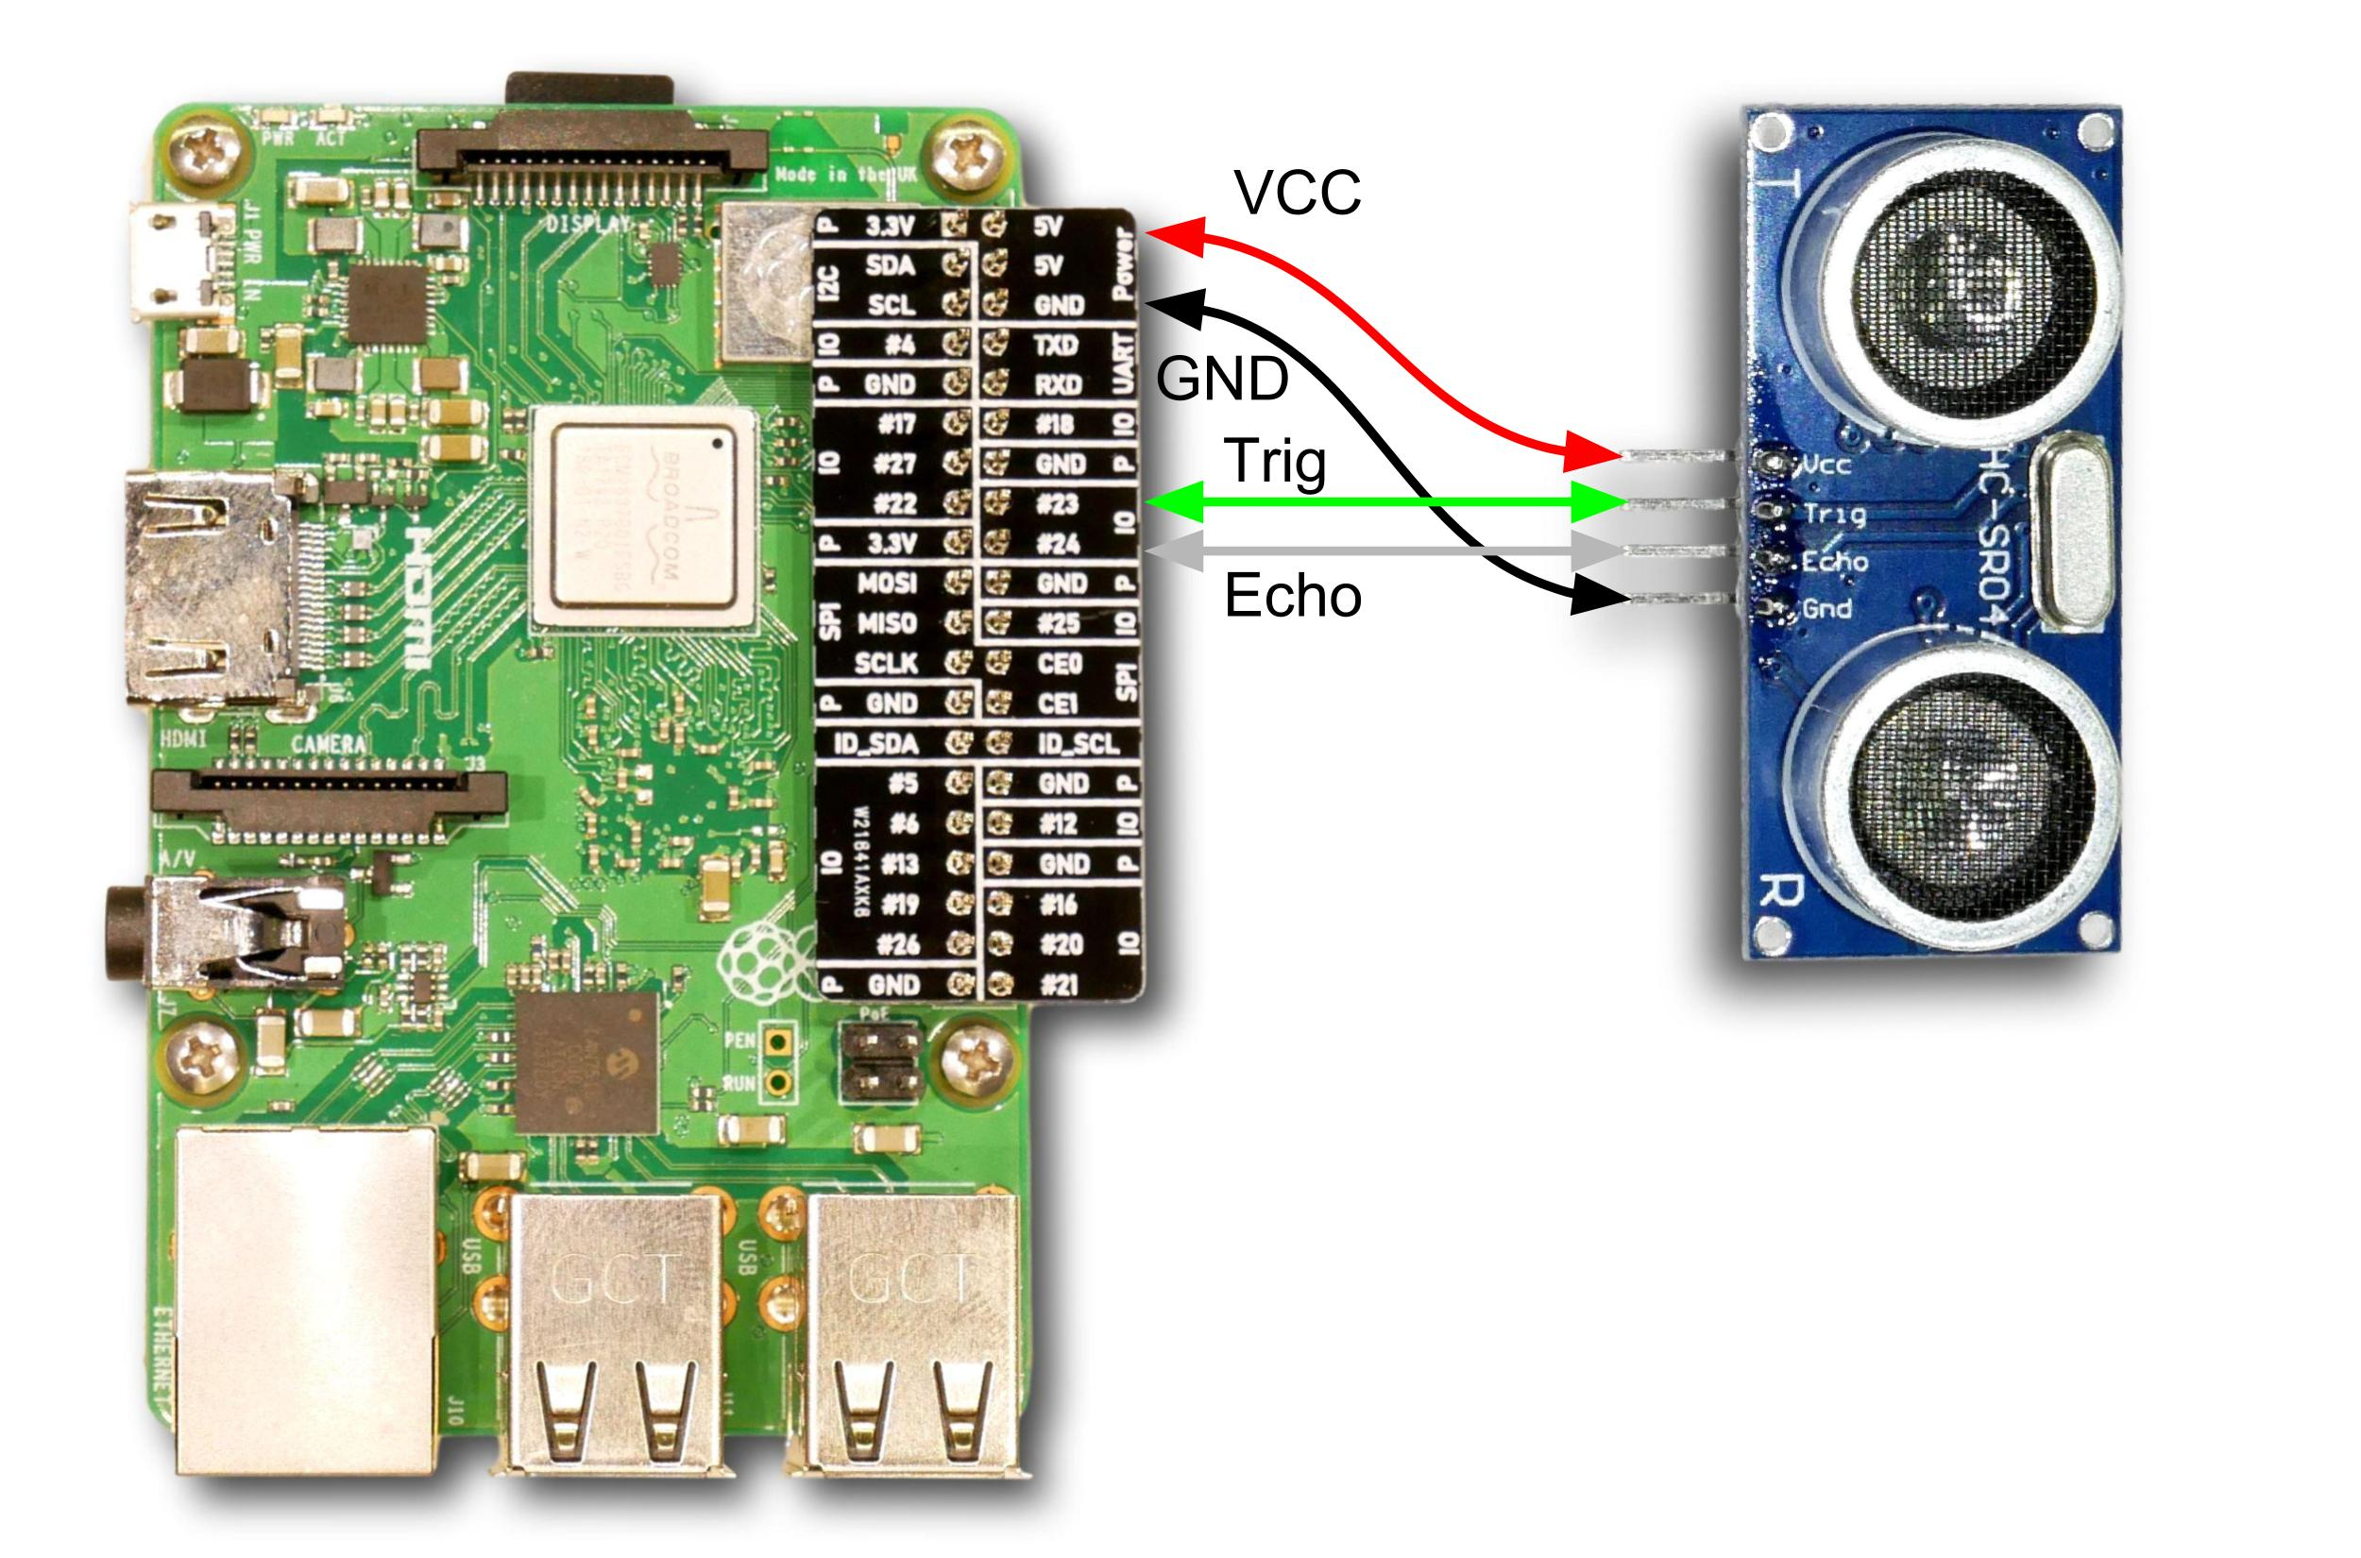
Ultrasonic Sensor

Slide 13
Accuracy Results
Ultrasonic sensor
Camera Module
Type of Stair | Accuracy
Up stair | 85 – 99 %
Down stair | 70 – 95 %
Type of stair | Accuracy
Up stair | 60 – 99 %
Down stair | 70 – 99 %

Slide 14
Limitations
Vision technology would not work on dark places.
The ultrasonic sensor would give the same data for objects with a minimum height and down stair even if there is hole ahead of the device.
Deviation of data in noisy places for ultrasonic sensor.
Heavy processing device required for object detection through vision technology.

Slide 15
Possible Applications
For visually impaired people
Multi floor navigation for robot systems

Slide 16
Future Work
To make the device less expensive while using cloud services for stair detection.
More power efficient.
To count the number of steps and the step size.

Slide 17
Conclusion
Solving the major problems of the previous models
Wide range of application

Slide 18
Thanks!
House is now open for discussion.

