Slide 1
Stairways Detection and Distance Estimation Approach Based on Three Connected Point and Triangular Similarity
Presented By:
Md. Ahsan Habib
Roll: 1507082

Slide 2
Outline
Proposed Framework
What the Problem is!
Distance estimation from camera to stair
Experiment Results
Conclusion

Slide 3
According to the World Health Organization (WHO), about 253 million people are visually impaired. Among them, around 36 million are blind and rest 217 million people have various vision impairment. Among the above 80%, people are 50 years aged or above.
Those people who are visually impaired, they require more help to navigate around the environment to avoid obstacles like stairs, path-holes, etc.
So, “Staircase Detection and Distance Estimation” is a serious problem for them.
What the Problem is !

Slide 4
Proposed Framework
The developed system has six elementary steps. They are:
Gabor filter is applied to extract stair edges properly.
Small and non-candidate edges are eliminated.
Edge linking and tracking.
Finding of Three connected points (TCP).
Increasing horizontal edge segments are extracted.
Detect staircase using vertical vanishing point (VP).

Slide 5
Proposed Framework
Input image
Gabor Filtering
Edges elimination
Edges linking
TCP finding
Edges extraction
Virtual VP calculation
Stair region
Flow through the system
Cont.

Slide 6
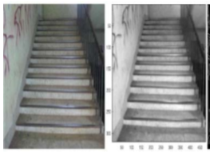
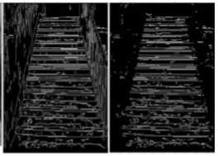
A
Gabor filter is applied to extract stair edges
Proposed Framework
Gabor Filter is used to remove noise from image.
It works on gray scale image for low computational cost.
Canny edge detector is used to extract edges form image.
Cont.
(a) (b)
(a) (b)
Fig. 1. (a) stair image (b) Gabor filtered image
Fig. 2. (a)Canny edge image (b) horizontal edge image

Slide 7
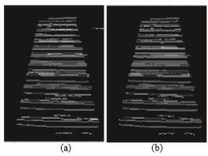
B
Small and non-candidate edges are eliminated
Proposed Framework
A THRESHOLD_LINE is used to remove small and discontinuous edges.
The non-candidate edges also be eliminated in this stage.
Cont.
Fig. 3. (a) Elimination of small edge (b) Elimination of non-candidate edge

Slide 8
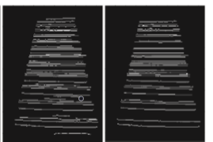
C
Edge linking and tracking
Proposed Framework
The edge linking process is applied to fill small gaps or breaks.
Potential longest horizontal edges are kept.
Cont.
(a) (b)
Fig. 4. (a) Edge linking (b) Potential longest horizontal edge

Slide 9
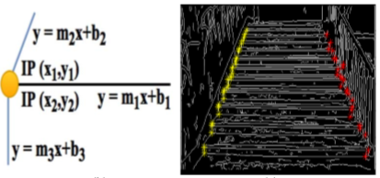
D
Finding Three Connected Point (TCP)
Proposed Framework
The beginning and ending point of each stairs step’s horizontal edges intersect with two vertical edge points.
Canny edge image is used to find TCP using vertical edges.
Cont.
(a) (b)
Fig. 5. (a) Procedure of calculating TCP (b) TCP in the edge image

Slide 10
E
Extracting increasing horizontal edge segments
Proposed Framework
The longest increasing horizontal edge is extracted.
This process is done using previous horizontal edge image.
Also use TCP.
Cont.

Slide 11
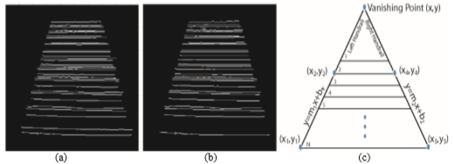
F
Calculating vertical Vanishing Point (VP)
Proposed Framework
VP (imaginary) is two handrails intersection point of a staircase.
Some stairs do not have either both handrails or one handrail.
For these cases, two virtual handrails may construct to calculate VP.
Cont.
Fig. 6. (a) Longest horizontal edge segment (b) Longest increasing horizontal edge segment
(c) Estimating vertical vanishing point

Slide 12
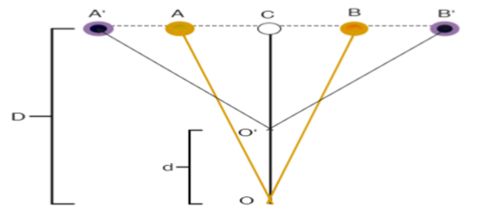
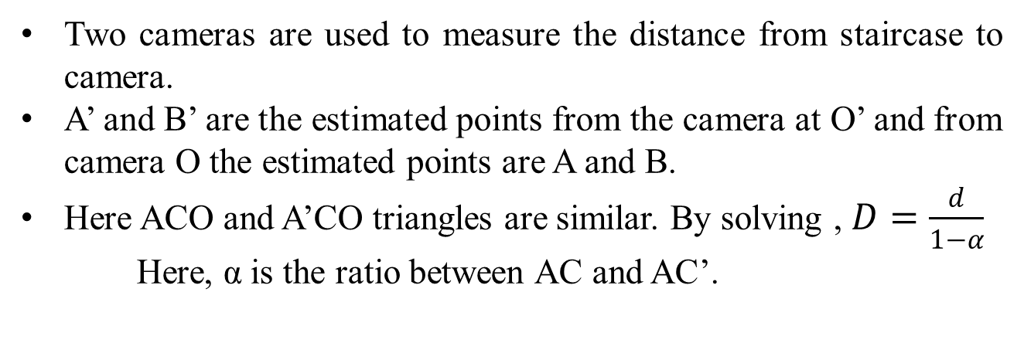
Distance estimation from camera to stair
Two cameras are used to measure the distance from staircase to camera.
A’ and B’ are the estimated points from the camera at O’ and from camera O the estimated points are A and B.
Here ACO and A’CO triangles are similar. By solving , $D=\frac{d}{1−α}$
Here, α is the ratio between AC and AC’.
Fig. 7. Estimating distance from the camera to stair

Slide 13
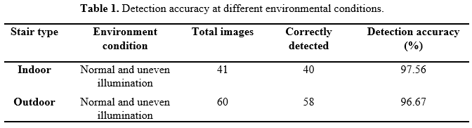
In case of Indoor stair type, the system achieved 97.56% accuracy and for outdoor it achieved slightly low accuracy of 96.67%.
The system had achieved an accuracy of 97.12% on average.
Experiment Results

Slide 14
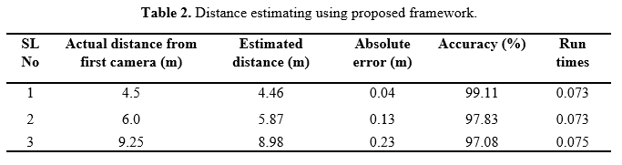
Experiment Results
The distance estimation from the camera also gives an accuracy of 98.01% on average.
Cont.

Slide 15
Conclusion
The developed system can detect staircase and estimate distance from user to stair except any prior information.
Some natural and unique properties of staircase are used to develop this framework.
The system had achieved an accuracy of 97.12%.

Slide 16

Any Question?

