Slide 1

Solving GREEN VEHICLE Routing Problem using heuristic approach
Supervisor:
Dr. Md. Aminul Haque Akhand
Professor
Presentator:
Md. Ahsan Habib
Roll: 1507082
Department of Computer Science and Engineering
Khulna University of Engineering & Technology

Slide 2
outlines
GVRP
Next Semester Work
Conclusion
Related Study
Methodology
Clustering
Routes Assignment
Improvement Heuristic
Expected Result

Slide 3
GREEN VEHICLE Routing Problem (gvrP)
Firstly, Let discuss about what VRP is.
VRP stands for Vehicle Routing Problem.
A Combinatorial Optimization and Integer Programming problem.
It’s an NP-hard optimization problem.
Goal is to find optimal routes for multiple vehicles visiting a set of customers.
The routes with the least total distance are Optimal routes.

Slide 4
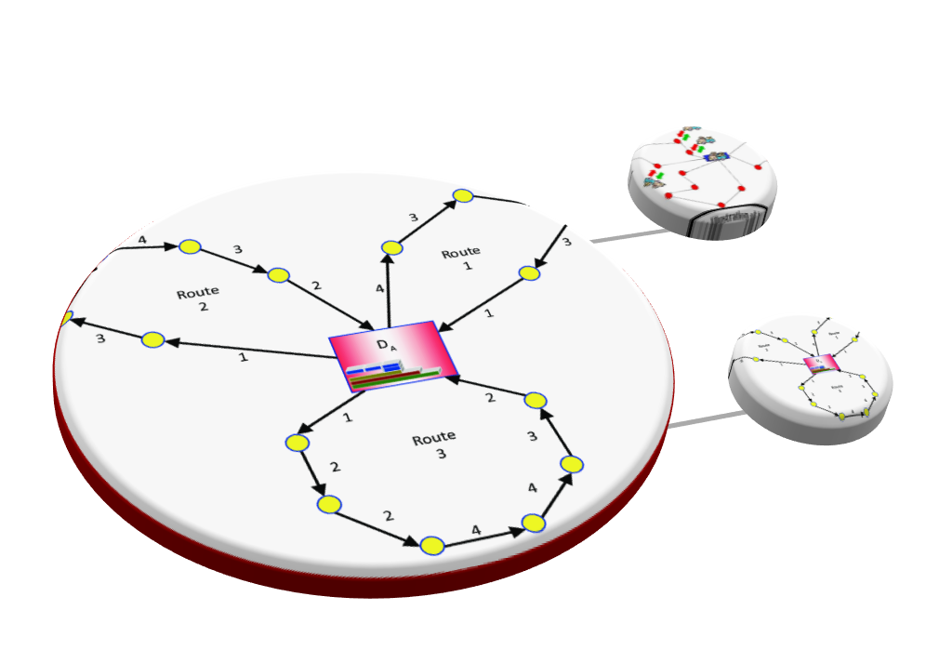
gvrP CONTD…
Now GVRP is,
GVRP stands for Green Vehicle Routing Problem.
It is a variant of VRP.
Considers both Conventional and Alternative Fuel Vehicles.
Multi-objective optimization problem.
Goat is to find optimal routes and reduce emissions.

Slide 5
Related Study
Authors & Year | Title of Paper | Contribution
Figliozzi, 2011 | The Recharging Vehicle Routing Problem | Calculates amount of fuel spent
Laporte, 2011 | The Pollution-Routing Problem | Considers polluting emission impact
Demir et al., 2014 | The Bi-objective Pollution-Routing Problem | Minimize both fuel consumption and driving time
Schneider, 2015 | Routing a Mixed Fleet of Electric and Conventional Vehicles | Considers both Conventional and Electrical Vehicle

Slide 6




Related Study
Authors & Year | Title of Paper | Contribution
Costa et al., 2018 | A Genetic Algorithm for a Green Vehicle Routing Problem | Minimizes the CO₂ emissions per route
Koc and Karaoglan, 2015 | The Green Vehicle Routing Problem: A Heuristic Based Exact Solution Approach | Considers limited driving range of vehicle with limited refueling infrastructure
Jabir et al., 2015 | Multi-objective Optimization Model for a Green Vehicle Routing Problem | Minimizes of Carbon Dioxide (CO₂) emission
Macrina et al., 2019 | The green mixed fleet vehicle routing problem with partial battery recharging and time windows | Considers both Conventional and Electrical Vehicles

Slide 7
Methodology
The process to solve GVRP is divided into three different phases.
Routes Assignment
Apply Improvement Heuristic
CLUSTERING

Slide 8
Methodology
The process to solve GVRP is divided into three different phases.
Clustering
Routes Assignment
Apply Improvement Heuristic

Slide 9
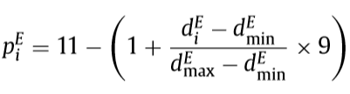
Methodology : CLUSTERING
Routes
Assignment
Apply Improvement Heuristic
CLUSTERING
Two clusters : C and E
Clusters are created based on two scores(P^{C}, P^{E}).
Scores are computed using customers location and demand.
The score for Electrical vehicle, P^{E} (1 <= P^{E} <= 10) is calculated using the following equation.

Slide 10





CLUSTERING CONTD…
Routes
Assignment
Apply Improvement Heuristic
CLUSTERING
The score for Conventional vehicle, P^{C} (1 <= P^{C} <= 10) is calculated using the following equation.
Where,

Slide 11
CLUSTERING CONTD…
Routes
Assignment
Apply Improvement Heuristic
CLUSTERING
The score for Electrical vehicle, P^{E} (1 <= P^{E} <= 10) is calculated using the following equation.
Where,
d_{i}^{E} is the distance between the customer i and the barycenter b_{e} of the set E
d_{min} is the distance between b_{e} and nearest customer
d_{max} is the distance between b_{e} and farthest customer

Slide 12
CLUSTERING CONTD…
Routes
Assignment
Apply Improvement Heuristic
CLUSTERING
The score for Conventional vehicle, P^{C} (1 <= P^{C} <= 10) is calculated using the following equation.
where,
And,
d_{i}^{C} is the distance between the customer i and the barycenter b_{c} of the set C
d_{min} is the distance between b_{C} and nearest customer and d_{max} is the distance between b_{C} and farthest customer
q_{min} and q_{max} are the smallest and largest customer demands respectively

Slide 13
Methodology : Route Assignment
Routes
Assignment
Apply Improvement Heuristic
CLUSTERING
To insert an unserved customer into the current route, we need:
Best position
Best customer
Before inserting the customer, we need to check:
Capacity constraint
Time windows constraint
We should define how much emission we are going to accept.
Load of the conventional vehicles determine the emissions.

Slide 14

Route Assignment CONtD…
Routes
Assignment
Apply Improvement Heuristic
CLUSTERING
To calculate best position inside the current route, the following equation is used:
Where,
u is the unserved customer
i(u) and j(u) are two adjacent customers into the current route.

Slide 15

Route Assignment CONtD…
Routes
Assignment
Apply Improvement Heuristic
CLUSTERING
To determine best customer from the unserved customers, the following equations are used:
Where,
u is the unserved customer
i(u) and j(u) are two adjacent customers into the current route.

Slide 16
Assign Route CONtD…
Routes
Assignment
Apply Improvement Heuristic
CLUSTERING
Firstly, we insert the customer into the conventional routes.
Secondly, any unserved customer of cluster C will be shifted to E.
Thirdly, insertion into electrical routes will be occurred.
And finally, the initial feasible solution is developed.

Slide 17
Methodology : Improvement Heuristic
Routes
Assignment
Apply Heuristic Improvement
CLUSTERING
To improve the initial solution, we applied:
Local Search
Perturbation

Slide 18
Improvement Heuristic CONTD..
Routes
Assignment
Apply Heuristic Improvement
CLUSTERING
Local Search strategies are:
Change of customers belonging to C routes.
Change of customers belonging to E routes.
Change of customers belonging to C and E routes.
Perturbation is the same strategies like Local Search but it allows worsening of solutions.

Slide 19
Improvement Heuristic CONTD..
Routes
Assignment
Apply Heuristic Improvement
CLUSTERING
Local Search strategies:
Change of customers belonging to C routes
Change of customers belonging to E routes
Change of customers of
C and E routes

Slide 20
Expected Results
Used modified Solomon, 1987 instances
First, Solved by CPLEX
Shows the comparison with expected result and optimal result
Class | α = 0.25 |  | α = 0.50 |  | α = 0.75
 | Cost Variation (%) | Speed Up | Cost Variation (%) | Speed Up | Cost Variation (%) | Speed Up
| N | = 5 | 5.25% | 1.46 | 9.32% | 1.05 | 9.30% | 1.11
| N | = 10 | 13.67% | 12.81 | 12.93% | 8.96 | 15.67% | 4.07
Average | 9.46% | 7.13 | 11.13% | 5.01 | 12.48% | 2.59

Slide 21
Work for Next Semester
Use hybrid vehicles (conventional and electrical engine)
Use bi-fuel vehicles (gasoline and CNG/LPG/Hydrogen)
Try to minimize cost and emissions
Make the used algorithms more efficient

Slide 22
Conclusion
Although GVRP is NP-hard optimization problem, we solved it efficiently through heuristic.
By the proposed heuristic, many real-world and large-scale problem can be solved efficiently.

Slide 23
references
https://en.wikipedia.org/wiki/Vehicle_routing_problem
Bektas¸ , T., Laporte, G., 2011. The pollution-routing problem. Transp. Res. Part B 45, 1232–1250.
Conrad, R.G., Figliozzi, M.A., 2011. The recharging vehicle routing problem. In: Doolen, T., Van Aken, E. (Eds.), Industrial Engineering Research Conference. Reno, Nevada.
Christofides, N., The vehicle routing problem, Revue Fran¸caise D’Automatique, D’Informatique et de Recherche Op´erationnelle. Recherche Op´erationnelle 10 (1976), pp. 55–70.
Baldacci, R., P. Toth and D. Vigo, Exact algorithms for routing problems under vehicle capacity constraints, Annals of Operations Research 175 (2010), pp. 213–245.
Baldacci R, Mingozzi A, Roberti R (2012) Recent exact algorithms for solving the vehicle routing problem under capacity and time window constraints. Eur. J. Oper. Res. 218(1):1–6.
Artmeier A, Haselmayr J, Leucker M, Sachenbacher M (2010) The shortest path problem revisited: Optimal routing for electric vehicles. KI 2010: Advances in Artificial Intelligence, Lecture Notes in Computer Science, Vol. 6359 (Springer, Berlin), 309– 316.

Slide 24
THANK YOU

Slide 25
Combinatorial optimization & Integer programming
Combinatorial optimization is an emerging field at the forefront of combinatorics and theoretical computer science that aims to use combinatorial techniques to solve discrete optimization problems. A discrete optimization problem seeks to determine the best possible solution from a finite set of possibilities.
An integer programming problem is a mathematical optimization or feasibility program in which some or all of the variables are restricted to be integers

