Slide 1

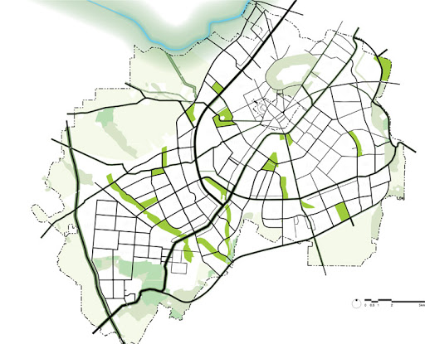
Physarum Inspired Bicycle Lane Network Design in Congested Mega City
Presented by:
Md. Ahsan Habib
Roll: 1507082
Supervised by:
Dr. Md. Aminul Haque Akhand
Professor
Department of Computer Science and Engineering
Khulna University of Engineering & Technology

Slide 2
OUTLINE
Introduction
Conclusion
Related Study
Experimental Study
References
Methodology
Specific Aim
Purpose
Problems

Slide 3
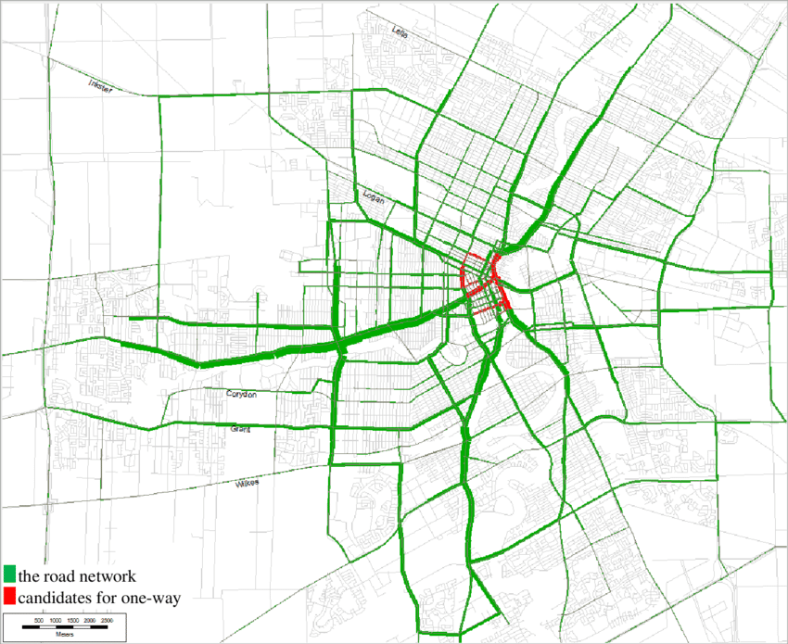
Introduction
In here, a network means a spatial network describes a structure which permits vehicular movement.
The Network Design Problem (NDP) is known as one of the most complex and challenging transportation problems for many years.
Effective and efficient network can minimize the total travel time, cost, CO₂ emission reduction, fuel usage reduction, etc.

Slide 4
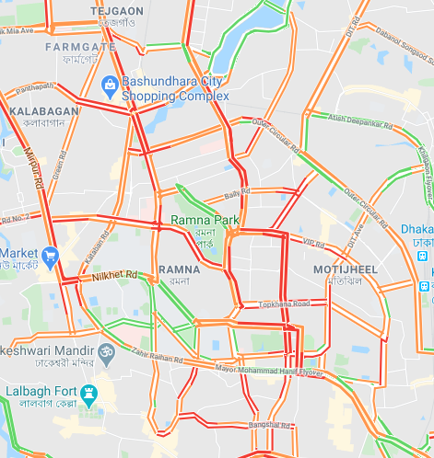
PROBLEMS
There exist lots of problems in mega city Dhaka:
- Road conditions are not good enough
- Cycling lanes & footways are hardly available
- Worst traffic
- Mobility problem
- Huge CO₂ gas emission
- Air pollution & noise pollution
- Unhealthy environment

Slide 5
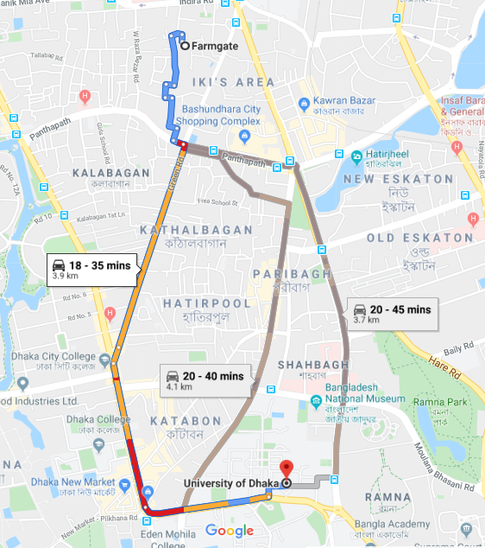
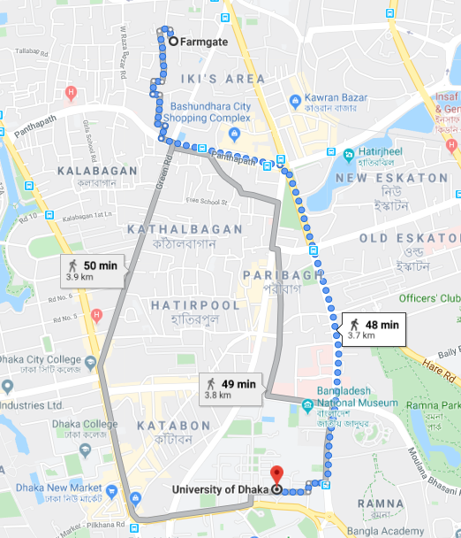
PROBLEMS
(A) Driving mode
(B) Walking mode
Figure 1: Farmgate to University of Dhaka routes and needed time.

Slide 6
Purpose
The global purpose is to construct efficient bicycle lane network in mega city, concerned with:
- Minimization of travel time
- Minimization of cost
- Minimization of CO₂ emission
- Efficient & effective network design
- Eco-friendly environment

Slide 7
RELATED STUDY
Authors | Year | Title of Paper | Journal | Contribution
Tero et al. | 2010 | Rules for Biologically Inspired Adaptive Network Design | Science | Tokyo Rail Network construction
Adamatzky et al. | 2011 | Rebuilding Iberian motorways with slime mould | Biosystems | Iberian motorway network construction
Adamatzky et al. | 2011 | Approximating Mexican highways with slime mould | Natural Computing | Mexican Federal highway network construction
Adamatzky et al. | 2013 | Slime mould imitates transport networks in China | International Journal of Intelligent Computing and Cybernetics | Slime mould protoplasmic networks on major urban areas of China
Tsompanas et al. | 2015 | Evolving Transport Networks With Cellular Automata Models Inspired by Slime Mould | IEEE Transactions on Cybernetics | Physarum-inspired cellular automaton (CA)-based network designing model
Zhang et al. | 2016 | A Physarum-inspired approach to supply chain network design | Science China Information Sciences | Supply chain network design

Slide 8

SPECIFIC AIM
We want to construct bicycle lane network in congested area of 10km centered with Motijheel using local lanes and try to avoid primary road and move towards the green city.
For this,
We create a bicycle lane network using modified Physarum-inspired technique.
We consider bicycles as vehicles.
Finally, we extend it to apply mega city Dhaka using electric bicycle as vehicle.

Slide 9
Physarum inspired Technique
Before discussing details about Physarum inspired technique let’s discuss what Physarum is.

Slide 10
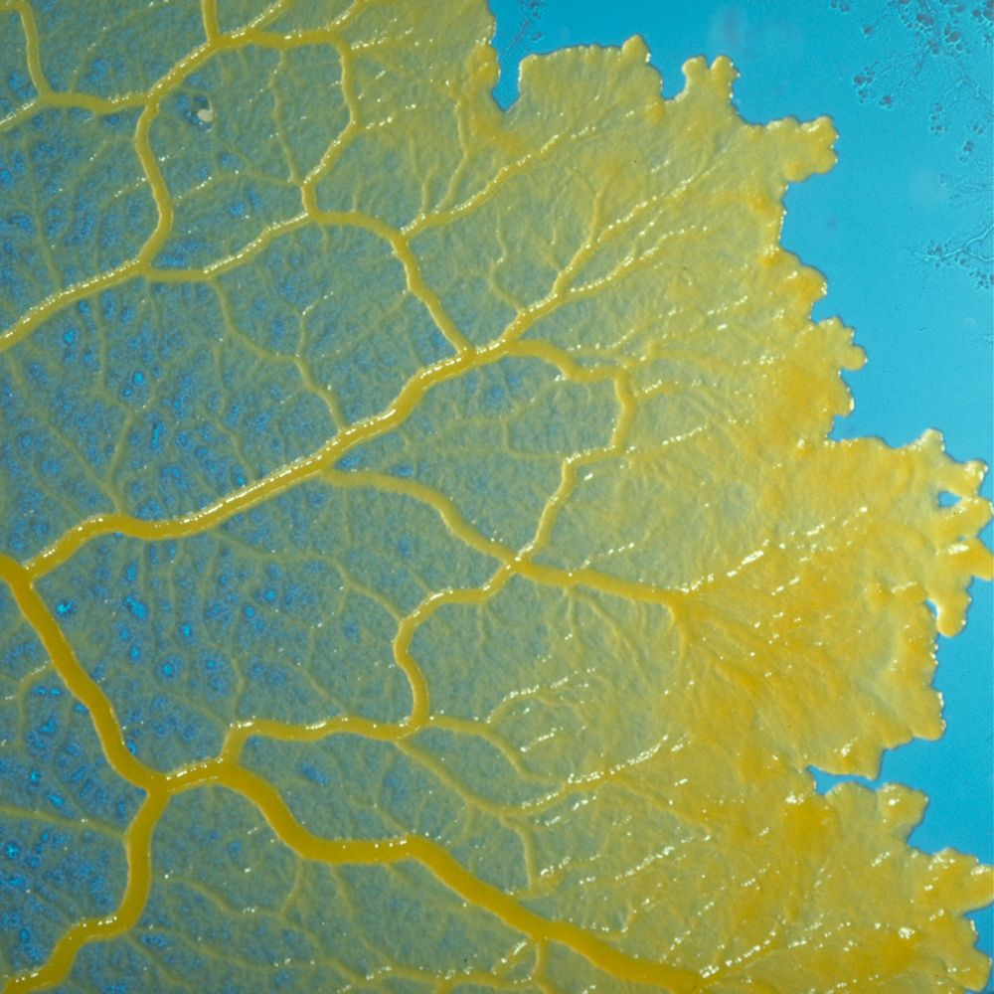
PHYSARUM
Physarum Polycephalum, also named as slime mold is:
Multi-headed
Brainless
Giant multi-nucleated
Single-celled protist
which can solve different complex problems.

Slide 11
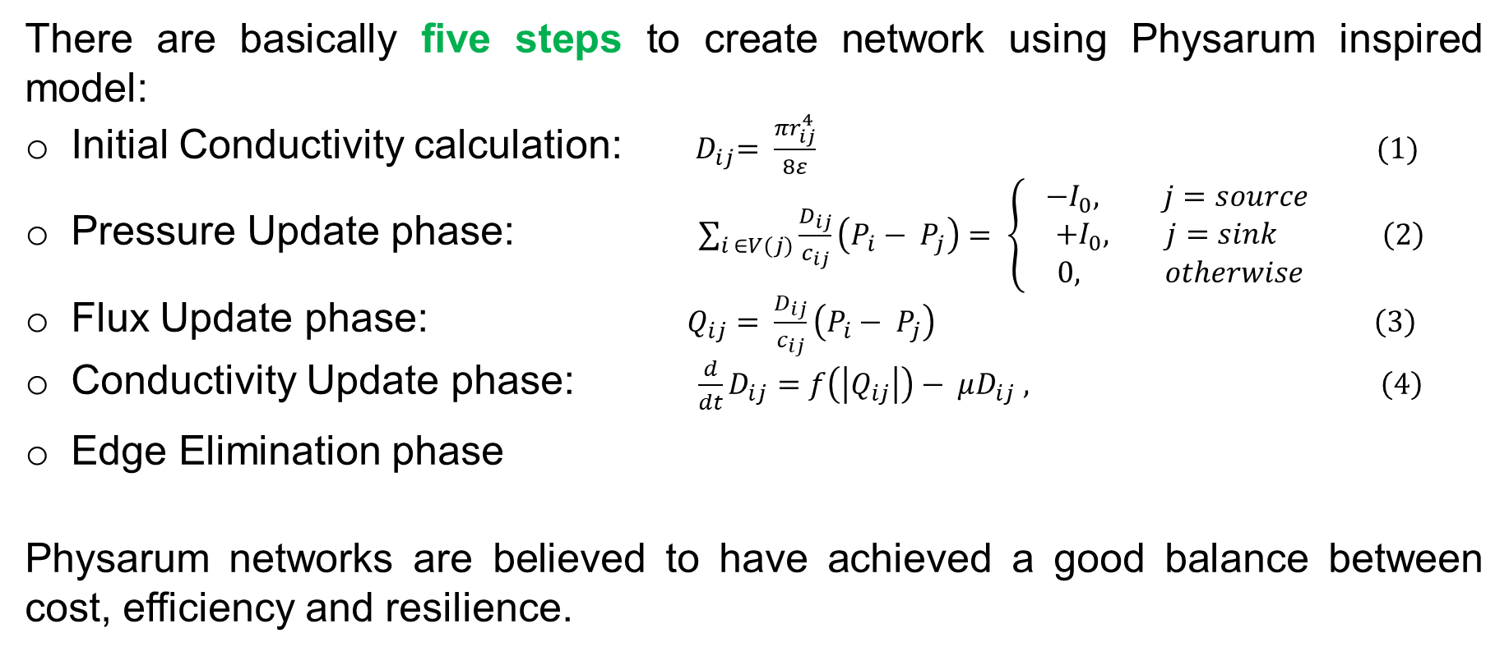
Physarum Technique
There are basically five steps to create network using Physarum inspired model:
Initial Conductivity calculation: ${ D}_{ij}= \frac{πr_{ij}^{4}}{8ε} (1)$
Pressure Update phase: $\sum_{i ∈V(j)}{\frac{D_{ij}}{c_{ij}}\left(P_{i}− P_{j}\right)= \left\{ \begin{aligned}−I_{0}, j=source \\ {+I}_{0}, j=sink \\ 0, otherwise\end{aligned}\right.} \left(2\right)$
Flux Update phase: $Q_{ij}= \frac{D_{ij}}{c_{ij}}\left(P_{i}− P_{j}\right) \left(3\right)$
Conductivity Update phase: $\frac{d}{dt}D_{ij}=f\left(\left|Q_{ij}\right|\right)− μD_{ij} , \left(4\right)$
Edge Elimination phase
Physarum networks are believed to have achieved a good balance between cost, efficiency and resilience.

Slide 12
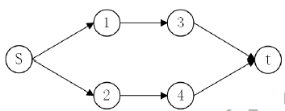
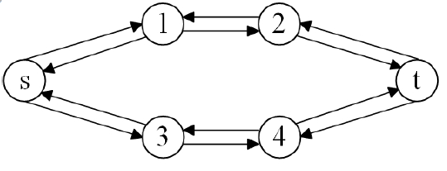
METHODOLOGY
The Physarum inspired technique doesn't directly works for real life network because the stream is only flowing from one node to another, but is never flowing in the opposite direction (Fig. 2). However, most roads have the features of double-way traffic in real traffic networks (Fig. 3).
Figure 2: Simple Physarum network.
Figure 3: Real traffic network.

Slide 13
METHODOLOGY
The bicycle lane network is constructed also using the following five steps using modified Physarum inspired technique:
Flux Update
Conductivity Update
Initial Conductivity
Pressure Update
Edge Eliminate

Slide 14
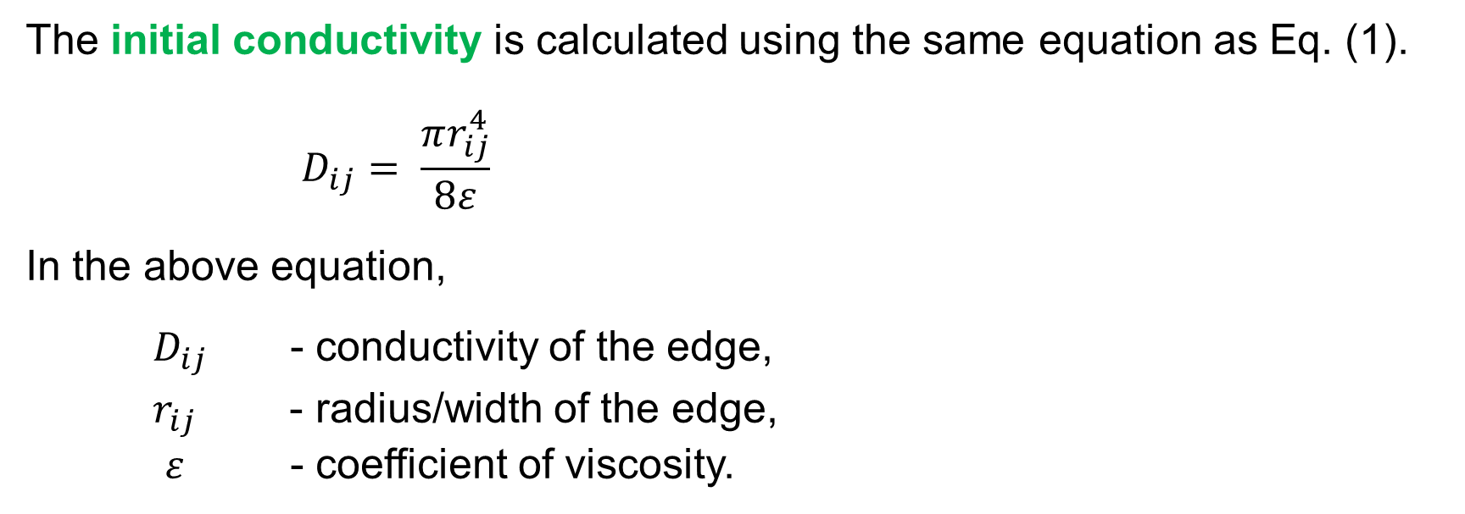
Flux Update
Conductivity Update
Pressure Update
Edge Eliminate
Initial Conduct-ivity
METHODOLOGY
First Step:
The initial conductivity is calculated using the same equation as Eq. (1).
$$D_{ij}= \frac{πr_{ij}^{4}}{8ε}$$
In the above equation,
$D_{ij}$ - conductivity of the edge,
$r_{ij}$ - radius/width of the edge,
$ε$ - coefficient of viscosity.

Slide 15
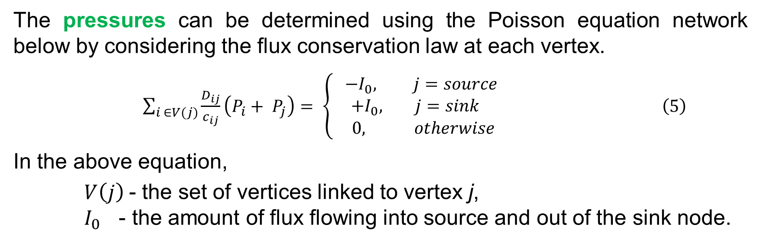
Flux Update
Conductivity Update
Pressure Update
Edge Eliminate
Initial Conductivity
METHODOLOGY
Second Step:
The pressures can be determined using the Poisson equation network below by considering the flux conservation law at each vertex.
$\sum_{i ∈V(j)}{\frac{D_{ij}}{c_{ij}}\left(P_{i}+ P_{j}\right)= \left\{ \begin{aligned}−I_{0}, j=source \\ {+I}_{0}, j=sink \\ 0, otherwise\end{aligned}\right.} \left(5\right)$
In the above equation,
$V\left(j\right)$- the set of vertices linked to vertex j,
$I_{0}$ - the amount of flux flowing into source and out of the sink node.

Slide 16
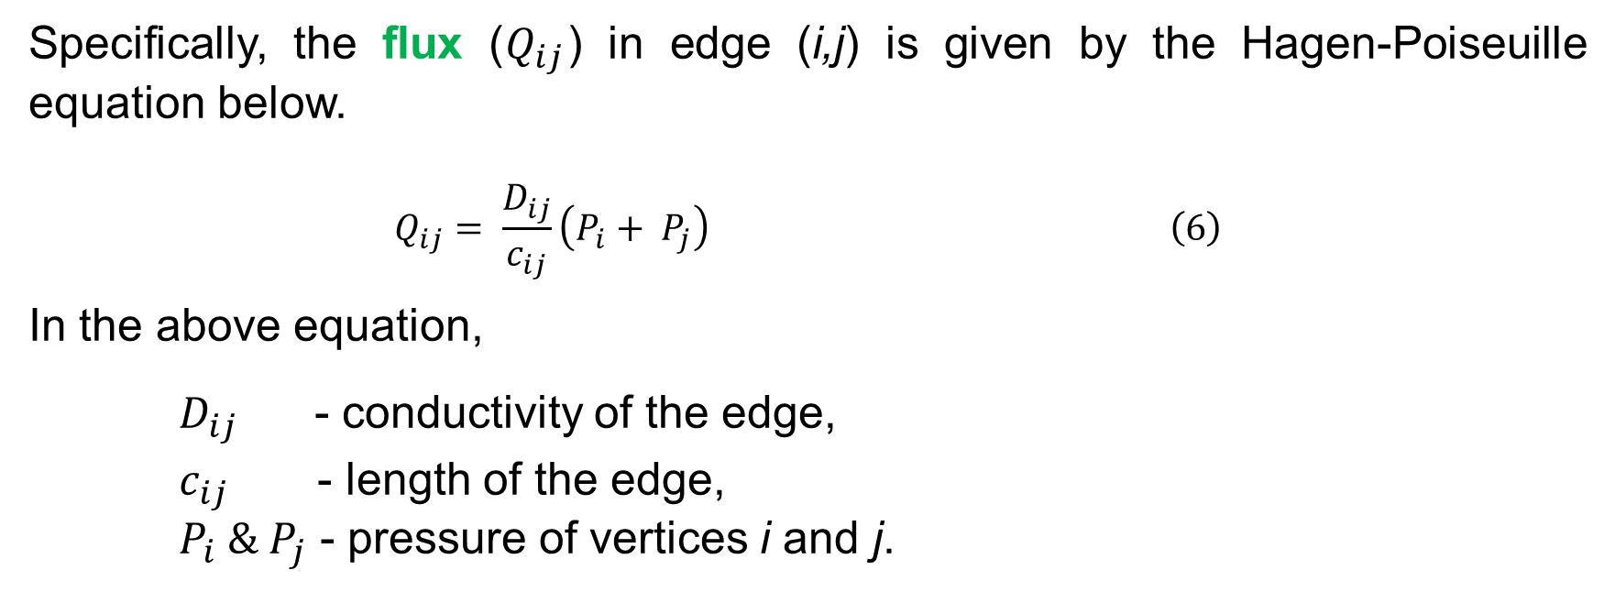
Flux Update
Conductivity Update
Pressure Update
Edge Eliminate
Initial Conductivity
METHODOLOGY
Third Step:
Specifically, the flux ($Q_{ij}$) in edge (i,j) is given by the Hagen-Poiseuille equation below.
$$Q_{ij}= \frac{D_{ij}}{c_{ij}}\left(P_{i}+ P_{j}\right) \left(6\right)$$
In the above equation,
$D_{ij}$ - conductivity of the edge,
$c_{ij}$ - length of the edge,
$P_{i} \& P_{j}$ - pressure of vertices i and j.

Slide 17
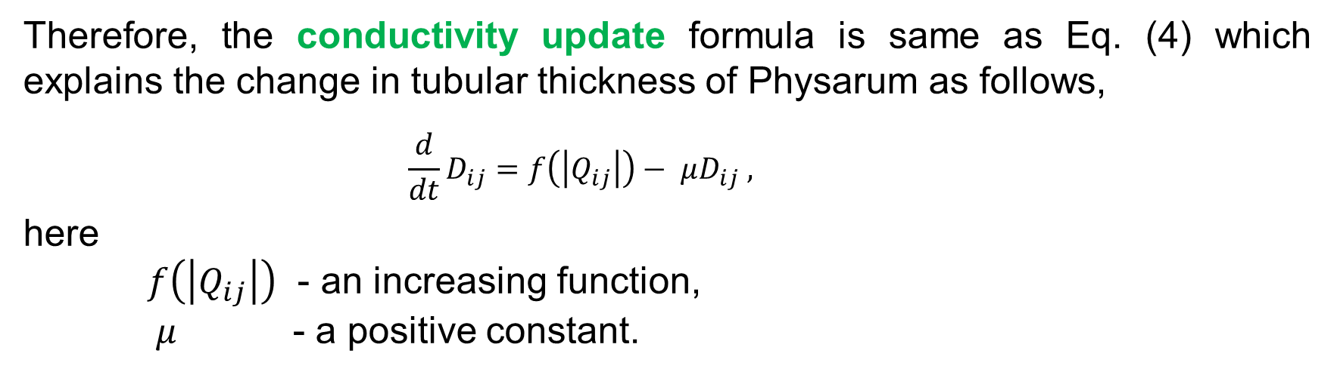
Flux Update
Conductivity Update
Pressure Update
Edge Eliminate
Initial Conductivity
METHODOLOGY
Fourth Step:
Therefore, the conductivity update formula is same as Eq. (4) which explains the change in tubular thickness of Physarum as follows,
$$\frac{d}{dt}D_{ij}=f\left(\left|Q_{ij}\right|\right)− μD_{ij} ,$$
here
$f\left(\left|Q_{ij}\right|\right)$ - an increasing function,
$μ$ - a positive constant.

Slide 18
Flux Update
Conductivity Update
Pressure Update
Edge Eliminate
Initial Conductivity
METHODOLOGY
Fifth Step:
In Edge elimination step, edges with conductivity lower than the threshold value are cut off from the network.
Third-step to fifth-step is repeated in finite iterations.

Slide 19
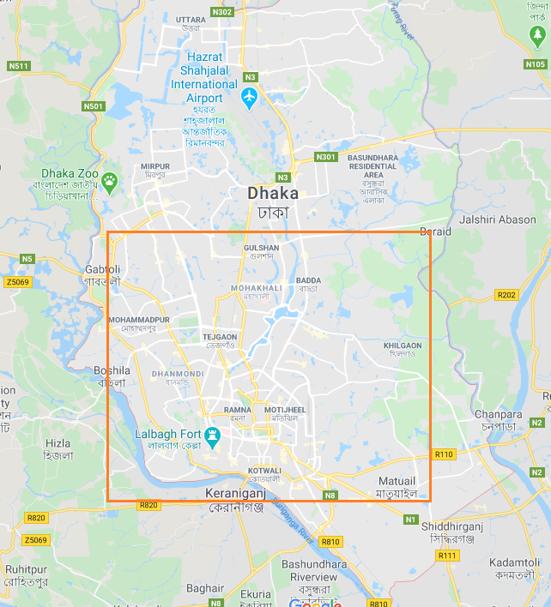
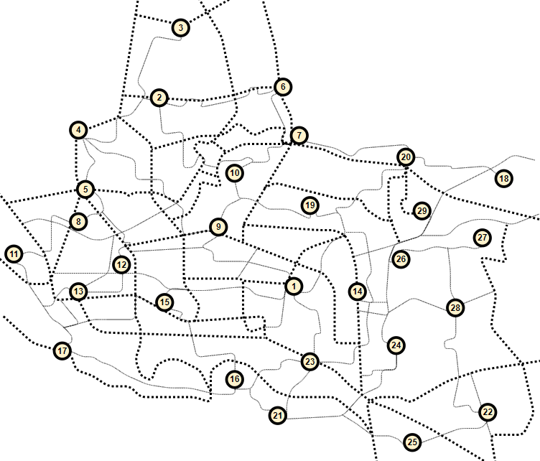
EXPERIMENTAL STUDY
For Congested Area
Figure 4. Congested area of Dhaka
Figure 5. Existing network of that area

Slide 20
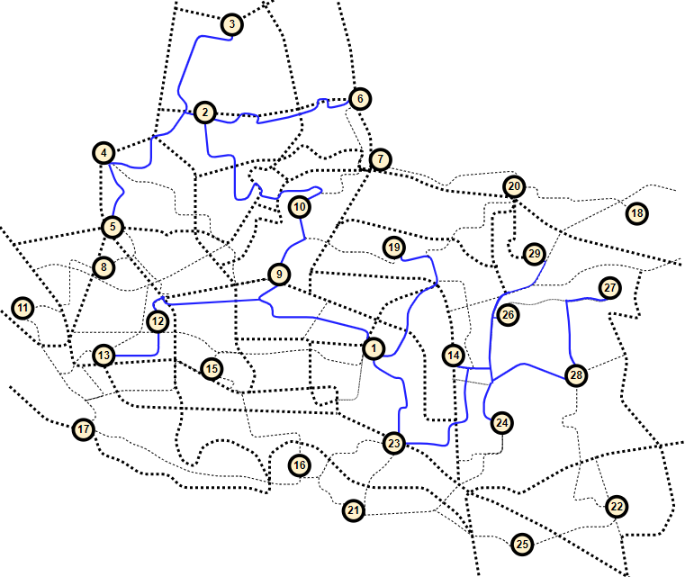
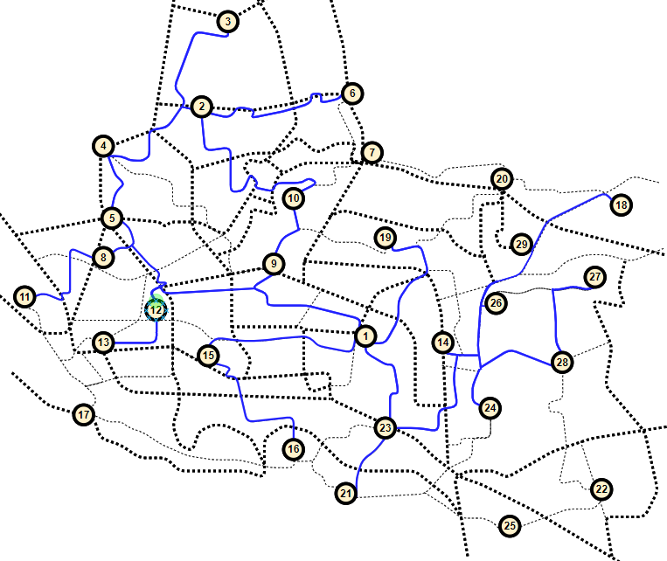
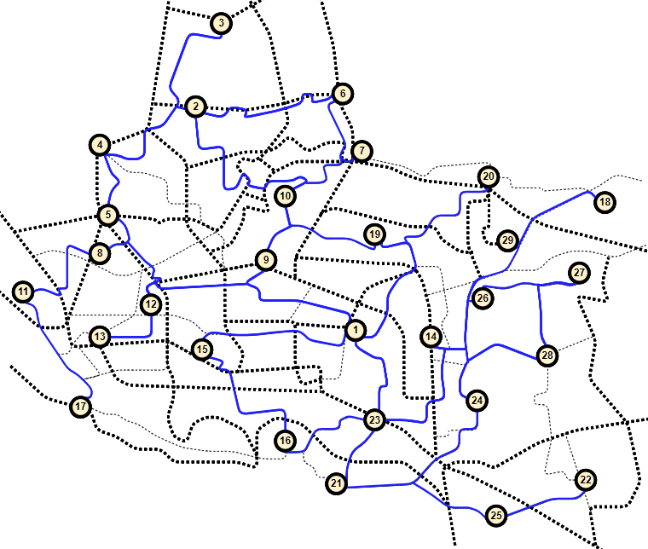
EXPERIMENTAL STUDY
(A) t = 10
(B) t = 20
(C) t = 50
Figure 6. Network growing steps of congested area.

Slide 21
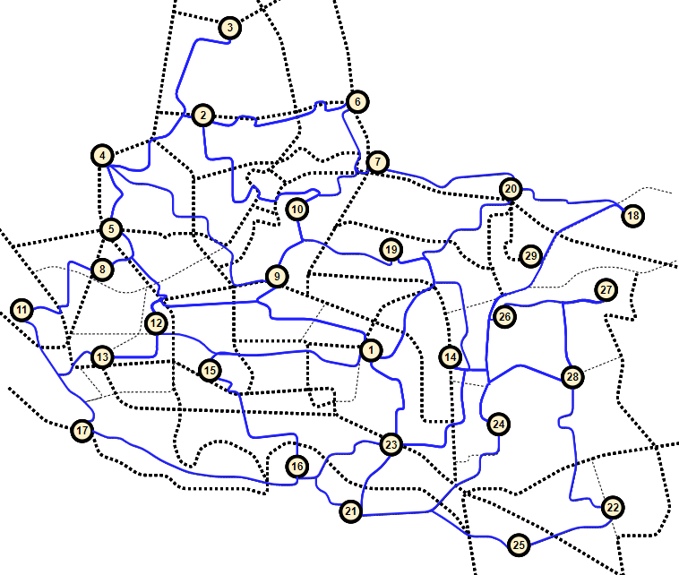
EXPERIMENTAL STUDY
Figure 7. Final network of congested area.

Slide 22
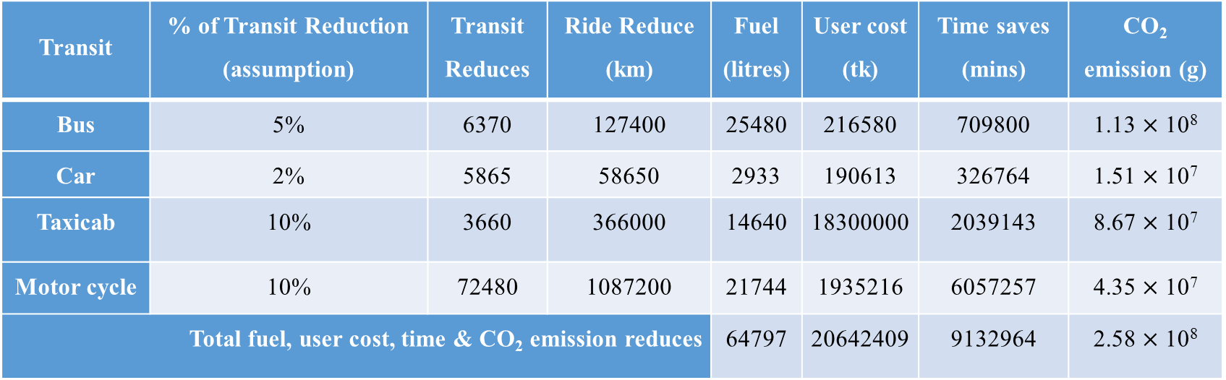
EXPERIMENTAL STUDY
Impact – For Congested Area
Transit | % of Transit Reduction (assumption) | Transit Reduces | Ride Reduce (km) | Fuel (litres) | User cost (tk) | Time saves (mins) | CO₂ emission (g)
Bus | 5% | 6370 | 127400 | 25480 | 216580 | 709800 | 1.13 $×$ 10⁸
Car | 2% | 5865 | 58650 | 2933 | 190613 | 326764 | 1.51 $×$ 10⁷
Taxicab | 10% | 3660 | 366000 | 14640 | 18300000 | 2039143 | 8.67 $×$ 10⁷
Motor cycle | 10% | 72480 | 1087200 | 21744 | 1935216 | 6057257 | 4.35 $×$ 10⁷
Total fuel, user cost, time & CO₂ emission reduces |  |  |  | 64797 | 20642409 | 9132964 | 2.58 $×$ 10⁸
Total fuel Saving = 64.8 thousand litres
Total user Cost = 20.64 million tk
Total CO₂ emission reduction = 0.26 million kg
Total working time saving = 0.15 million hours

Slide 23
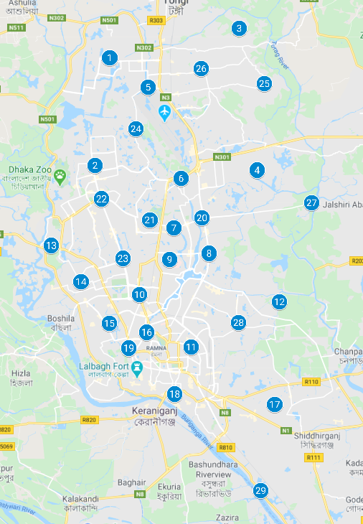
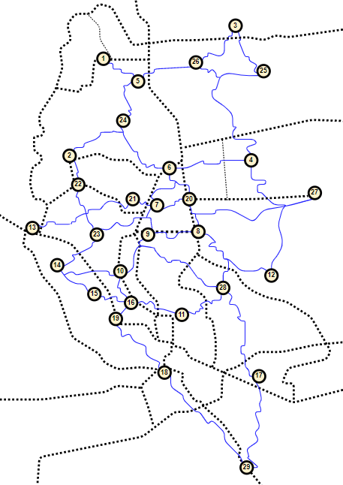
EXPERIMENTAL STUDY
Entire Dhaka City
Figure 8. Dhaka city Map
Figure 9. Constructed network of Dhaka city

Slide 24
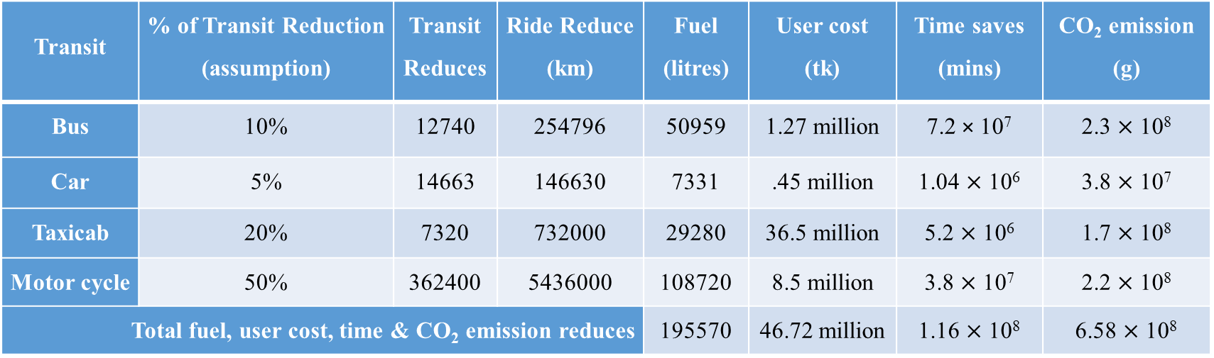
EXPERIMENTAL STUDY
Impact – For Enitre Dhaka
Transit | % of Transit Reduction (assumption) | Transit Reduces | Ride Reduce (km) | Fuel (litres) | User cost (tk) | Time saves (mins) | CO₂ emission (g)
Bus | 10% | 12740 | 254796 | 50959 | 1.27 million | 7.2 × 10⁷ | 2.3 $×$ 10⁸
Car | 5% | 14663 | 146630 | 7331 | .45 million | 1.04 $×$ 10⁶ | 3.8 $×$ 10⁷
Taxicab | 20% | 7320 | 732000 | 29280 | 36.5 million | 5.2 $×$ 10⁶ | 1.7 $×$ 10⁸
Motor cycle | 50% | 362400 | 5436000 | 108720 | 8.5 million | 3.8 $×$ 10⁷ | 2.2 $×$ 10⁸
Total fuel, user cost, time & CO₂ emission reduces |  |  |  | 195570 | 46.72 million | 1.16 $×$ 10⁸ | 6.58 $×$ 10⁸
Total fuel Saving = 0.2 million litres
Total user Cost = 46.72 million tk
Total CO₂ emission reduction = 0.66 million kg
Total working time saving = 1.9 million hours

Slide 25
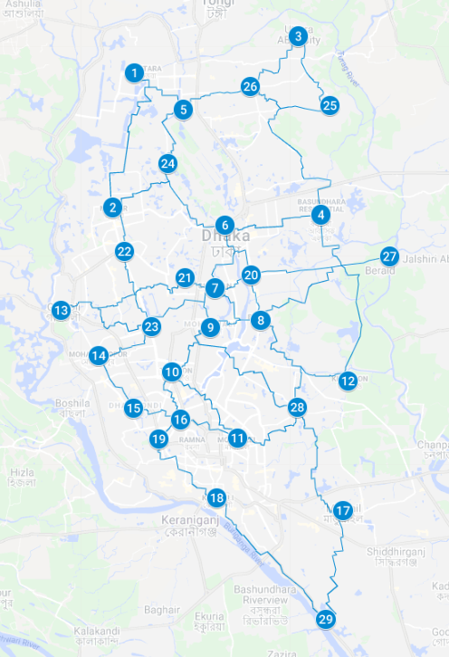
CONCLUSION
In unorganized and unplanned mega city, we have developed an bicycle lane network.
With that, most problems like traffic jams, environmental pollution, fuel consumption will be reduced.
The costs will be reduced and people can have some physical activity also.
This also enriches the economy and the environment.

Slide 26

REFERENCES
https://en.wikipedia.org/wiki/Sustainable_city
http://archive.boston.com/business/blogs/global-business-hub/2013/10/12_essential_as.html
Tero et al., “Rules for Biologically Inspired Adaptive Network Design,” Science (80-. )., vol. 327, no. 5964, pp. 439–442, Jan. 2010.
A. Adamatzky and R. Alonso-Sanz, “Rebuilding Iberian motorways with slime mould,” Biosystems, vol. 105, no. 1, pp. 89–100, Jul. 2011.
A. Adamatzky, G. J. Martínez, S. V. Chapa-Vergara, R. Asomoza-Palacio, and C. R. Stephens, “Approximating Mexican highways with slime mould,” Nat. Comput., 2011.
A. Adamatzky, X.-S. Yang, and Y.-X. Zhao, “Slime mould imitates transport networks in China,” Int. J. Intell. Comput. Cybern., vol. 6, no. 3, pp. 232–251, Aug. 2013.
M. Becker, “Design of fault tolerant networks with agent-based simulation of Physarum polycephalum,” in 2011 IEEE Congress of Evolutionary Computation (CEC), 2011, pp. 285–291.
M.-A. I. Tsompanas, G. C. Sirakoulis, and A. I. Adamatzky, “Evolving Transport Networks With Cellular Automata Models Inspired by Slime Mould,” IEEE Trans. Cybern., vol. 45, no. 9, pp. 1887–1899, Sep. 2015.
X. Zhang, A. Adamatzky, X.-S. Yang, H. Yang, S. Mahadevan, and Y. Deng, “A Physarum-inspired approach to supply chain network design,” Sci. China Inf. Sci., vol. 59, no. 5, p. 052203, May 2016.

Slide 27
Thank You..

Slide 28
Details Calculation
Assumption: Car - 5%, Motor cycle - 50%, Bus - 10%, Taxicab - 20% reduces.
Time saving bus = 254796 × 40 × ( 8.57 – 1.5) mins
Time saving car = 146634 × (8.57 – 1.5) mins
Time saving taxicab = 732000 × (8.57 – 1.5) mins
Time saving motor cycle = 5.4 × 106 × (8.57 – 1.5) mins
Fuel saving for bus = 254796 km × 1/5 litres
Fuel saving for car = 146634 km × 1/20 litres
Fuel saving for taxicab = 732000 km × 1/25 litres
Fuel saving for motor cycle = 5.4 × 106 km × 1/50 litres
CO₂ reduction for bus = .1×127398×20×887 gm
CO₂ reduction for car = .05×293268×10×258 gm
CO₂ reduction for taxicab = .2×36600×100×237 gm
CO₂ reduction for motorcycle = 0.5× 724800×15×40 gm
Total working time saving = 1.9 million hours
Total fuel saving = 0.2 million litres
Total CO₂ emission reduction = 6.58 × 10⁵ kg

Slide 29
MOTIVATION
We aim to apply our model in unorganized and unplanned mega city like Dhaka where exits some challenges discussed in followings:
No separate cycling roads
No available spaces in footway exist for bi-cycle riding
Traffic jam
Air Pollution (AQI- 309; Standard- 50)
Noise Pollution (Level 80-110dB; Standard- 60dB)
Scarcity of natural gas and petroleum
Automobiles are increasing around 10% annually

