Slide 1


GREEN CITY USING PHYSARUM INSPIRED NETWORK
2
+
Supervisor:
Dr. Md. Aminul Haque Akhand
Professor
Presentator:
Md. Ahsan Habib
Roll: 1507082
Department of Computer Science and Engineering
Khulna University of Engineering & Technology

Slide 2

OUTLINE
Purpose
Conclusion
Green City
Experimental Study
References
Methodology
Physarum polycephalum
Motivation
Related Study

Slide 3

PURPOSE
We want to create Dhaka, capital city of Bangladesh, the green city.
For this,
We consider electric bi-cycles as vehicle to move around the city
And also construct a bi-cycle network.

Slide 4
MOTIVATION
We aim to apply our model in unorganized and unplanned Dhaka, capital city of Bangladesh, where exits some challenges discussed in followings:
No separate cycling roads
No available spaces in footway exist for bi-cycle riding
Traffic jam
Air Pollution (AQI- 309; Standard- 50)
Noise Pollution (Level 80-110dB; Standard- 60dB)
Scarcity of natural gas and petroleum
Automobiles are increasing around 10% annually

Slide 5
GREEN CITY
Green city is a city designed with consideration for social, economic, environmental impact.
Inhabited by people whom are dedicated towards minimization of required inputs of energy, water, food, waste, output of heat, air pollution - CO₂, methane, and water pollution.
Also named as Eco-city, Sustainable city.

Slide 6
FUNDAMENTAL ELEMENTS OF GREEN CITY
Green Oxygen
Green Houses
Urban Forests
Control Environment Pollution
Street Network
alternatives to car use

Slide 7
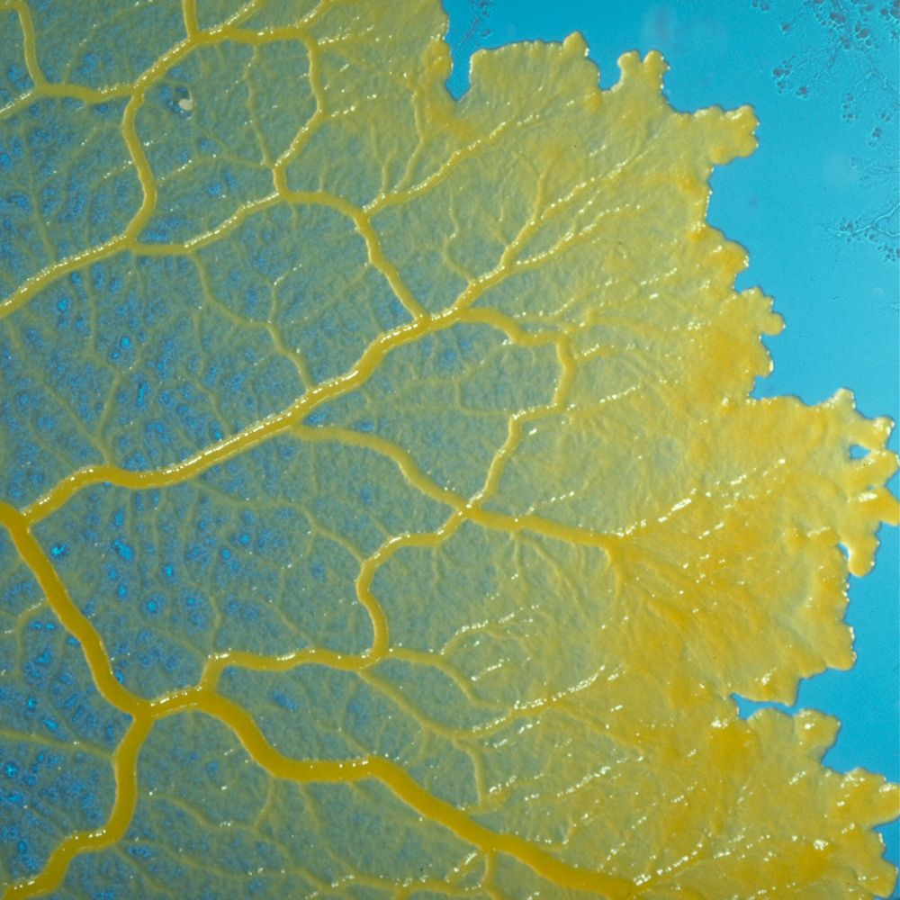
PHYSARUM POLYCEPHALUM
Physarum Polycephalum is:
many-headed
brainless
a giant multi-nucleated
single-celled protist
which can solve different complex problems.

Slide 8
PHYSARUM INSPIRED NET
Physarum constructed networks with comparable qualities.
Physarum-inspired network model has exhibited an extraordinary intelligence to build efficient networks to connect multiple food sources.
Physarum networks are believed to have achieved a good balance between cost, efficiency and resilience.

Slide 9
RELATED STUDY
Authors & Year | Title of Paper | Contribution
Tero et al., 2010 | Rules for Biologically Inspired Adaptive Network Design | Tokyo Rail Network construction
Adamatzky et al., 2011 | Rebuilding Iberian motorways with slime mould | Iberian motorway network construction
Adamatzky et al., 2011 | Approximating Mexican highways with slime mould | Mexican Federal highway network construction
Adamatzky et al., 2013 | Slime mould imitates transport networks in China | Slime mould protoplasmic networks on major urban areas of China
Becker et al., 2011 | Design of fault tolerant networks with agent-based simulation of Physarum polycephalum | Construction of fault tolerant connection networks for the Tokyo rail system using an agent based simulation of Physarum polycephalum
Tsompanas et al., 2015 | Evolving Transport Networks With Cellular Automata Models Inspired by Slime Mould | Physarum-inspired cellular automaton (CA)-based network designing model
Zhang et al. 2016 | A Physarum-inspired approach to supply chain network design | Supply chain network design

Slide 10
METHODOLOGY
The network is constructed using the following five steps:
Flux Update
Conductivity Update
Initial Conductivity
Pressure Update
Edge Eliminate

Slide 11

Flux Update
Conductivity Update
Pressure Update
Edge Eliminate
Initial Conductivity
METHODOLOGY
The initial conductivity is calculate using the following equation:
Where-
D_{ij} - conductivity of the edge,
r_{ij} - radius of the edge,
£ - coefficient of viscosity.

Slide 12

Flux Update
Conductivity Update
Pressure Update
Edge Eliminate
Initial Conductivity
METHODOLOGY
The pressures can be determined using the Poisson equation network below by considering the flux conservation law at each vertex.
Where-
V(j) - the set of vertices linked to vertex j,
I0 - the amount of flux flowing into and out of the node of the source.

Slide 13

Flux Update
Conductivity Update
Pressure Update
Edge Eliminate
Initial Conductivity
METHODOLOGY
Specifically, the flux (Q_{ij}) in edge (i,j) is given by the Hagen-Poiseuille equation below.
Where-
D_{ij} - conductivity of the edge,
c_{ij}/L_{ij} - length of the edge,
p_{i} & p_{j} - pressure of vertices i and j,

Slide 14

Flux Update
Conductivity Update
Pressure Update
Edge Eliminate
Initial Conductivity
METHODOLOGY
Therefore, the conductivity update formula can explain the change in tubular thickness of Physarum as follows.
Where-
f(|Q_{ij}|) - an increasing function,
µ - a positive constant.

Slide 15
Flux Update
Conductivity Update
Pressure Update
Edge Eliminate
Initial Conductivity
METHODOLOGY
In Edge elimination step, edges with conductivity lower than the threshold value are cut off from the network.
This process runs in finite iteration.
Step-3 to Step-5 is repeated in finite iterations.

Slide 16
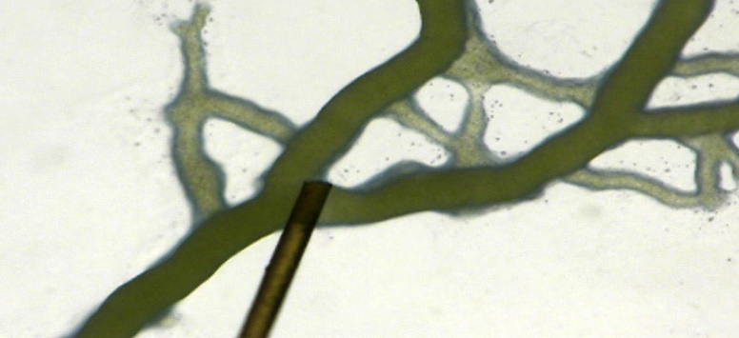


METHODOLOGY
The protoplasmic flow through Physarum’s tubular veins is believed to account for Physarum’s intelligence.
Figure 1. Protoplasmic flow
There is protoplasmic flow in every edge.
At each vertex there is pressure and the amount of flux in each edge is proportional to the difference in pressure between the two terminals of this edge.

Slide 17
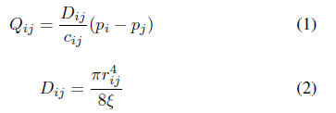
METHODOLOGY
Specifically, the flux (Q_{ij}) in edge (i,j) is given by the Hagen-Poiseuille equation below.
Where-
D_{ij} - conductivity of the edge,
c_{ij}/L_{ij} - length of the edge,
p_{i} & p_{j} - pressure of vertices i and j,
r_{ij} - radius of the edge,
£ - coefficient of viscosity.

Slide 18

METHODOLOGY
Therefore, the conductivity update formula can explain the change in tubular thickness of Physarum as follows.
Where-
f(|Q_{ij}|) - an increasing function,
µ - a positive constant.
We must first calculate the pressures to calculate the flux and update the edge conductivities.

Slide 19

METHODOLOGY
The pressures can be determined using the Poisson equation network below by considering the flux conservation law at each vertex.
Where-
V(j) - the set of vertices linked to vertex j,
I0 - the amount of flux flowing into and out of the node of the source.

Slide 20
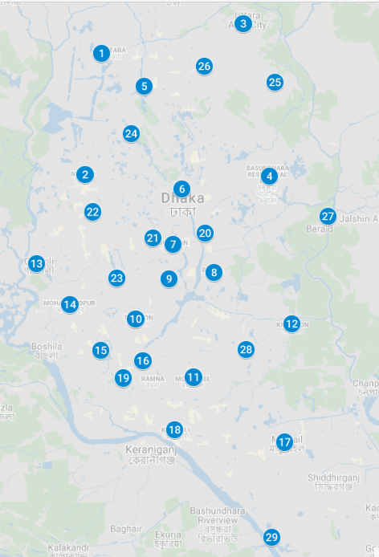
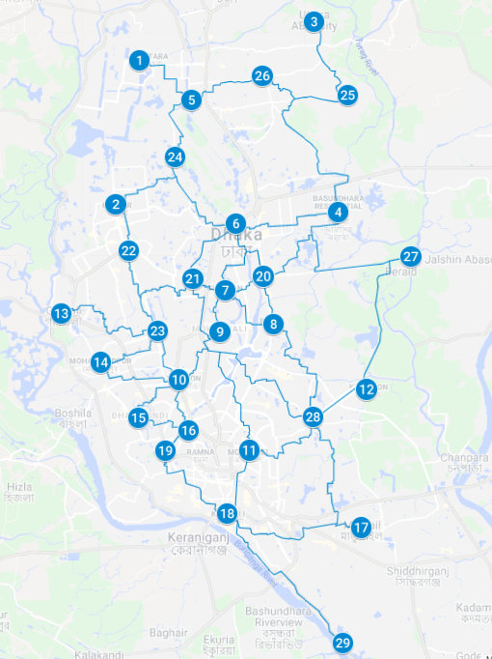
EXPERIMENTAL STUDY
Figure 2. Dhaka city Map
Figure 3. Constructed network of Dhaka city

Slide 21
CONCLUSION
As we all know that, recently, business organizations and governments have revealed close attention on Green Logistics.
In unorganized and unplanned Dhaka city, we have developed an electric bi-cycle network.
With that, most problems like traffic jams, environmental pollution, fuel shortages will be reduced.
The costs will be reduced and people can have some physical activity also.
This also enriches the economy and the environment.

Slide 22
REFERENCES
https://en.wikipedia.org/wiki/Sustainable_city
http://archive.boston.com/business/blogs/global-business-hub/2013/10/12_essential_as.html
Tero et al., “Rules for Biologically Inspired Adaptive Network Design,” Science (80-. )., vol. 327, no. 5964, pp. 439–442, Jan. 2010.
A. Adamatzky and R. Alonso-Sanz, “Rebuilding Iberian motorways with slime mould,” Biosystems, vol. 105, no. 1, pp. 89–100, Jul. 2011.
A. Adamatzky, G. J. Martínez, S. V. Chapa-Vergara, R. Asomoza-Palacio, and C. R. Stephens, “Approximating Mexican highways with slime mould,” Nat. Comput., 2011.
A. Adamatzky, X.-S. Yang, and Y.-X. Zhao, “Slime mould imitates transport networks in China,” Int. J. Intell. Comput. Cybern., vol. 6, no. 3, pp. 232–251, Aug. 2013.
M. Becker, “Design of fault tolerant networks with agent-based simulation of Physarum polycephalum,” in 2011 IEEE Congress of Evolutionary Computation (CEC), 2011, pp. 285–291.
M.-A. I. Tsompanas, G. C. Sirakoulis, and A. I. Adamatzky, “Evolving Transport Networks With Cellular Automata Models Inspired by Slime Mould,” IEEE Trans. Cybern., vol. 45, no. 9, pp. 1887–1899, Sep. 2015.
X. Zhang, A. Adamatzky, X.-S. Yang, H. Yang, S. Mahadevan, and Y. Deng, “A Physarum-inspired approach to supply chain network design,” Sci. China Inf. Sci., vol. 59, no. 5, p. 052203, May 2016.

Slide 23
Thank You..

Slide 24
Thank You..

Slide 25
REFERENCES

