Slide 1
Handwritten Numeral Recognition Combining Start-End Writing Measure with CNN
Presented By:
Md. Rahat-uz-Zaman
Roll: 1507006
Supervised by:
Dr. Muhammad Aminul Haque Akhand
Professor
Department of Computer Science & Engineering
Khulna University of Engineering and Technology

Slide 2
Outline
Global Goal: HNR
Related works
Specific Goal
HNR Combining SEWM with CNN
System diagram
Experimental Studies
ISI Numeral Datasets
CNN + SEWM Result
Conclusion
Future works

Slide 3
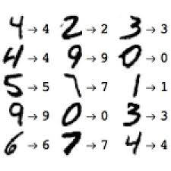
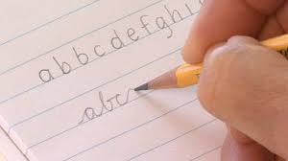
Global Purpose: HNR
Handwritten Numeral Recognition (HNR) is:
The ability of a computer to receive and interpret intelligible handwritten input from source.
Offline HNR:
Fig 1: Handwritten characters and digits

Slide 4
Related works
Table 1: Literature Review
Author | Year | Journal | Work Description
Mahtab Ahmed et al. | 2019 | International Journal of Image, Graphics and Signal Processing | Proposed Bangla HNR with deep LSTM to characterize singular numerals. Had high recognition precision
M. A. H. Akhand et al. | 2018 | IETE Journal of Research | Proposed a CNN model architecture. Has used rotational augmentation. Trained 3 separate CNN model and 1 CNN model on those data.
S. Prabhanjan et al. | 2016 | International Journal of Multimedia and Ubiquitous Engineering | Extracted local and global features from binary images of Devanagari numerals with SVM classifier. Found 98.77% recognition rate

Slide 5
Our Specific Proposal
Global Purpose: HNR
Related works
Specific Purpose
HNR Combining SEWM with CNN
System diagram
Experimental Studies
ISI Numeral Datasets
CNN + SEWM Result
Conclusion
Future works

Slide 6
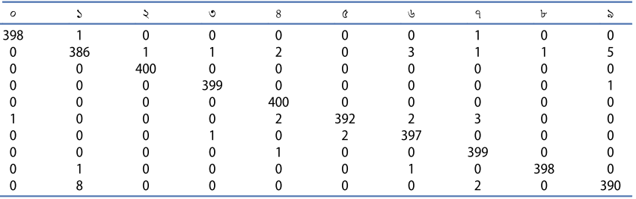
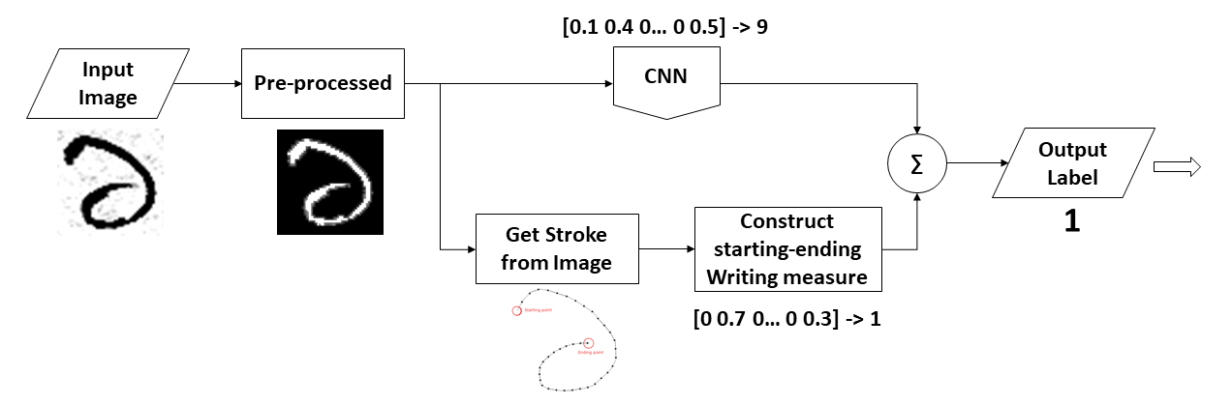
Specific Purpose
Table 2: Confusion table of a Convolutional Neural Network Training incorporating Rotation-Based Generated Patterns and Handwritten Numeral Recognition of Major Indian Scripts

Slide 7
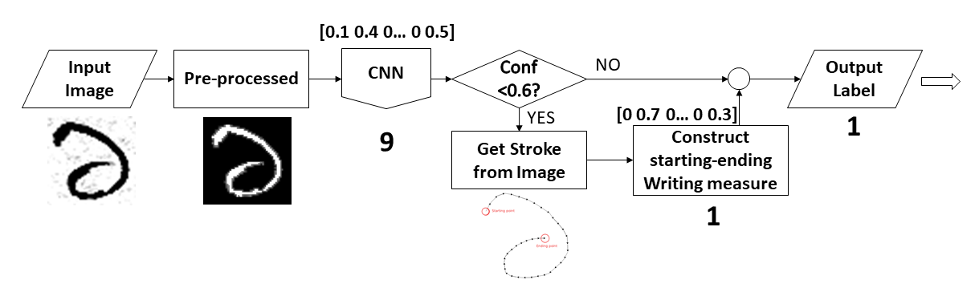
Alternative Proposed System diagram
Fig 2: Diagram of proposed system flow chart

Slide 8
Proposed System diagram
Fig 2: Diagram of proposed system flow chart

Slide 9
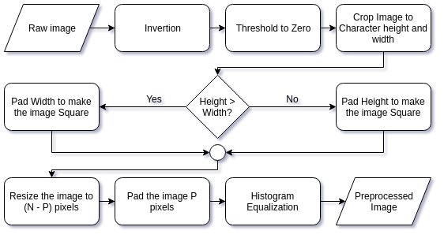
Methodologies: Dataset Pre-processing
Fig 3: Overall preprocessing flow chart

Slide 10


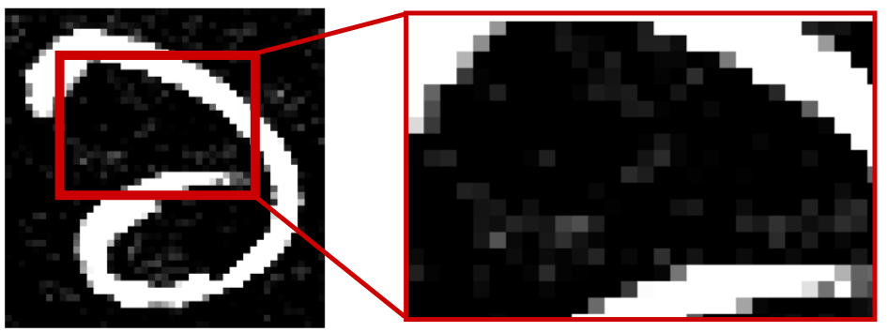
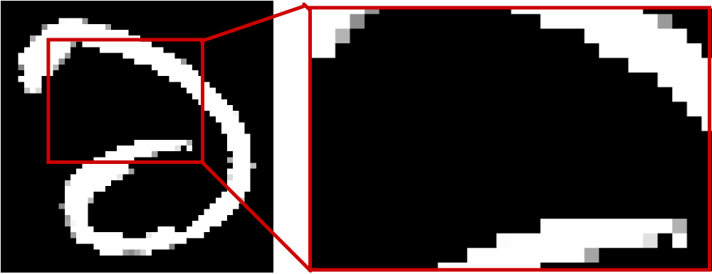


Methodologies: Dataset Pre-processing
Fig 4: Some examples of preprocessing steps

Slide 11
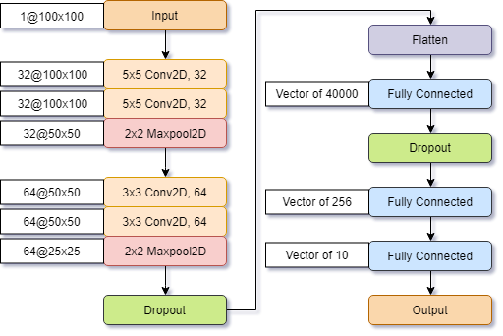
Methodologies: Our Proposed CNN model
Adam Optimizer
Categorical Cross Entropy Loss Function
Used dropout to reduce overfit
Fig 5: Diagram of CNN architecture

Slide 12
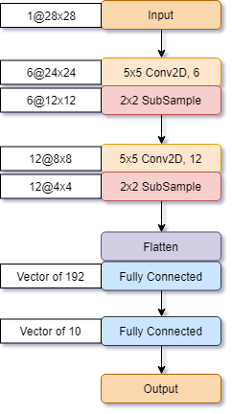
Methodologies: Selected CNN model
Input: Various (in figure 28x28)
Adam Optimizer
Categorical Cross Entropy Loss Function
Used dropout to reduce overfit
Output: 10x1 [0-1] (Confidence)
Fig 5: Diagram of CNN architecture

Slide 13
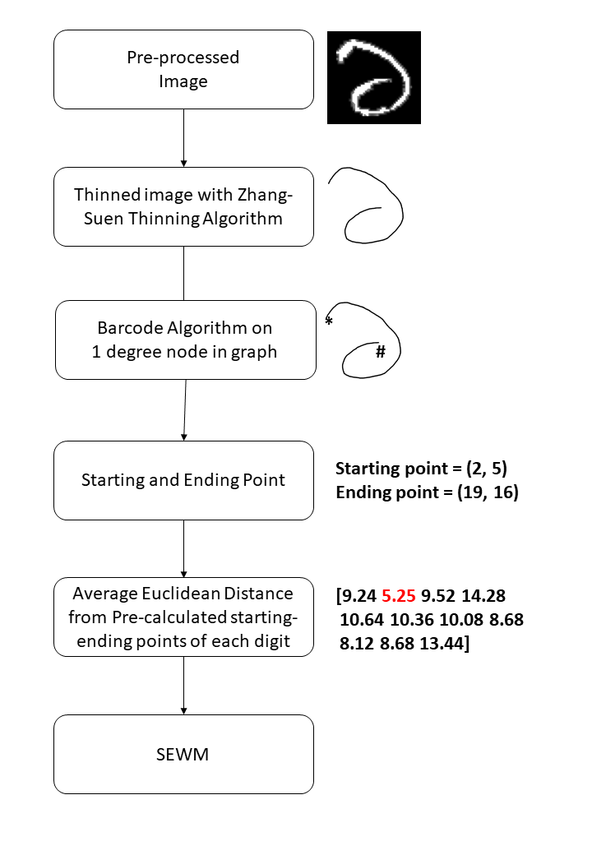
Methodologies: SEWM Extraction (Overview)
Fig 6: Overall picture of SEWM

Slide 14
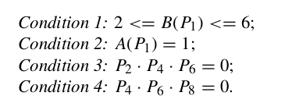
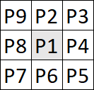
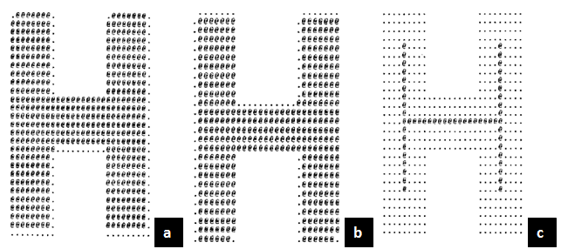
Methodologies: Zhang-Suen Thinning
Define A(P1) = the number of transitions from white to black, (0 -> 1) in the sequence P2, P3, P4, P5, P6, P7, P8, P9, P2
Define B(P1) = The number of black pixel neighbours of P1. ( = sum(P2 .. P9) )
Fig 7: Zhang- Suen thinning algorithm

Slide 15




Methodologies: Zhang-Suen Thinning (cont.)
Application of Zhang-Suen Thinning algorithm
Fig 8: Application of Zhang- Suen thinning algorithm

Slide 16
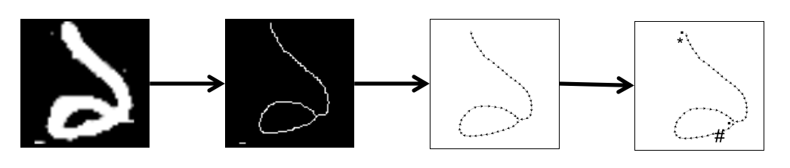
Methodologies: TSP application
So we
Apply Zhang-Suen Thinning.
Apply TSP solution problem to the thinned image.
Get the starting and ending points using Barcode Algorithm.
Fig 9: Application of TSP.

Slide 17
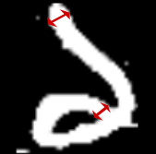


Methodologies: Barcode Algorithm
We extract starting and ending point applying the barcode algorithm on the edges of the image.
Barcode Algorithm.
Fig 10: Starting and Ending point classification with Barcode Algorithm.

Slide 18
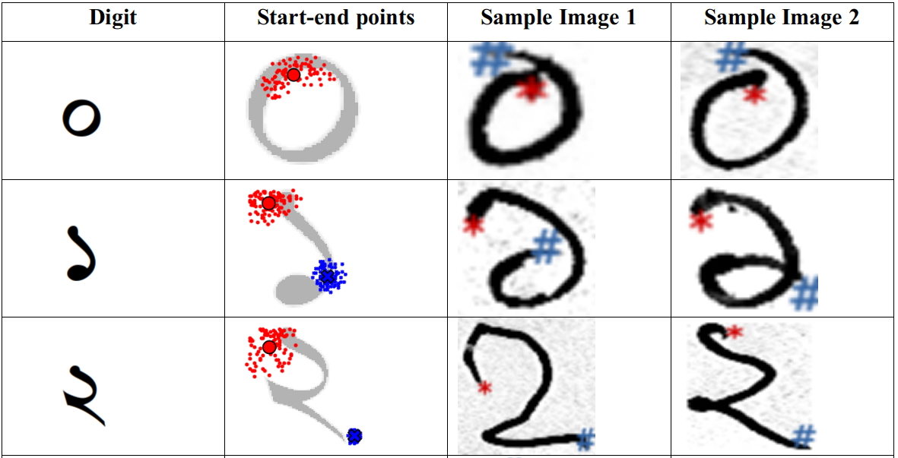
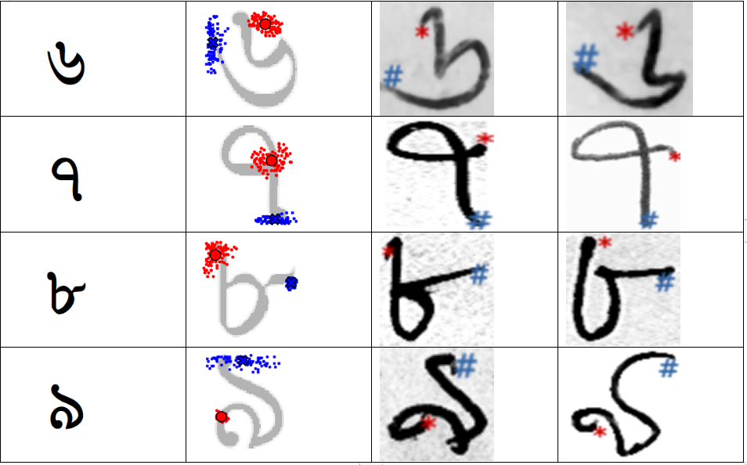
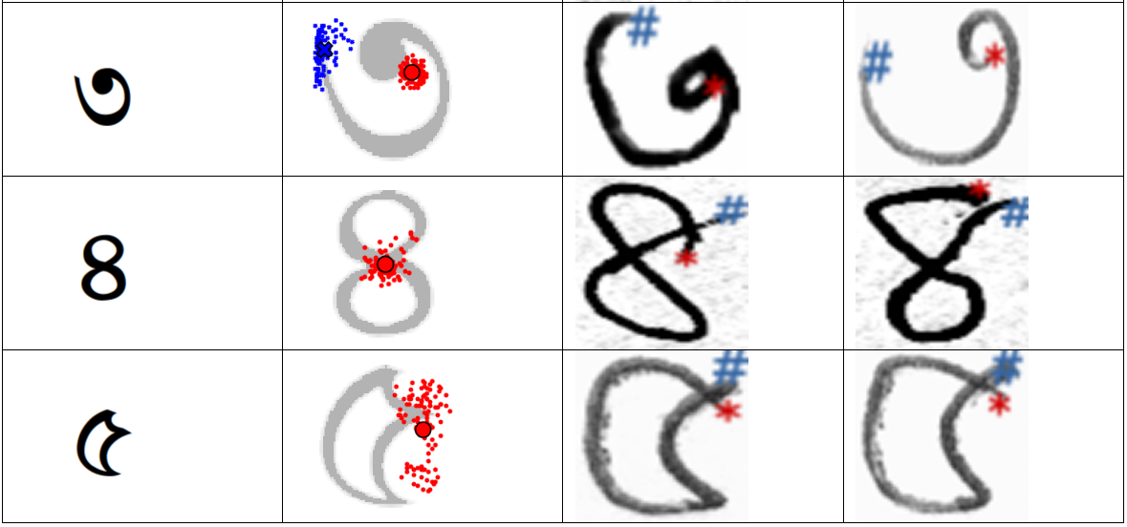
Methodologies: SEWM Clustering
Fig 11: Clustering of start and points of all images of train dataset

Slide 19
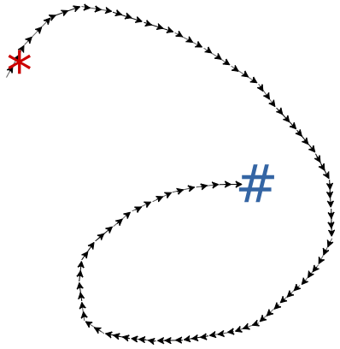

Methodologies: SEWM Calculation
SEWM value:
8
1.5
2.1
Fig 12: SEWM value calculation

Slide 20
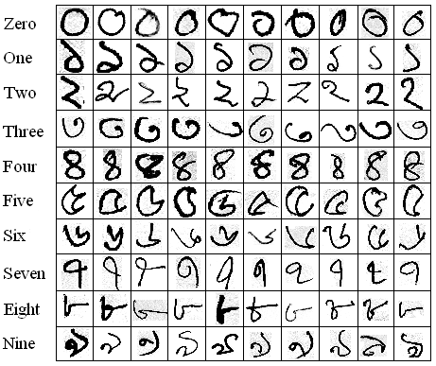
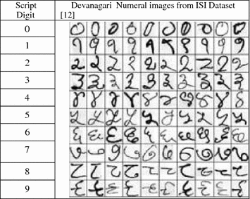
Experimental Studies: ISI Numeral Datasets
Bangla
Samples: 23392
Written by: 1106 persons
Devanagari
Samples: 22556
Written by: 1049 persons

Slide 21
Experimental Studies: CNN + SEWM Result
Table 2: Result of CNN + SEWM
 | ISI Bangla Numeral Dataset |  |  | ISI Devanagari Numeral Dataset
 | CNN Alone | SEWM Alone | CNN + SEWM | CNN Alone | SEWM Alone | CNN + SEWM
Errors (out of 4000) | 41 | 958 | 32 | 36 | 971 | 31
Accuracy (%) | 98.975 | 76.05 | 99.2 | 99.1 | 75.725 | 99.225

Slide 22
Future works
The whole model is to be trained and tuned it to improve the accuracy.
The model will be used in other languages like arabic, telugu and persian.
Comparison of our model performance with state-of-the-art models available will be done.
More models will be added to our ensembling techniques like LSTM.
The methodology will be applied in character recognition.

Slide 23
Conclusion
Optical Character Recognition(OCR) is very popular that almost everyday
So all these works will always be useful in the era of computer vision.
This semester, we have worked together to build this wonderful project.
Next semester, we will continue this project separately.

Slide 24
Thank you!

